Slide 1
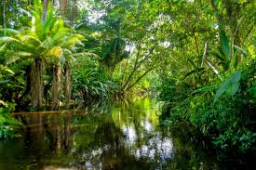
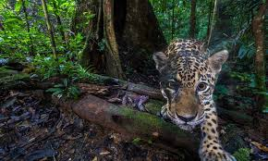
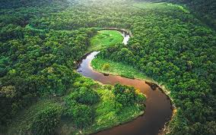
Friday 22nd January
L.O. To recognise and use past and present tense verbs.
We will be using the suffix -ed and –ing.

Slide 2
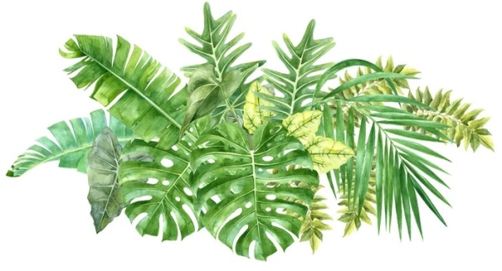
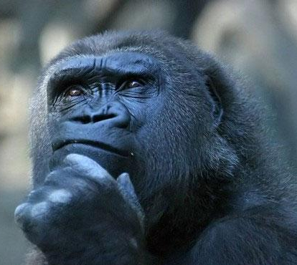
Key Questions
What are verbs?
When do we use the past tense?
When do we use the present tense?

Slide 3

Verbs = action/doing words
We use the past tense when we are writing about something that has already happened e.g. Yesterday I …
We use the present tense when writing about something that is happening now. It is something that is true now.

Slide 4
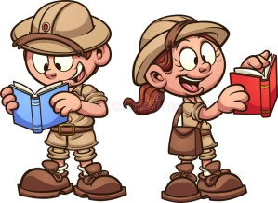
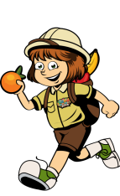

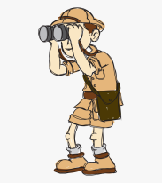
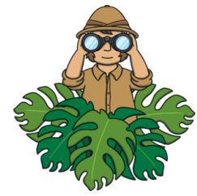

Simple Present Tense
These verbs are in the present tense. You use present tense verbs to talk about the things you do now and on a regular basis. The simple present tense is used to describe something which is true at this moment in time.
I read
I point
I run
I look
I hide
I wave

Slide 5
Present Tense using the – ing Suffix
You can also show that an event is happening now by adding the suffix –ing to a word.
I am reading
I am pointing
I am running
I am looking
I am hiding
I am waving

Slide 6
Did you notice what happened to the words hide and wave?
If the verb ends in e then the e is removed and –ing is added.
I hide
I am hiding
I wave
I am waving

Slide 7

Past Tense using the –ed suffix
When describing an event that happened in the past we can often put the –ed suffix at the end of the verb.
I looked
I pointed
I waved
E.g. Yesterday the explorer grabbed hold of a vine and jumped over the log.

Slide 8
Can you remember the rules for adding -ed to words ending in a consonant and then -y?
If the verb ends in a consonant and then y, change it to an i and then add –ed.
cry
cried
try
tried
fry
fried

Slide 9
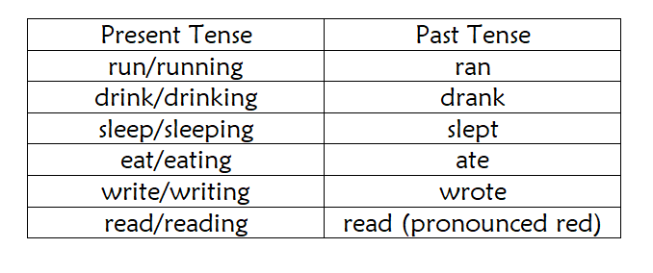
Some verbs do not follow the same pattern when being written in the past tense. You do not use –ed instead the word changes completely.

Slide 10
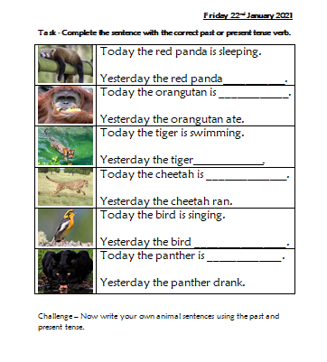
Your Task
Option 1- Print out the sheet and complete the sentences.
Option 2-Complete the sheet digitally in Word.
Option 3 - Look at the sheet on a device and write the missing words on a separate piece of paper.
Challenge – Write your own animal sentences in the past and present tense.

