Slide 1
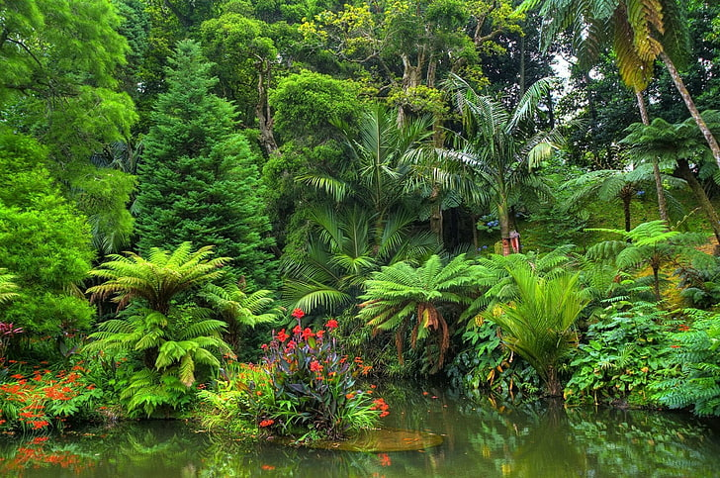
Tuesday 19th January 2021
LO: To read about different rainforest animals from the text ‘A Day and Night in the Amazon Rainforest’.
To write a ‘fact file’ for your chosen animal.

Slide 2
Our new book this week is: ‘A Day and Night in the Amazon Rainforest’
This book gives us lots of facts about animals that live in the Amazon Rainforest.
This section of the book is on the following slides of this powerpoint.
Read through the information about the different animals.
Chose which animal you would like to make a ‘fact file’ about.

Slide 3
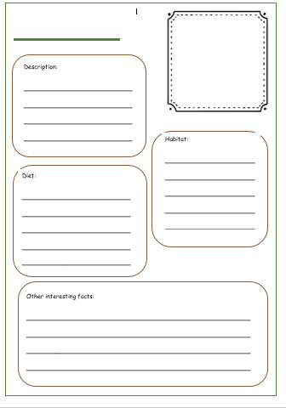
Your animal ‘Fact File’
You can choose to create your fact file in different ways:
Use the template given. This is in the class pages on the school website. You can either type into it or print it off.
Create a powerpoint slide. The following slide is a template or you can create your own slide.
Use your own paper and format.
Helpful Tips
A habitat is where an animal lives.
Diet is what an animal eats.

Slide 4
Name of animal
Description
Habitat
Picture
Diet
Interesting Facts

Slide 5
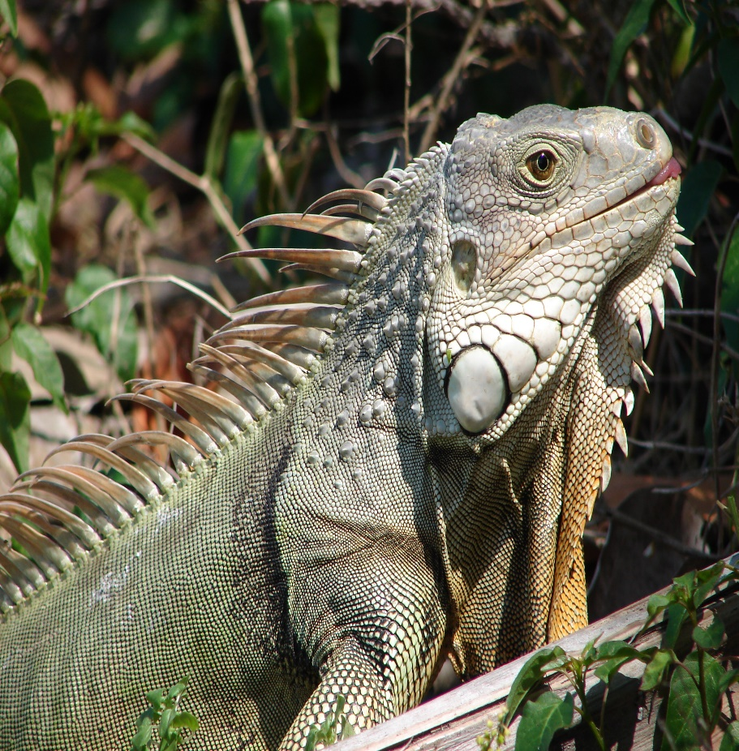
Remember:
‘Say’ your sentence first so that it makes sense.
Capital letters to start your sentence.
Full stop (or an exclamation mark) to end your sentence.
Finger spaces between words.
Best handwriting and letter formation.
E.g. Iguanas eat flowers, fruit and leaves.
You can use other resources to find out about your animal if you want to.

Slide 6
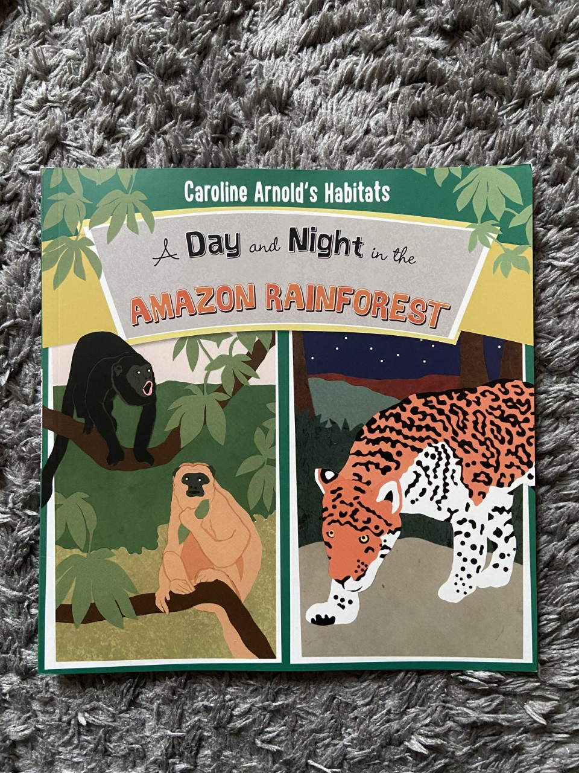

Slide 7
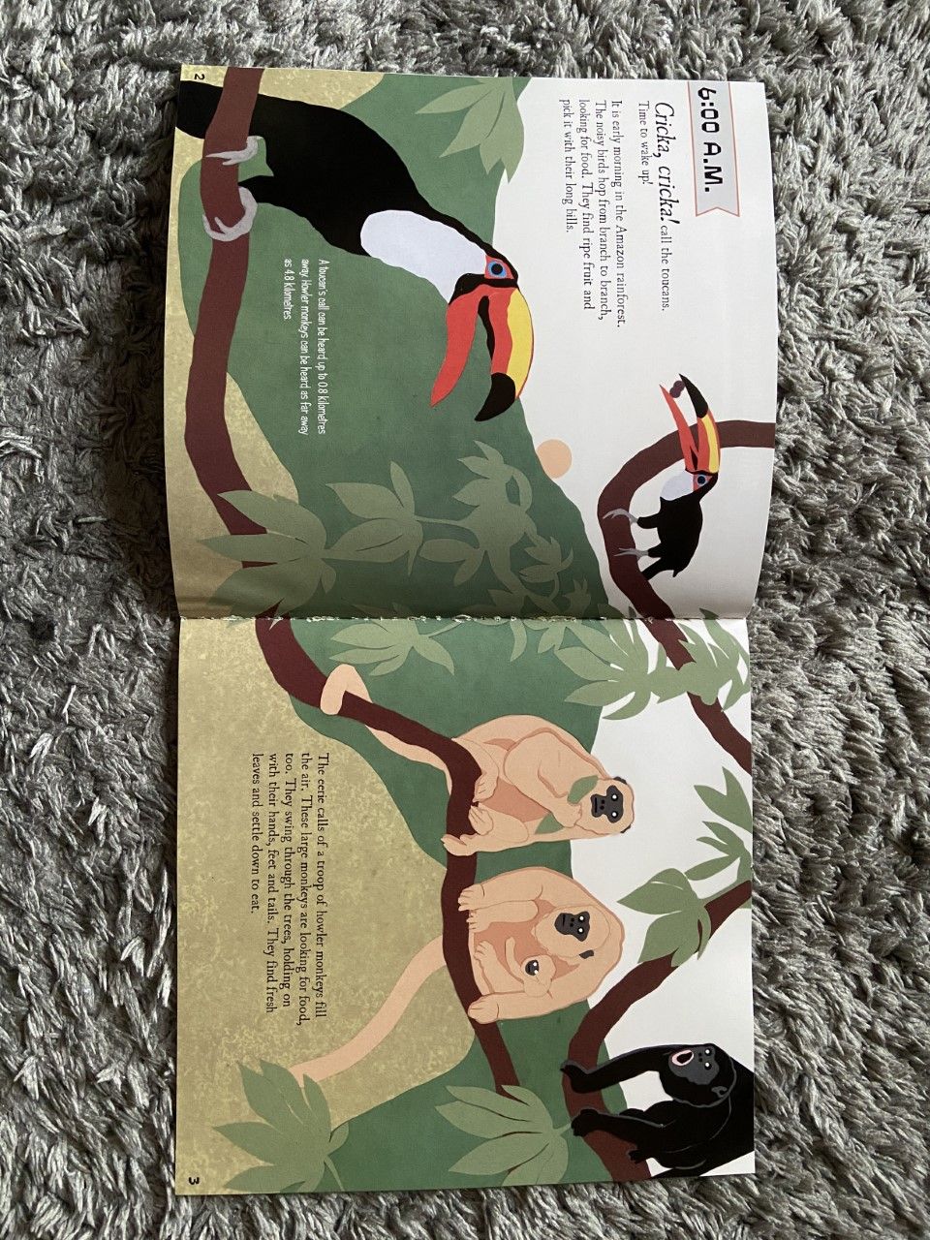

Slide 8
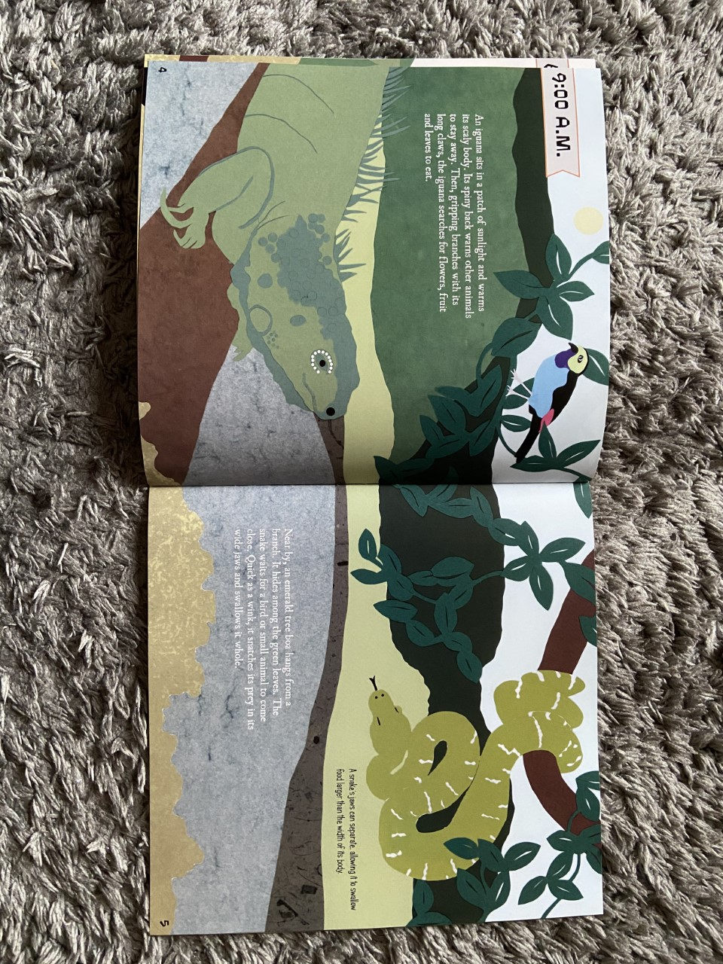

Slide 9
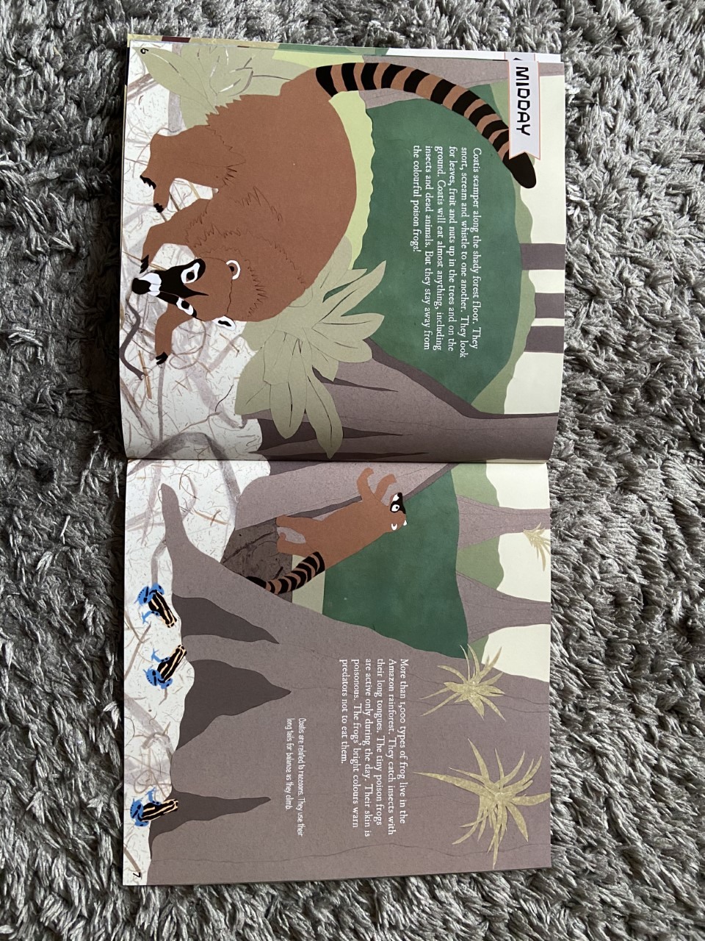

Slide 10
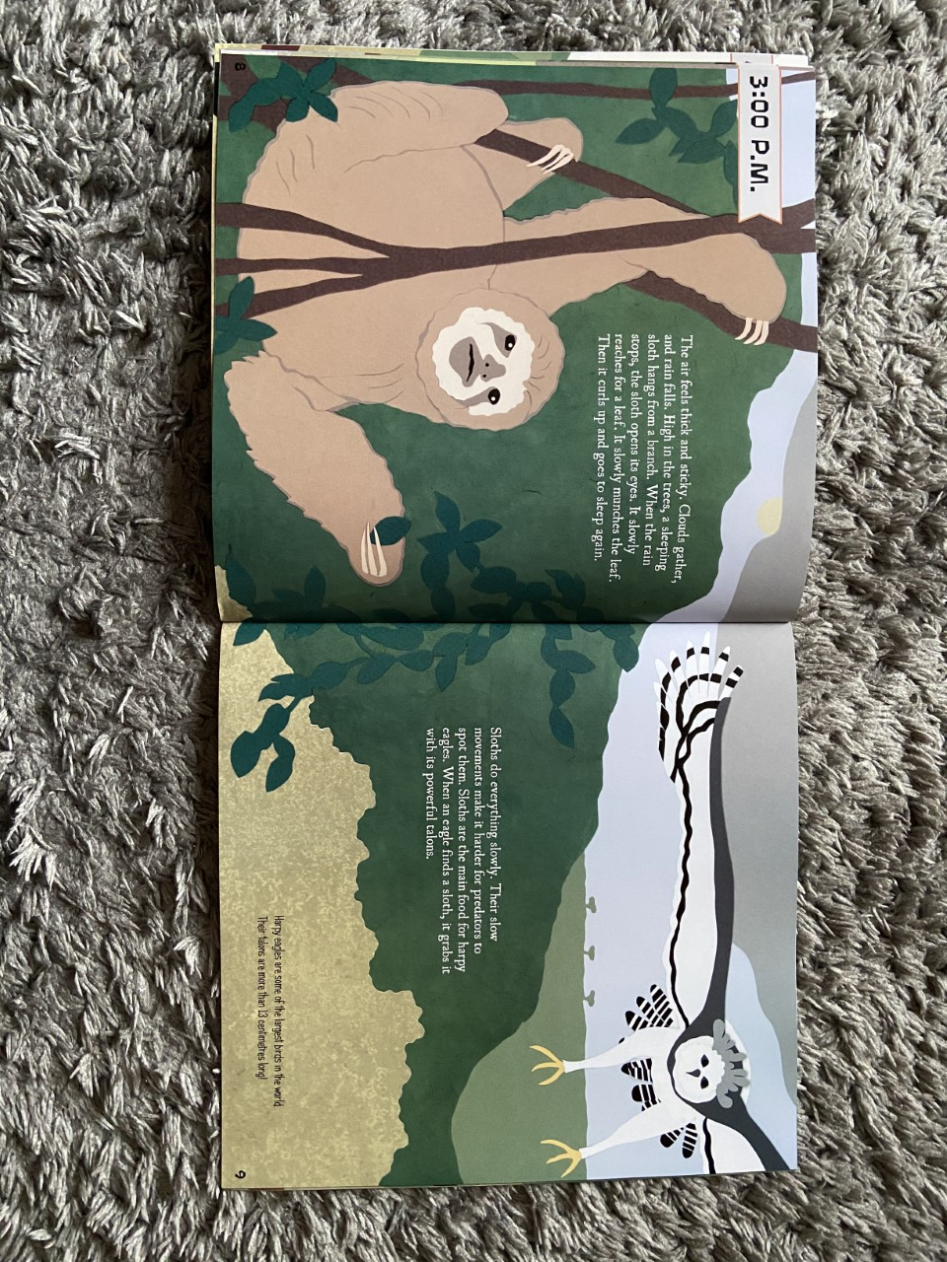

Slide 11
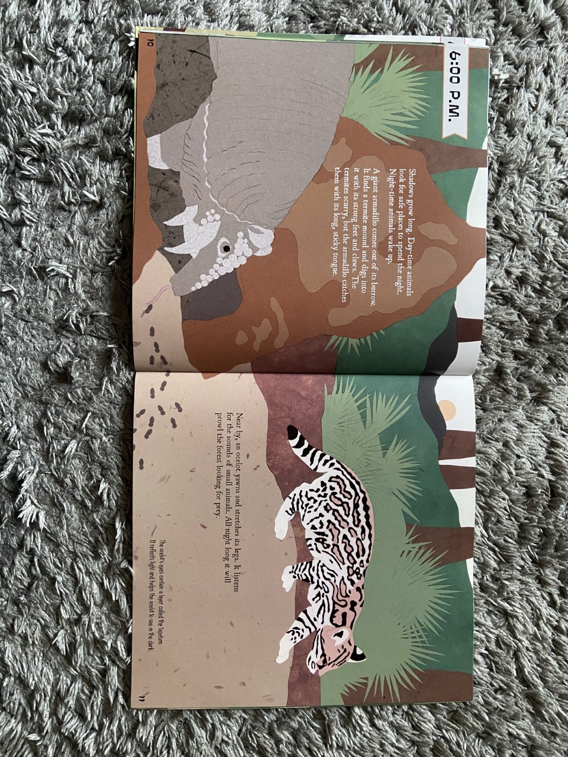

Slide 12
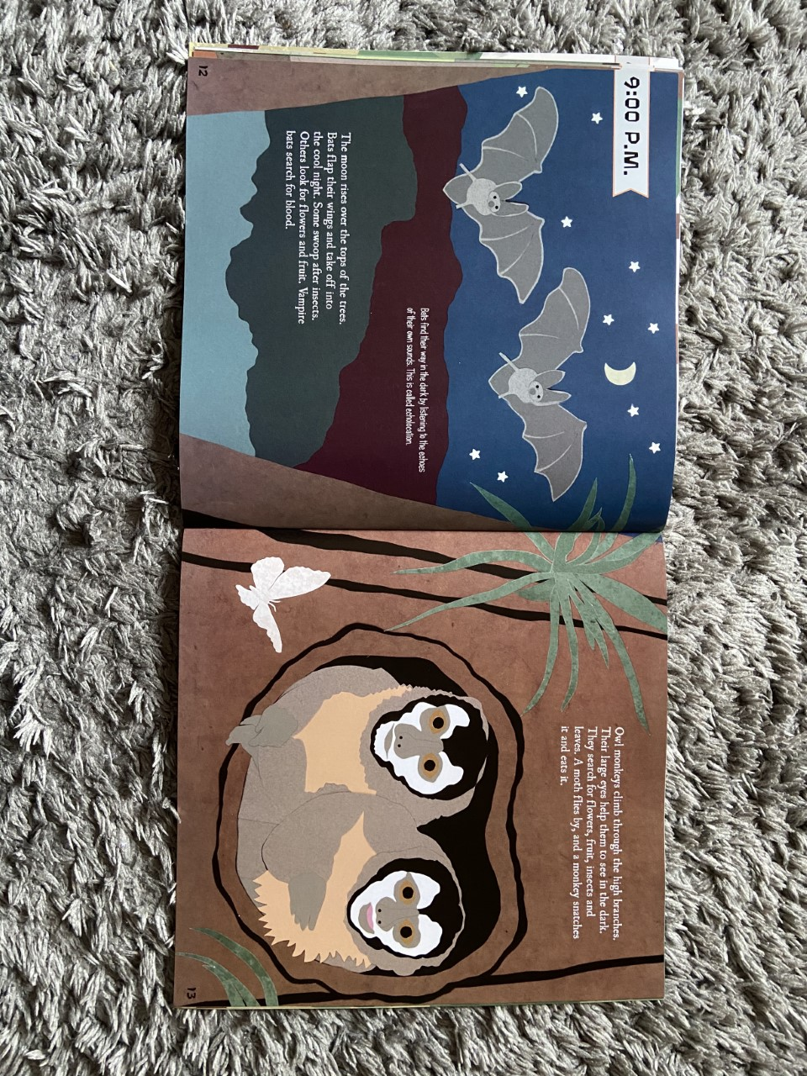

Slide 13
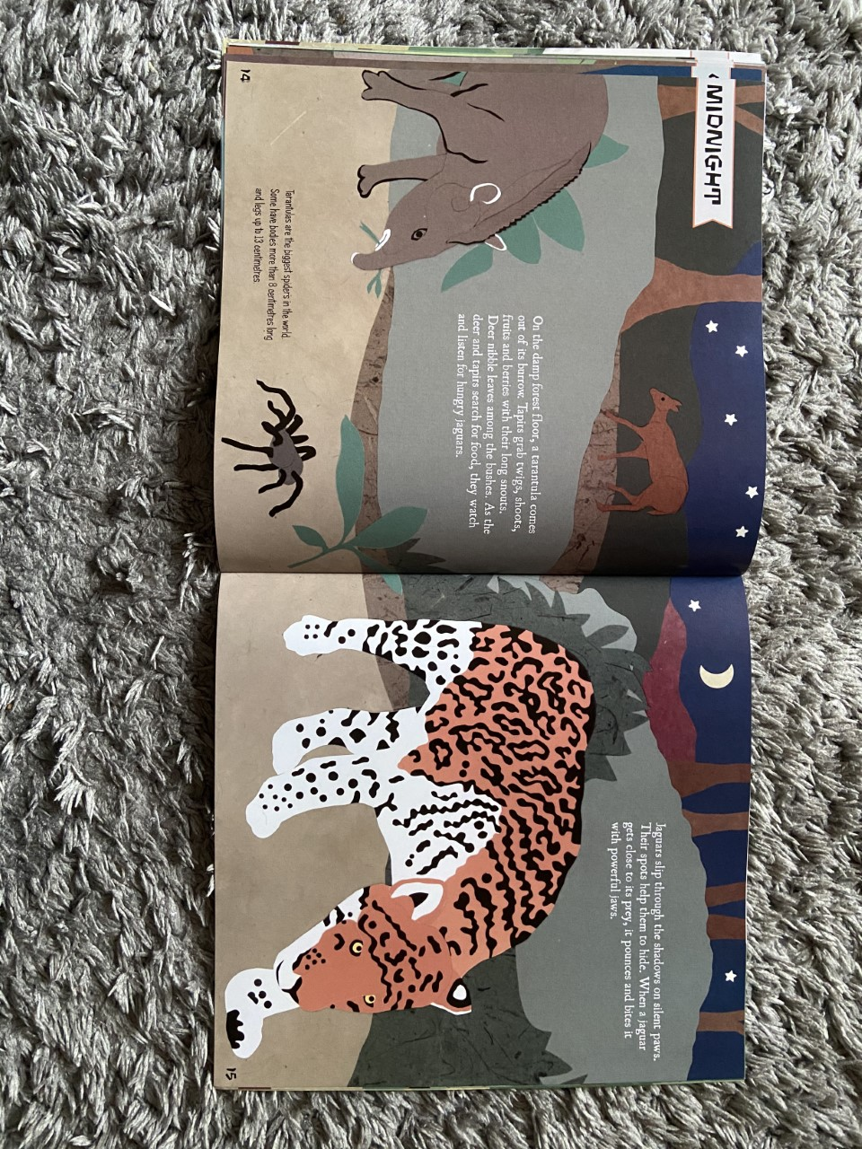

Slide 14
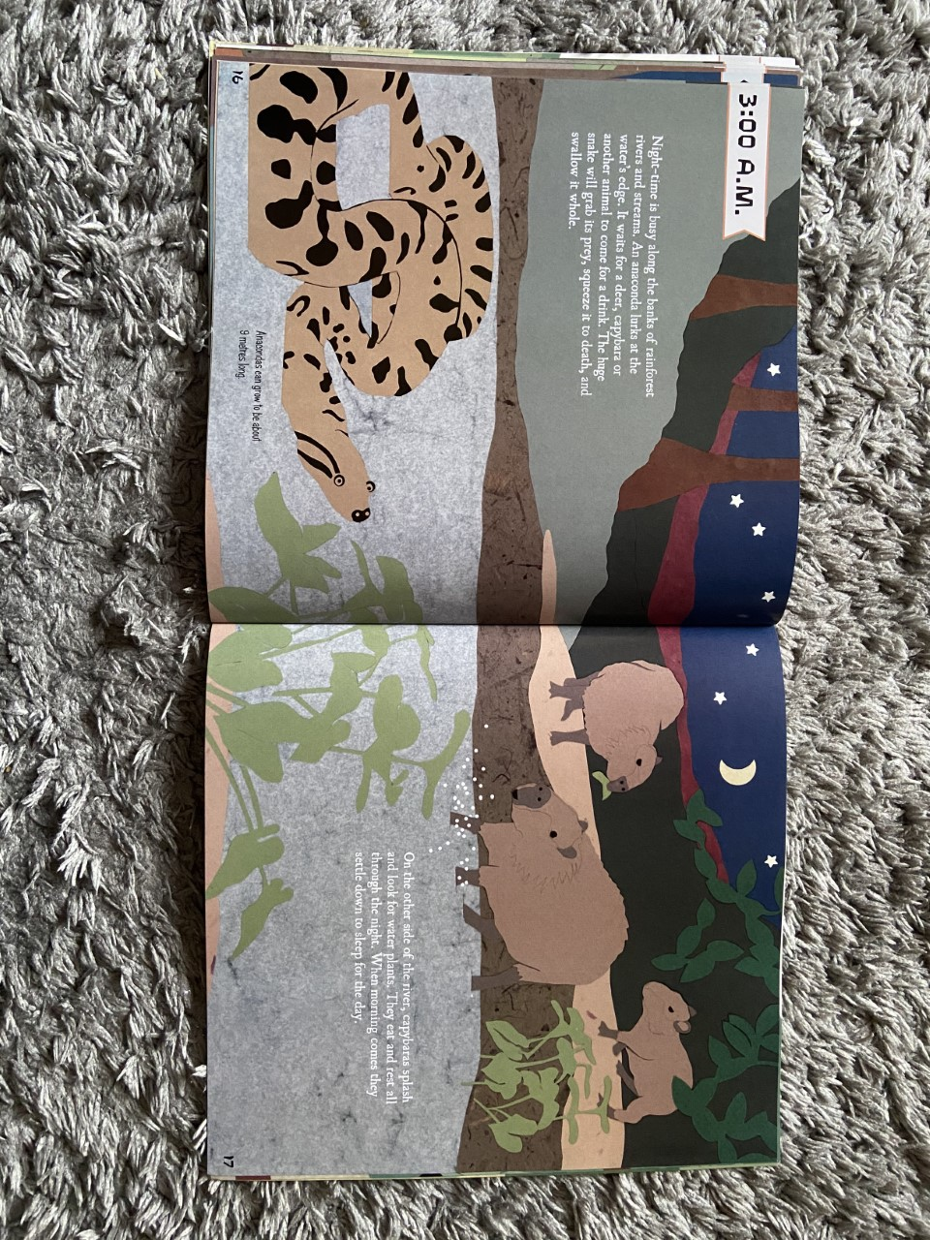

Slide 15


