Slide 2

Revisit and Review
Let’s revisit last week’s focus words…
I’ll say them and you write them down!

Slide 3

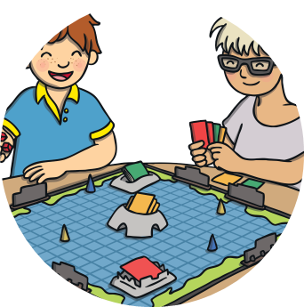
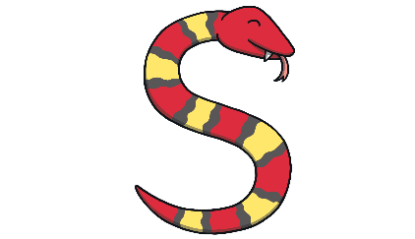
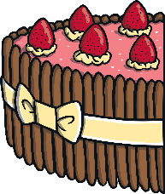

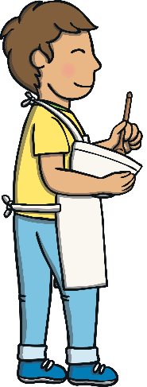


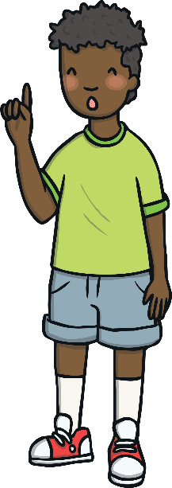
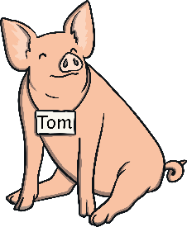
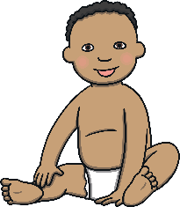


Slide 4
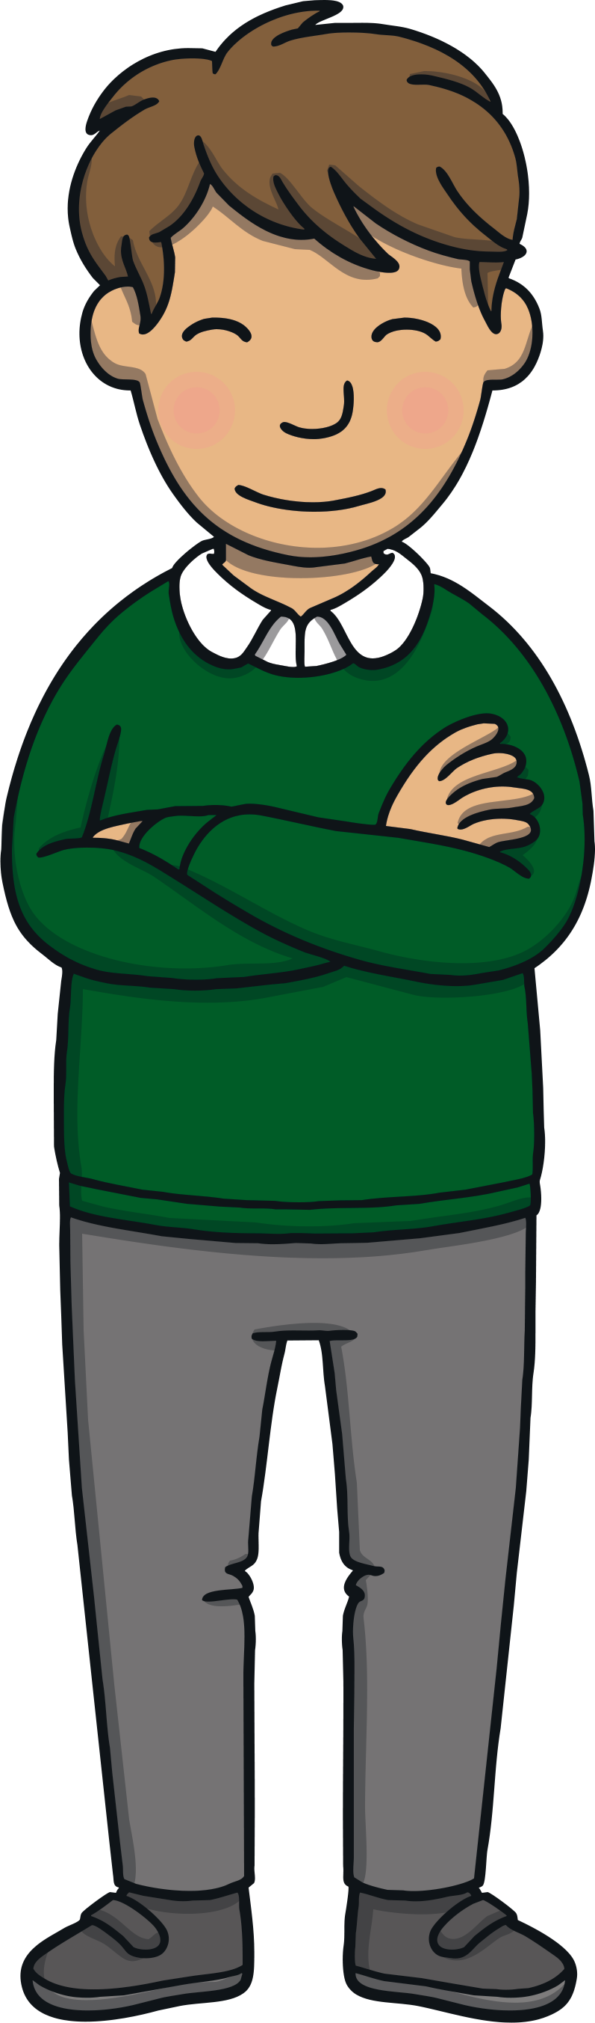
Teach
Here are this week’s focus words for reading…
people
looked

Slide 5


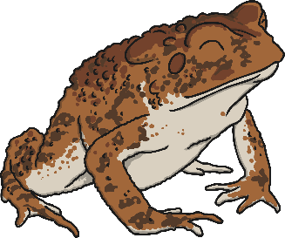



Fairytale Words
Practise
Click on the toadstools to reveal
the tricky words and fairy-tale characters.
looked
people
looked
looked
people
people

Slide 6
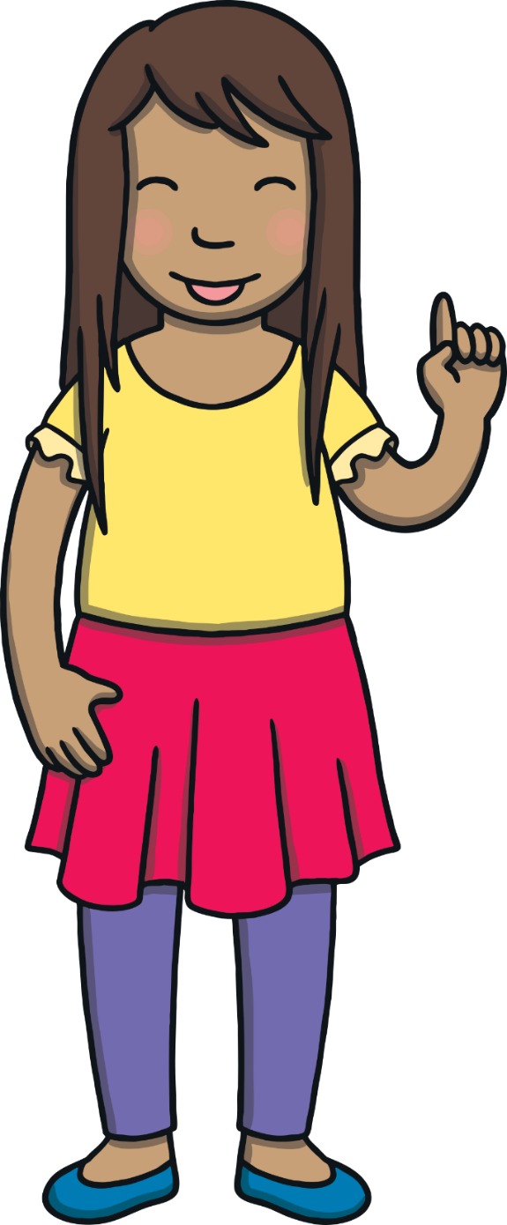
Teach
Today, we are learning to read words that contain i_e saying /igh/.

Slide 7
Teach
i and e are cheeky partners. When i and e work together, they say /igh/.
i and e are too cheeky to sit together so they have to have a letter sit between them.
i
_
e

Slide 8

Teach
Let’s read these words.
bike
five
kite
bite
X
You can teach children to say the first grapheme, followed by the /igh/ before the letter in between i.e. /b/ /igh/ /k/. It may help some children to explain that the ‘e’ is telling the ‘i’ to say its name and that they shouldn’t make the /e/ sound.
lime
Click me for Kit’s teaching tips!

Slide 9
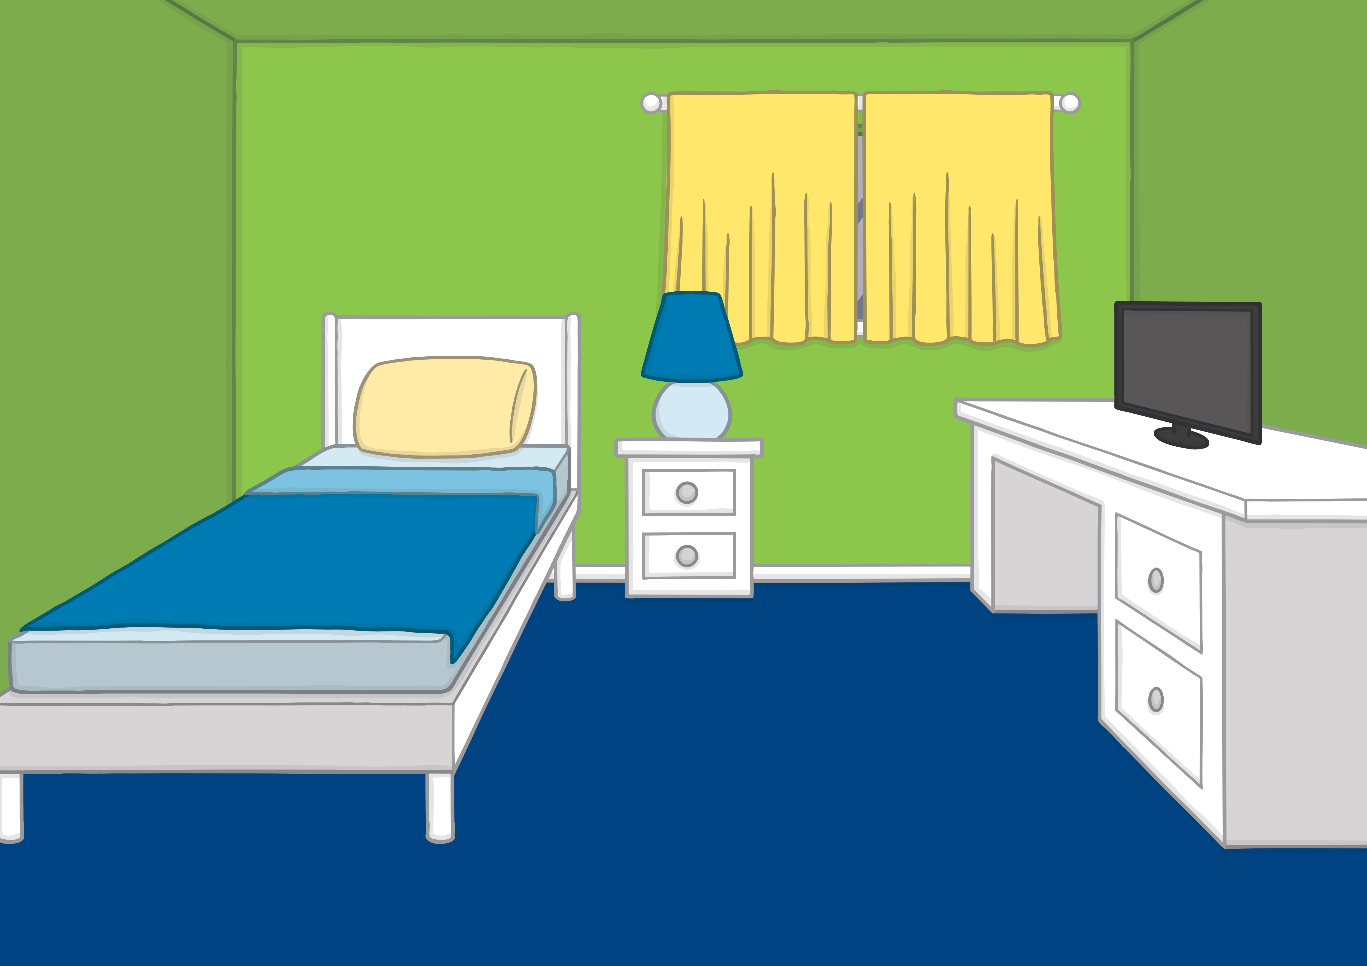




Teach
Kit and Sam were playing at dressing up. “You are a girl, so you will be the evil witch and I will be the good knight,” said Kit.
“Why do I always have to be an evil witch?” asked Sam.

Slide 10
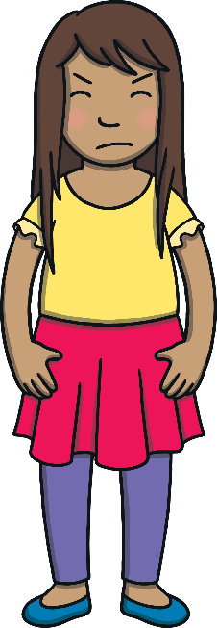

Teach
“I am getting fed up of that game,” explained Sam. “Look, here in my Fairy tale book there are lots of girls who are not evil witches.”
“Hmm, I suppose you are right,” said Kit grumpily.

Slide 11

Teach
“I read a story about a little girl who was a hero,” said Sam. “She went into an enchanted forest and helped to save a magic ring for some elves. I wish we could go on an adventure like that!”

Slide 12
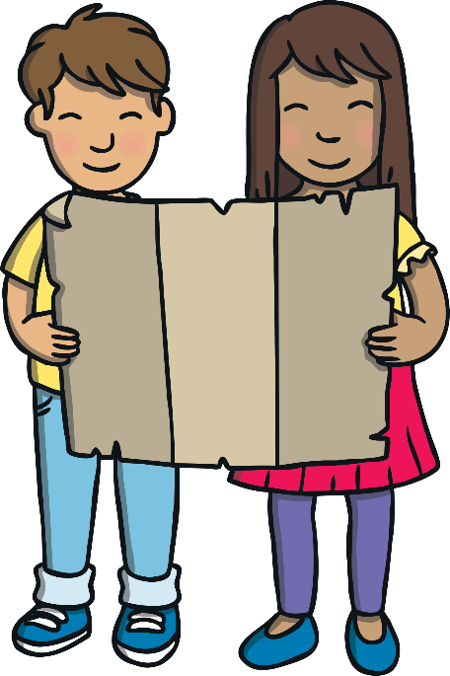
Teach
“Maybe we can,” said Kit, pulling the magic book out from under his bed with a smile.
“To the Enchanted Forest!” they both shouted as the room began to fade.

Slide 13

Teach
Kit and Sam are off on a fairy tale adventure! Can you read the different i_e words on the trees and match them to the pictures?

Slide 14

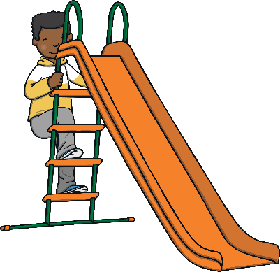
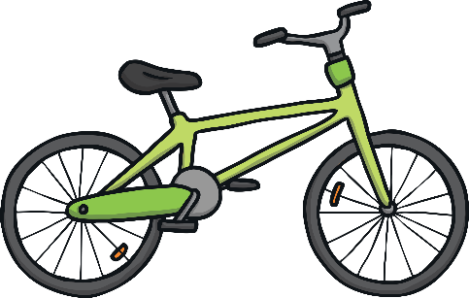






Teach
bike

Slide 15
Teach
pine

Slide 16
Teach
slide

Slide 17
Teach
prize

Slide 18
Teach
shine

Slide 19
Teach
invite

Slide 20
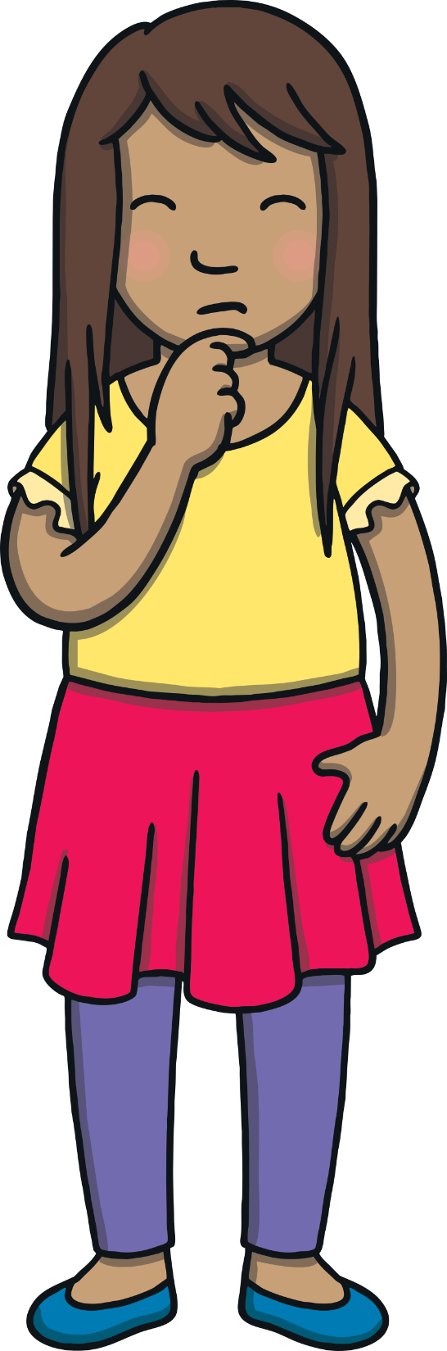
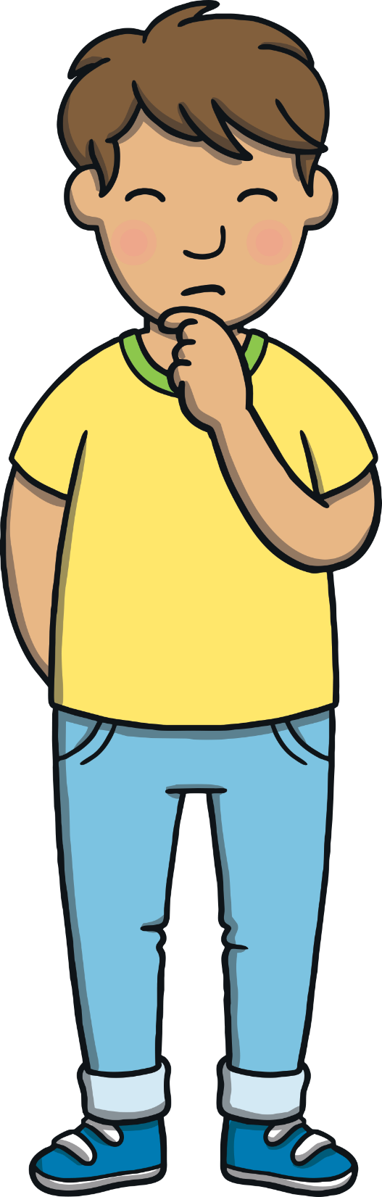
In the Enchanted Forest
Practise
Kit and Sam are zooming over an enchanted forest.
Can you read the i_e words as they go?

Slide 21
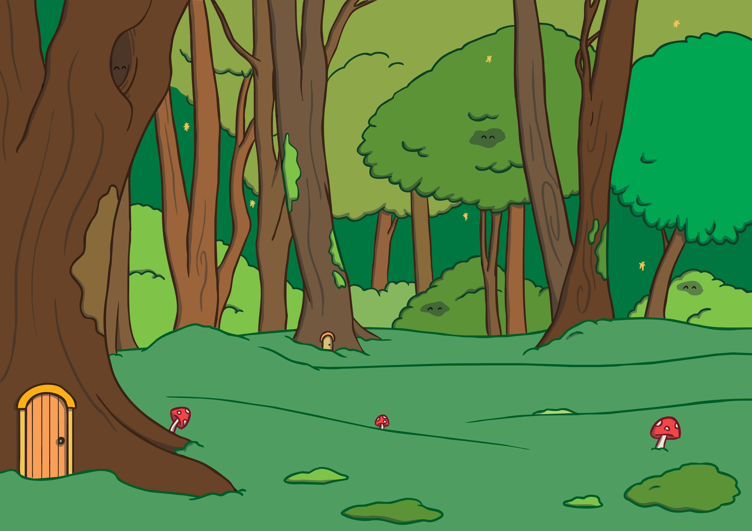


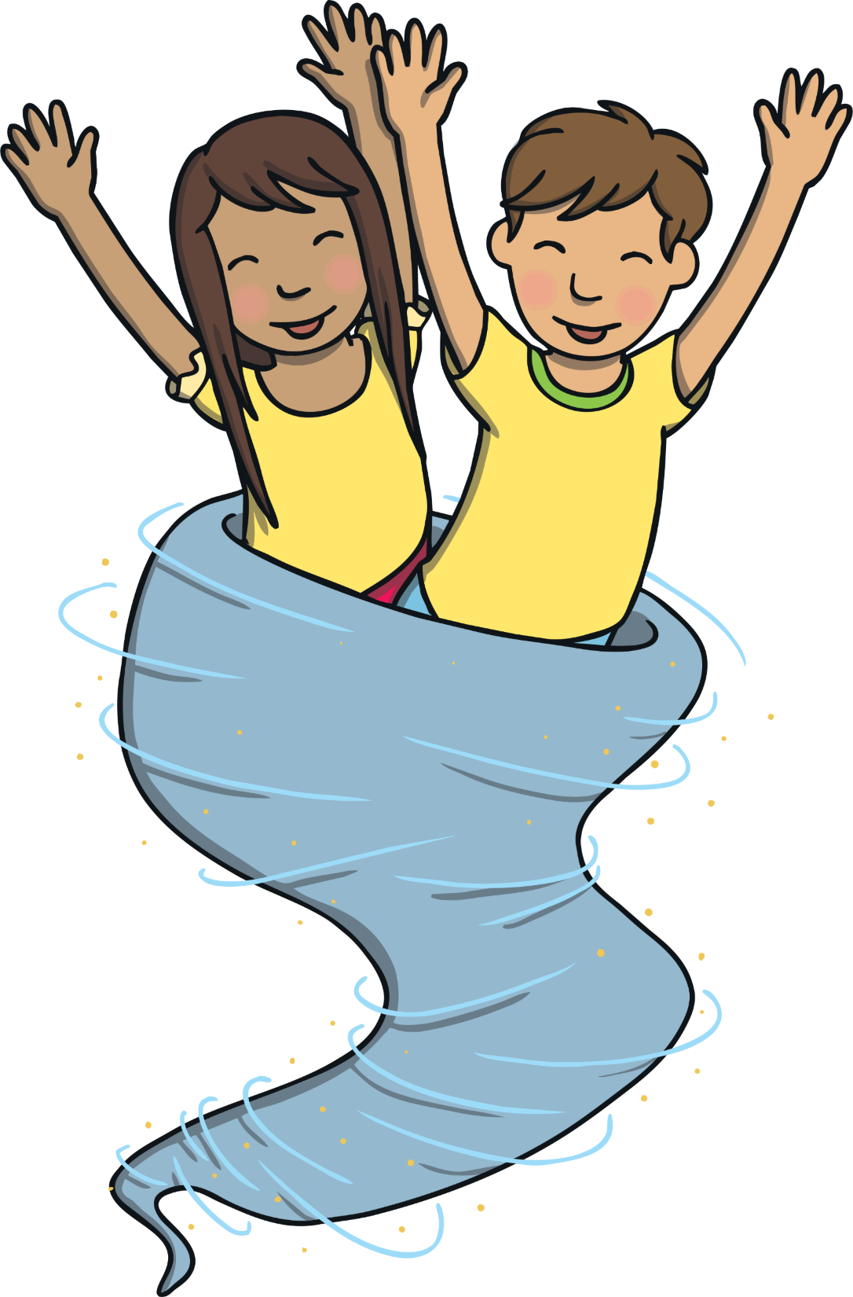

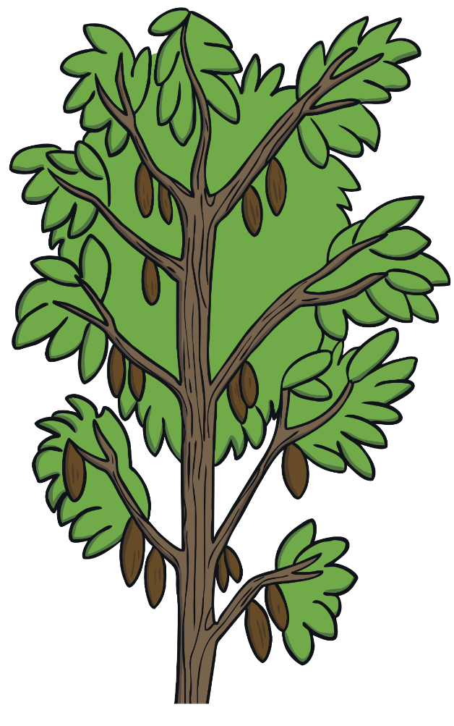


Practise
slide
prize
inside
shine
pine
ripe
time
bike

Slide 22


Apply
Kit and Sam arrived in the Enchanted Forest. It was full of pine trees and it was very dark and damp. In the distance, they could see a cottage that was leaning to one side. It looked like a magic cottage!

Slide 23
Apply
Sam looked around as Kit put away the magic book. “Where do you think all of the people are?” asked Sam nervously.

Slide 24

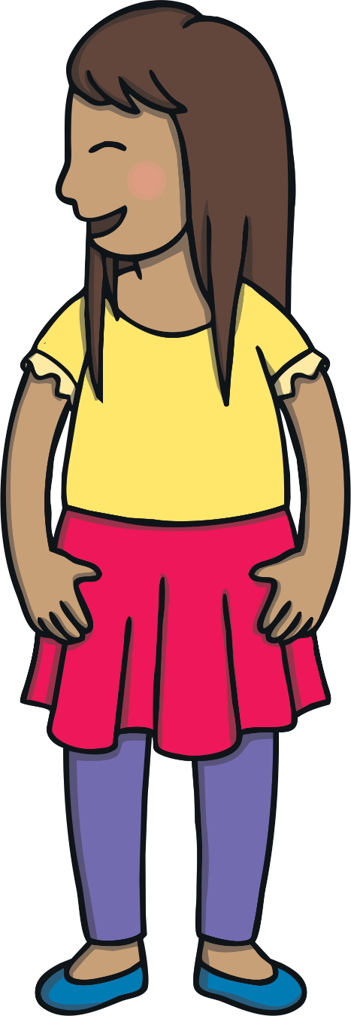
Sentence Time
Apply
Sam isn’t sure about being in the forest. What does she whisper to Kit?

Slide 25
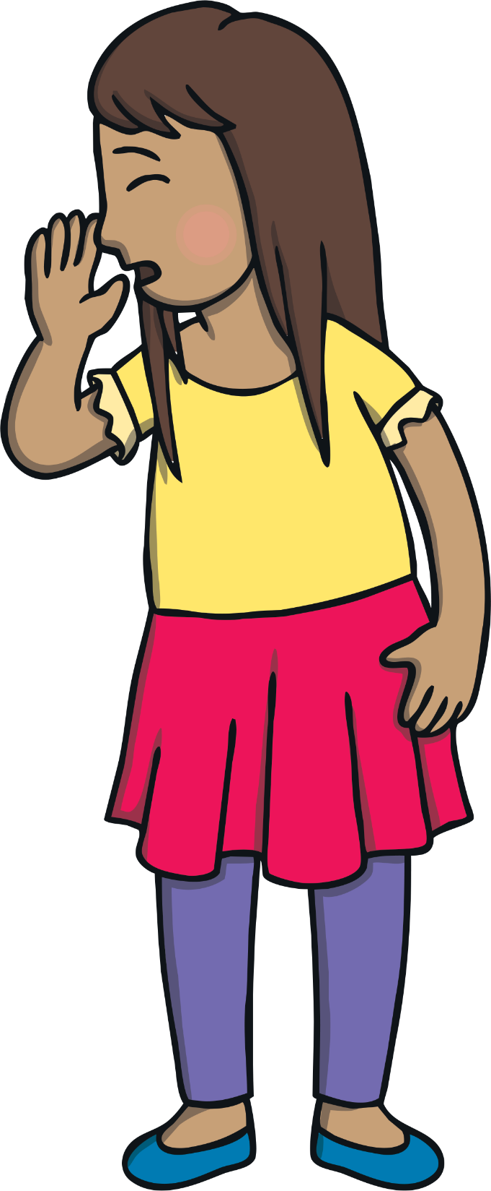

Apply
“I do not think I like this
pine forest with no people.”
Sound Buttons On/Off
Show

Slide 26
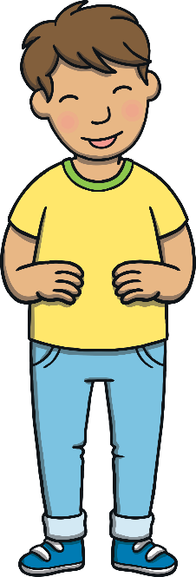

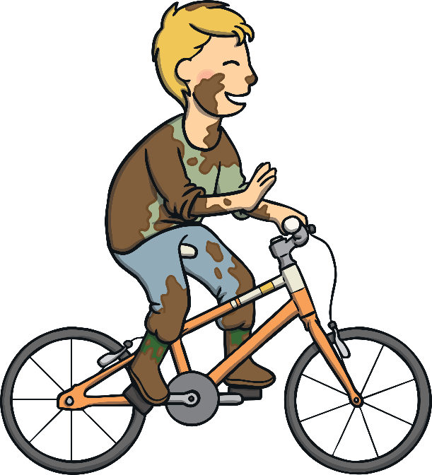
Apply
Suddenly, a little boy covered in mud and slime came towards them on his bike. He looked pleased to see them. “Who are you?” laughed Kit in surprise.

Slide 27

Today, we have learnt…
i_e
saying /igh/
The adventure continues next lesson!

