Slide 1
LO: To write sentences to go with sequenced pictures.
You must include:
Capital letters at the start of your sentences and for names.
Adjectives to describe objects or characters.
Use conjunctions such as ‘and’ ‘but’ ‘so’ or ‘because’.

Slide 2
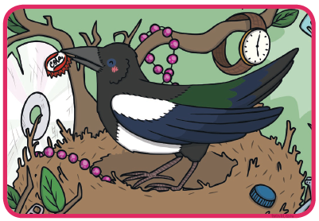
Write a sentence to go with each picture you sequenced yesterday. Stick them next to the pictures.
The Messy Magpie loved to collect things because he liked things that shone.

Slide 3
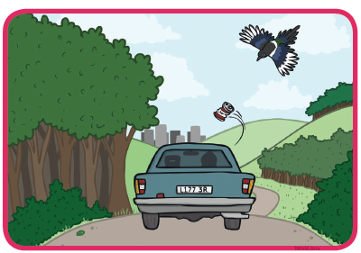
Here’s another example…
The person in the fast car threw out an old can and drove off.

Slide 4
Once you have written your sentences, read out your own version of the story.
What do you like about your story?
How could you improve your piece of writing?
  Have you included capital letters?
  Have you included adjectives?
  Have you use conjunctions to link your ideas?
  Send us pictures of your finished story board! We can’t wait to see them.

