Slide 1


Slide 3


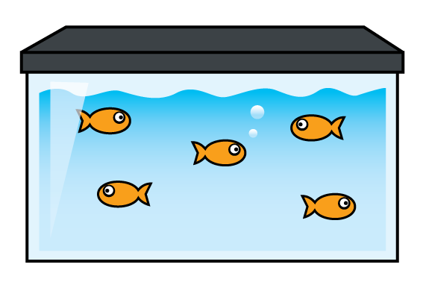
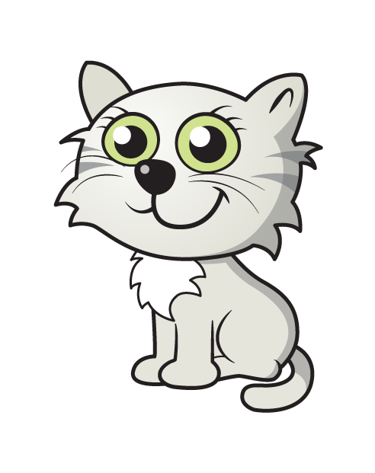

Have a think
How many?

Slide 4



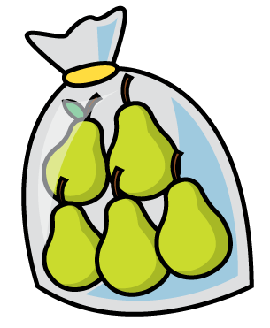


Have a think
Why count in 5s?

Slide 5
What can you find that you can count in 5’s?

Slide 6

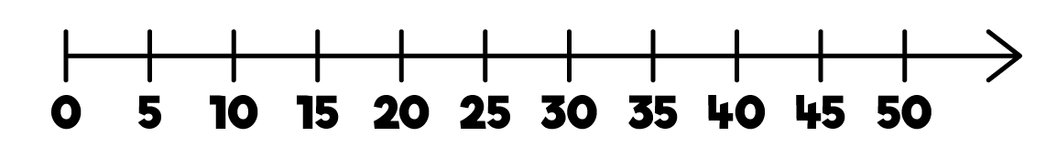
Have a think
Can you count in 5s with your
fingers and thumbs?

Slide 7
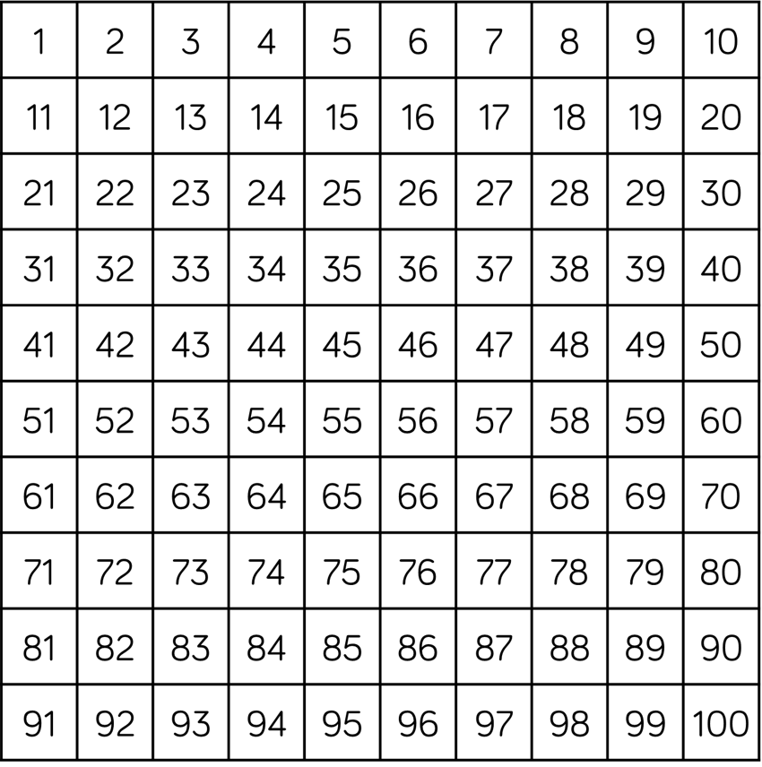
Have a think
Try counting backwards in 5s!

Slide 8
Try this with a partner.

Slide 9
Have a think
What patterns can you see?

Slide 10

You can practice skip counting by 5s when you colour in a 50 chart

Slide 11


