Slide 1


Slide 3


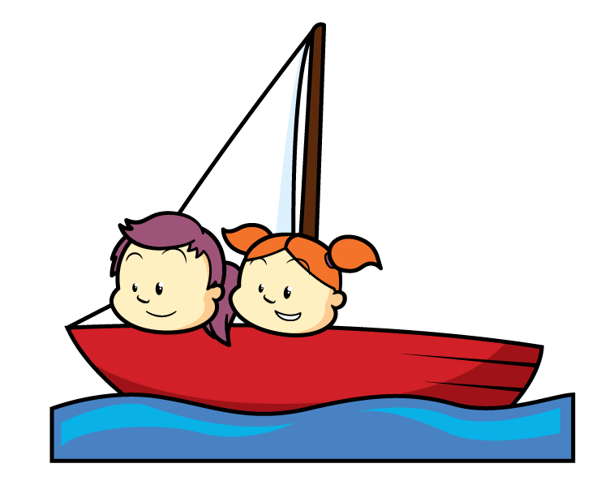
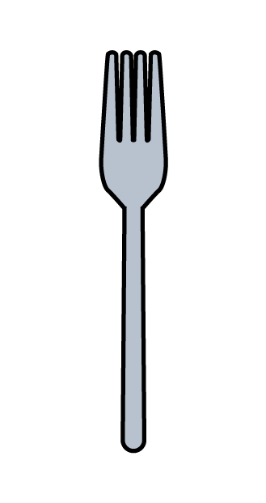



Have a think
How many?

Slide 4





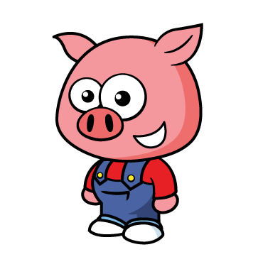


Have a think
Why count in 2s?

Slide 5
What can you find that you can count in 2s?

Slide 6







Have a think
Can you count in 2s
with your fingers?

Slide 7
Have a think
Try “Whisper… Shout”

Slide 8
Try “Whisper… Shout” with a partner.

Slide 9
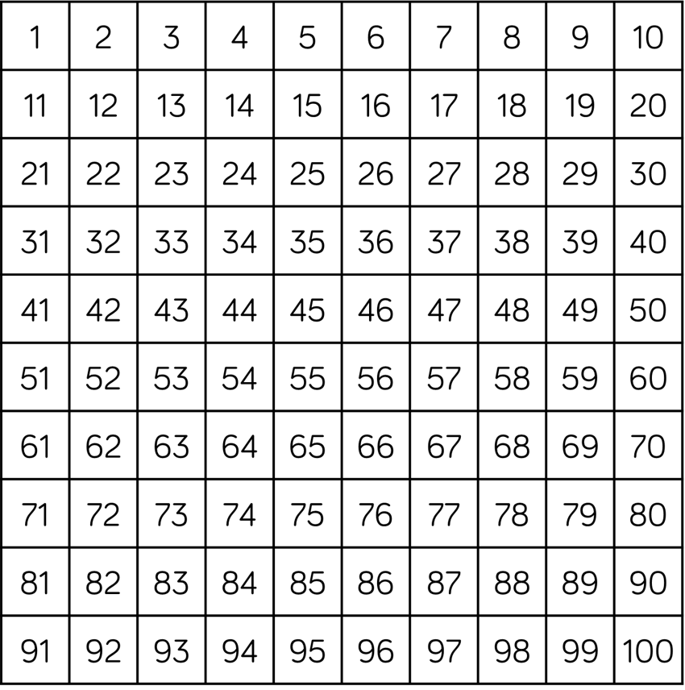
Have a think
What patterns can you see?

Slide 10

You can practice skip counting by 2 when you colour in a 50 or 100 chart
100 Square Splat Square Interactive Link

Slide 11
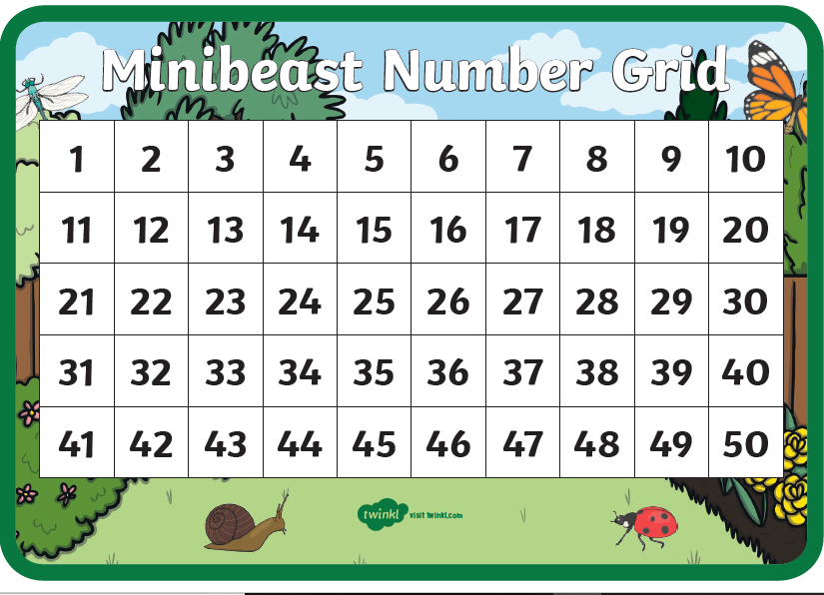

Slide 12
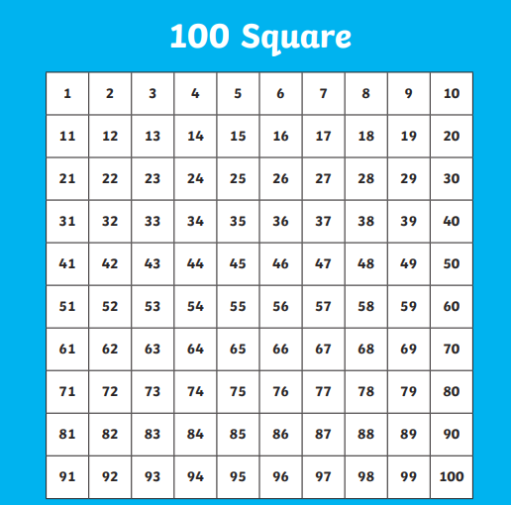

Slide 13
You could try counting objects at home in 2’s!

Slide 14
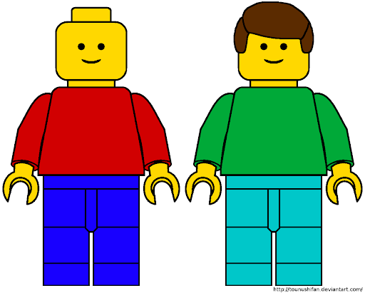
2
4
6
8
10
12
14
16
18
20

