Slide 1
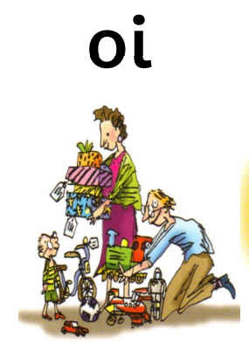
Our Set 3 phoneme for today is…. oi – spoil the boy!
join
coin
voice
choice
noise

Slide 2
LO: Draw and Label the Egg Box Dragon
Monday 22nd February 2021

Slide 3
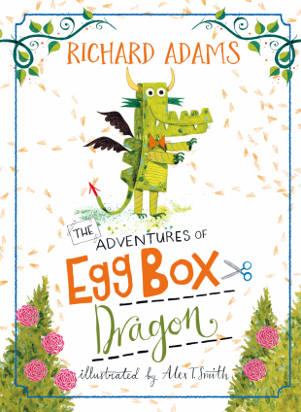

Slide 4
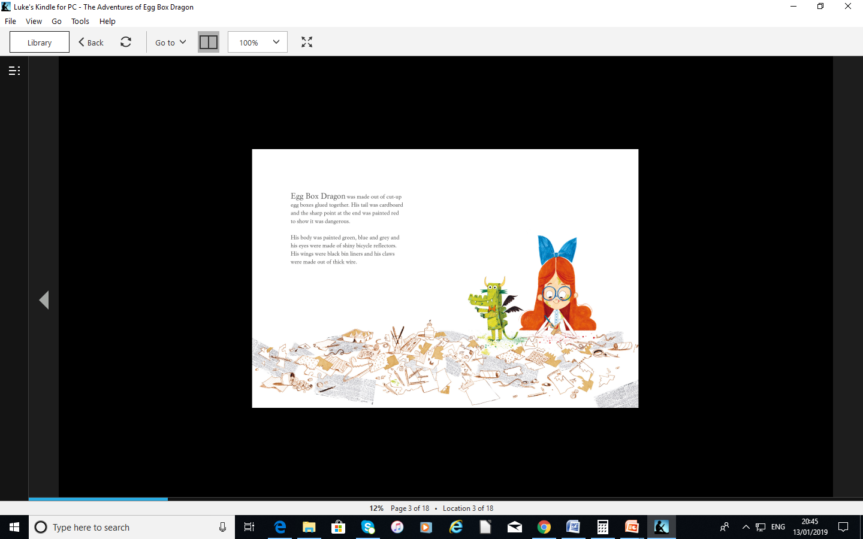

Slide 5
Think about the description of Egg Box Dragon! What descriptive words (adjectives) can you see?
Egg Box Dragon was made out of cut up egg boxes glued together. His tail was cardboard and the sharp point at the end was painted red to show it was dangerous. His body was painted green, blue and grey and his eyes were made of shiny bicycle reflectors. His wings were black bin liners and his claws were made out of thick wire.

Slide 6
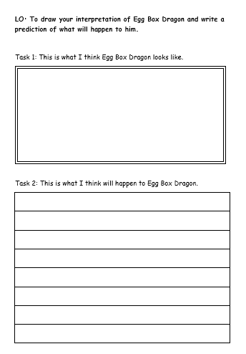
Your tasks today!
Task 1: Read the description and draw and label your own interpretation (idea) of what the Egg Box Dragon looks like.
Task 2: Write a prediction about what sort of dragon he is (kind / cruel / good / scary / naughty).
What will he do on his adventure?
Opt. 1 – Print out the Word Document Template, draw the dragon and answer the questions by hand.
Opt. 2 – Draw your dragon on a blank piece of paper and type the answers into the Word Document Template.

