Slide 1
TUESDAY 12th January 2021 Topic Session 2
LO: TO MAKE YOUR OWN INSTRUMENT USING THINGS IN YOUR HOUSE.

Slide 2
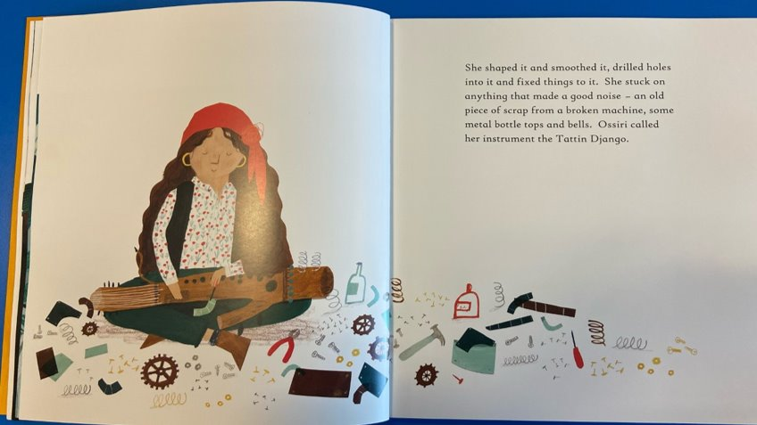
In Ossiri and the Bala Mengro, Ossiri designs and makes her own instrument out of things she finds around her.

Slide 3
YESTERDAY YOU DESIGNED YOUR INSTRUMENT...
Today you can spend some time making it! It need not be completed in one afternoon. You may wish to paint it or do a more complicated make that will take more time!
We would love to see your finished instruments and you could even send us a video of you playing it!

