Slide 1


Slide 3


1) What comes next? 8, 9, 10, ___
2) 1 ten and 4 ones = ____
3) Can you count from 12 to 17?
4) How many straws?

Slide 4
1) What comes next? 8, 9, 10, ___
2) 1 ten and 4 ones = ____
3) Can you count from 12 to 17?
4) How many straws?
11
14
12, 13, 14, 15, 16, 17
15

Slide 6
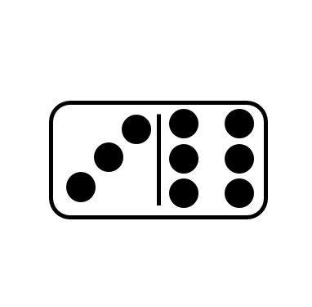
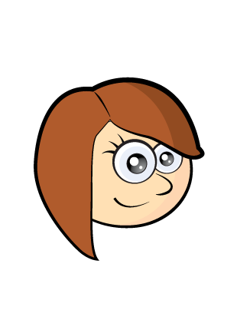
Counting on is fun!
6 + 3
6
7, 8, 9

Slide 7

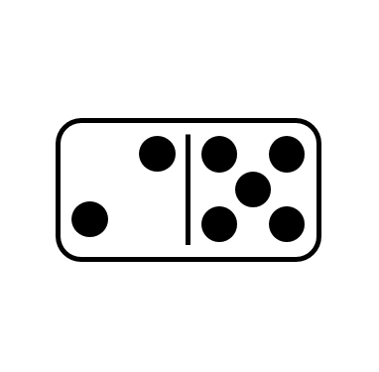
Have a think
Counting on is fun!
5 + 2
5
6, 7

Slide 8
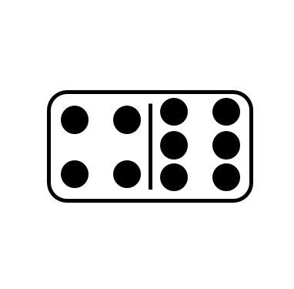


Have a think
Which way did you count on?
4 + 6
6 + 4
5, 6, 7, 8, 9, 10
6
4
7, 8, 9, 10

Slide 9
Have a go at this activity

Slide 10
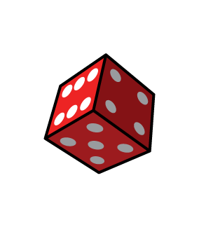

Counting on is fun!
5
1
2
18
20
13
Choose a card
16
Roll the dice
Count on
16
17, 18, 19

Slide 11

Counting on is fun!
Have a think
5
1
2
18
20
Choose a card
13
Roll the dice
Count on
13
14, 15, 16, 17, 18

Slide 12
Have a think
Try this yourself!
16
9
14
5
13
1
2
18
20
13
12
10
15
17

Slide 13
Have a go at these activities

