Slide 1
Friday 15th January 2021
LO: To show an understanding of the book ‘Ossiri and the Bela Mengro’ by responding to comprehension questions.

Slide 2
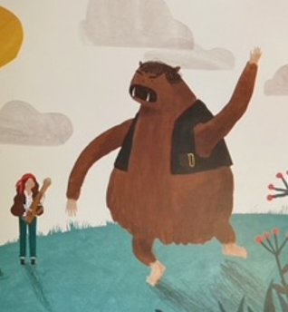
Comprehension of ‘Ossiri & the Bala Mengro’.
Read the last section of the book. This is provided in the slides that follow on this powerpoint.
Can you talk about the events of the end of the story?
Talk through the comprehension questions together.
Write a full sentence to answer the questions.

Slide 3
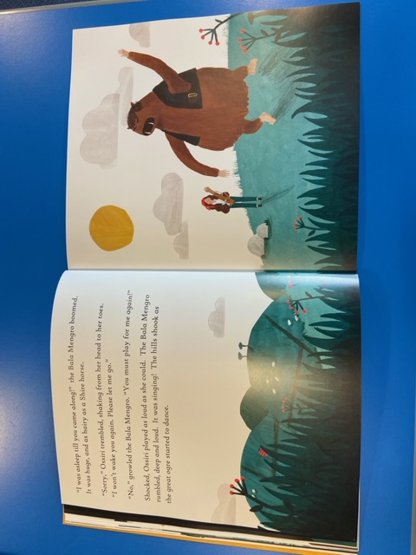

Slide 4
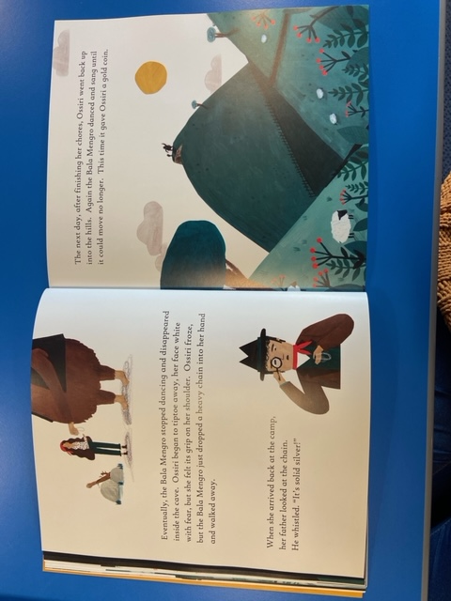

Slide 5
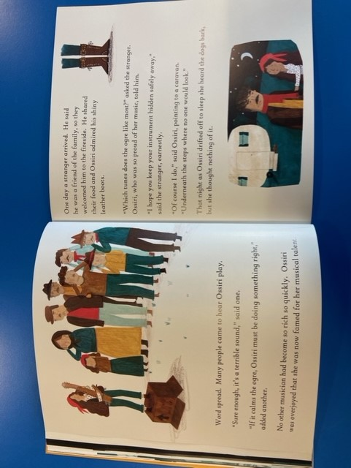

Slide 6
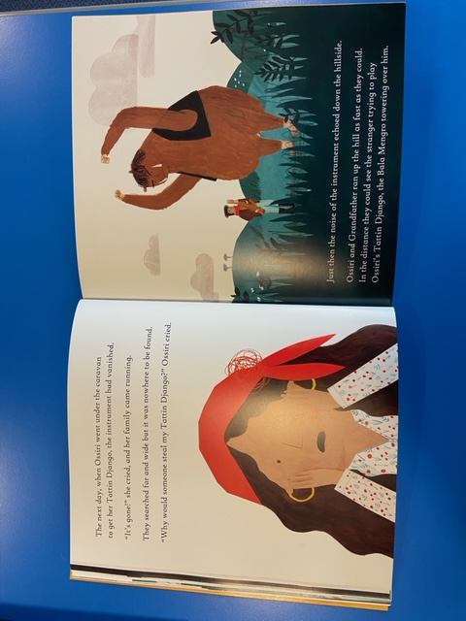

Slide 7
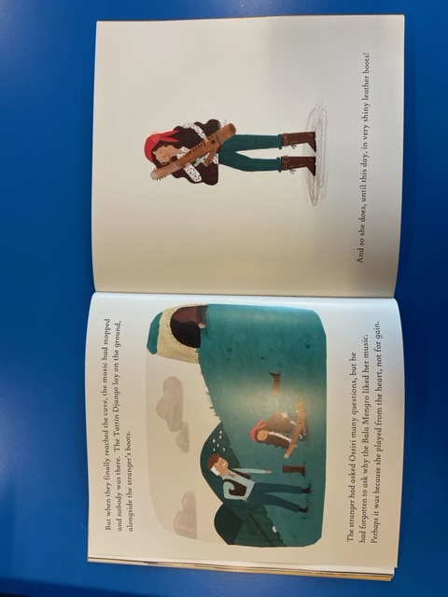

Slide 8
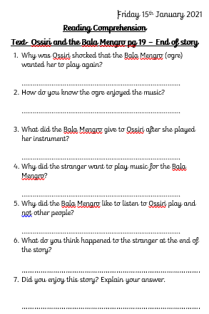
Your Task Today
Show your understanding of the story ‘Ossiri & the Bala Mengro’ by answering the comprehension questions.
Find the questions on the school website.
Remember to compose & write a full sentence. The words in the question can help you to compose your sentence. Say it out loud first.

