Slide 1

Friday 8th January 2021
LO: To describe a story setting.
SC: To use adjectives

Slide 2

What is a story setting?

Slide 3
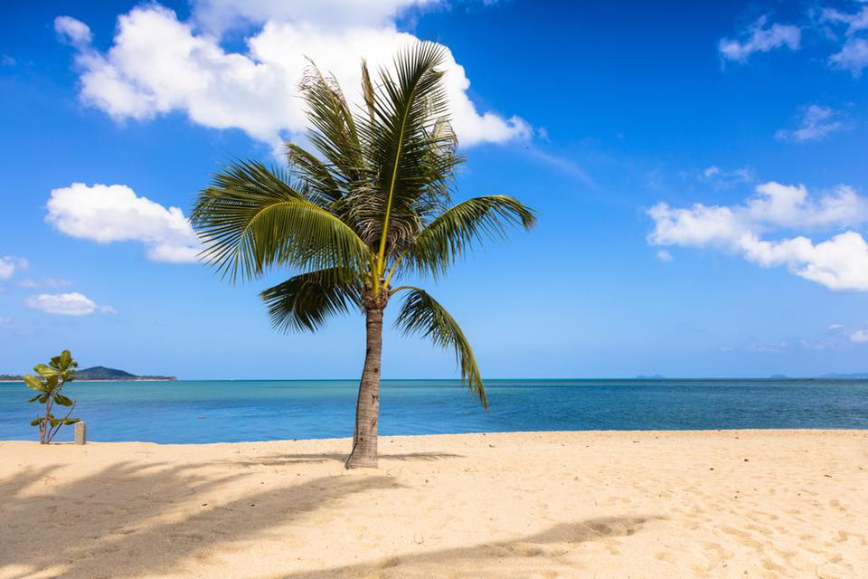
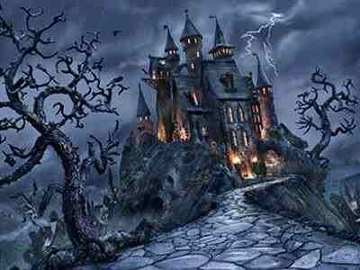
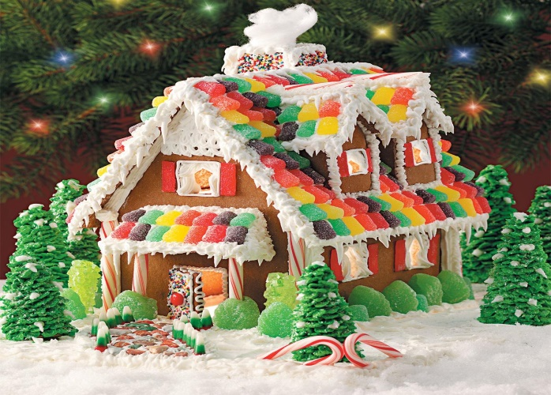
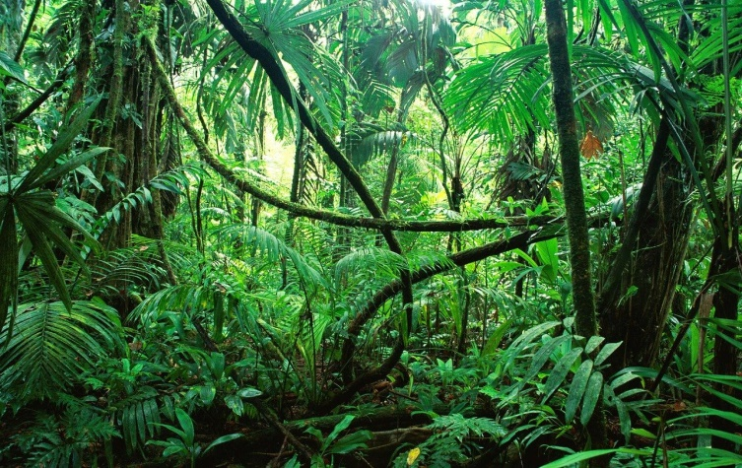
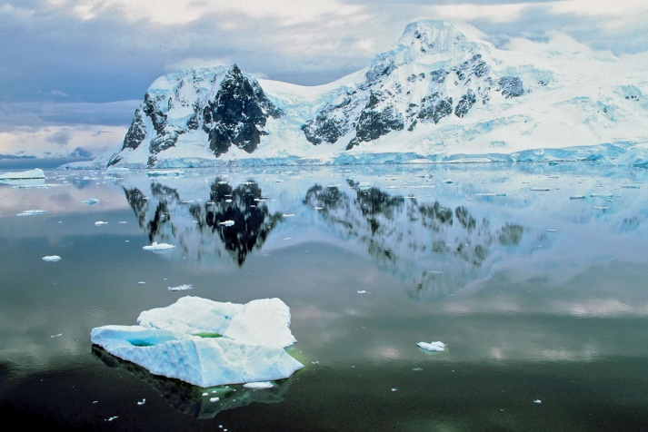
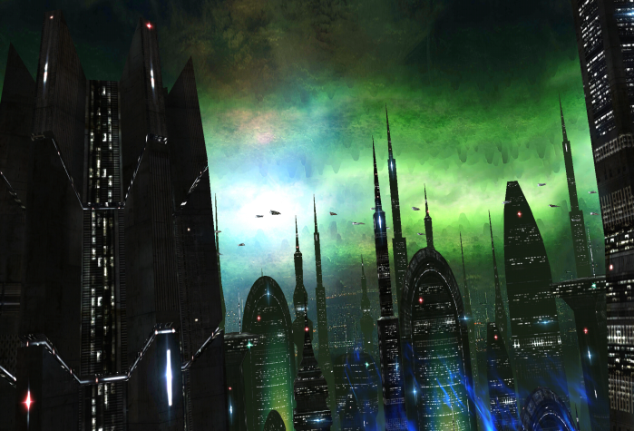
A story setting is where a story takes place.

Slide 4
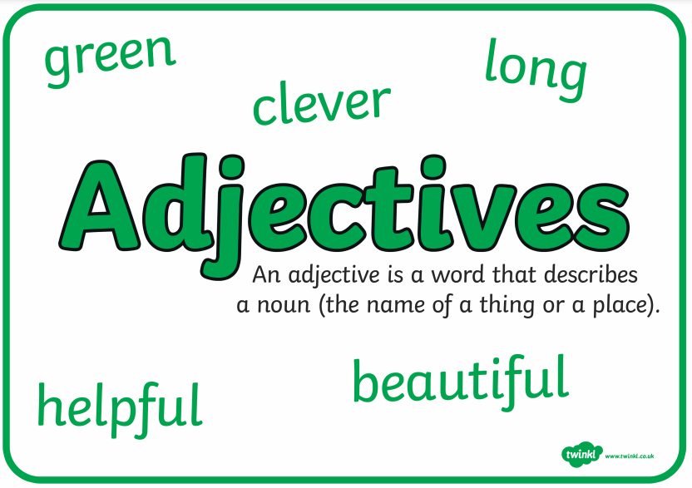
What is an adjective?

Slide 5
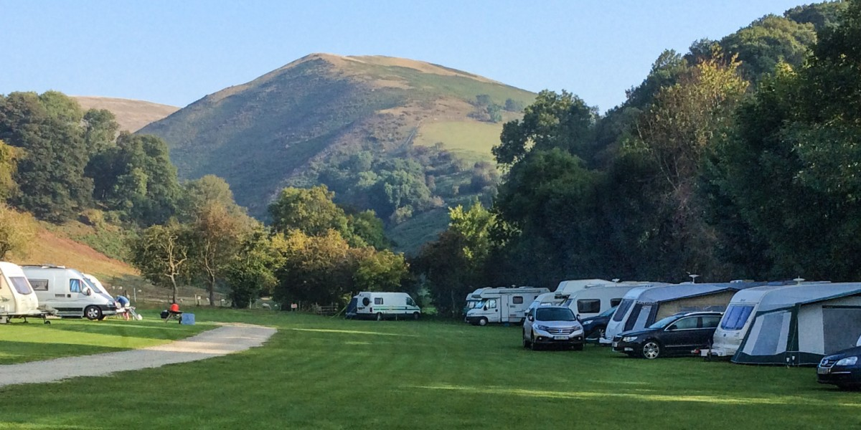
What adjectives could you use to describe this …

Slide 6
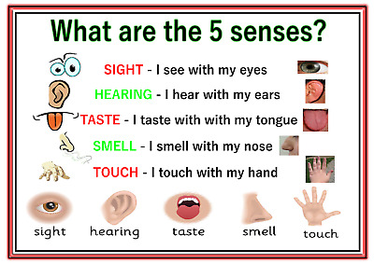
Remember to use your senses when describing a setting.

Slide 7
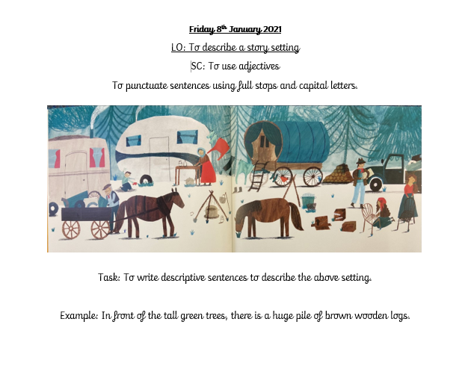
Your Task today: Worksheet available.
Your Task today: To write sentences to describe this setting.
Let's come up with some together.

Slide 8
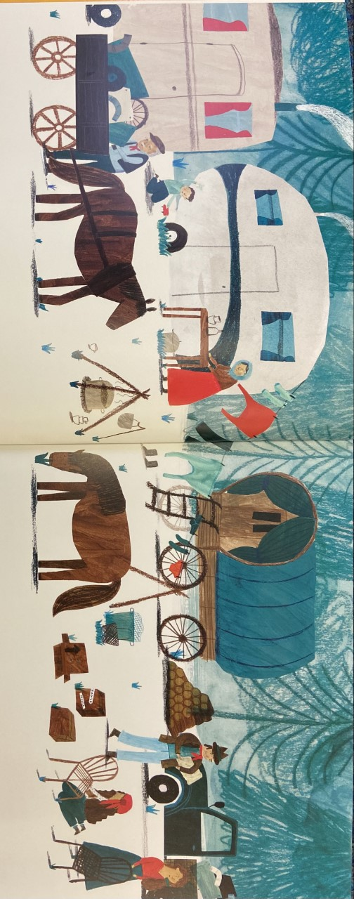
Looking at this picture, what adjectives could you use to describe this setting.
The busy people are all wearing something red.
The dark brown horses are eating green grass.

Slide 9

Think!
What adjectives did you use?
What or who were you describing?

