Slide 1


Slide 2
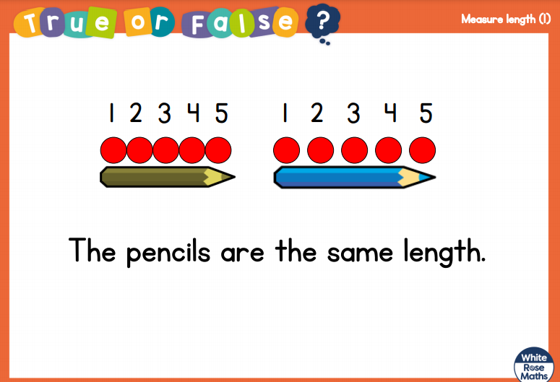

Slide 3
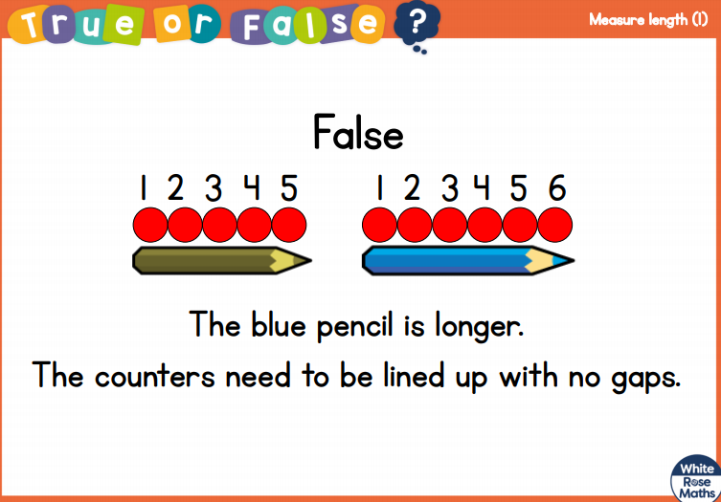

Slide 5

These words help us compare heights:
short
tall
height
same
shorter
tallest
shortest
taller

Slide 6
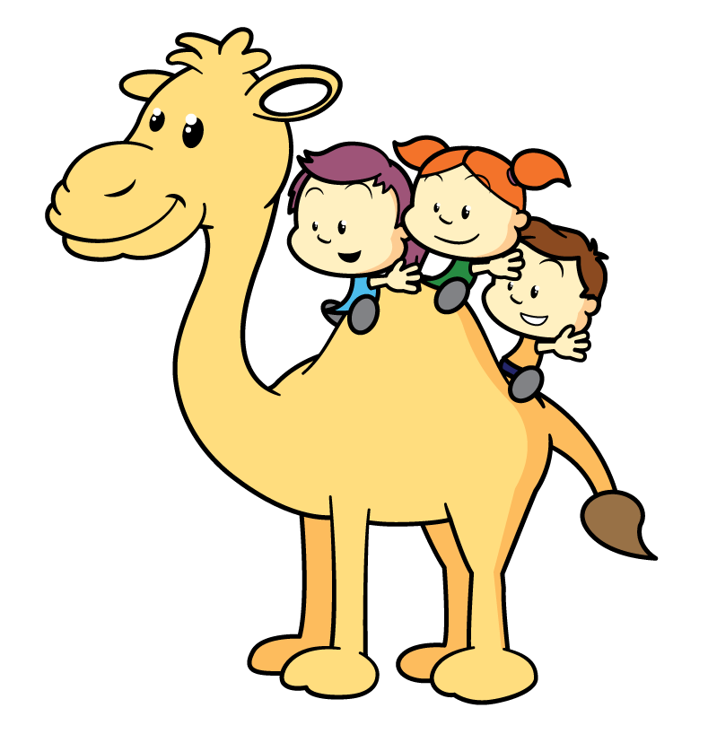
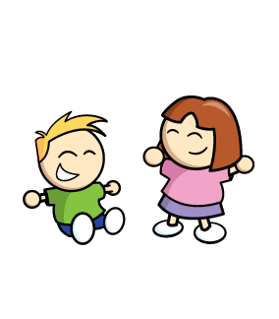

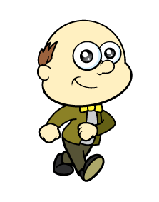

Who is tallest?
I can see who is tallest!
Remember to stand up straight.

Slide 7






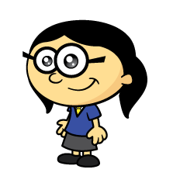
Who is the tallest?
Have a think
How can we compare?
Remember to stand up side by side.

Slide 8
Who is the shortest?
Have a think
How can we compare?
Remember to stand up side by side.

Slide 9
Have a think
How tall are you?
Can you find someone taller?
Can you find someone shorter?

Slide 10
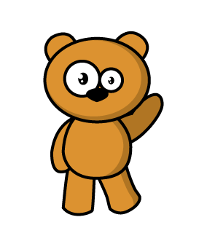
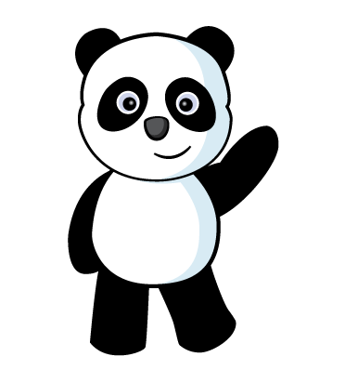
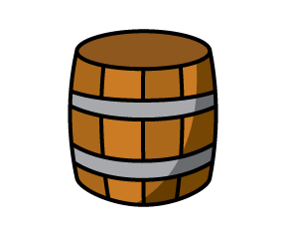
Have a think
Let’s compare!
I can see they are the SAME height.
Panda is shorter than
the brown bear.

Slide 11
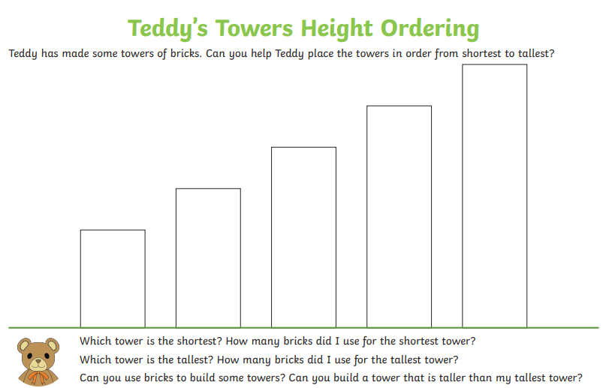






Slide 12
Have I put these in the right order? How do you know?

Slide 13
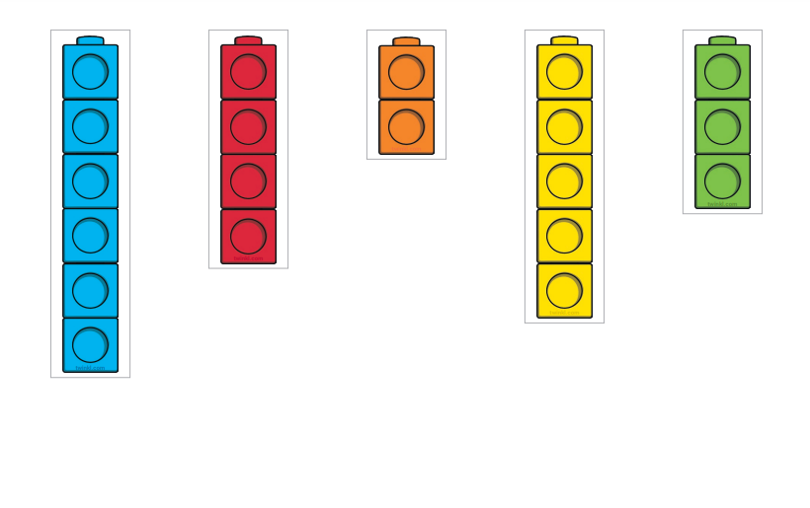
Complete the order from shortest to tallest.
Can you make your own towers to compare?

Slide 14
Can you find 3 things shorter than you?

Slide 15
Can you find 3 things taller than you?

Slide 16
Can you find 3 things the same height as you?

