Slide 1
LO: Who was King Henry VIII?
Monday 1st March 2021

Slide 2
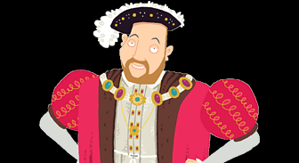
This is King Henry VIII.
He is remembered for starting the Church of England, and for having six wives!

Slide 3
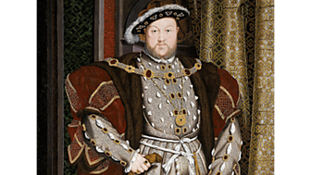
Key Facts for you to remember!
Born: 28 June 1491
Died: 28 January 1547
King Henry VIII had six wives. Most of his wives were not treated well. He even had two of them beheaded!
He wanted to look rich and strong. He had jewels sewn into his clothes and ate the finest foods.
He also set up the Church of England.

Slide 4
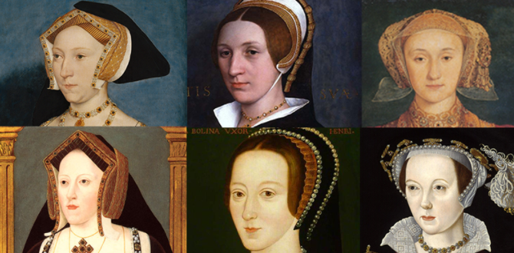
Who were Henry VIII’s Six Wives?
Catherine of Aragon. (divorced)
Anne Boleyn. (beheaded)
Jane Seymour. (died)
Anne of Cleves. (divorced)
Catherine Howard. (beheaded)
Kateryn Parr. (survived)
If Henry VII got tired of his wife, he divorced them or beheaded them so he could marry again.
Jane Seymour died before he could divorce or behead her and Kateryn Parr survived her marriage to Henry.

Slide 5
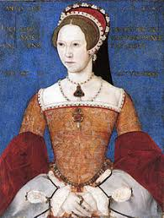
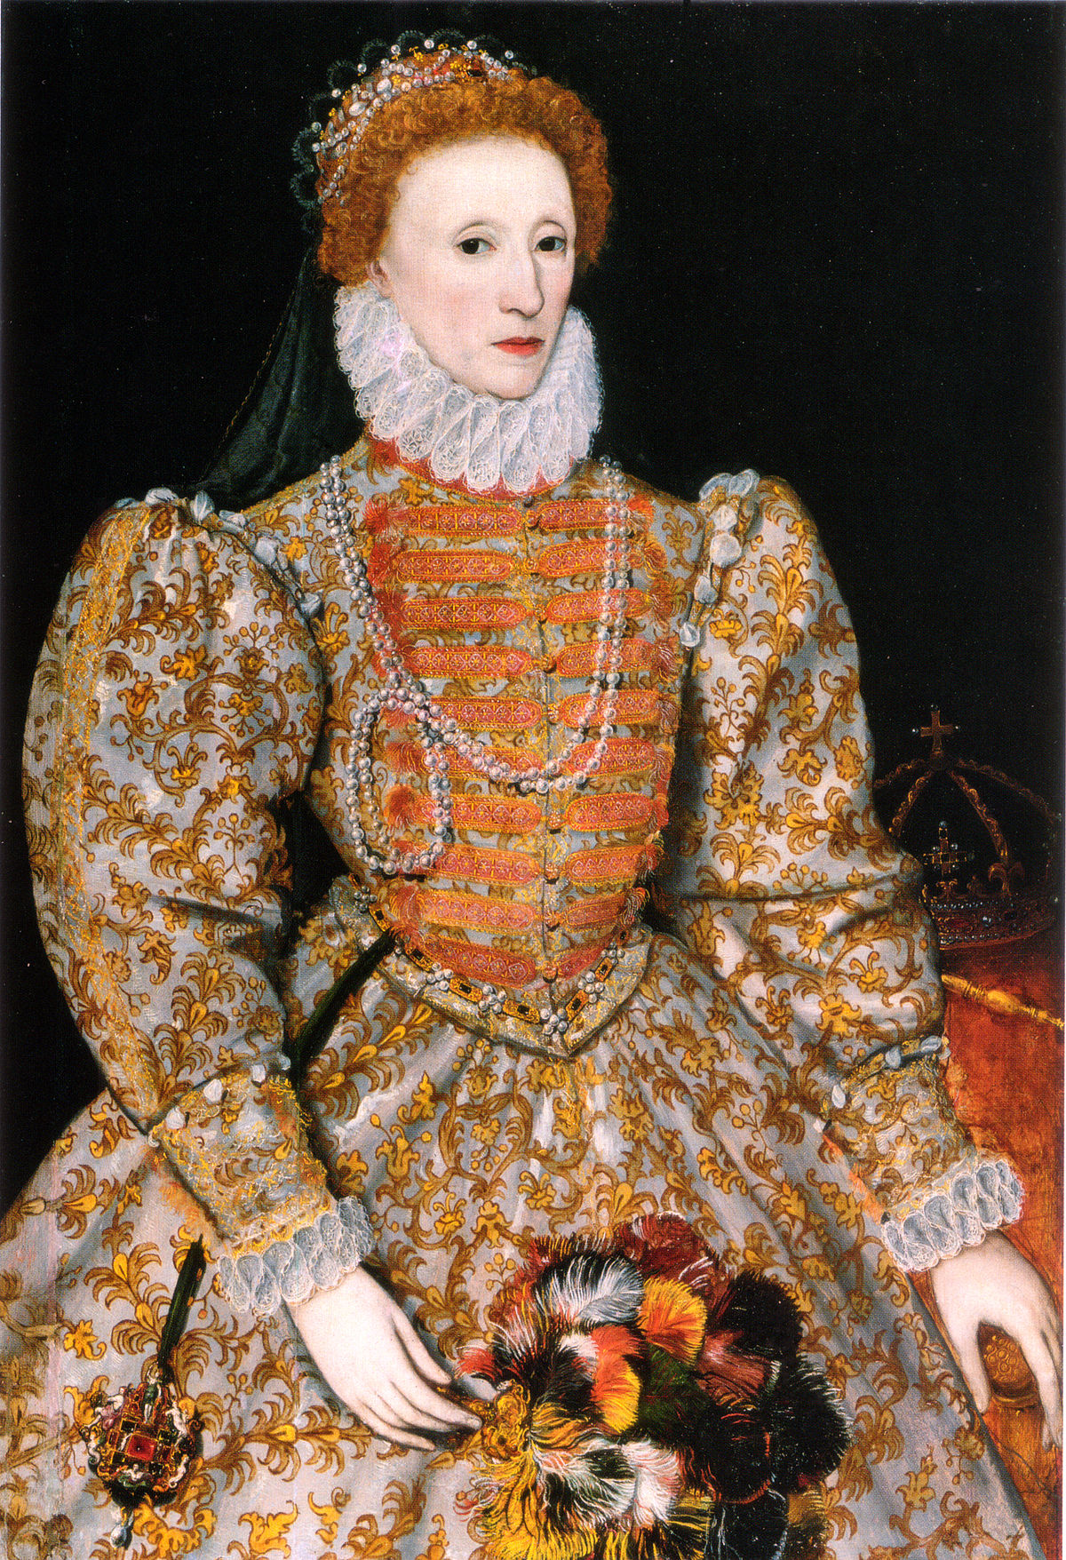
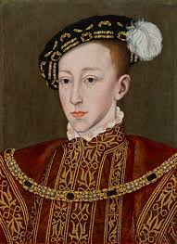
Did Henry VIII have children?
Henry VII (8th) had several children with three of his wives.
  Mary I (1st) born 1516
  Elizabeth I (1st) born 1533
  Edward VI (6th) born 1537

Slide 6
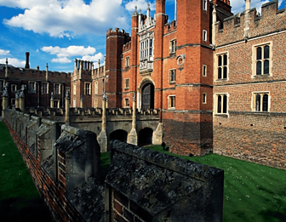
Extra Facts…
King Henry VIII wasn't the nicest person. He liked to get his own way and was a bit of a show off.
Henry had a fool (jester) to make him laugh. The fool told jokes and did funny things, like a clown.
When Henry died, he owned 50 different palaces. The most famous is Hampton Court.
Henry had a bowling alley and tennis courts at Hampton Court!

Slide 7
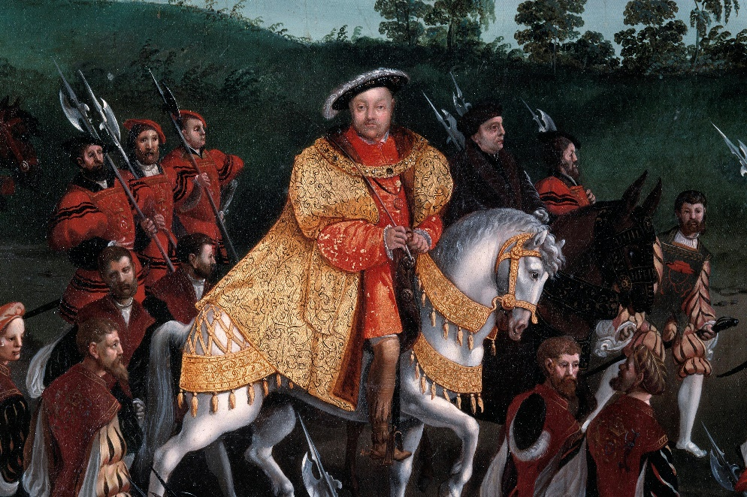
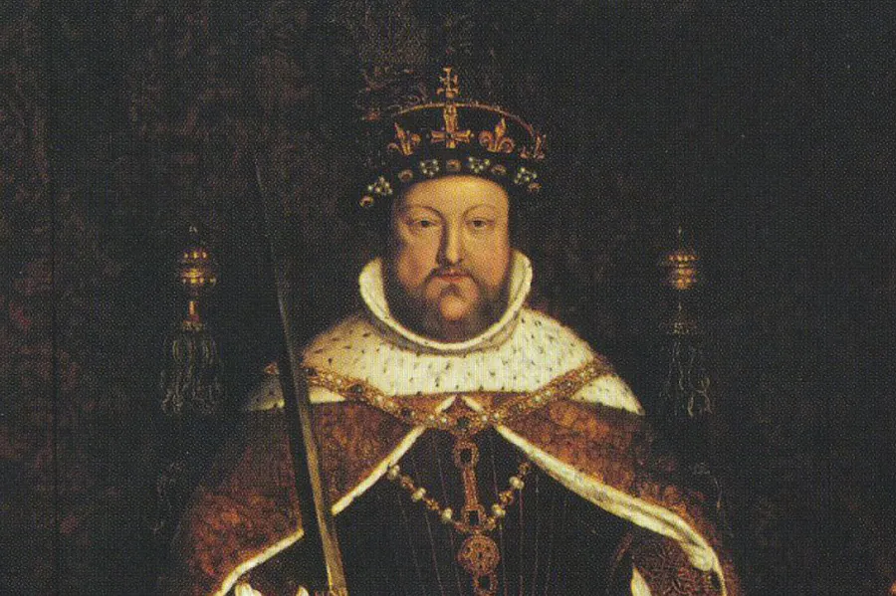
Watch these videos for more information about Henry VIII
https://www.bbc.co.uk/bitesize/topics/zkrkscw/articles/zv2bmfr
Horrible Histories Video Link

Slide 8
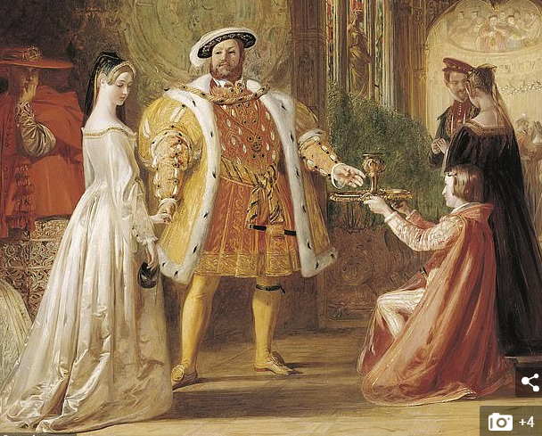
Your Task
Create a poster fact file about King Henry VIII – include at least 6 facts.
Present it in any way you wish!
You could create a collage of facts and pictures, paint a picture of Henry VIII and stick facts around it. You could even create a poster with flaps with facts on it!
Henry III with Ann Boleyn his second wife, before she was beheaded!

