Slide 2



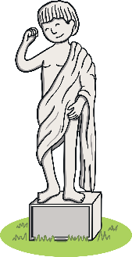



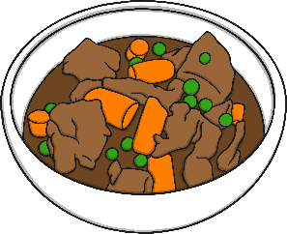
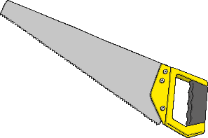
Revisit and Review
Let’s practise Sam’s Sounds and Common Exception Words!
y
au
ir
ue
ue
ew
aw
ew
house
many
work
laughed
because
eyes
different
friend
also

Slide 3
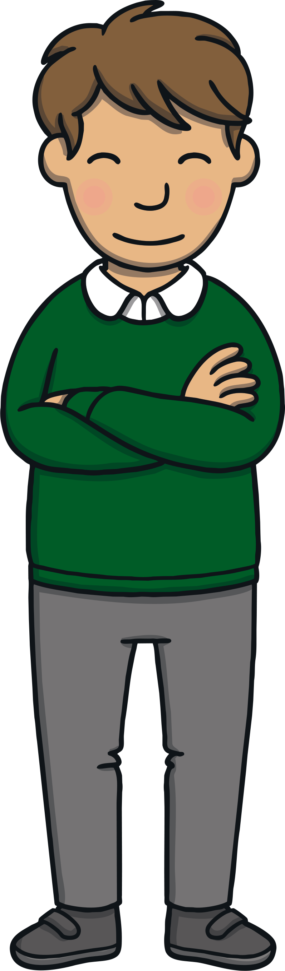

Teach
This week, we are learning to spell the common
exception words who and why. Watch the magic pencil write the words. Can you join in?

Slide 4


Teach
who
Play

Slide 5
Teach
why
Play

Slide 6
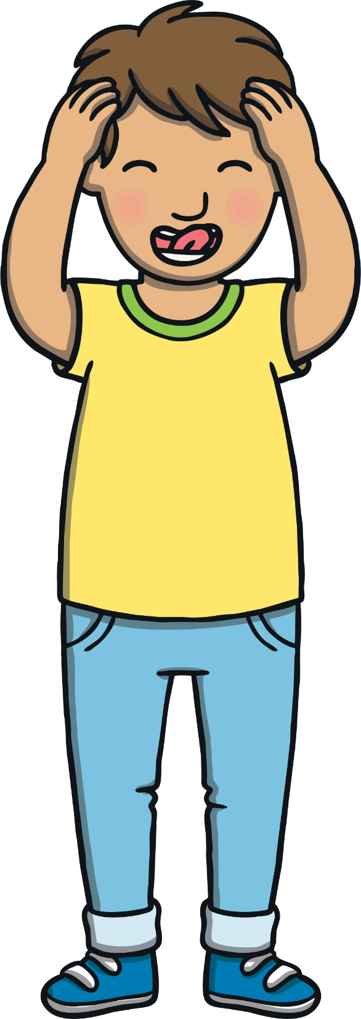
Teach
Today, we are learning to read words that contain aw saying /or/.

Slide 7
Teach
Sometimes when we see a and w as partners, they make an /or/ sound. Let’s try and say these together:
paw
claws
strawberry

Slide 8
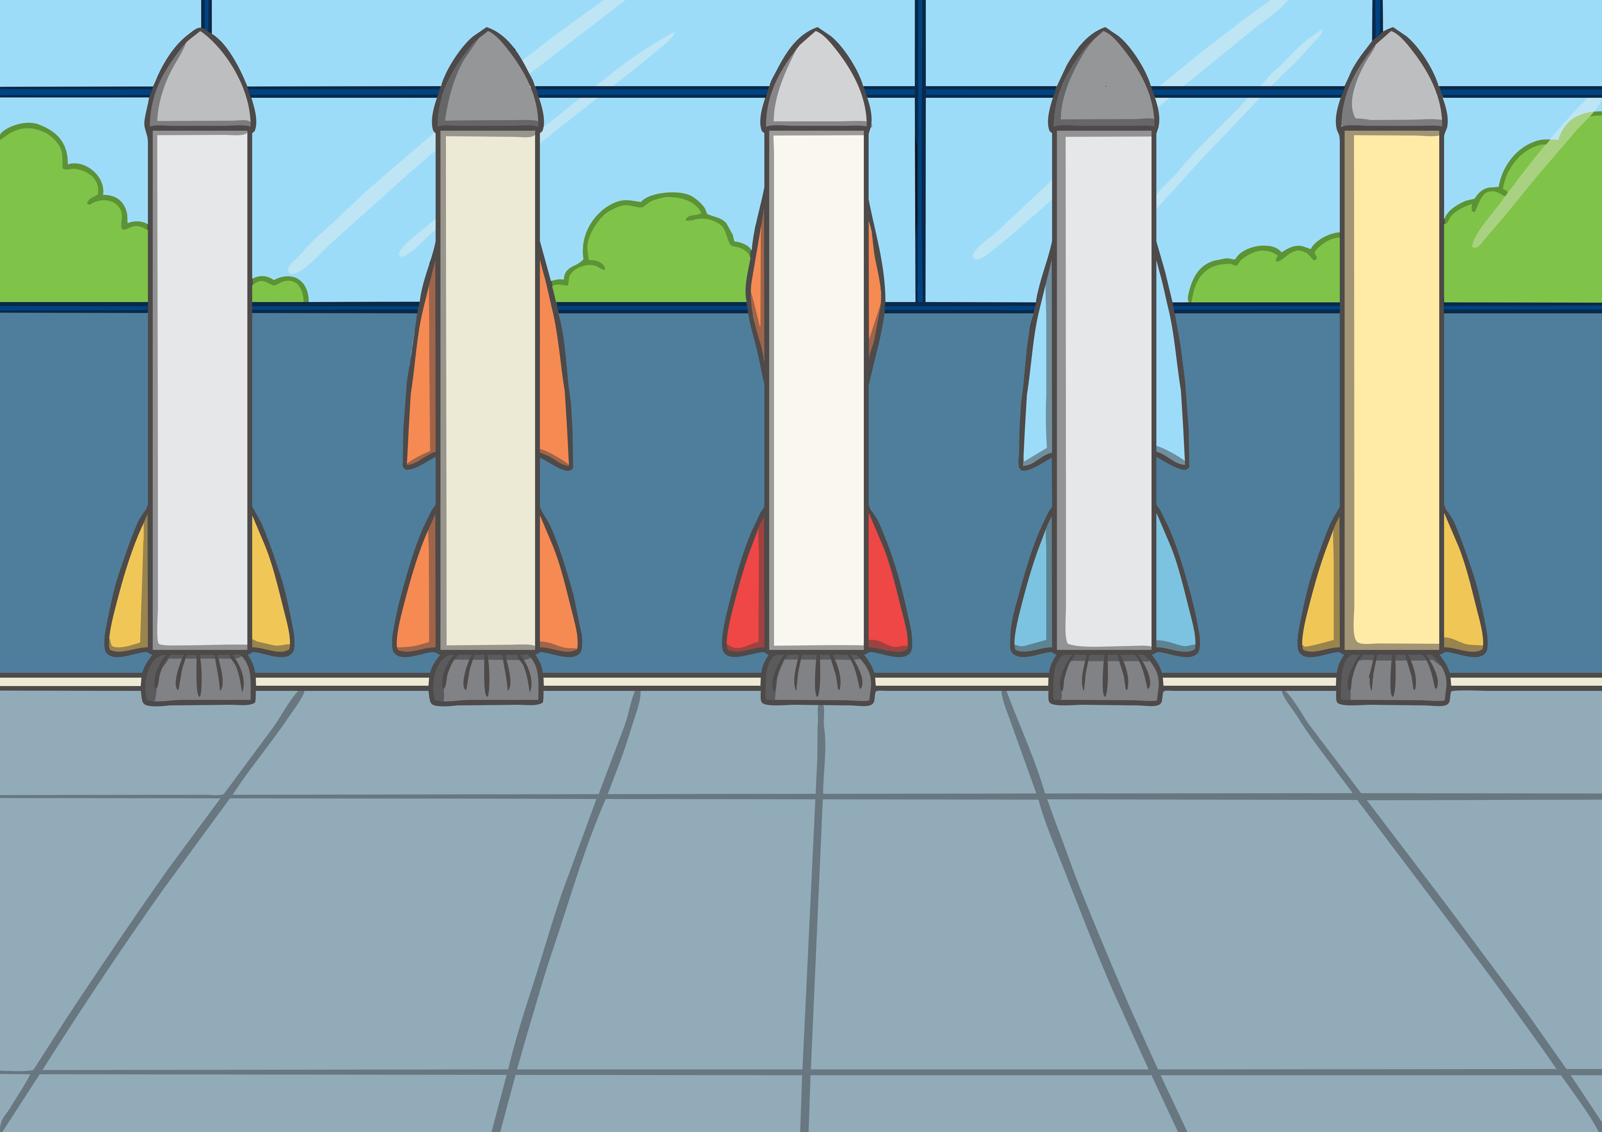
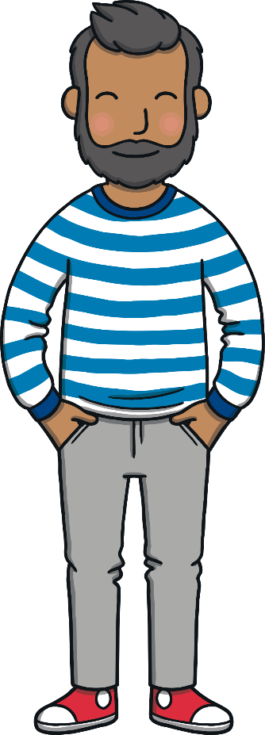

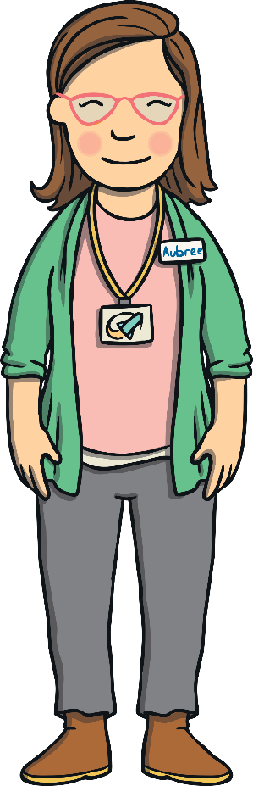


Teach
Kit, Sam, Mum and Dad were still having fun at the space museum. Aubree, the museum guide, had just asked Kit and Sam if they wanted to go in a real spaceship! Of course their answer was, “Yes!”

Slide 9
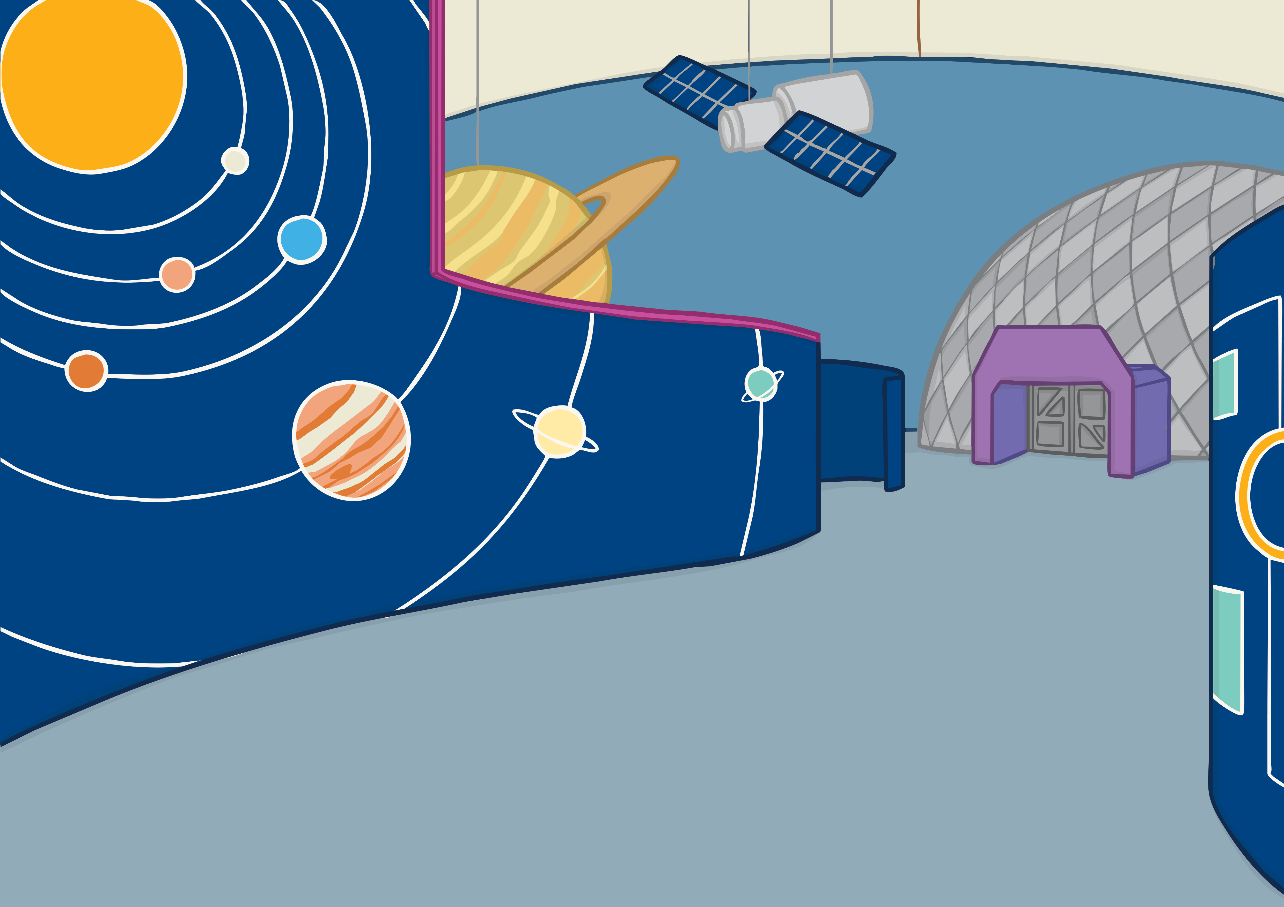
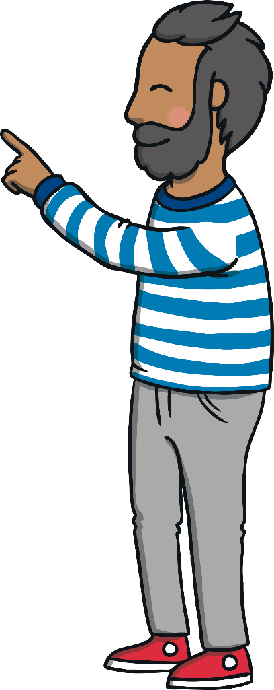


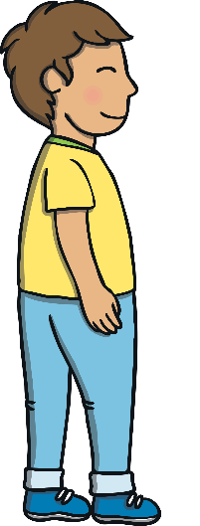
Teach
Sam and Kit followed Aubree eagerly past pictures of stars and model planets. Mum and Dad followed behind. “We even have a new feature in the spaceship that I think you are going to love!” Aubree informed them.

Slide 10
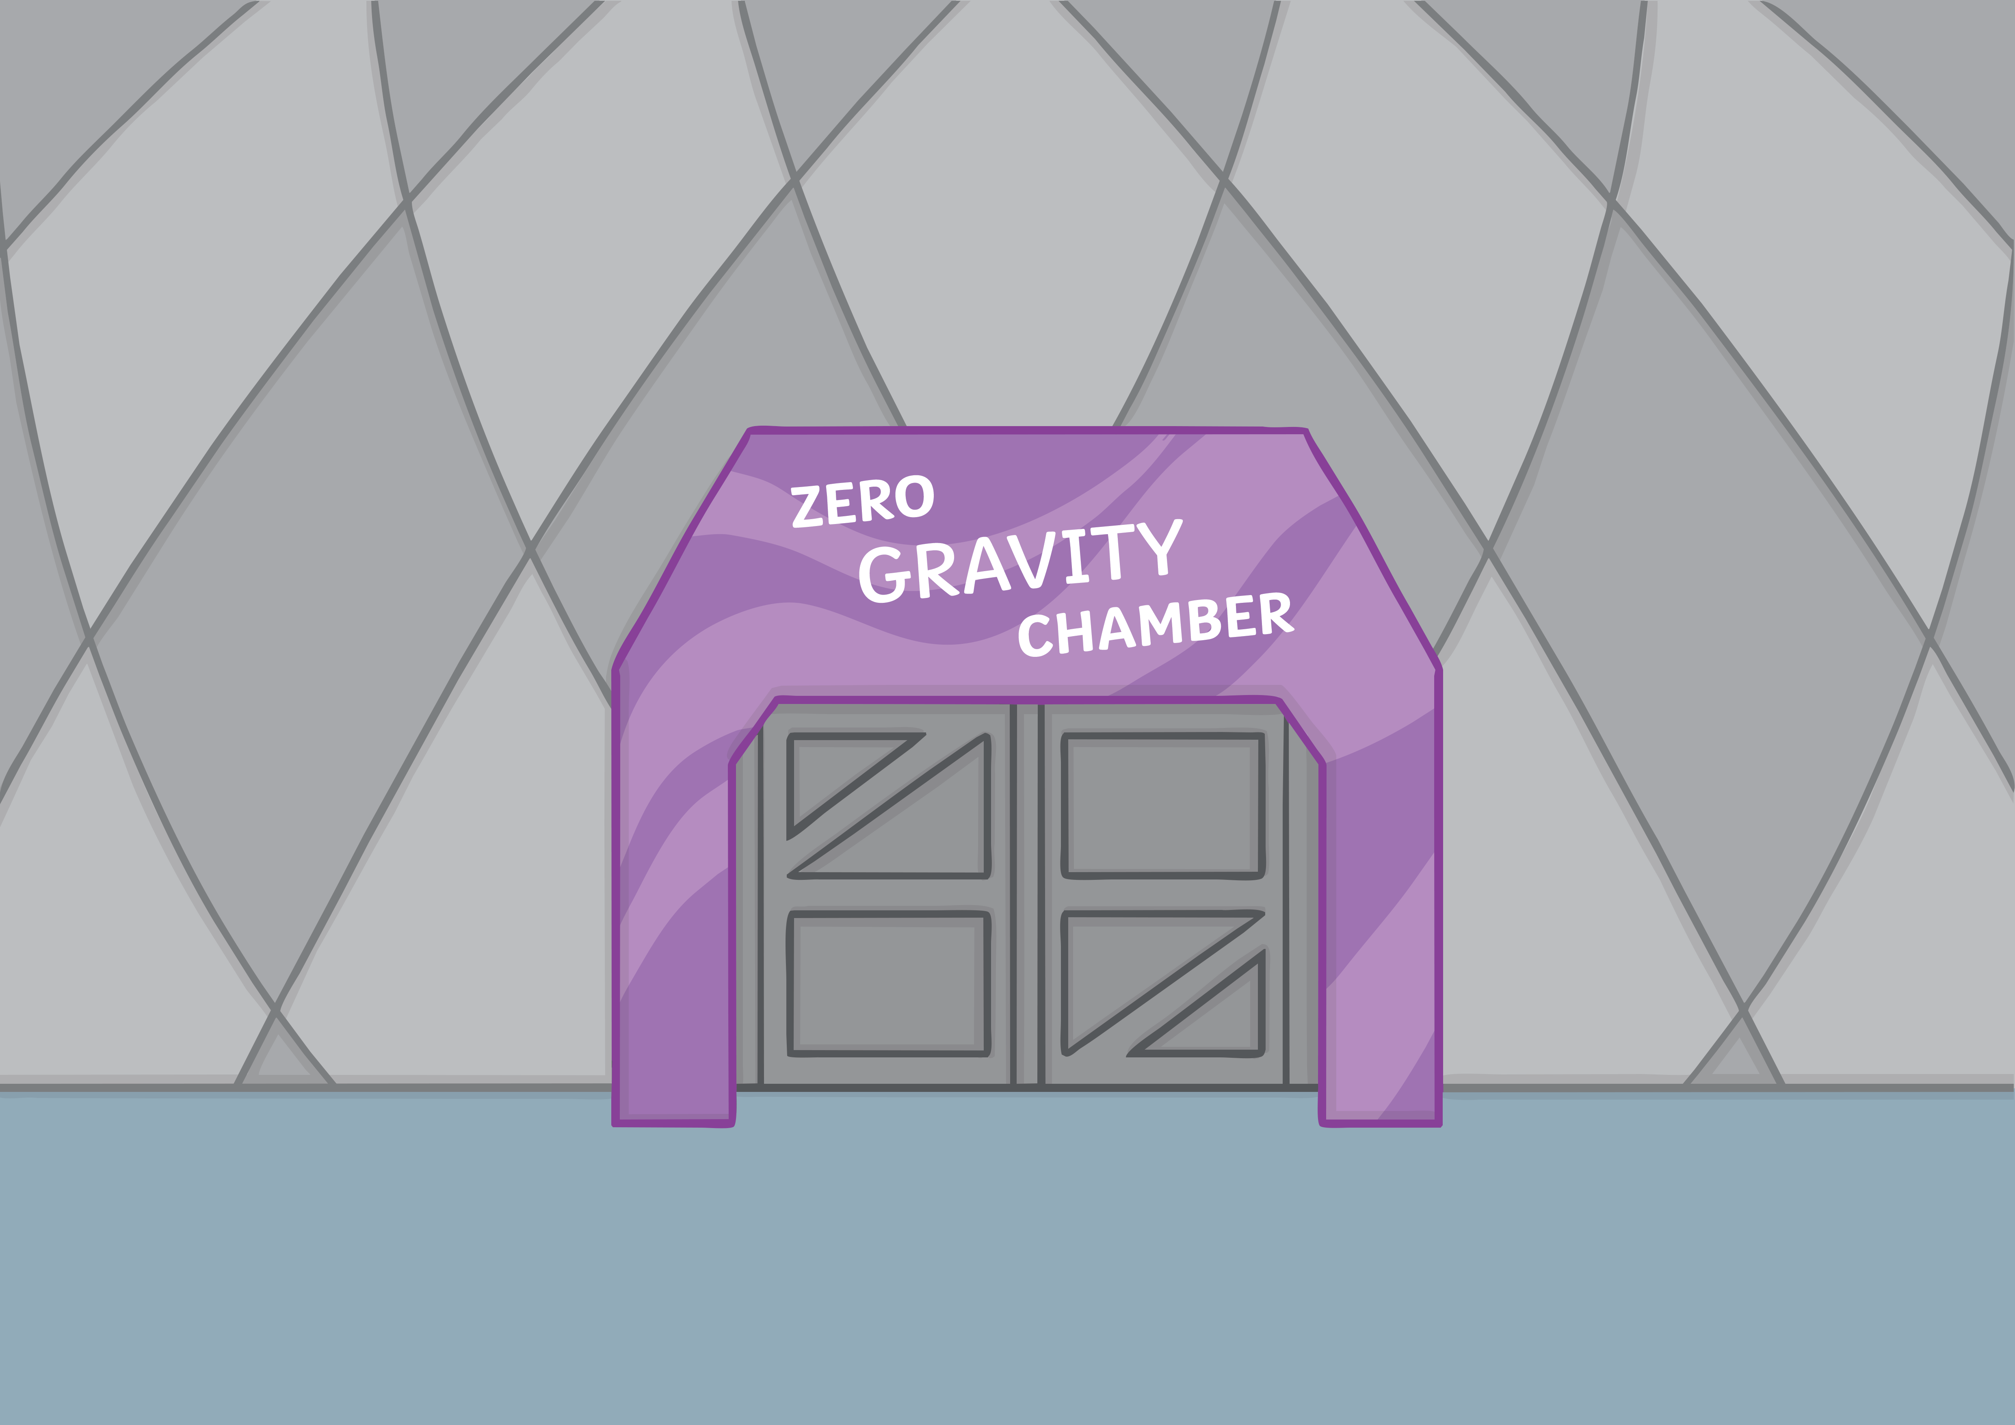

Teach
“We call this the zero gravity chamber! Do you want to try?”
“Yes please!” squealed Kit and Sam together.
“OK then, join the line for your space suits and get ready to feel as light as air!” said Aubree, enthusiastically.

Slide 11
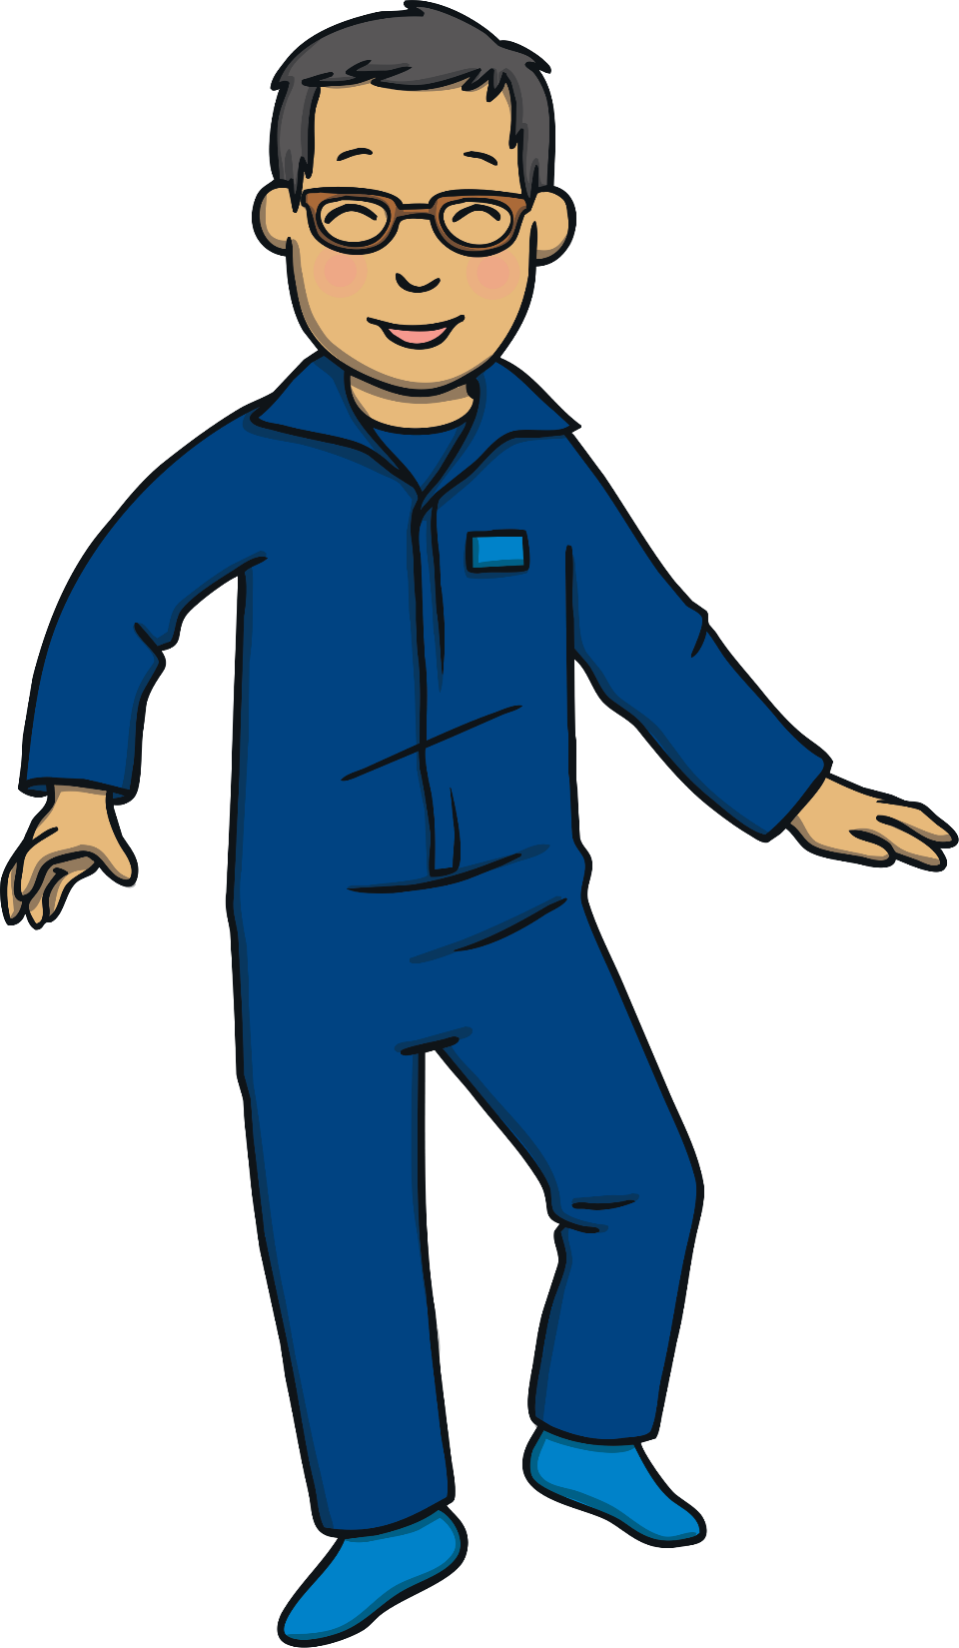
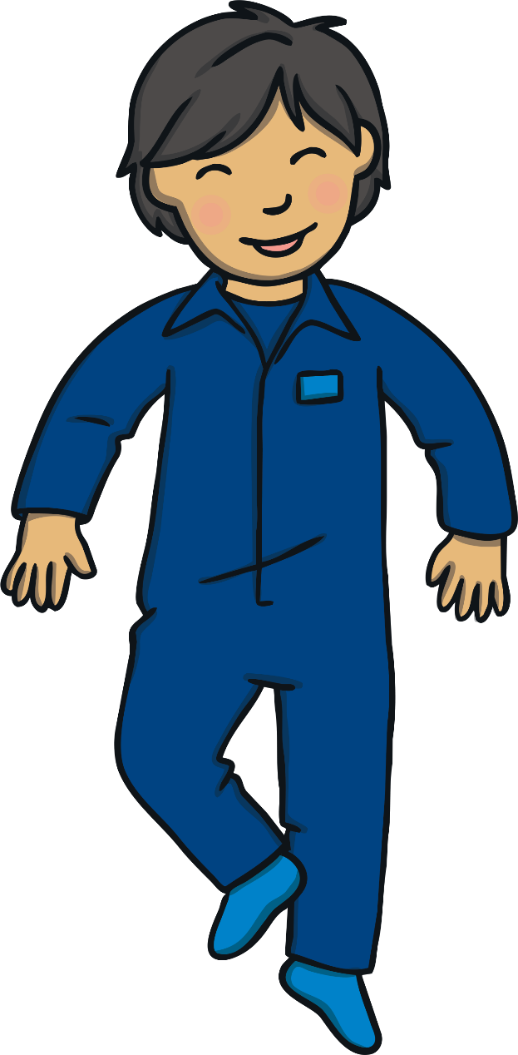
Zero Gravity
Teach
Sam and Kit are watching another family in the zero gravity chamber.
Click each object to reveal a word to read.

Slide 12
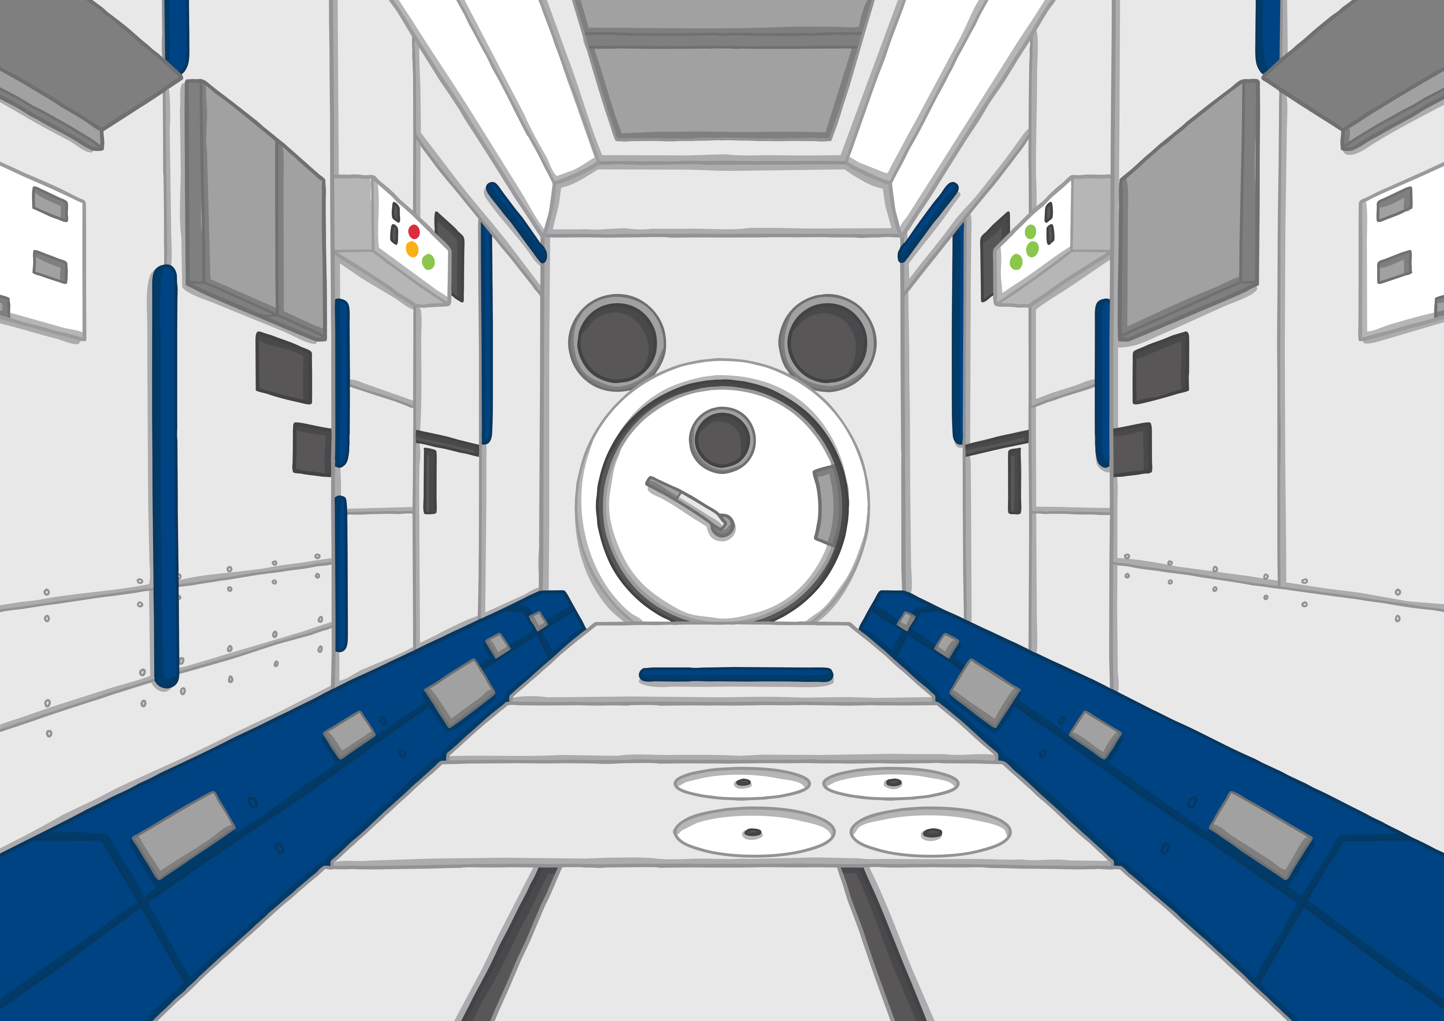
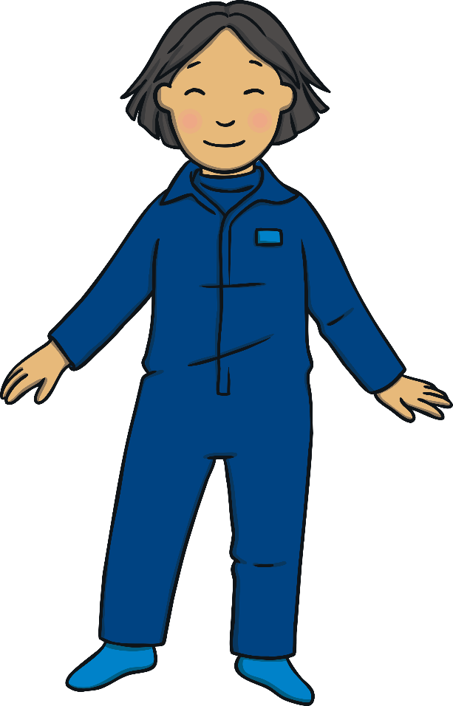




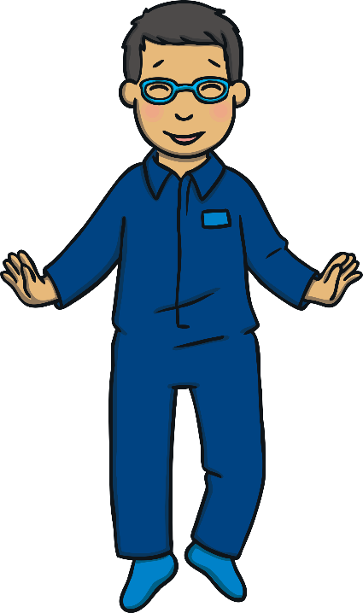

Teach
draw
saw
yawn
paw

Slide 13

Tips For Space Training
Practise
Mum is reading a sign on the wall about how to train to be an astronaut. Help her read the tips and find the correct words for the spaces.

Slide 14


Tips for Space
Practise
Wake up at the crack of .
Wake up at the crack of dawn.
Do not .
Do not yawn.
Have a run on your .
Have a run on your lawn.
Check your outfit for .
Check your outfit for flaws.
Check

Slide 15
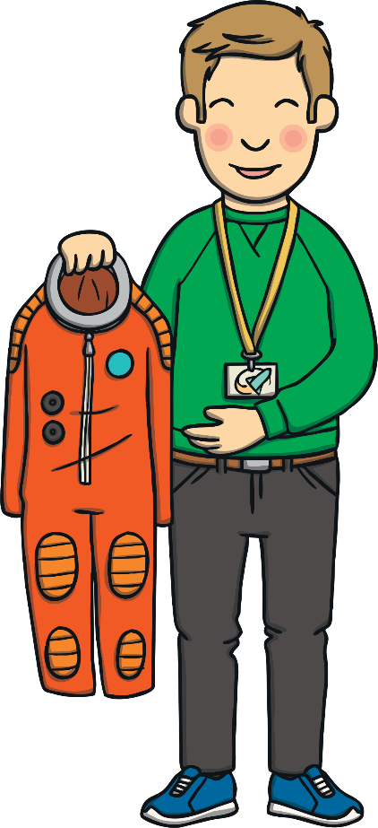
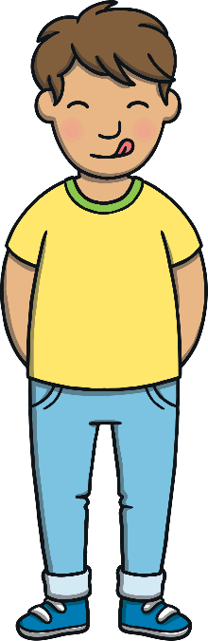
Apply
After waiting patiently, the whole family were given space suits to wear. “I already feel like an astronaut!” smiled Sam.
“I feel awesome!” said Kit as he looked inside the zero gravity chamber eagerly.

Slide 16
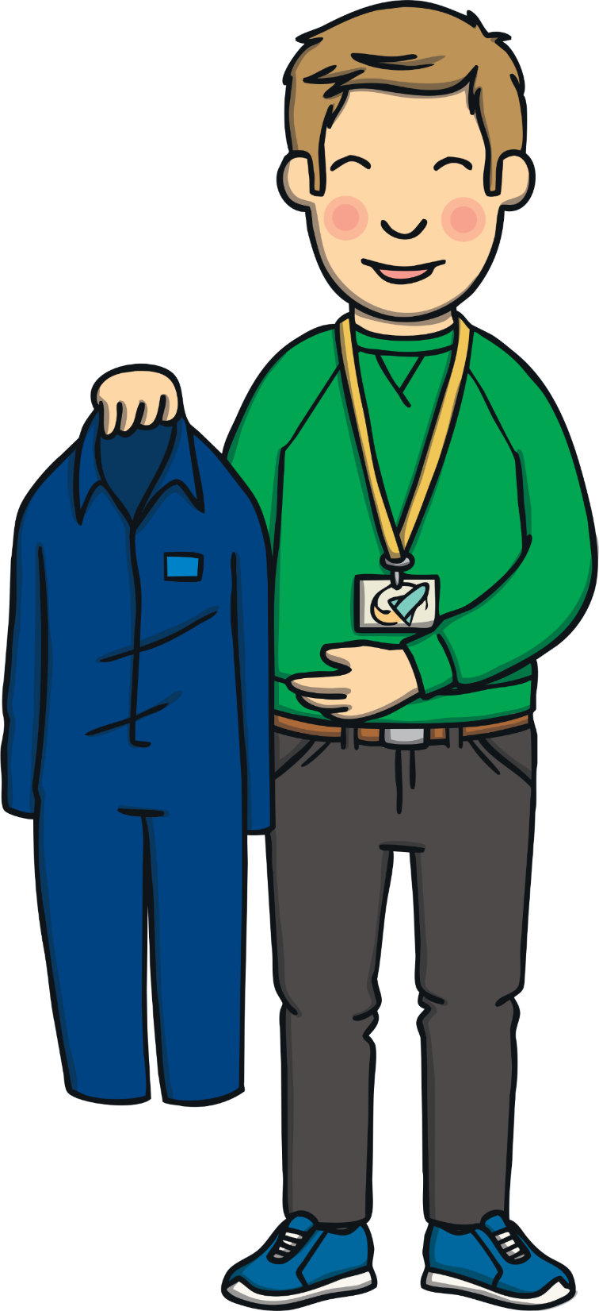
Sentence Time
Apply
The guide is talking.
Can you guess what he is saying to the people in the queue?

Slide 17
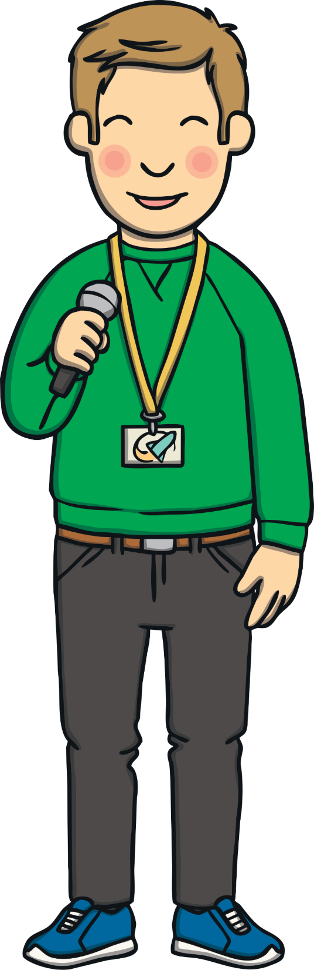
Apply
Who wants to be our first
astronaut to enter the chamber?
Sound Buttons On/Off
Show

Slide 18
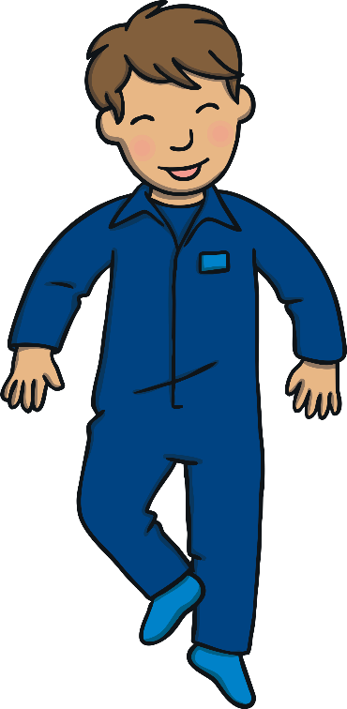
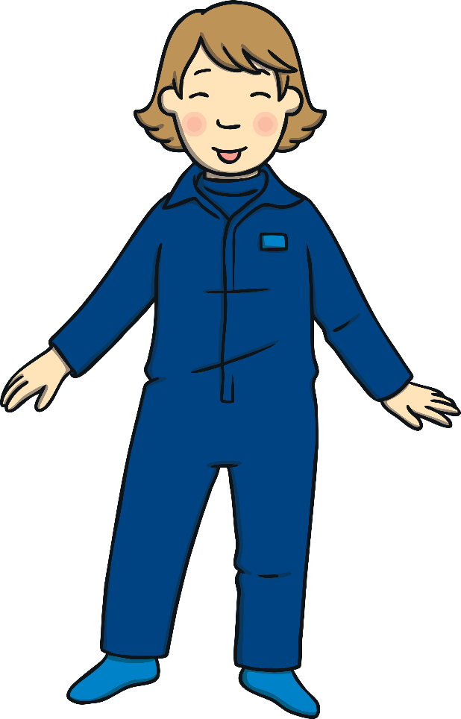
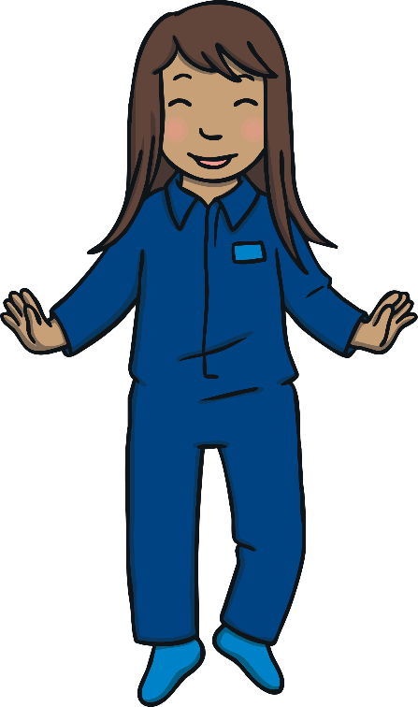
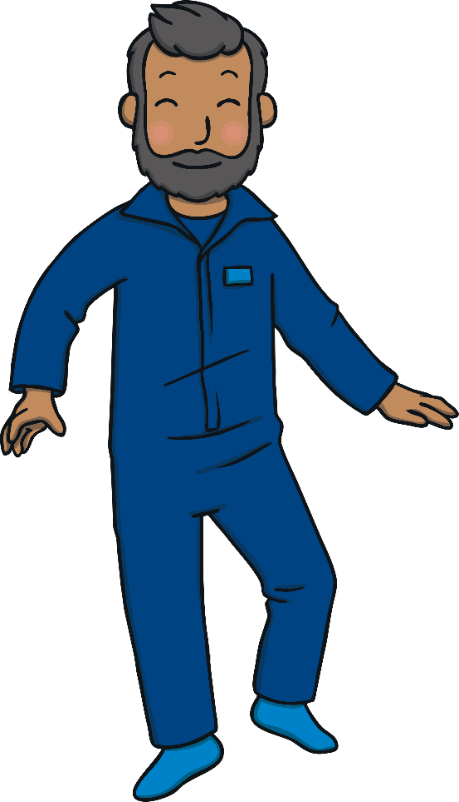
Apply
“Me! Me!” cried Kit and Sam, jumping up and down. Mum, Dad, Sam and Kit stepped inside the chamber. The door was sealed and then Kit could hear a loud whirring sound.
“It’s starting!” shouted Kit.
“Woah,” shouted Sam, just as she started lifting off the floor.

Slide 19

Today, we have learnt…
aw
saying /or/
The adventure continues next lesson!

