Slide 1

Our Set 3 phoneme for today is…. aw
saw
yawn
law
claw

Slide 2
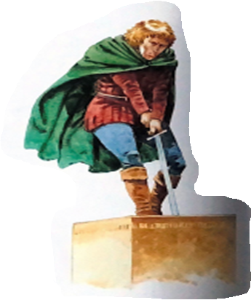
Wednesday ^{3rd} March 2021
LO: To write a diary from the viewpoint of Arthur describing becoming the true King of England.

Slide 3

Writing a Diary Entry
When you write a diary entry, you are writing about a day in the life of a real person or character.
The diary entry has to sound as if the person or character has written it, so it needs to be written from their point of view.
It also needs to be exciting
and interesting to read.
To get this right,
just follow a few easy steps...

Slide 4

Diary Writing Must...
include the date and/or time
The date or time can be written at the top of the page like this...
Tuesday 2nd February
Dear Diary,
I thought today was going to be like every other day but I was very wrong. From now on my life will never be the same. My brother Kay had just become a knight and so this morning we decided to travel to London so that Kay could take part in a jousting tournament. We were almost there when Kay suddenly began to panic. He had lost his sword…

Slide 5

Diary Writing Must...
use the words
‘I’, ‘my’, ‘we’ and ‘our’
These words are special because they tell us the diary is being
written by someone and they are talking about themselves.
We call this kind of writing ‘first person’. Look at these two examples. Which one uses the correct words to be written in ‘first person’?
I felt the cold steel handle of the sword in my hands. A magical feeling rushed up my arm. I knew something special was about to happen.
First person!
He felt the cold steel handle of the sword in his hands. A magical feeling rushed up his arm. He knew something special was about to happen.
person!

Slide 6
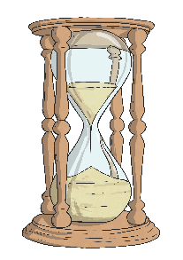
Diary Writing Must...
be written in the past tense
When we write a diary, we write in the past tense.
This is because we are writing about something that has
already happened.
Look at the sentences below. Which is written in the past tense?
I couldn’t believe my eyes. I pulled the sword out of the stone. I was so excited to find out that I was the true King of England.
As I pull the sword out of the stone, I realise that I am the true King of England.

Slide 7

Diary Writing Must...
use time linking words, e.g. ‘next’, ‘first’ and ‘then’
A diary is usually describing lots of events.
To make sense of when these events happened it is helpful to include time linking words, such as ‘next’, ‘first’ and ‘then’.
If we just use one word, such as ‘and’ to link the events in our diary it can get very boring!

Slide 8
Diary Writing Must...
write as if you were there
When we write a diary, we have to make
the reader think we were really there.
We can do this by including lots of detail and description.
What extra detail and description could you add to make it sound as if it was written by someone who was really there?

Slide 9
Diary Writing Must...
describe feelings
A diary is usually a secret place to write how you feel about what has happened to you in the day.
In a diary, you might include feelings, hopes or fears that you wouldn’t want anyone to know about.
Question: How might Arthur feel when he realises that he is the only one who can pull the sword out of the stone and that he is the true King of England?

Slide 10
Friday 3rd September
Dear Diary,
I thought today was going to be like every other day but I was very wrong. From now on my life will never be the same. My brother Kay had just become a knight and so this morning we decided to travel to London so that Kay could take part in a jousting tournament. We were almost there when Kay suddenly began to panic. He had lost his sword. I knew I had seen a sword sticking out of a stone in the churchyard. I hurried back to find it. I placed my small hands around the cold steel handle of the sword. To my surprise the sword slid out of the stone easily. I felt a wave of magic rush up my arm as if something important had just happened. Little did I know, I was in for a big surprise. . .

Slide 11
Your Task
Write a diary entry. You should imagine that you are Arthur and talk about how it felt to take the sword out of the stone and what happened afterwards. How would Arthur have felt when he found out that he is the true King of England?
You can choose to either write or type your diary entry.

