Slide 1
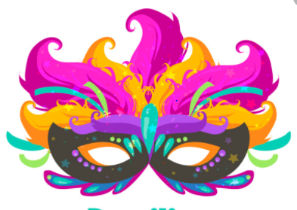
End of Topic Quiz
Rio De Vida

Slide 2
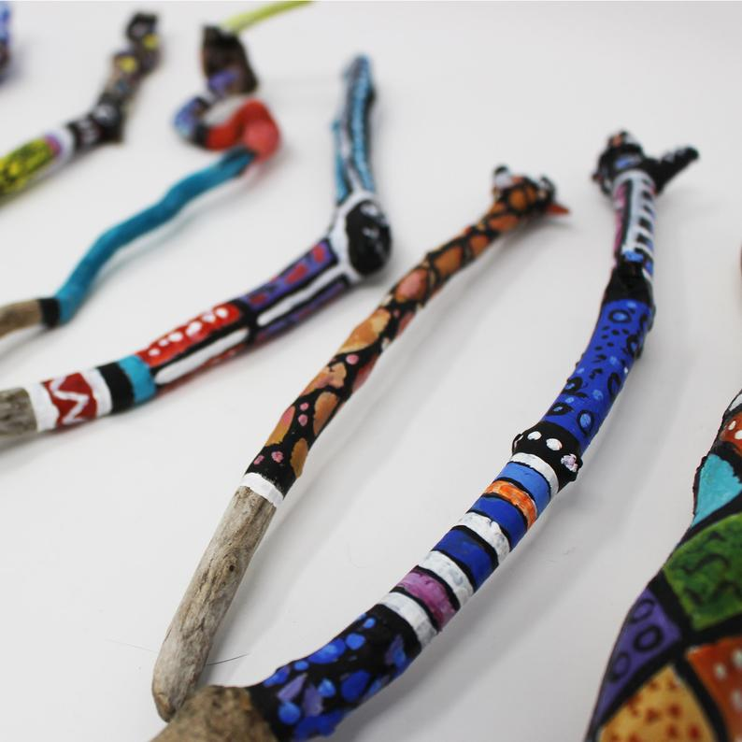
Question 1
Which continent is Brazil part of?
Question 2
What are
these?

Slide 3
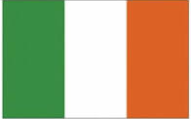

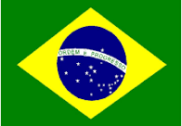
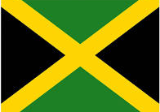
Question 3
Which of these is the Brazilian flag?
A.
B.
c.
D.

Slide 4
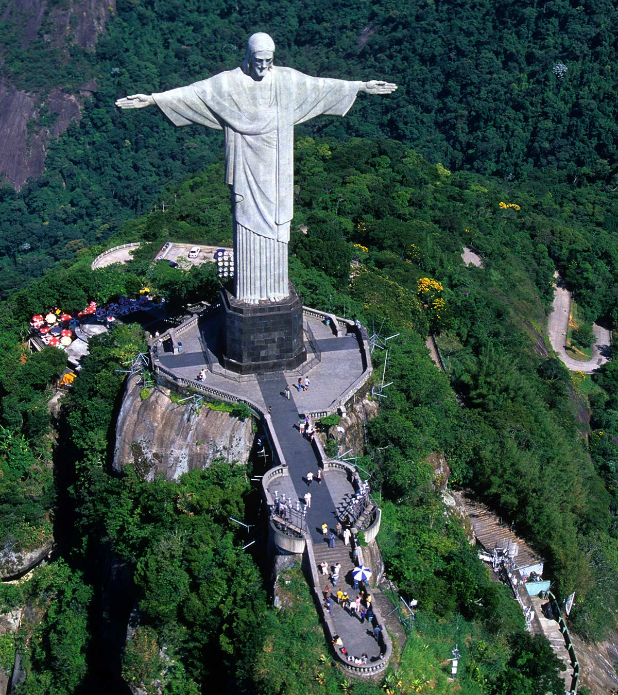
Question 4
What is the main language spoken in Brazil?
Question 5
What is this
statue called?

Slide 5
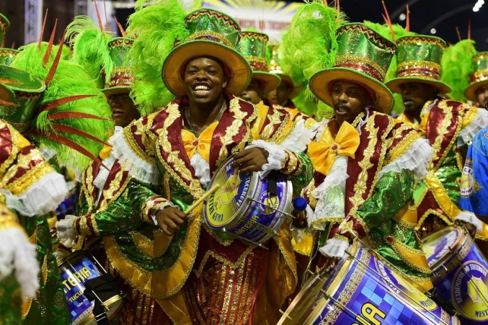
Question 6
What is the capital of Brazil?
Question 7
What type of music is played at carnivals?

Slide 6
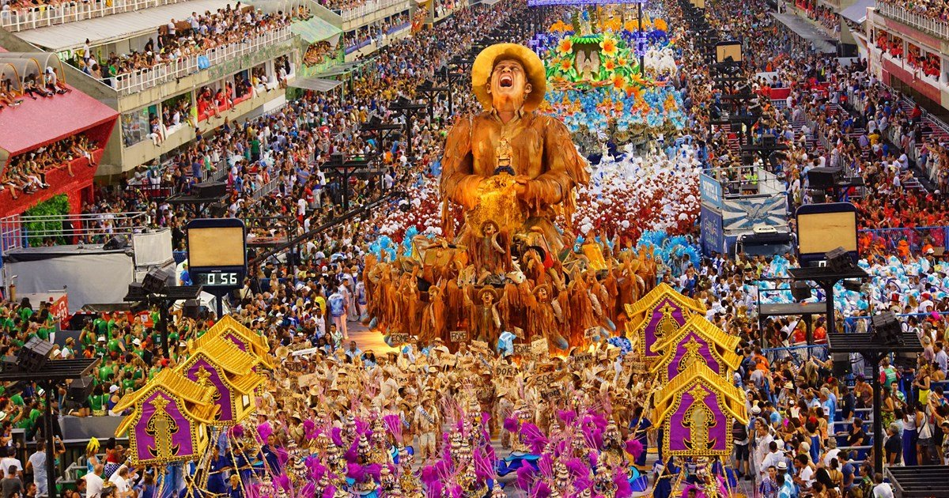
Question 8
In what city does the most famous carnival in Brazil take place?

Slide 7
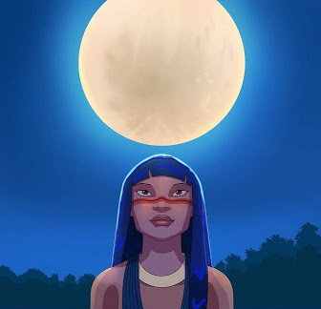
Question 9
What does the girl in the famous Brazilian myth Vitoria Regia turn in to?

Slide 8
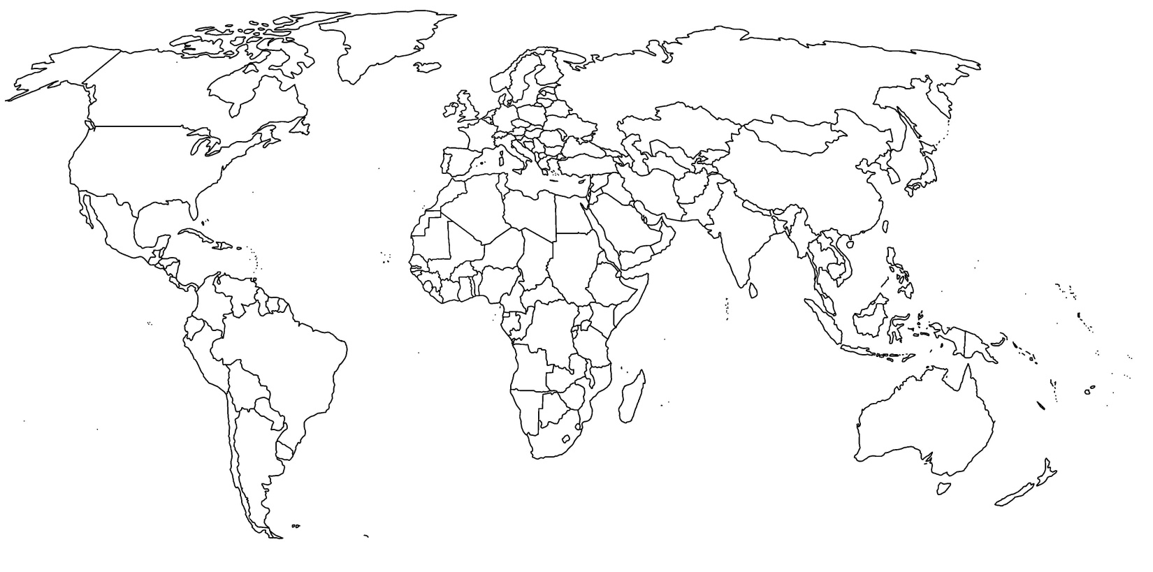
Question 10
Where is Brazil on this map of the world?
A
c
B
D

Slide 9
Answers

Slide 10
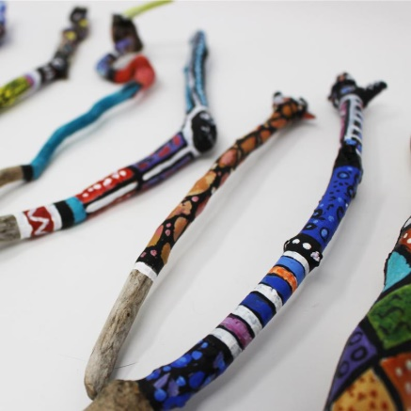
Question 1
Which continent is Brazil part of? South America
Question 2
What are
these? Tribal talking
sticks

Slide 11
Question 3
Which of these is the Brazilian flag?
c.

Slide 12

Question 4
What is the main language spoken in Brazil?
Portuguese
Question 5
What is this
statue called?
Christ the
Redeemer

Slide 13
Question 6
What is the capital of Brazil? Brasilia
Question 7
What type of music is played at carnivals?
Samba music

Slide 14
Question 8
In what city does the most famous carnival in Brazil take place?
Rio de Janeiro

Slide 15
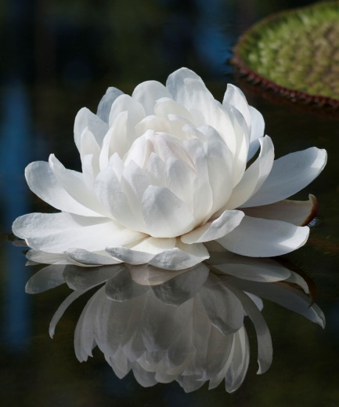
Question 9
What does the girl in the famous Brazilian myth Vitoria Regia turn in to?
A type of lily that opens at night.

Slide 16
Question 10
Where is Brazil on this map of the world?
B

Slide 17
Well Done!
How many facts were you able to remember?

Slide 18
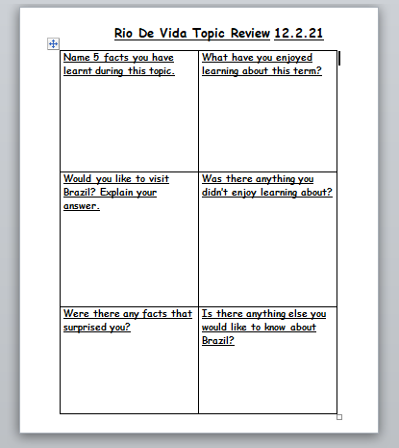
Your Task
Tell me about what you have learnt this half term using this sheet.
Option 1 – Print the sheet and write on it.
Option 2 – Type directly on to the sheet.
Option 3 – Look at the questions and write your answers on a separate piece of paper.

