Slide 1
Literacy & Phonics
Monday 8th Februrary 2021

Slide 2
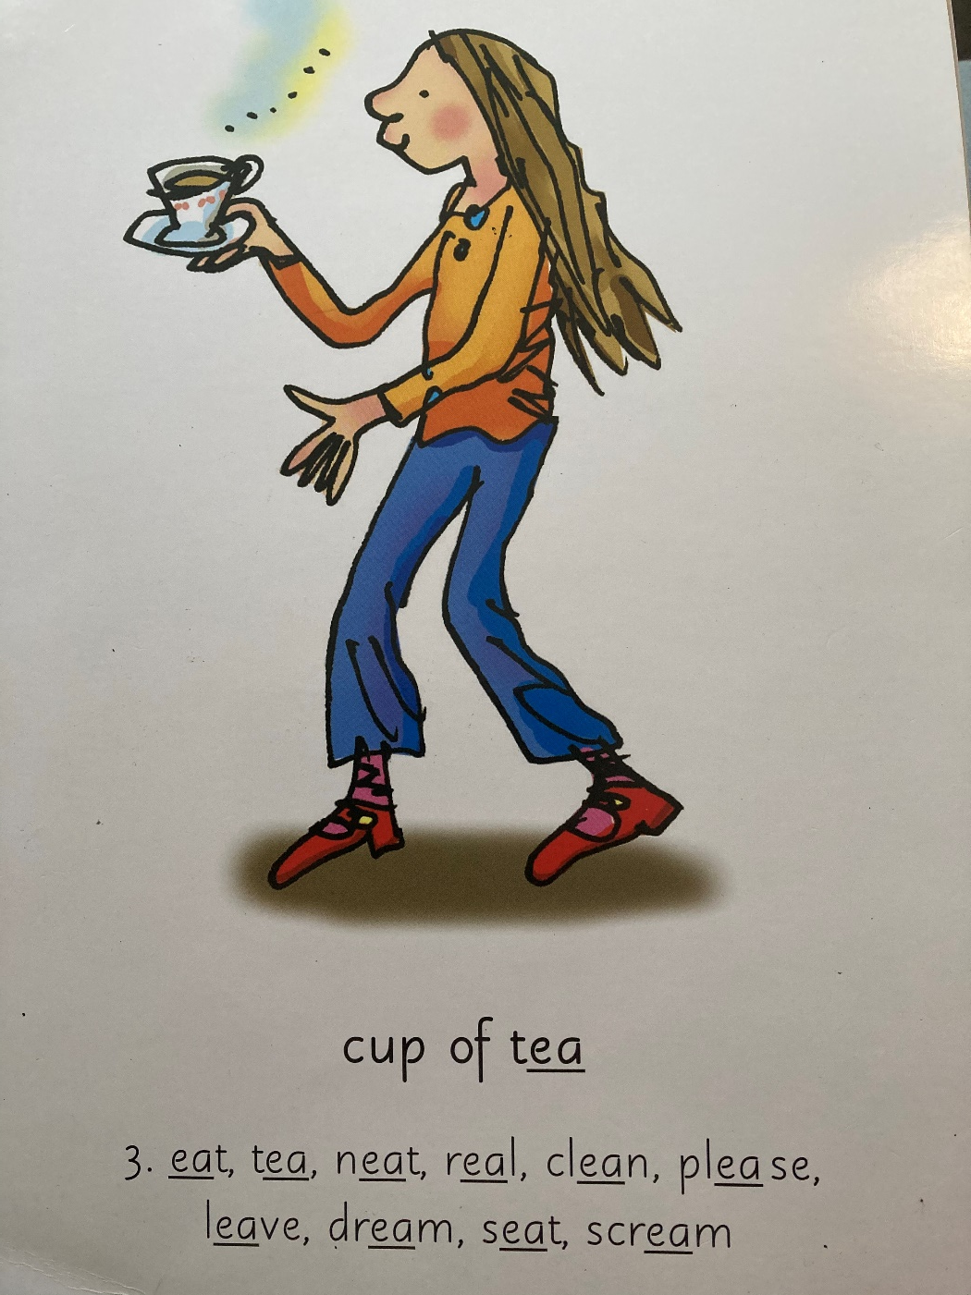
Our Set 3 phoneme for today is…. ea - cup of tea!
eat
tea
neat
clean
please
leave

Slide 3
LO: To write a list of things to take to explore the rainforest.
To write a list
To explain why you need these items using complete sentences.
Use conjunctions because, so, but & and.

Slide 4


Slide 5


Slide 6
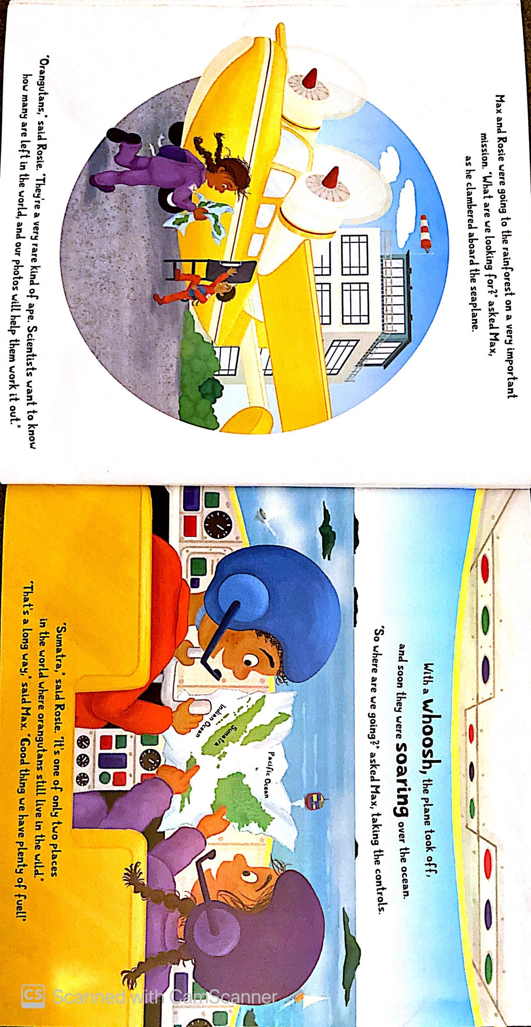
a map

Slide 7
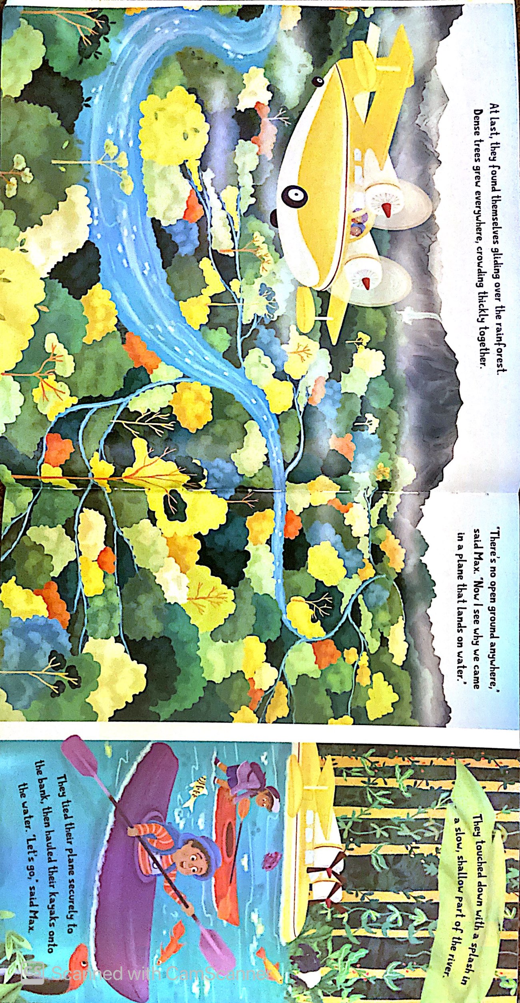
a kayak and paddle

Slide 8
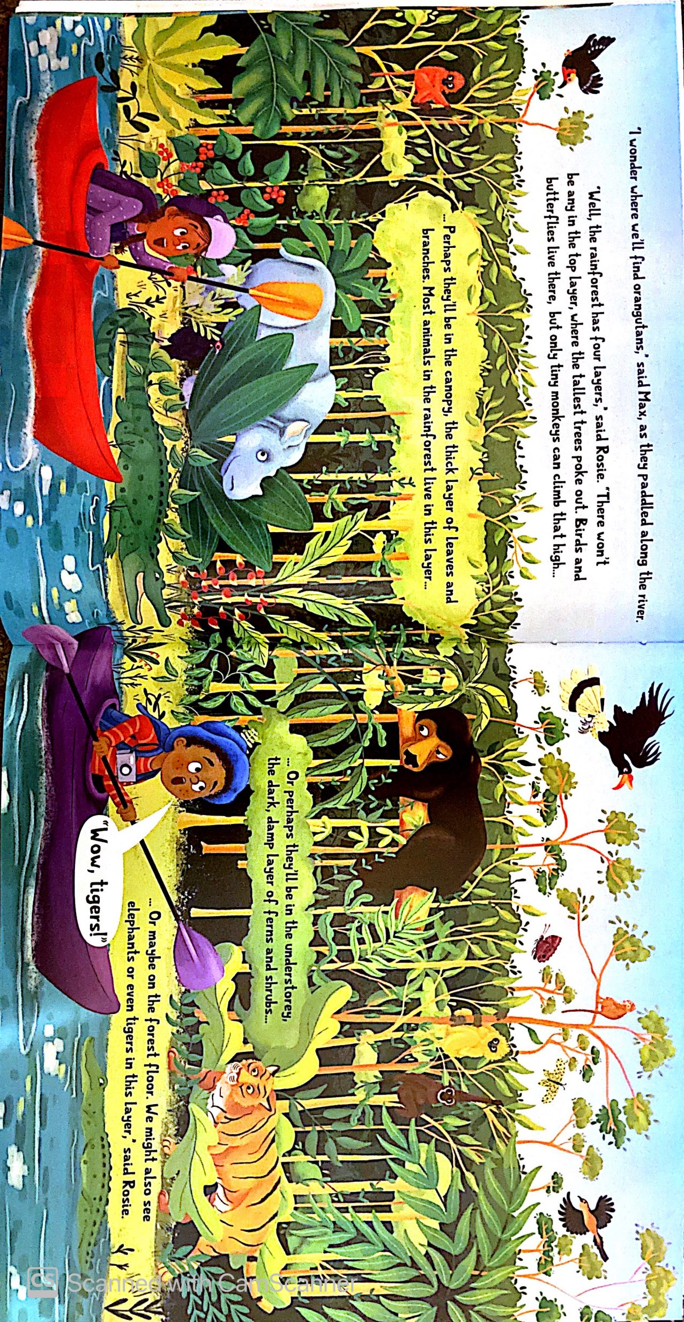
a camera

Slide 9
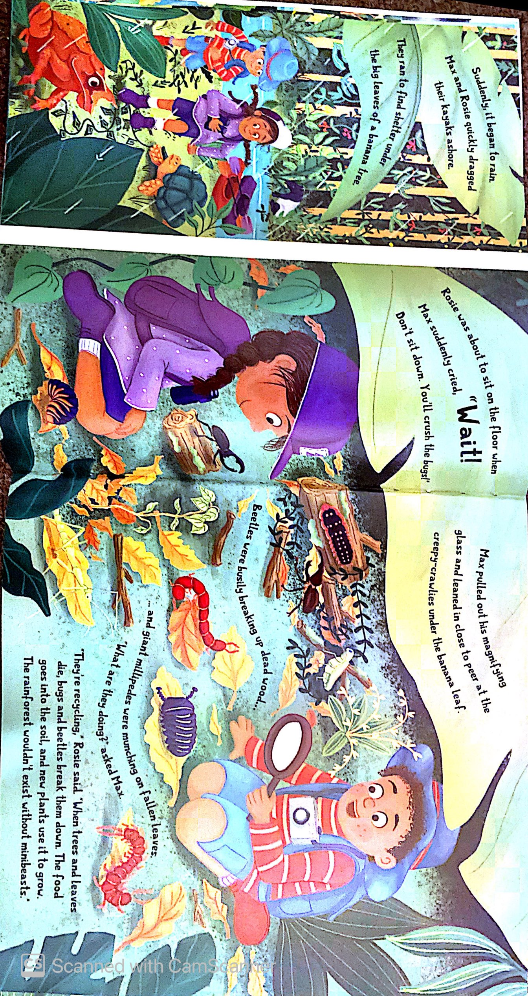
a magnifying glass

Slide 10
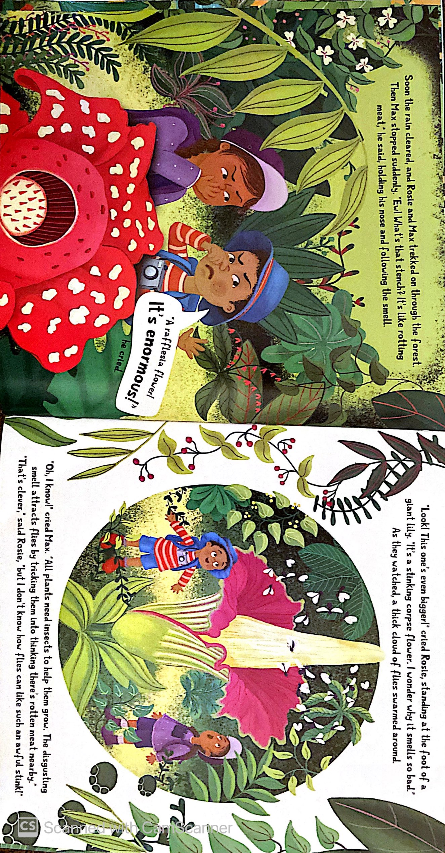
a hat
a pair of binoculars

Slide 11
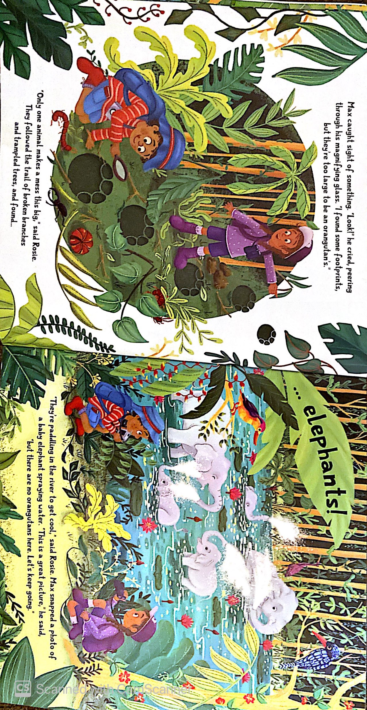
good boots

Slide 12
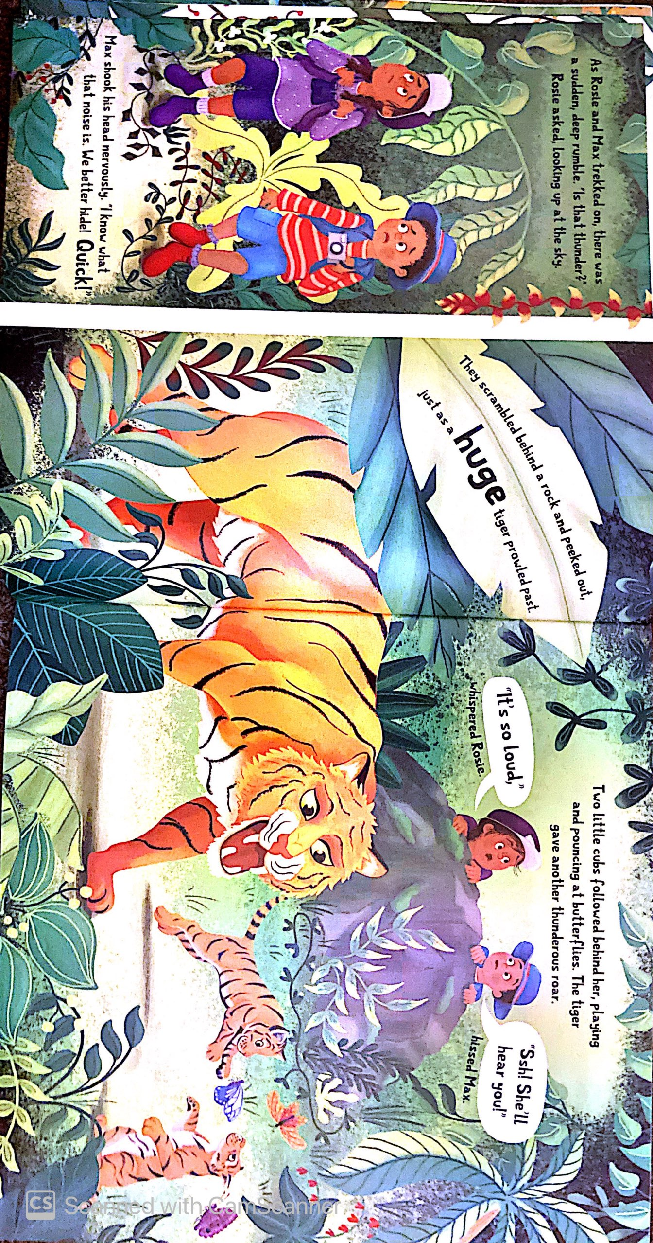
meat to feed hungry tigers

Slide 13
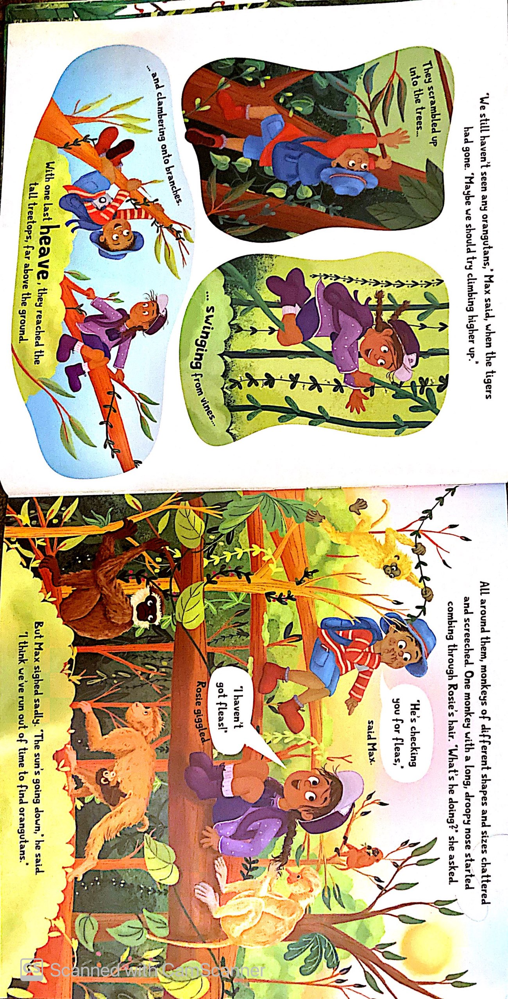
Fruit to eat and feed to monkeys

Slide 14
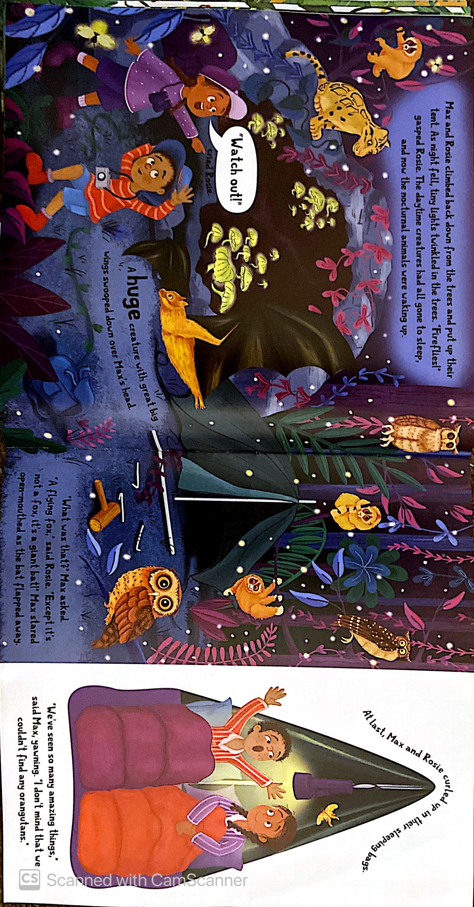
a tent
a torch
A sleeping bag

Slide 15
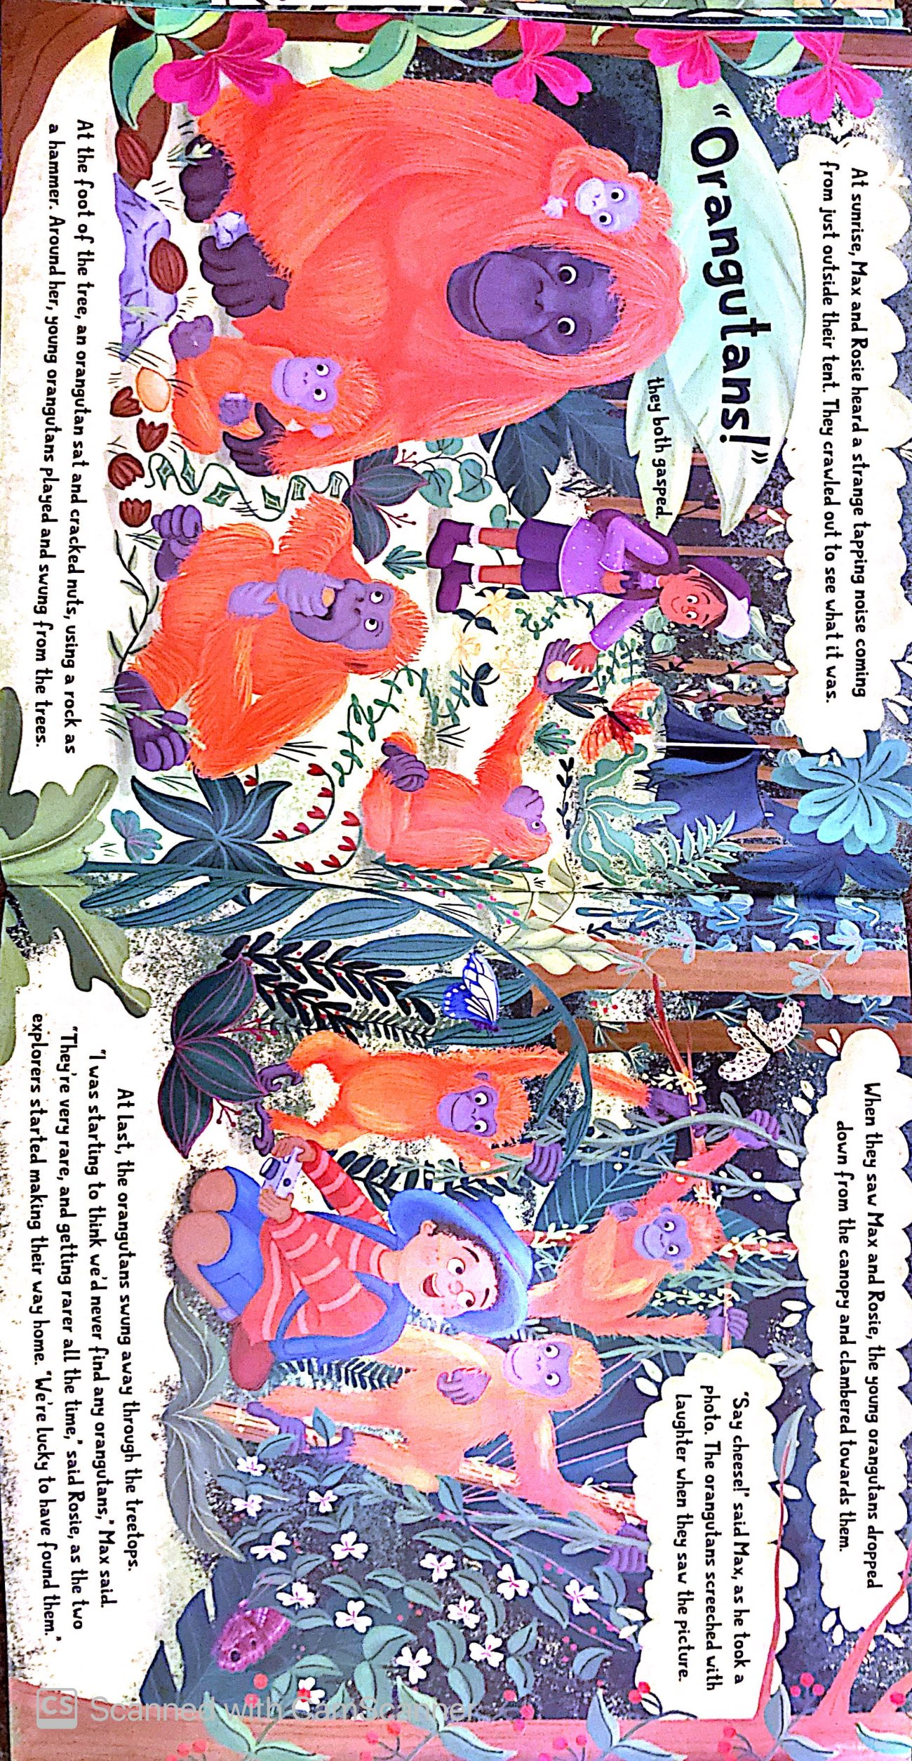

Slide 16
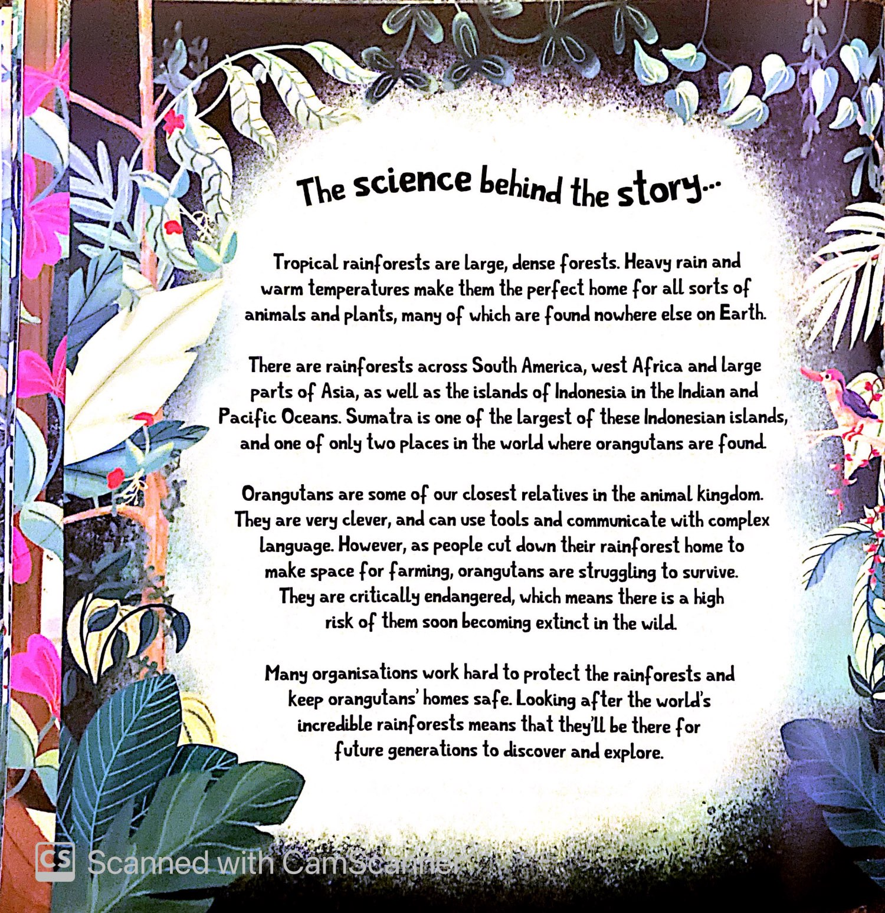

Slide 17
What things did you spot that the children took with them on their journey?
meat to feed hungry tigers
a map
good boots
a tent
Fruit to eat and feed to monkeys
a kayak and paddle
a pair of binoculars
a torch
a camera
a magnifying glass
A sleeping bag
good boots

Slide 18
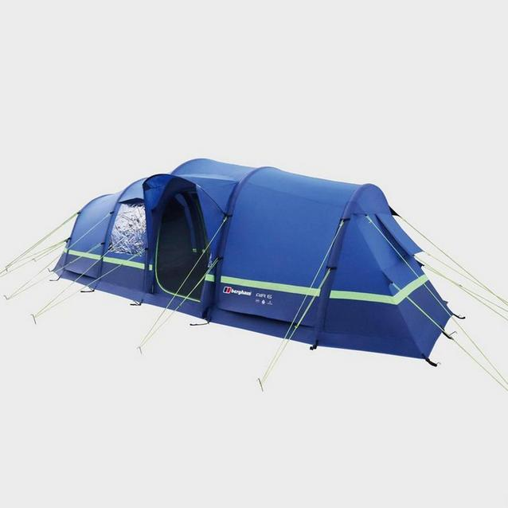
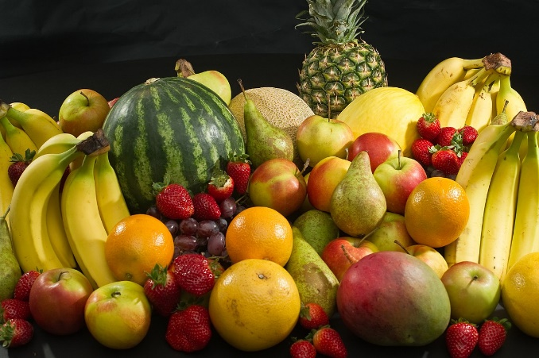
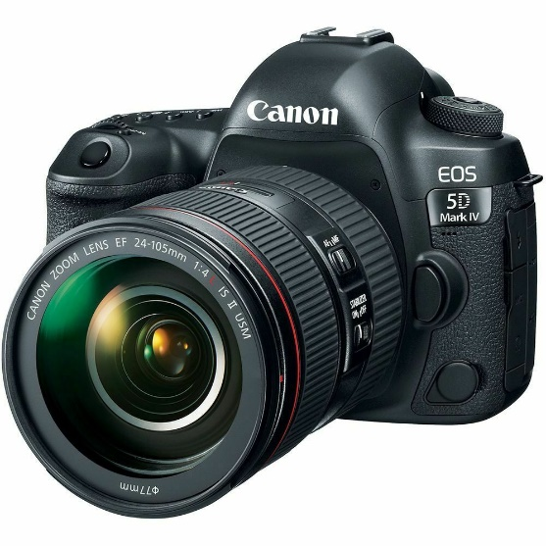
My Packing List for the Rainforest
For my rainforest exploring trip, I would pack:
1) A tent because I would want to stay dry at night.
2) Fruit to eat and to feed monkeys so they won’t chase me.
3) A camera to take photos because I wouldn’t want to forget what I saw.

Slide 19
You can create your own list of items to take with you.
You can use some of the ideas from the story and add your own ideas too!
Option 1: complete the powerpoint template using online pictures and your own text.
Option 2: Print out the template and add your own drawings and writing.
Option 3: Use a blank piece of paper and create your own list with drawings and text.

Slide 20
My Packing List For My Rainforest Trip
Item 1
1)
2)
3)
Item 2
Item 3

Slide 21
My Packing List For My Rainforest Trip
Item 4
4)
5)
6)
Item 5
Item 6

Slide 22
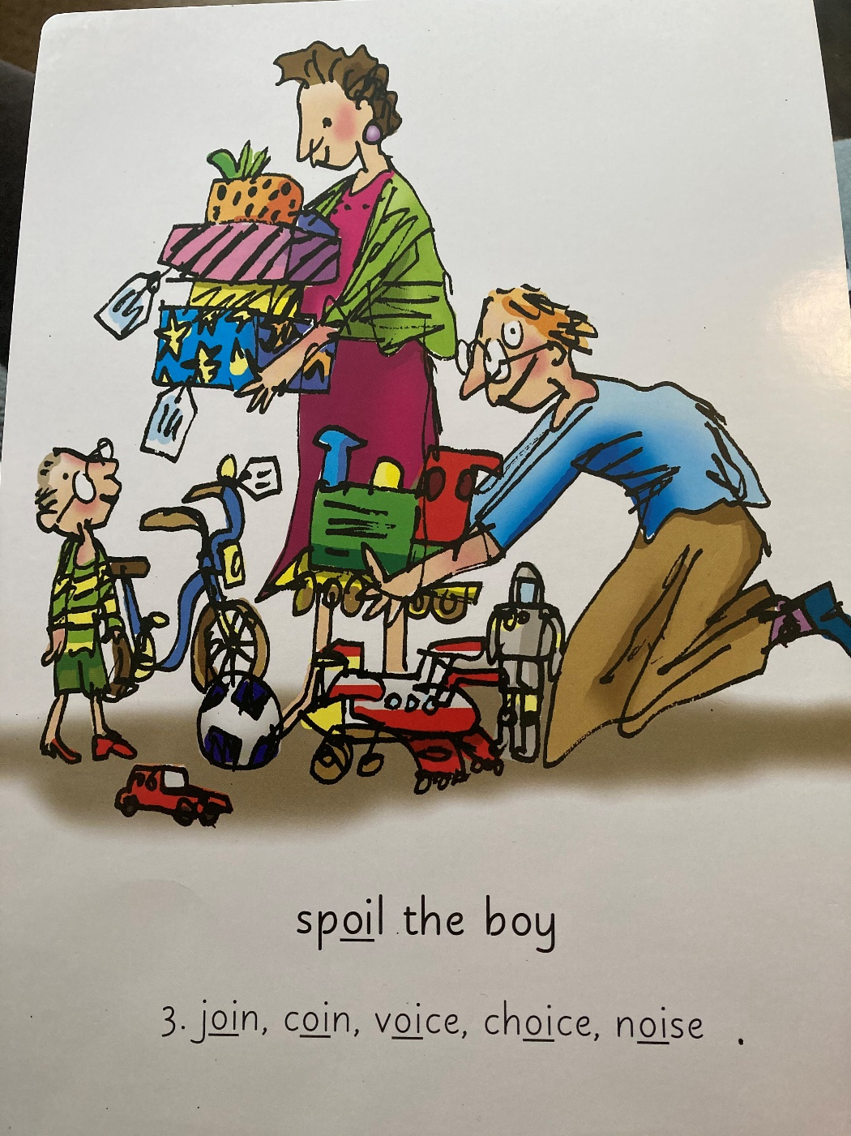
Our Set 3 phoneme for today is…. oi – spoil the boy!
Tuesday 9th February 2021
join
coin
voice
choice
noise
soil

