Slide 1
Wednesday 27th January 2021
LO: To sort rainforest animals into 4 different groups.

Slide 2
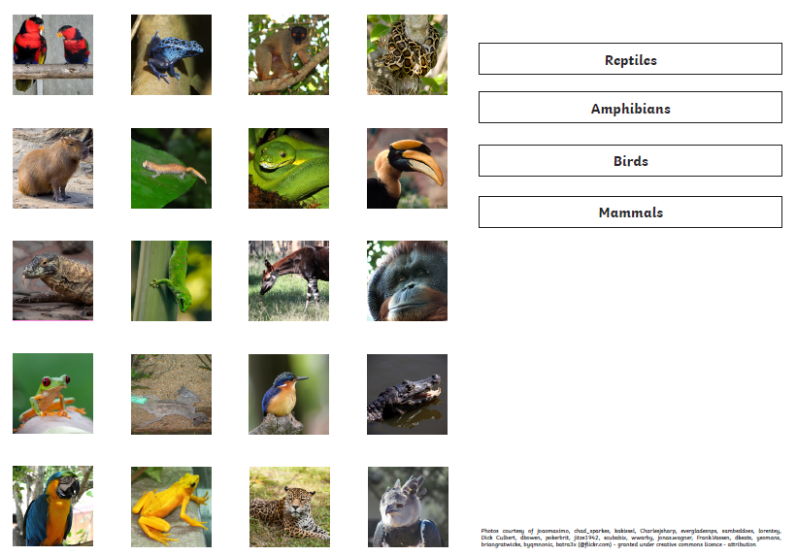
Your task is to sort the creatures into it’s correct group.
Reptiles
Amphibians
Birds
Mammals
See the internet links above to find out what makes these animals either a reptile, ambibian, bird or mammal!

