Slide 1


Slide 3
1) If 5 + 4 = 9, then 4 + 5 =
2) 3 + 4 and 2 + 5 are bonds to ?
3) How do you spell the number 7?
4) If 5 + 3 = 8, then 15 + 3 =

Slide 4
1) If 5 + 4 = 9, then 4 + 5 =
2) 3 + 4 and 2 + 5 are bonds to ?
3) How do you spell the number 7?
4) If 5 + 3 = 8, then 15 + 3 =
9
7
seven
18

Slide 6



Related Facts
9
6
15
9 + 6 = 15
6 + 9 = 15
15 = 9 + 6
15 = 6 + 9

Slide 7
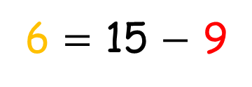
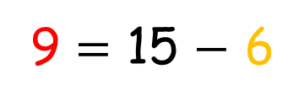
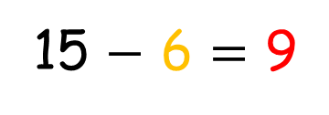
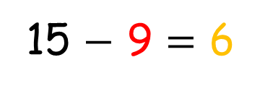
Related Facts
15
9
6
15 $−$ 9 = 6
15 $−$ 6 = 9
9 = 15 $−$ 6
6 = 15 $−$ 9

Slide 8
Have a go at question 1 on the worksheet

Slide 9

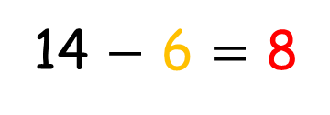
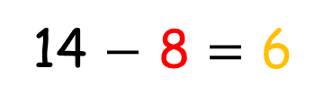
Bar Models
I can use a bar model
to show a fact family!
14
8
6
8 + 6 = 14
6 + 8 = 14
14 $−$ 8 = 6
14 $−$ 6 = 8

Slide 10
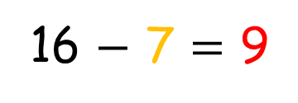
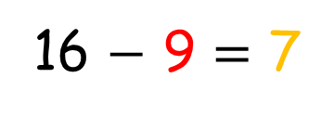
Bar Models
Can you use a bar model
to show a fact family?
16
9
7
7 + 9 = 16
9 + 7 = 16
16 $−$ 7 = 9
16 $−$ 9 = 7

Slide 11
Have a go at question 2 on the worksheet

