Slide 1

Thursday 28th January 2021
PSHE: Positivity

Slide 2

Go and watch ‘The world made a rainbow’
story read aloud
https://www.youtube.com/watch?v=WgoWLcurq3c

Slide 3
In the story the little girl decides to make a beautiful picture to put on display to spread happiness and positivity while being at home. Her friend Violet also made a picture and the two friends were able to go and see each others art work when they went out for a walk.
Your task is to be like the characters in the story and create a picture/poster to spread positivity to the other children in the class as well as your local area.
You can use paint, colouring pencils/pens, glitter etc.

Slide 4



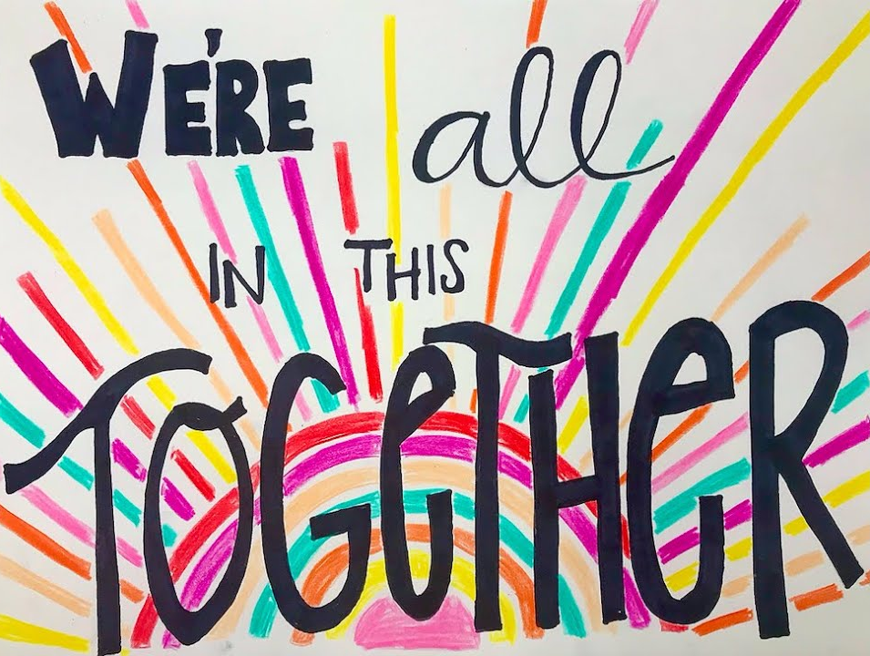
Here are a few picture/poster ideas

Slide 5
It would be great if we
could share your positive pictures/posters during talk and tell at 2pm Friday 29th Jan

