Slide 1
Thursday 28th & Friday 29th January 2021
LO: To Plan and Write a Rainforest Story

Slide 2
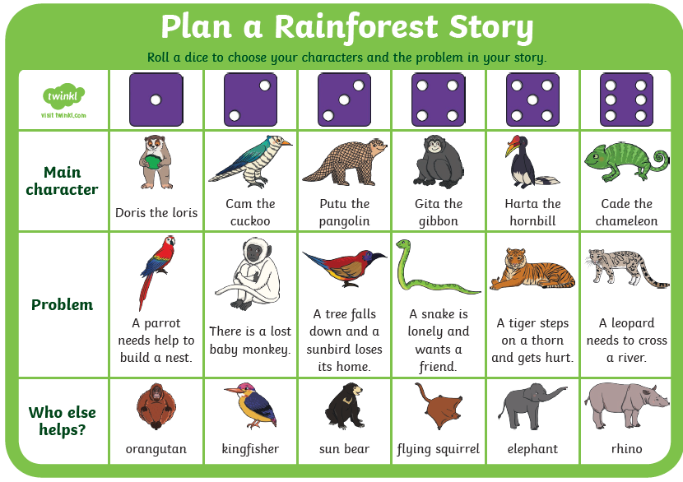
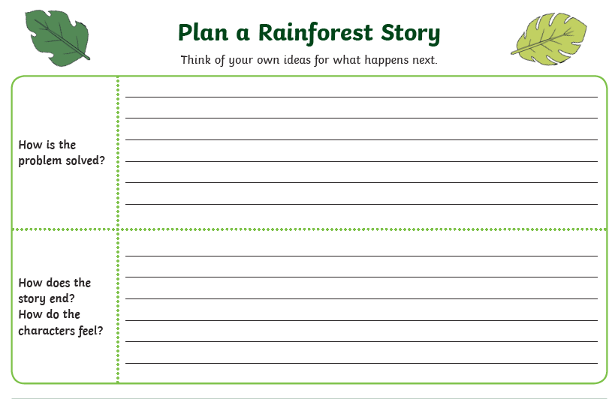
Thursday: Your task is to roll the dice to see what will happen in your story.
Roll the dice and see what will happen in your story! You can write notes on the sheet provided then create a cartoon strip to show the whole story in pictures!

Slide 3
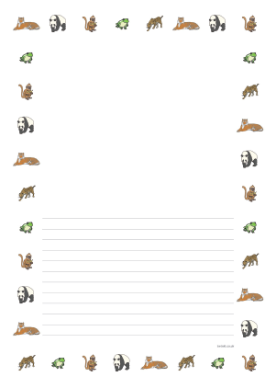
Friday: Your task is write your story!
Make sure you use time words, Once upon a time…, Once there was…
Next, Then, After that, Suddenly, Instantly, Without warning…
In the end, Finally, When it was all over…

