Slide 1
Thursday 28th January 2021
LO: To show an understanding of the book ‘Invisible Lizard’ by responding to comprehension questions.

Slide 2
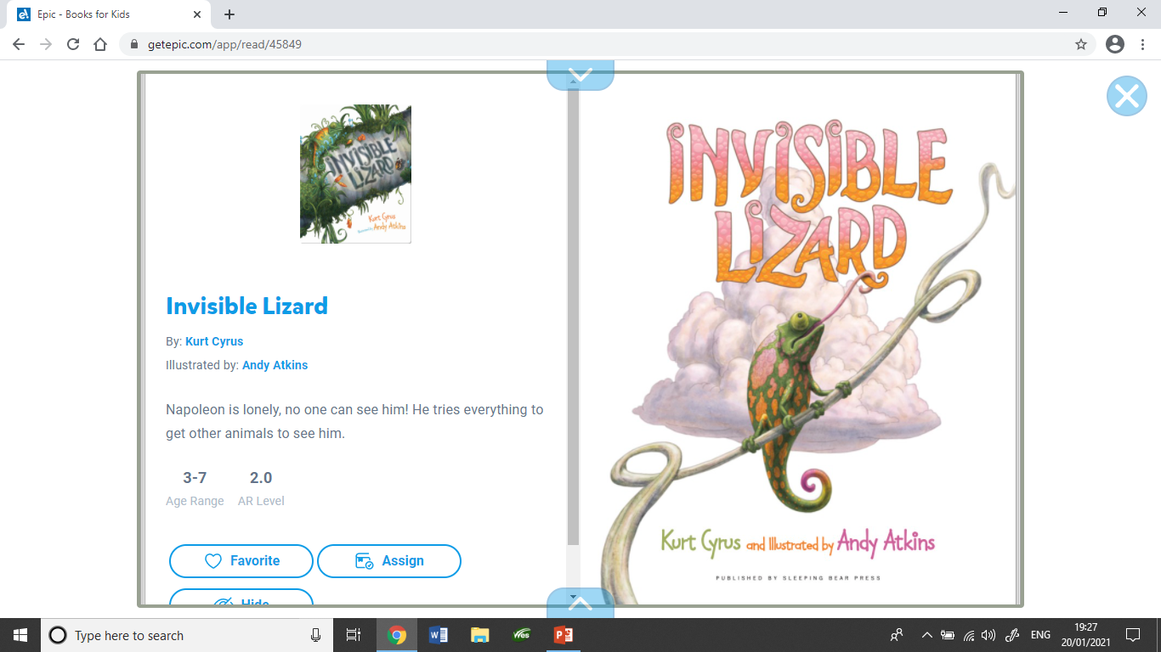

Slide 3
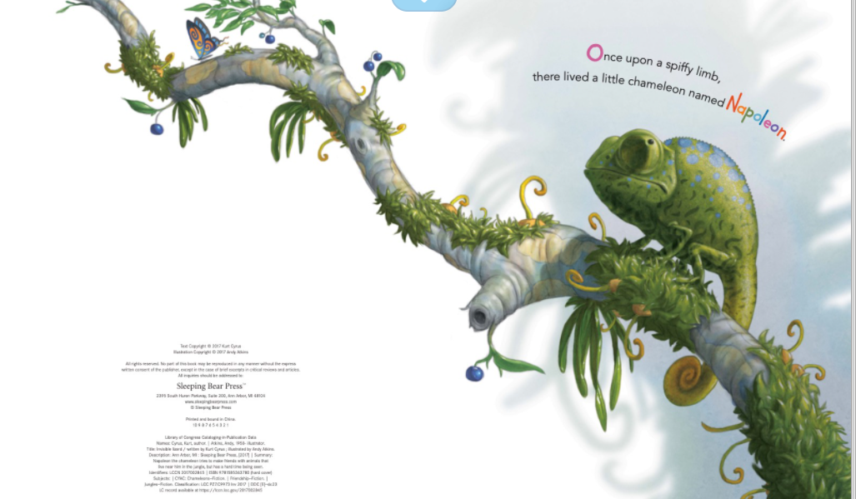

Slide 4
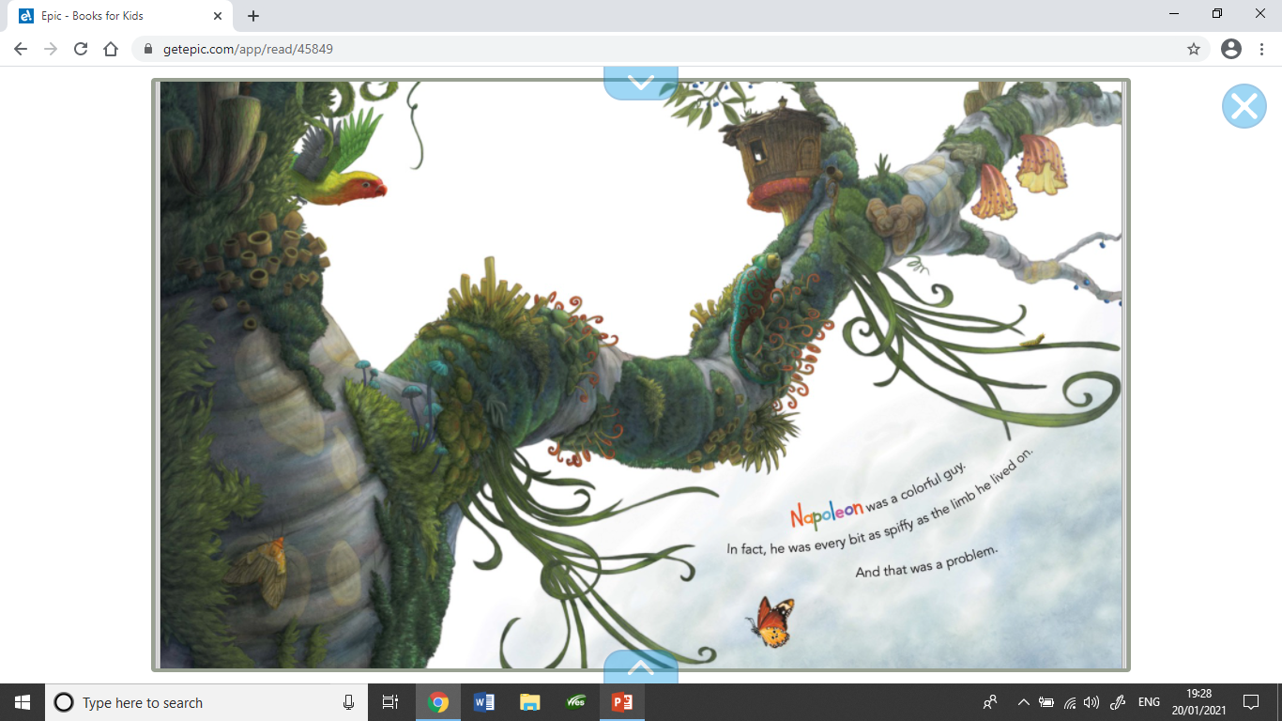

Slide 5
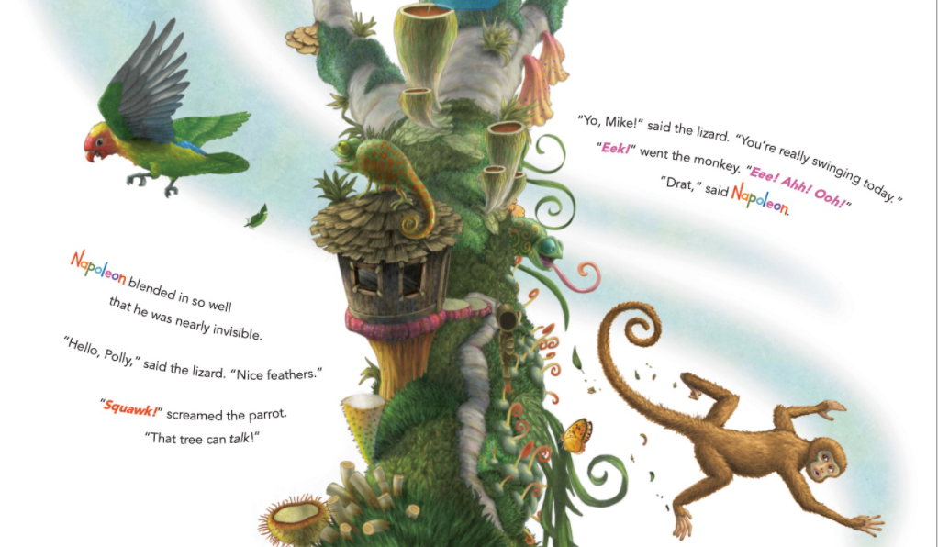

Slide 6
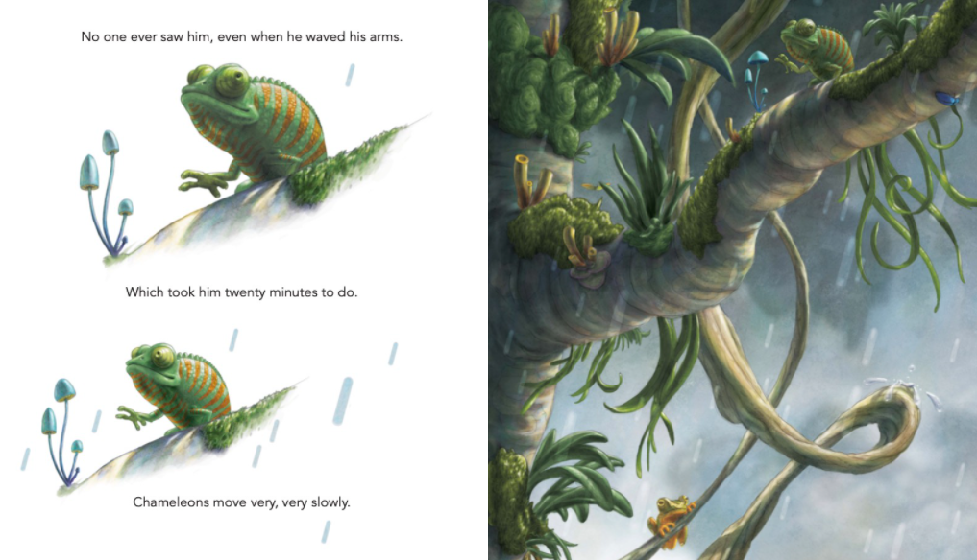

Slide 7
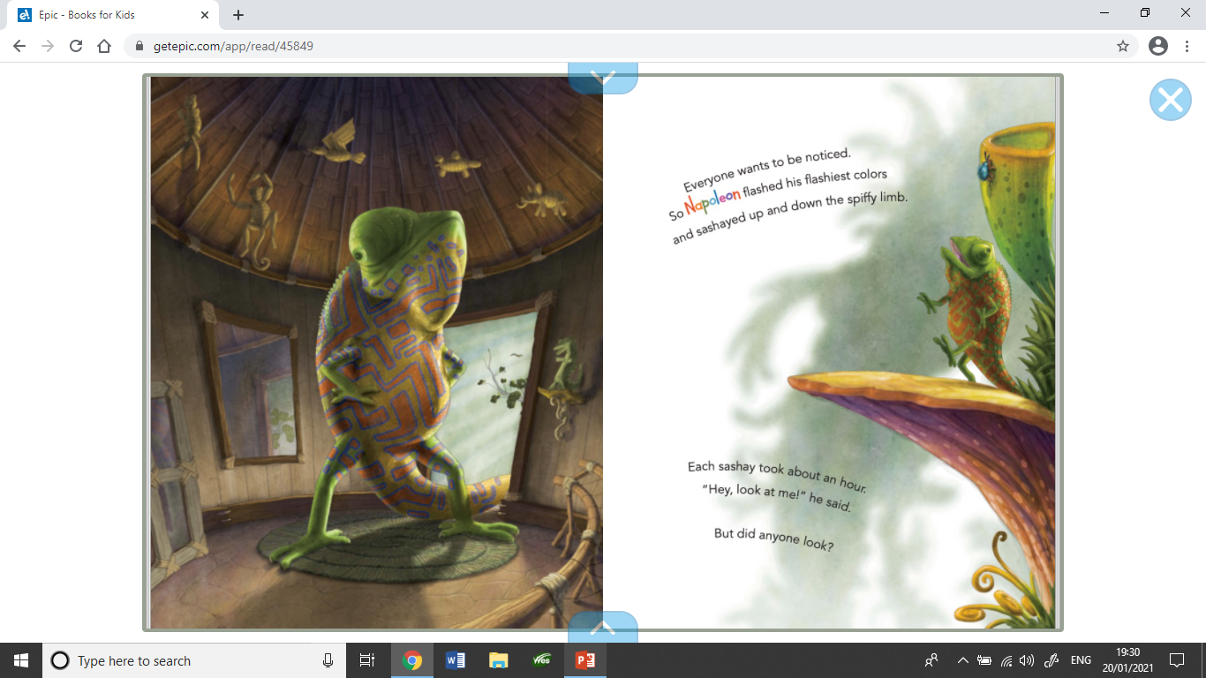

Slide 8
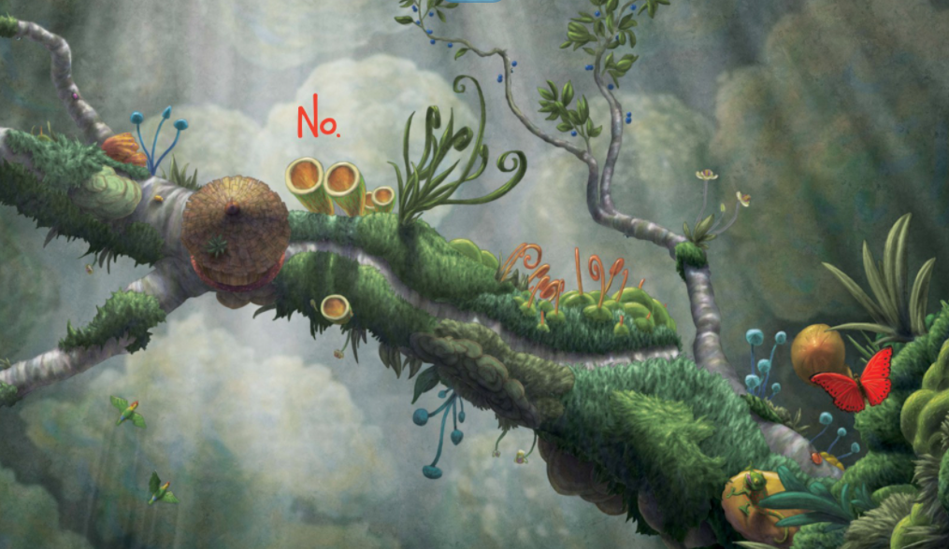

Slide 9
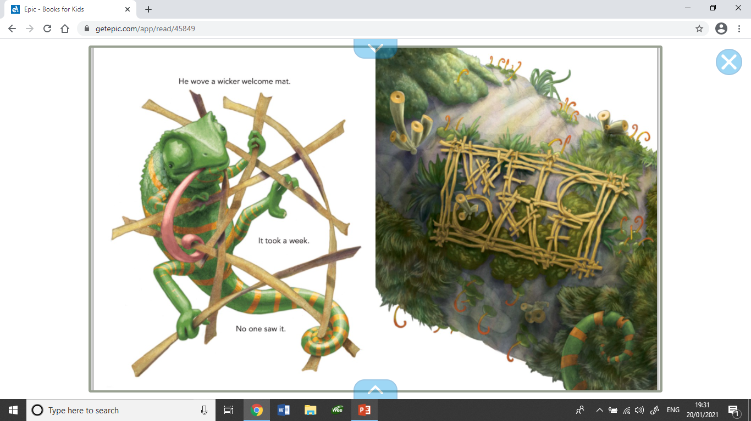

Slide 10
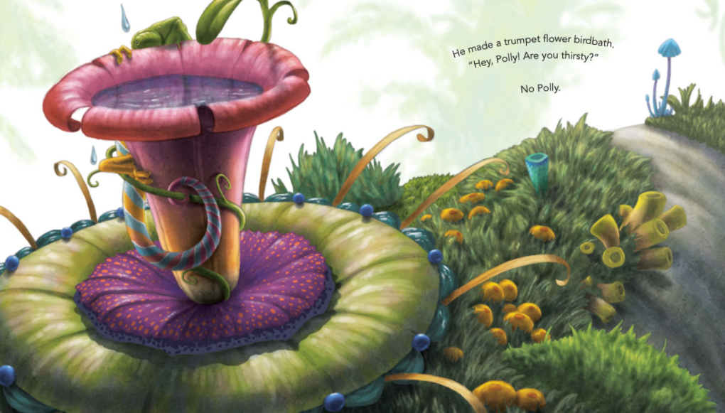

Slide 11
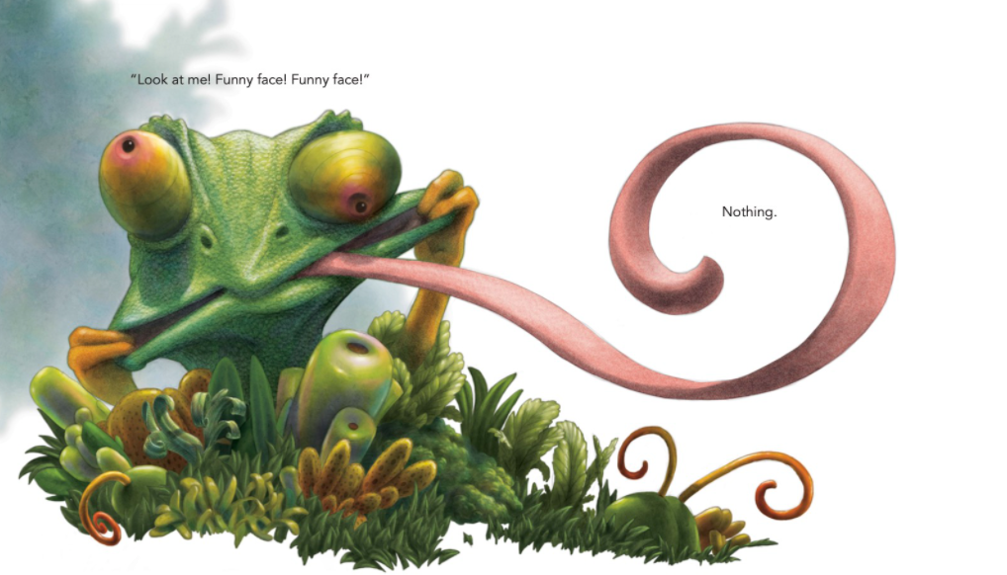

Slide 12
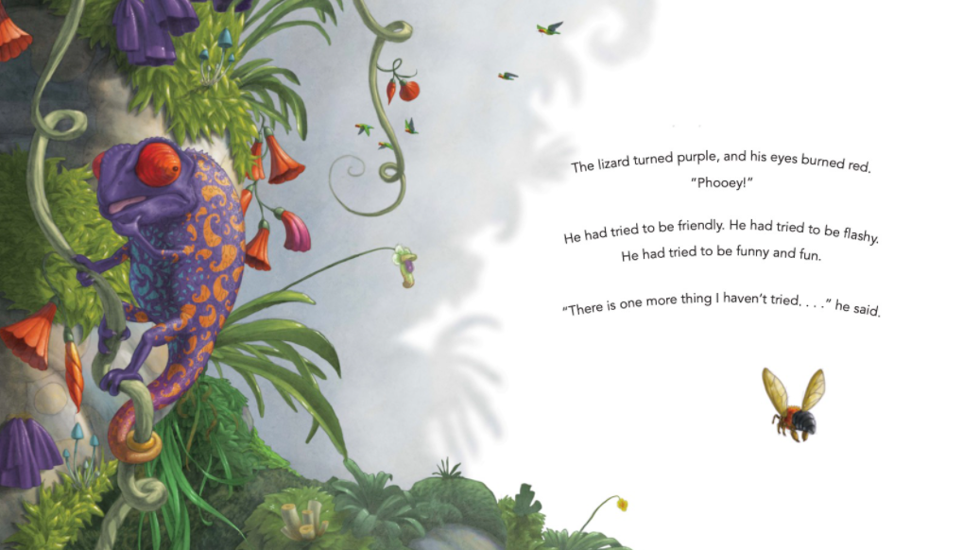

Slide 13
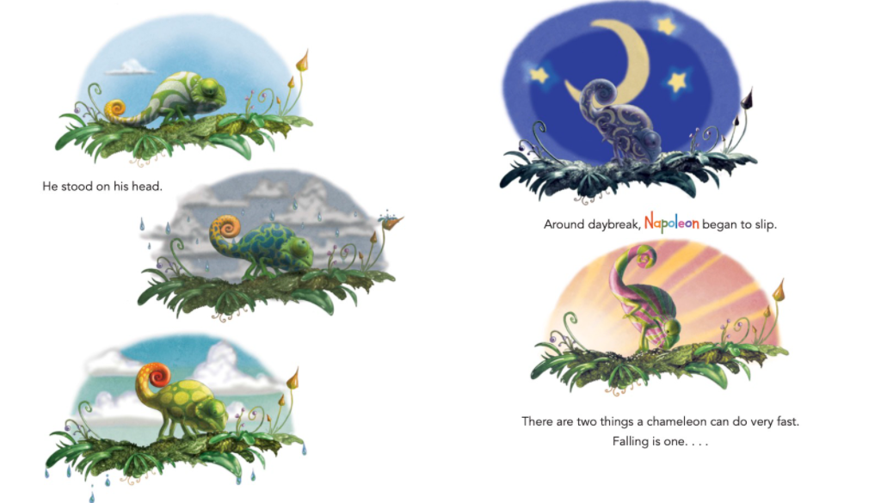

Slide 14
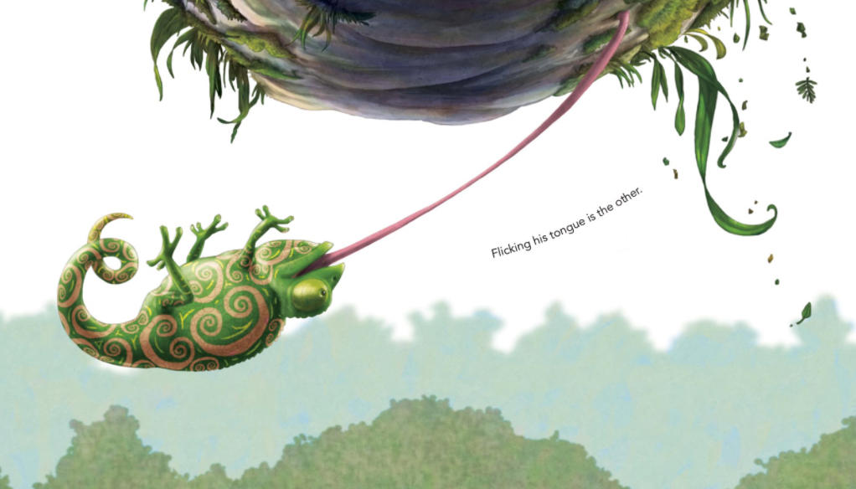

Slide 15
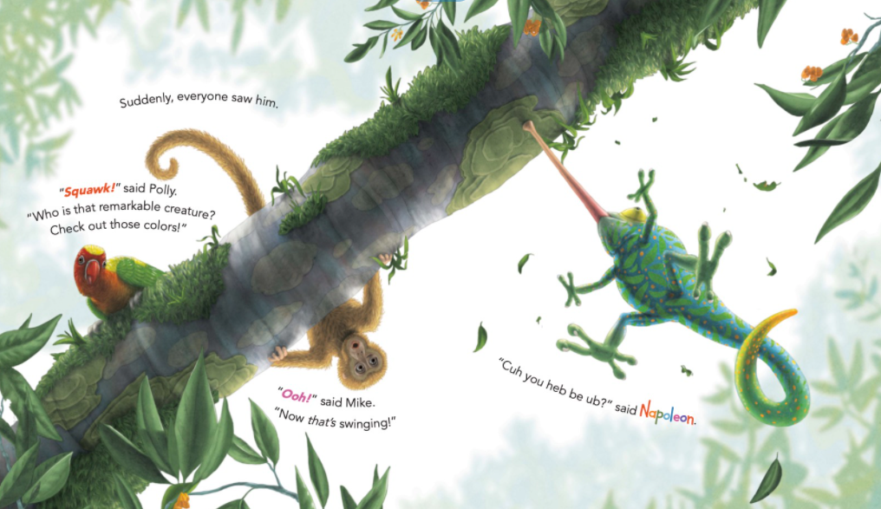

Slide 16
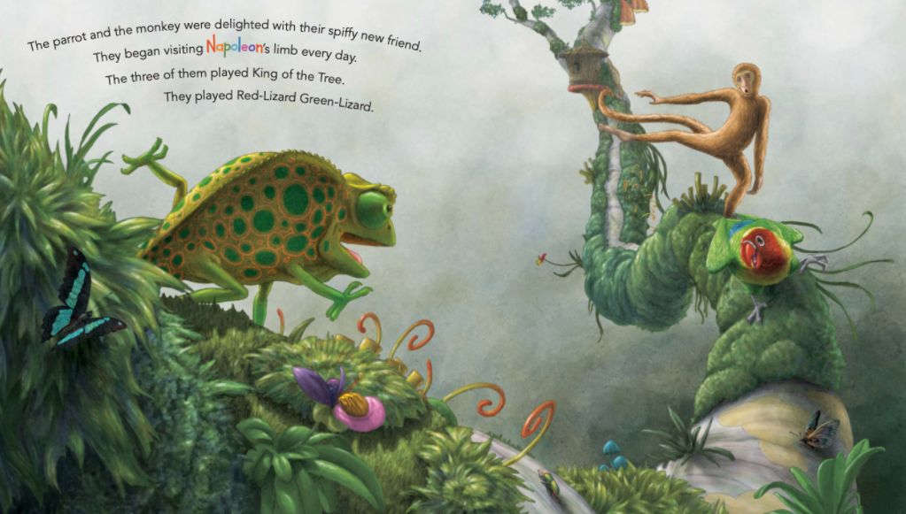

Slide 17
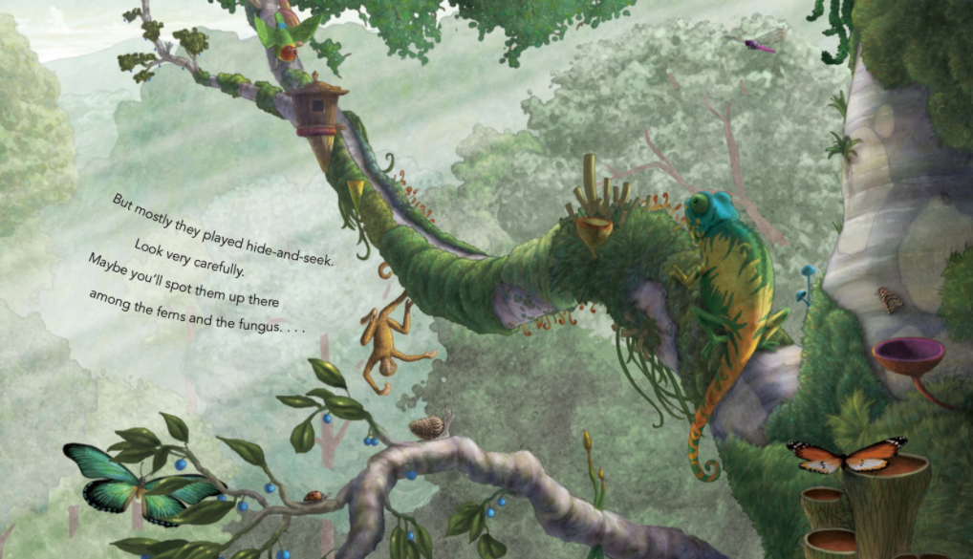

Slide 18
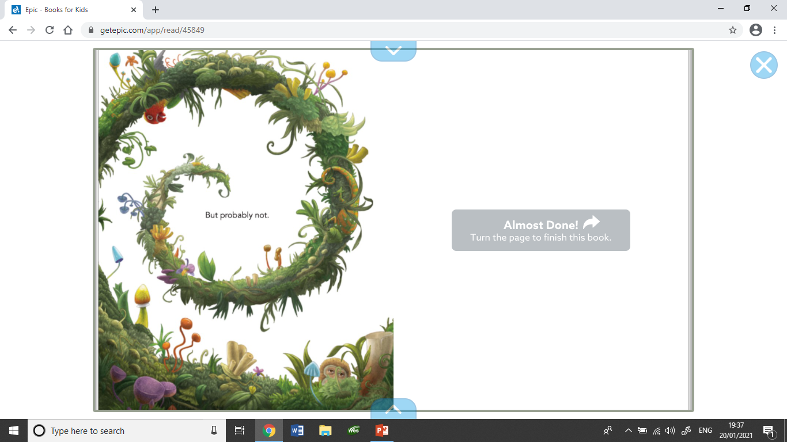

Slide 19
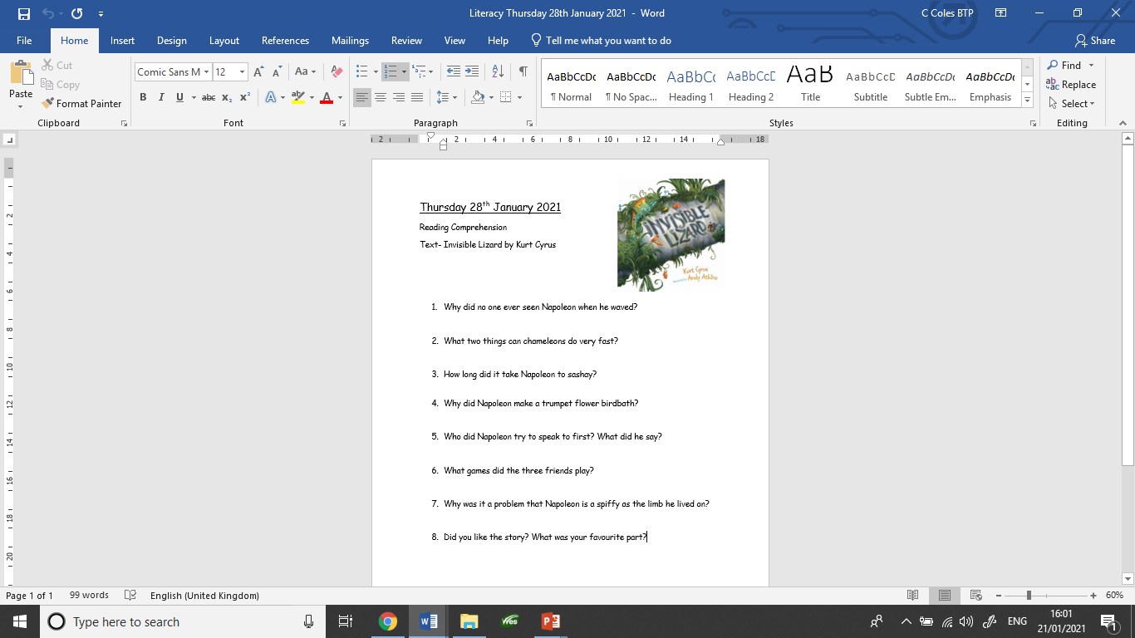
Your Task Today
Show your understanding of the story ‘Invisible Lizard’ by answering the comprehension questions.
Find the questions on the school website.
Remember to compose & write a full sentence. The words in the question can help you to compose your sentence. Say it out loud first.

Slide 20
Let’s answer one together
What does Napoleon do that finally make the other animals see him?
He flicks his tongue and hands from the limb of the tree.

