Slide 1




Year 5 - Spring - Block 2
Fractions

Slide 2

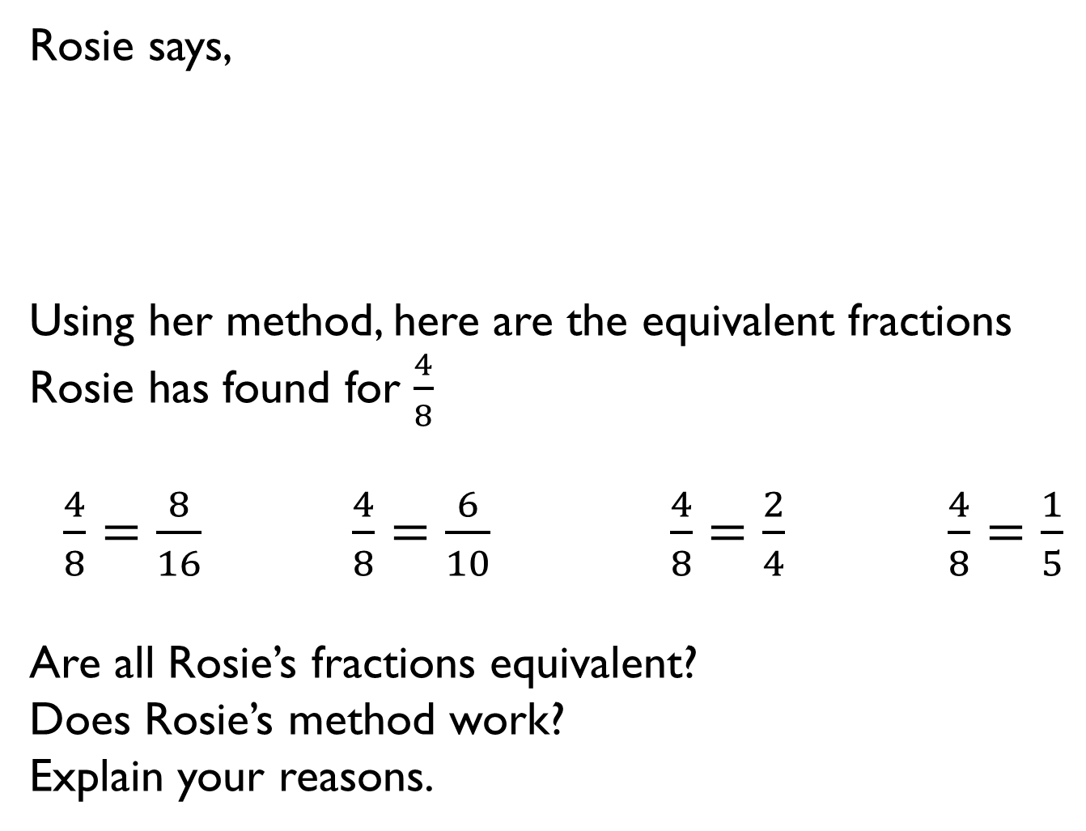
Rosie says,
Using her method, here are the equivalent fractions Rosie has found for $\frac{4}{8}$
$\frac{4}{8}=\frac{8}{16} \frac{4}{8}=\frac{6}{10}$ $\frac{4}{8}=\frac{2}{4}$ $\frac{4}{8}=\frac{1}{5}$
Are all Rosie’s fractions equivalent?
Does Rosie’s method work?
Explain your reasons.
To find equivalent fractions, whatever you do to the numerator, you do to the denominator.

Slide 3
Ron thinks you can only simplify even numbered fractions because you keep on halving the numerator and denominator until you get an odd number.
Do you agree?
Explain your answer.

Slide 4
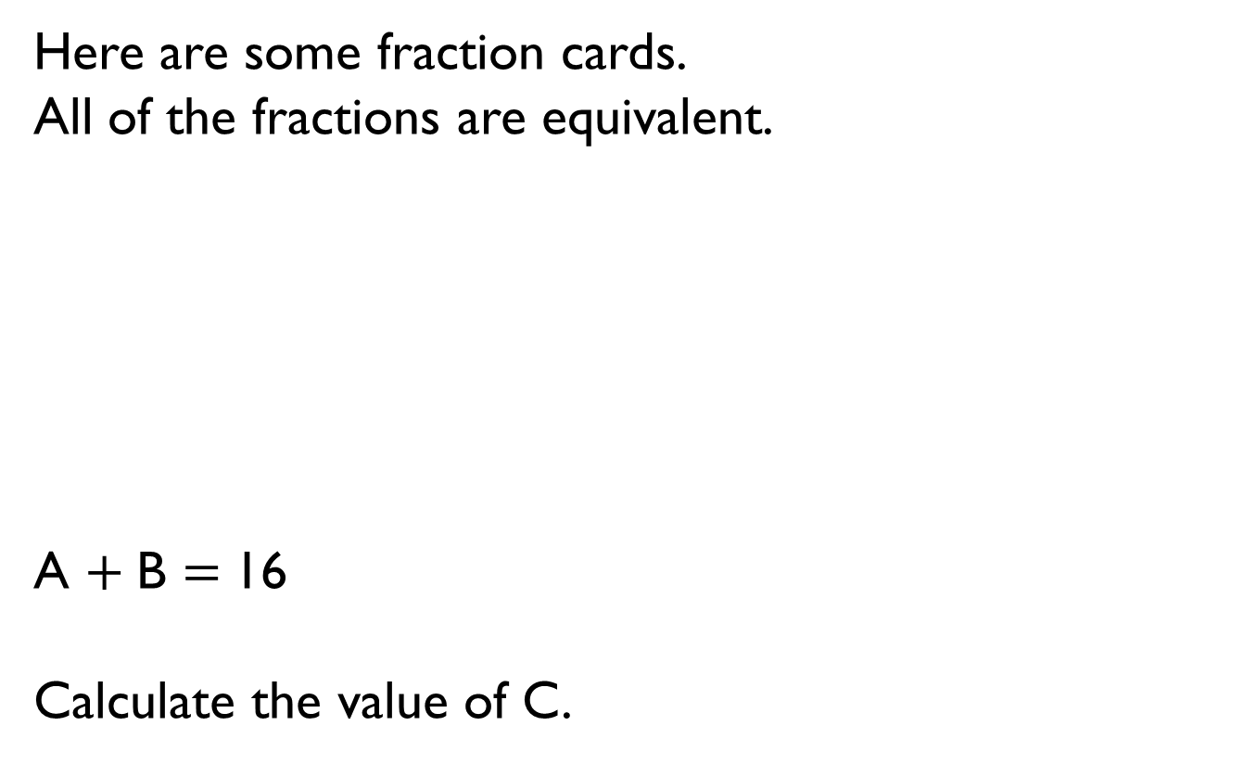
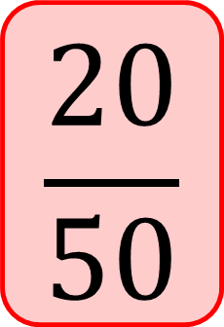
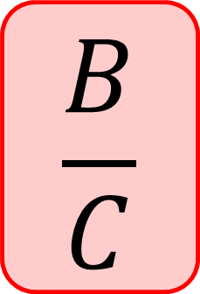
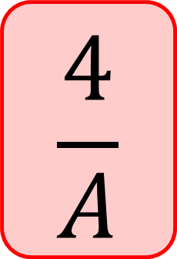
Here are some fraction cards.
All of the fractions are equivalent.
A $+$B $=$16
Calculate the value of C.
$$\frac{4}{A}$$
$$\frac{B}{C}$$
$$\frac{20}{50}$$

Slide 5

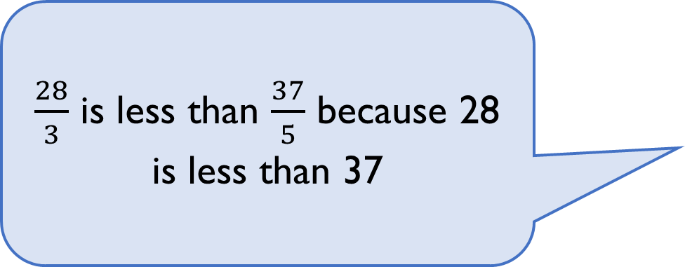
Amir says,
Do you agree?
Explain why.
$\frac{28}{3}$ is less than $\frac{37}{5}$ because 28 is less than 37

Slide 6
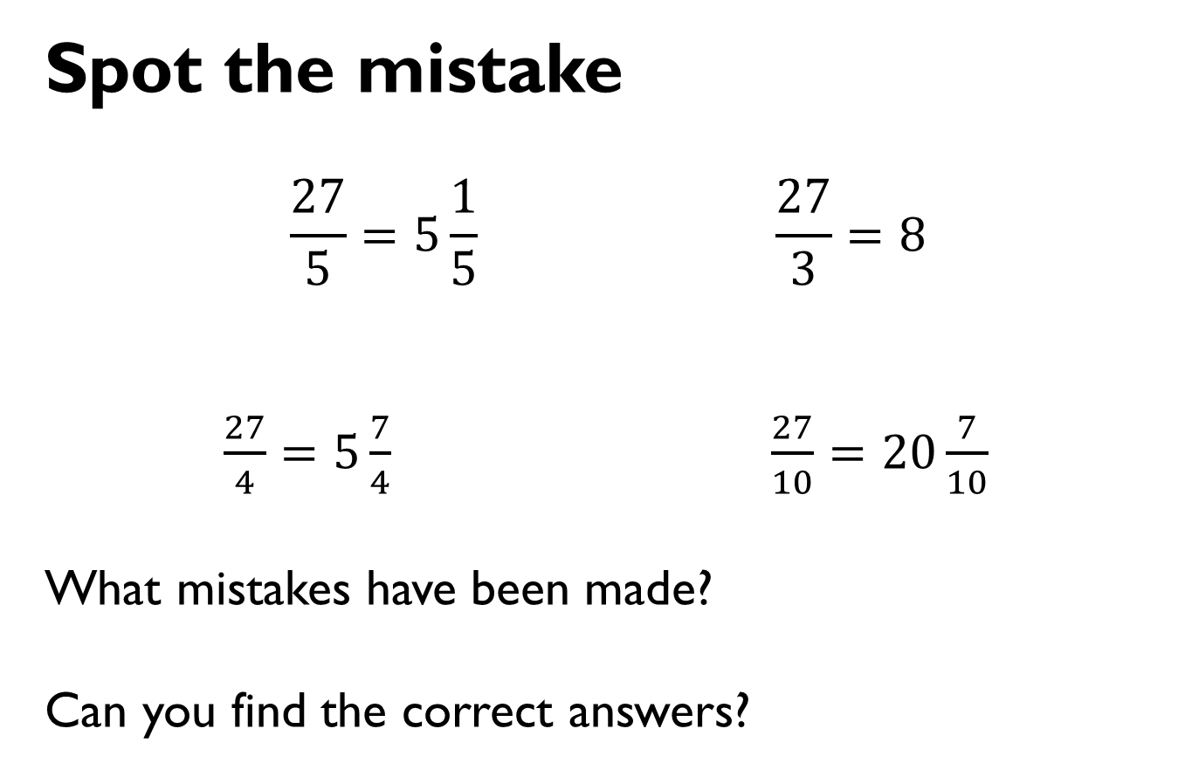
Spot the mistake
$$\frac{27}{5}=5\frac{1}{5} \frac{27}{3}=8$$
$\frac{27}{4}=5\frac{7}{4}$ $\frac{27}{10}=20\frac{7}{10}$
What mistakes have been made?
Can you find the correct answers?

Slide 7



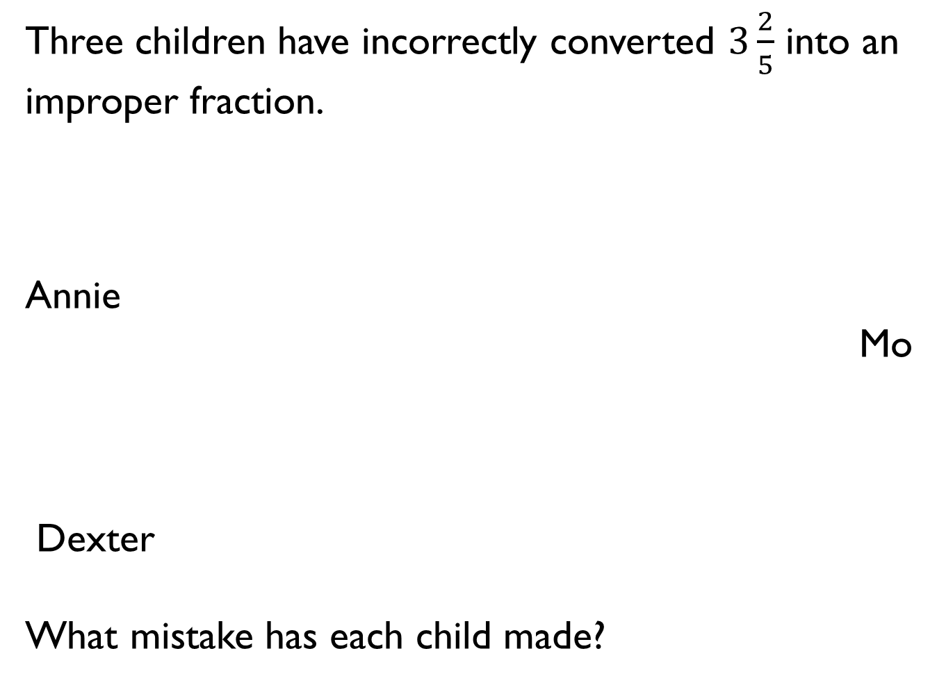
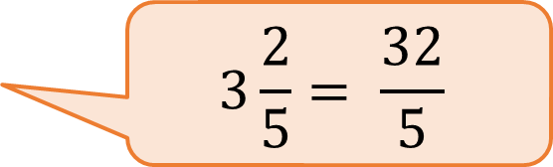
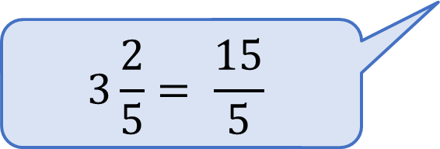
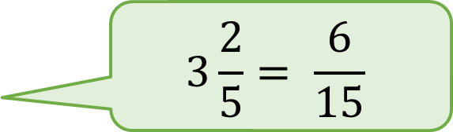
Three children have incorrectly converted $3\frac{2}{5}$ into an improper fraction.
Annie
Mo
Dexter
What mistake has each child made?
$$3\frac{2}{5}= \frac{6}{15}$$
$$3\frac{2}{5}= \frac{15}{5}$$
$$3\frac{2}{5}= \frac{32}{5}$$

Slide 8
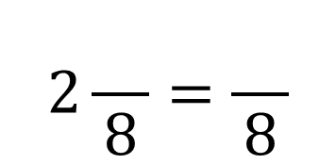
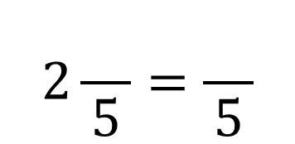
Fill in the missing numbers.
How many different possibilities can you find for each equation?
Compare the number of possibilities you found.
$$2\frac{}{8}=\frac{}{8}$$
$$2\frac{}{5}=\frac{}{5}$$

Slide 9



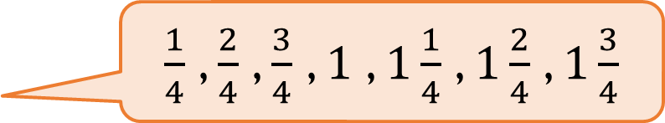
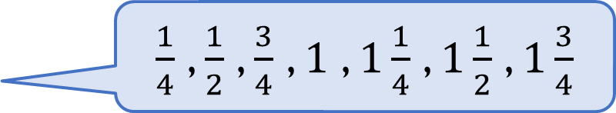
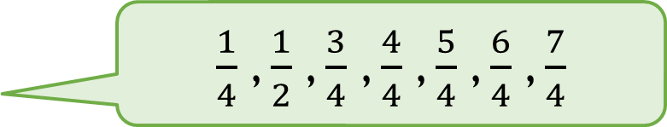
Three children are counting in quarters.
Whitney
Teddy
Eva
Who is counting correctly?
Explain your reasons.
$\frac{1}{4}$ , $\frac{1}{2}$ , $\frac{3}{4}$ , $\frac{4}{4}$ , $\frac{5}{4}$ , $\frac{6}{4}$ , $\frac{7}{4}$
$\frac{1}{4}$ , $\frac{1}{2}$ , $\frac{3}{4}$ , $1$ , $1\frac{1}{4}$ , $1\frac{1}{2}$ , $1\frac{3}{4}$
$\frac{1}{4}$ , $\frac{2}{4}$ , $\frac{3}{4}$ , $1$ , $1\frac{1}{4}$ , $1\frac{2}{4}$ , $1\frac{3}{4}$

Slide 10
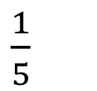
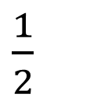
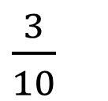
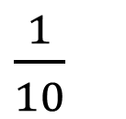
Play the fraction game for four players.
Place the four fraction cards on the floor.
Each player stands in front of a fraction.
We are going to count up in tenths starting at 0
When you say a fraction, place your foot on your fraction.
How can we make 4 tenths?
What is the highest fraction we can count to?
How about if we used two feet?
$\frac{1}{10}$
$\frac{1}{5}$
$\frac{3}{10}$
$\frac{1}{2}$

Slide 11


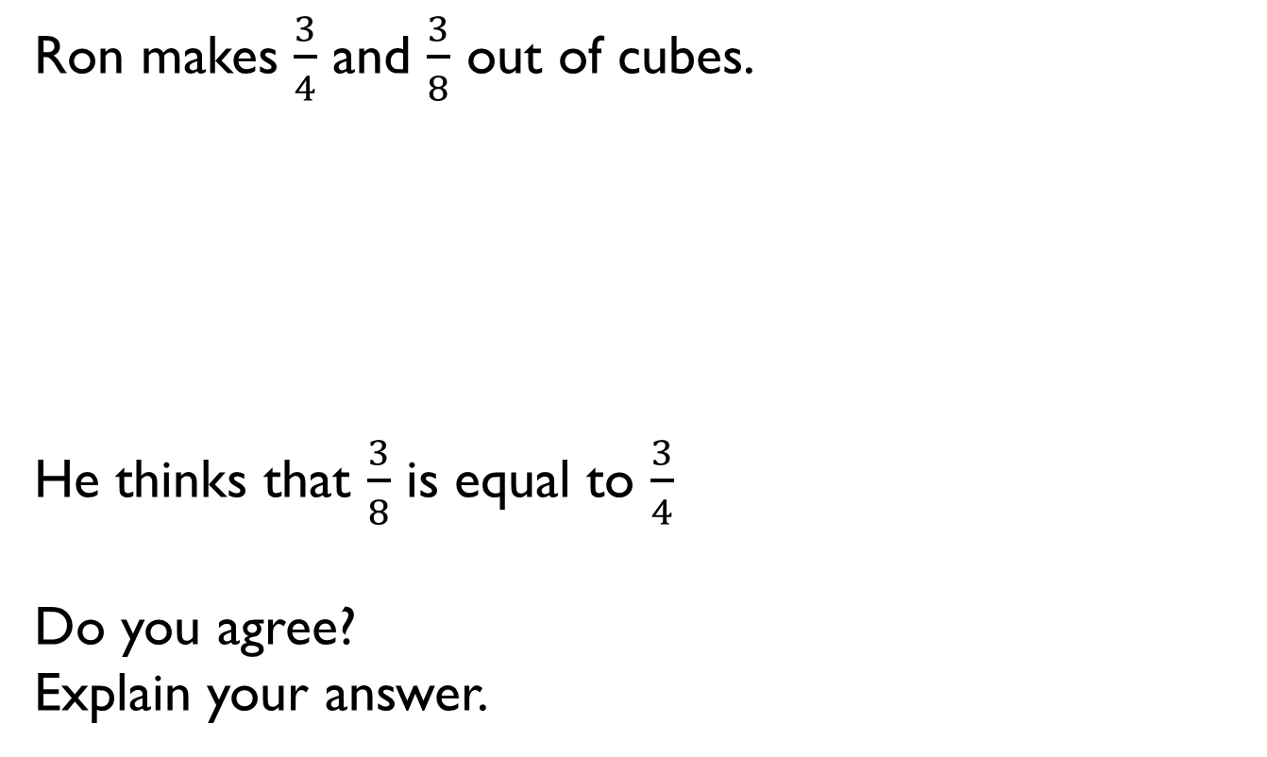
Ron makes $\frac{3}{4}$ and $\frac{3}{8}$ out of cubes.
He thinks that $\frac{3}{8}$ is equal to $\frac{3}{4}$
Do you agree?
Explain your answer.

Slide 12
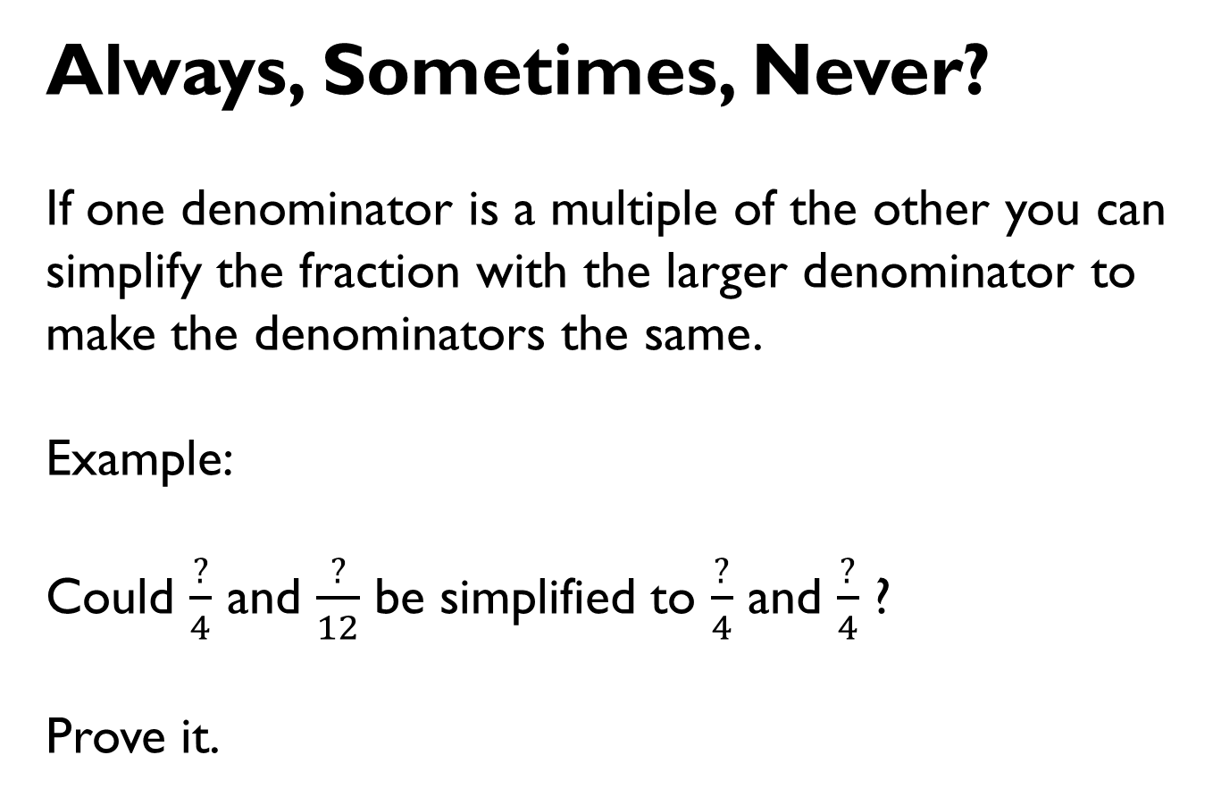
Always, Sometimes, Never?
If one denominator is a multiple of the other you can simplify the fraction with the larger denominator to make the denominators the same.
Example:
Could $\frac{?}{4}$ and $\frac{?}{12}$ be simplified to $\frac{?}{4}$ and $\frac{?}{4}$ ?
Prove it.

Slide 13
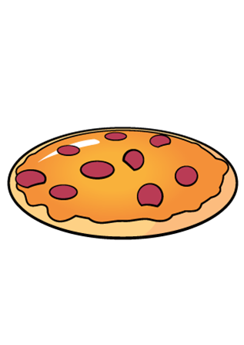

Eva and Alex each have two identical pizzas.
Eva says,
Alex says,
Who ate the most pizza?
Use a drawing to support your answer.
I have cut each pizza into 6 equal pieces and eaten 8
I have cut each pizza into 9 equal pieces and eaten 15

Slide 14
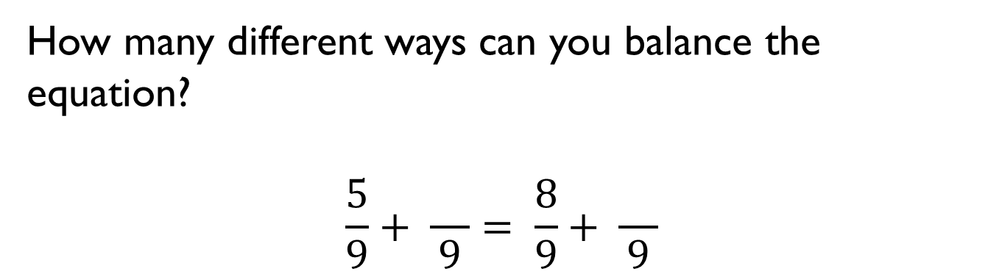
How many different ways can you balance the equation?
$$\frac{5}{9}+ \frac{}{9}= \frac{8}{9}+ \frac{}{9}$$

Slide 15
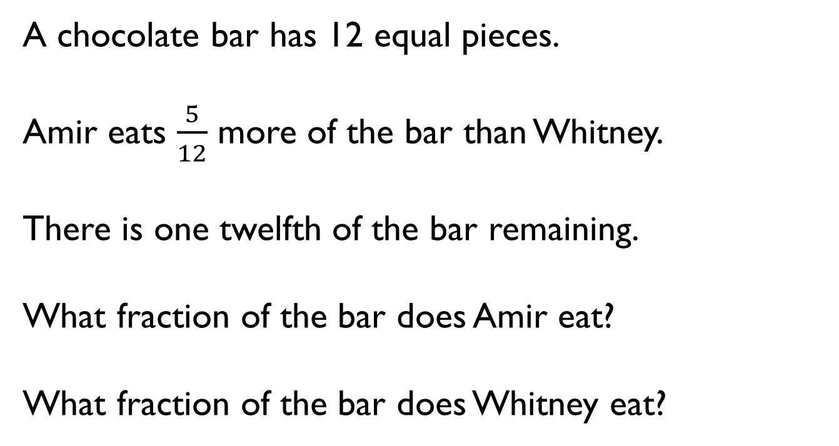
A chocolate bar has 12 equal pieces.
Amir eats $\frac{5}{12}$ more of the bar than Whitney.
There is one twelfth of the bar remaining.
What fraction of the bar does Amir eat?
What fraction of the bar does Whitney eat?

Slide 16

$$\frac{5}{16}+ \frac{}{8}= \frac{15}{16}$$
$$\frac{}{20}+ \frac{7}{10}= \frac{17}{20}$$

Slide 17
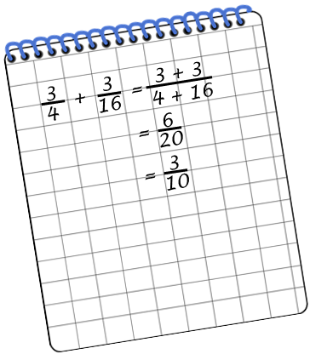
Annie solved this calculation.
Can you spot and explain her mistake?

Slide 18
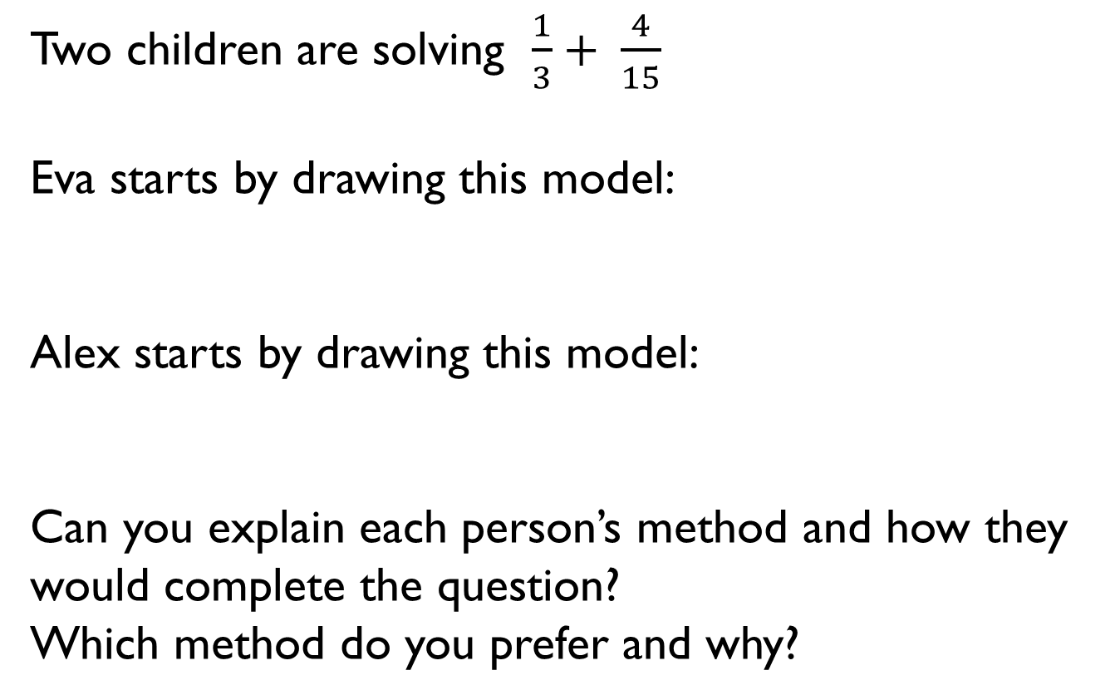
Two children are solving $\frac{1}{3}+ \frac{4}{15}$
Eva starts by drawing this model:
Alex starts by drawing this model:
Can you explain each person’s method and how they would complete the question?
Which method do you prefer and why?

Slide 19

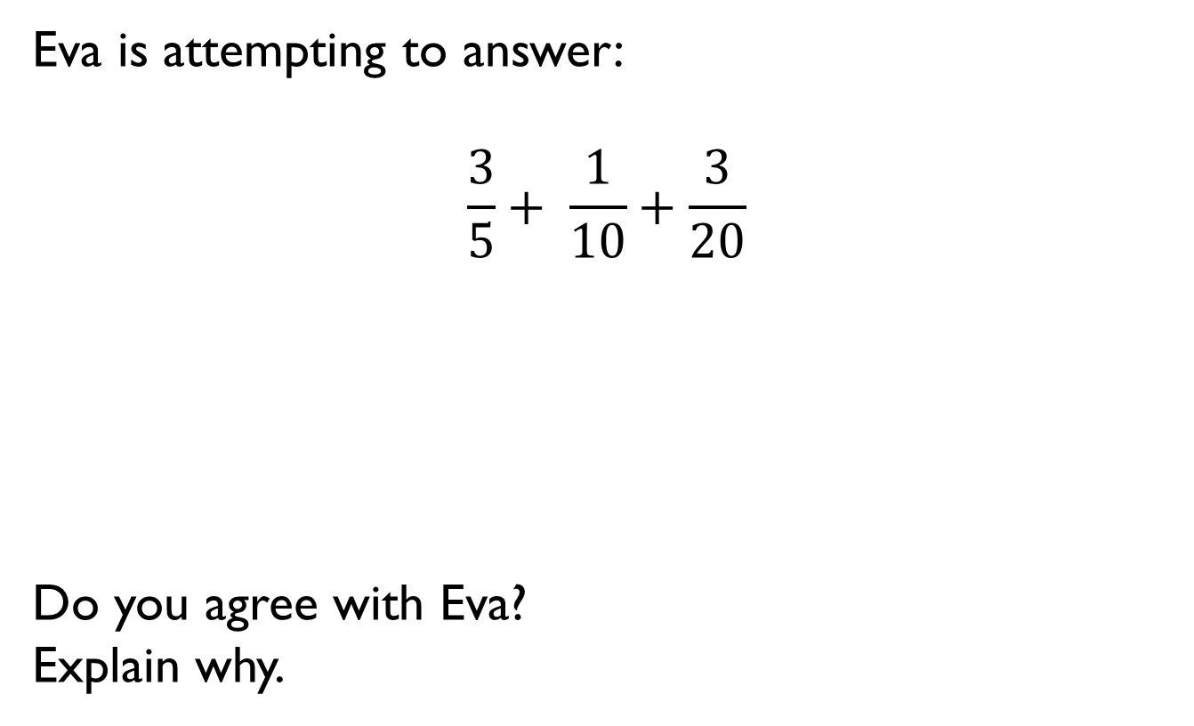
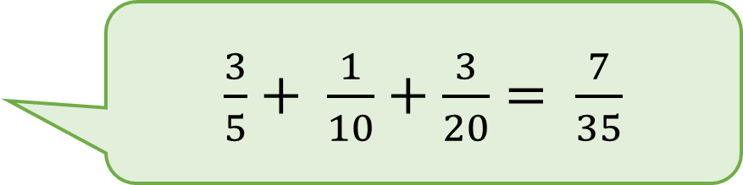
Eva is attempting to answer:
$$\frac{3}{5}+ \frac{1}{10}+\frac{3}{20}$$
Do you agree with Eva?
Explain why.
$\frac{3}{5}+ \frac{1}{10}+\frac{3}{20}= \frac{7}{35}$

Slide 20
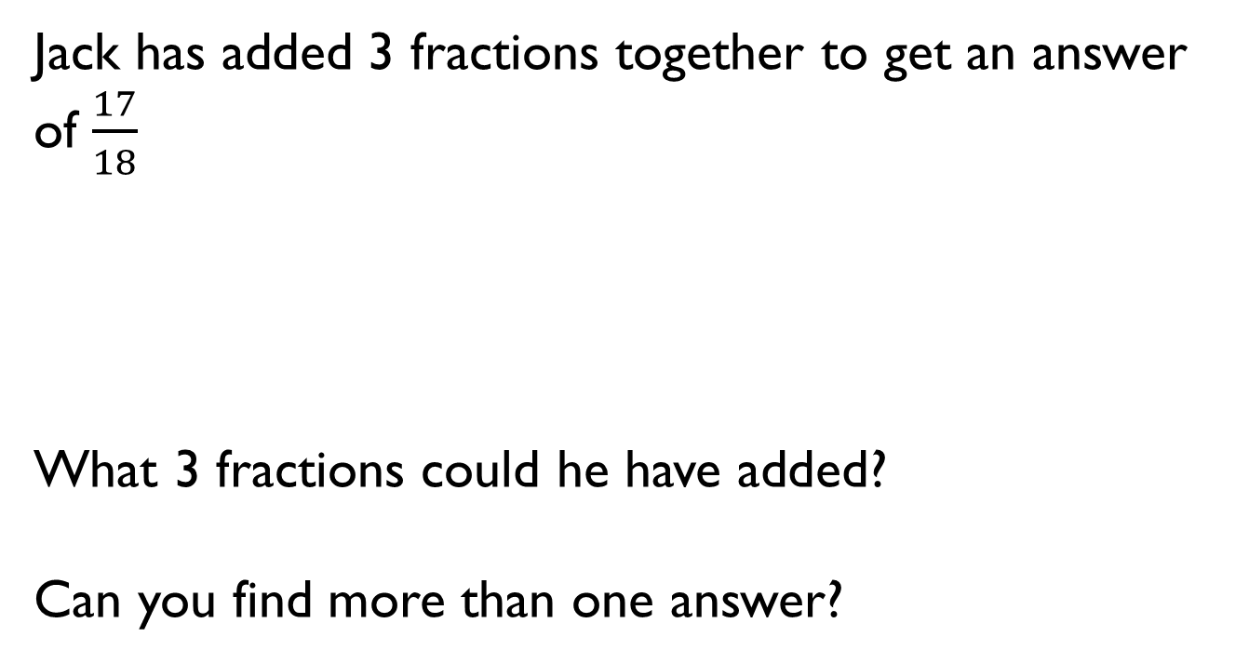
Jack has added 3 fractions together to get an answer of $\frac{17}{18}$
What 3 fractions could he have added?
Can you find more than one answer?

Slide 21
Annie is adding three fractions.
She uses the model to help her.
What could her three fractions be?
How many different combinations can you find?
Can you write a number story to represent your calculation?

Slide 22
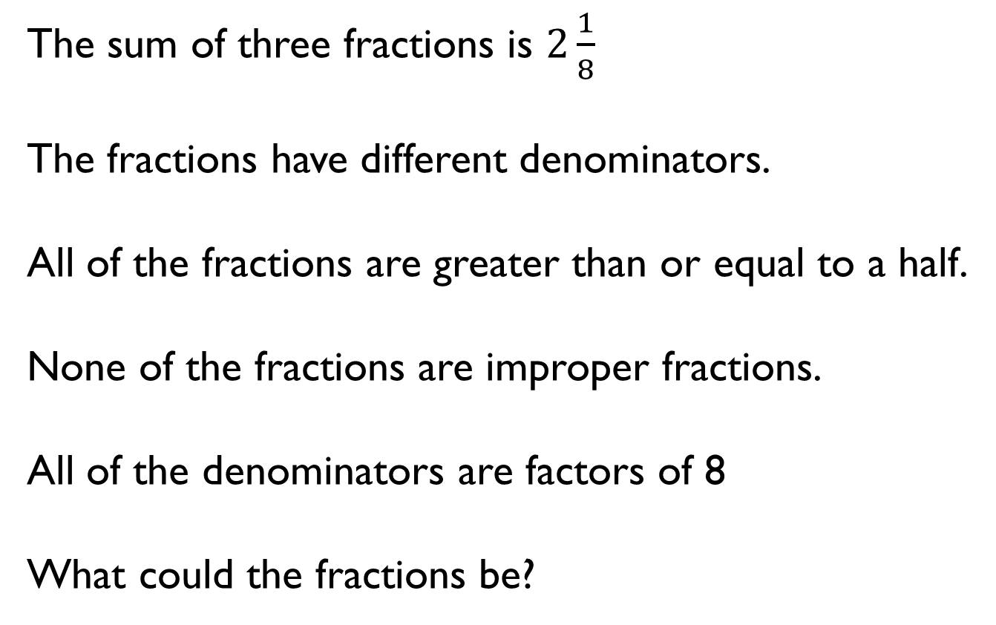
The sum of three fractions is $2\frac{1}{8}$
The fractions have different denominators.
All of the fractions are greater than or equal to a half.
None of the fractions are improper fractions.
All of the denominators are factors of 8
What could the fractions be?

Slide 23
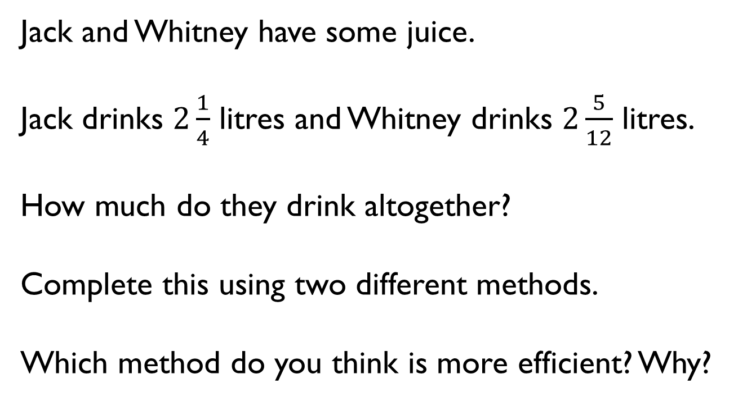
Jack and Whitney have some juice.
Jack drinks $2\frac{1}{4}$ litres and Whitney drinks $2\frac{5}{12}$ litres.
How much do they drink altogether?
Complete this using two different methods.
Which method do you think is more efficient? Why?

Slide 24
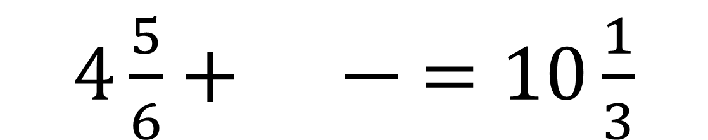
Fill in the missing numbers.
$4\frac{5}{6}+ \frac{}{}=10\frac{1}{3}$

Slide 25
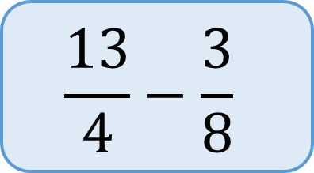
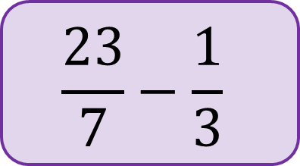
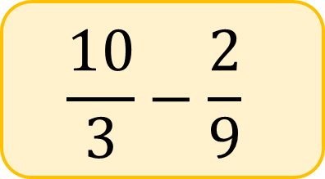
Which subtraction is the odd one out?
A
B
C
Explain why.
$$\frac{13}{4}−\frac{3}{8}$$
$$\frac{10}{3}−\frac{2}{9}$$
$$\frac{23}{7}−\frac{1}{3}$$

Slide 26
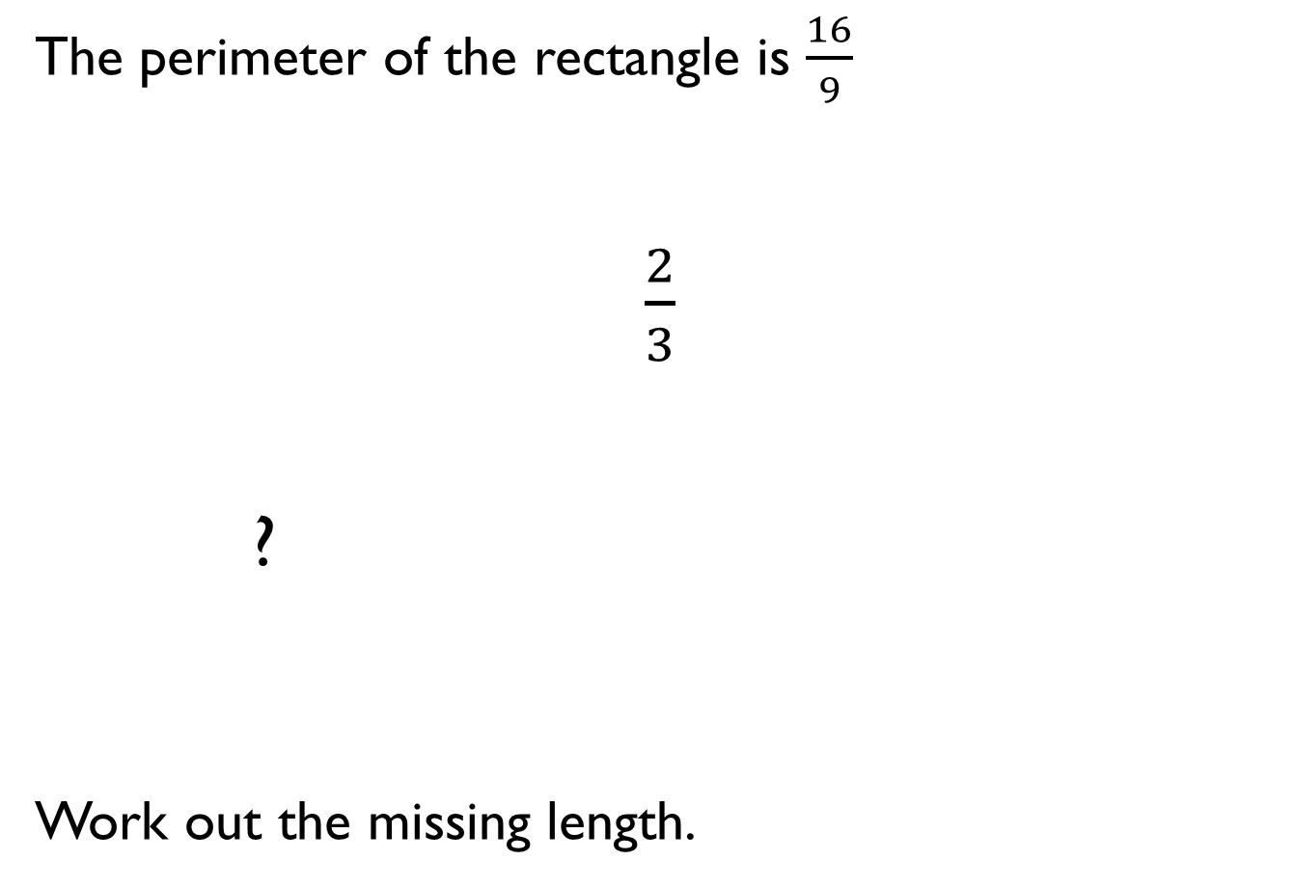
The perimeter of the rectangle is $\frac{16}{9}$
$\frac{2}{3}$
?
Work out the missing length.

Slide 27

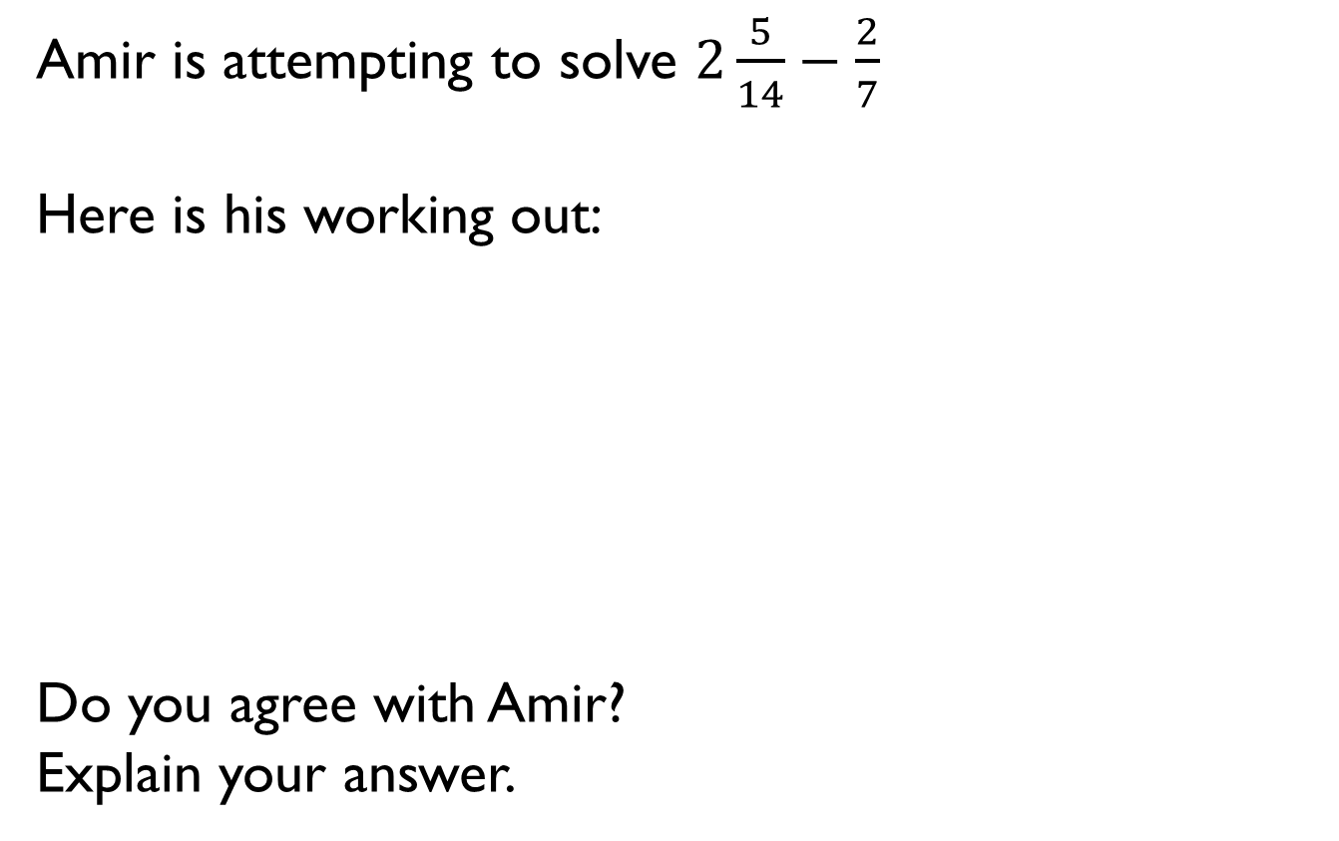
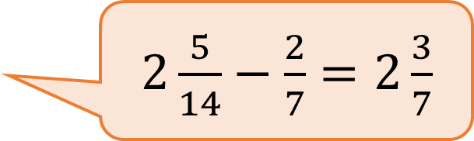
Amir is attempting to solve $2\frac{5}{14}−\frac{2}{7}$
Here is his working out:
Do you agree with Amir?
Explain your answer.
$2\frac{5}{14}−\frac{2}{7}=2\frac{3}{7}$

Slide 28

Here is Rosie’s method.
What is the calculation?
Can you find more than one answer?
Why is there more than one answer?

Slide 29
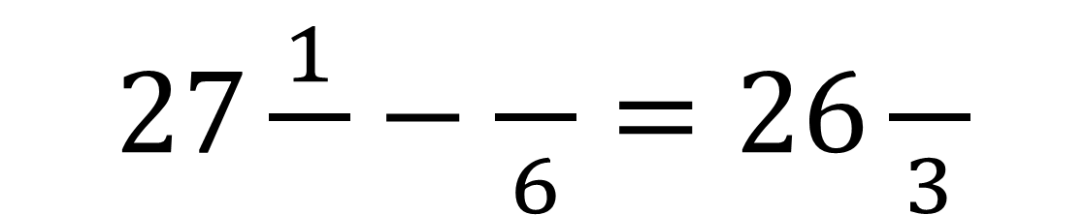
Place 2, 3 and 4 in the boxes to make the calculation correct.
$27\frac{1}{}−\frac{}{6}=26\frac{}{3}$

Slide 30
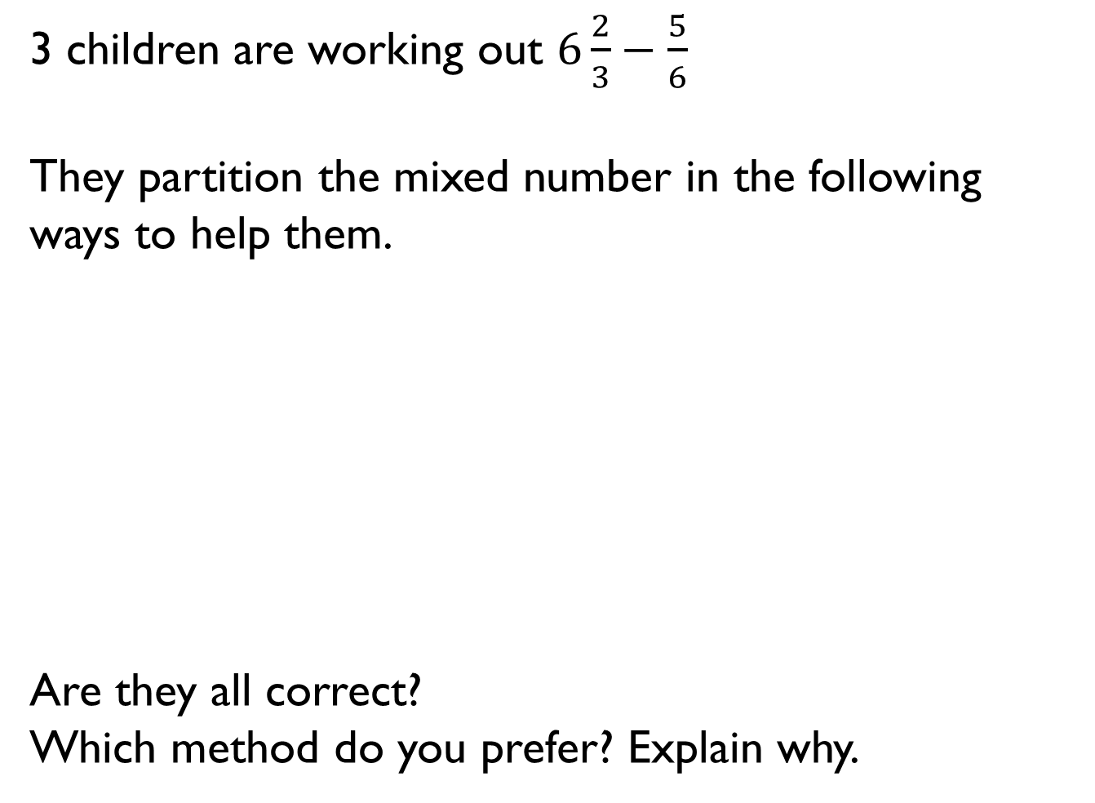
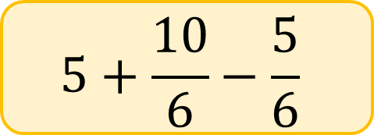
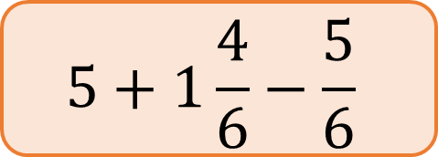
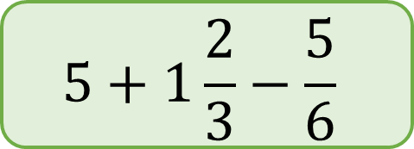
3 children are working out $6\frac{2}{3}−\frac{5}{6}$
They partition the mixed number in the following ways to help them.
Are they all correct?
Which method do you prefer? Explain why.
$$5+1\frac{2}{3}−\frac{5}{6}$$
Dora
$$5+1\frac{4}{6}−\frac{5}{6}$$
Alex
$$5+\frac{10}{6}−\frac{5}{6}$$
Jack

Slide 31
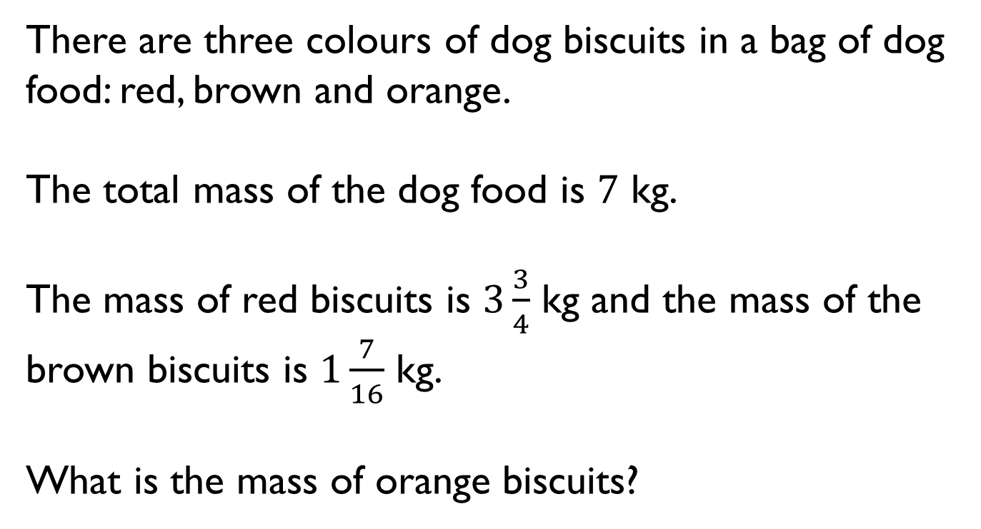
There are three colours of dog biscuits in a bag of dog food: red, brown and orange.
The total mass of the dog food is $7$ kg.
The mass of red biscuits is $3\frac{3}{4}$ kg and the mass of the brown biscuits is $1\frac{7}{16}$ kg.
What is the mass of orange biscuits?

Slide 32
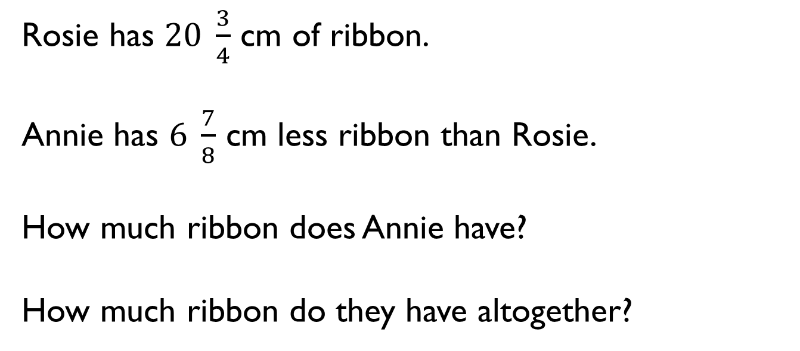
Rosie has $20 \frac{3}{4}$ cm of ribbon.
Annie has $6 \frac{7}{8}$ cm less ribbon than Rosie.
How much ribbon does Annie have?
How much ribbon do they have altogether?

Slide 33
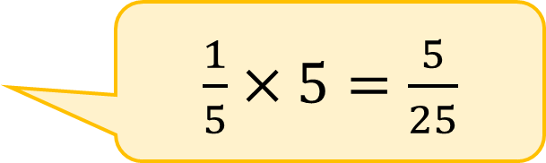
Amir is multiplying fractions by a whole number.
Can you explain his mistake?
$\frac{1}{5}×5=\frac{5}{25}$

Slide 34
Always, Sometimes, Never?
When you multiply a unit fraction by the same number as it’s denominator the answer will be one whole.

Slide 35
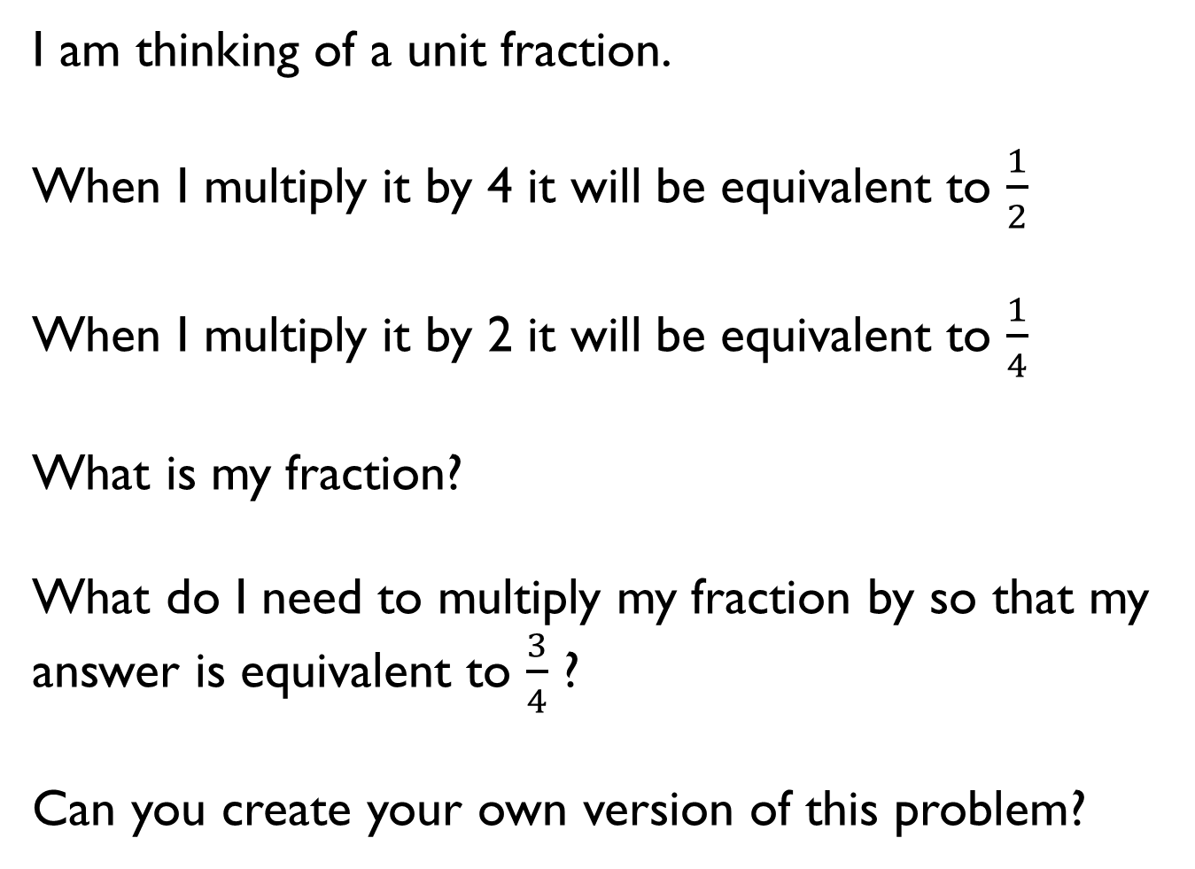
I am thinking of a unit fraction.
When I multiply it by 4 it will be equivalent to $\frac{1}{2}$
When I multiply it by 2 it will be equivalent to $\frac{1}{4}$
What is my fraction?
What do I need to multiply my fraction by so that my answer is equivalent to $\frac{3}{4}$ ?
Can you create your own version of this problem?

Slide 36
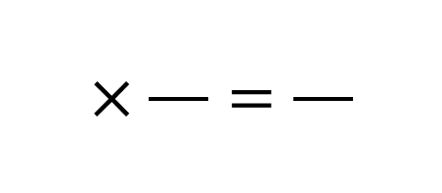
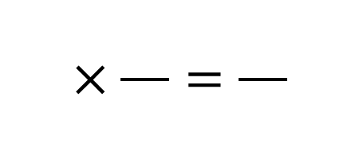
Use the digit cards only once to complete these multiplications.
9
2
4
6
3
1
2
3
4
5
6
$$×\frac{}{}=\frac{}{}$$
$$×\frac{}{}=\frac{}{}$$

Slide 37

Jack runs $2\frac{2}{3}$ miles three times per week.
Dexter runs $3\frac{3}{4}$ miles twice a week.
Who runs the furthest during the week?
Explain your answer.

Slide 38

Work out the missing numbers.
Explain how you worked it out.
$$\frac{}{}× = \frac{}{}$$
2
7
7
8
8

Slide 39
Write a problem that matches the bar model.
What other questions could you ask from this model?
96
?

Slide 40

$\frac{7}{16}$ of a class are boys.
There are 18 girls in the class.
How many children are in the class?

Slide 41
Find the area of each colour in the rectangle.
What would happen if one of the red or green rectangles was changed to a blue?
8 cm

Slide 42

Which method would you use to complete these calculations: multiply the fractions or find the fraction of an amount?
Explain your choice for each one.
Compare your method to your partner.
25 $×\frac{3}{5}$ or $\frac{3}{5}$ of 25
6 $×\frac{2}{3}$ or $\frac{2}{3}$ of 6
5 $×\frac{3}{8}$ or $\frac{3}{8}$ of 5

Slide 43

Dexter and Jack are thinking of a two-digit number between 20 and 30
Dexter finds two thirds of the number.
Jack multiplies the number by $\frac{2}{3}$
Their new two-digit number has a digit total that is one more than that of their original number.
What number did they start with?
Show each step of their calculation.

