Slide 1
Notes:
Start your mornings with this lovely Maths PowerPoint, focusing on addition and subtraction. There is one slide a day for five days, with three questions for each day. The three questions are on the same topic but have different degrees of challenge and are indicated by the chillies next to the questions; yellow chilli shows the least challenge, red chilli the middle and green chilli the most challenge.

Slide 2

Contents
Day 1
Day 2
Day 3
Day 4
Day 5

Slide 3


Day 1
<
Menu
Place Value
Problem Solving
17
10
?
7
How many circles are there?
4
Answer
Answer
+ and -
Reasoning
9 + 3 =
If I count in 2s from 0, I will say the number 6.
1
2
12
Is Henry correct? Explain why.
Answer

Slide 4

Day 2
<
Menu
Place Value
Problem Solving
0, 2, 4, 6,
8
What is the next number?
How many squares are there?
3
Answer
Answer
+ and -
Reasoning
20
0, 2, 6, 8
11
9
?
What number has Alison missed out?
Answer

Slide 5

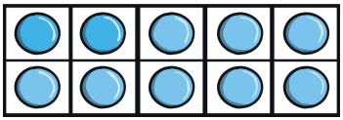
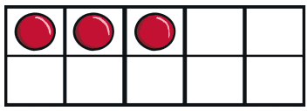




Day 3
<
Menu
Place Value
Problem Solving
34
Write the number that is one more.
Write a subtraction sentence
about this picture.
35
13 − 5 = 8
Answer
Answer
+ and -
Reasoning
Is my
part-whole model correct?
26
20 - 3 =
17
20
8
Answer
Explain why.

Slide 6




Day 4
<
Menu
Place Value
Problem Solving
24
19
10
Which number is the greatest?
What number is shown here?
24
28
Answer
Answer
+ and -
Reasoning
Which line is the longest?
Explain how you know.
14 - 6 =
8
Answer

Slide 7


Day 5
<
Menu
Place Value
Problem Solving
5
0 |  | 10 | 15 | 20 | 25 | 30
30
31
32
33
34
35
What number is behind the chick?
What are the missing numbers on the number line?
Answer
Answer
+ and -
Reasoning
9 + 4 =
13
If I count in 5s from 0, I will say the number 18.
1
3
Is Henry correct? Explain why.
Answer

