Slide 2


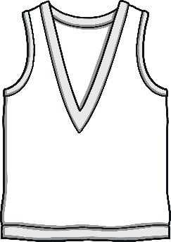




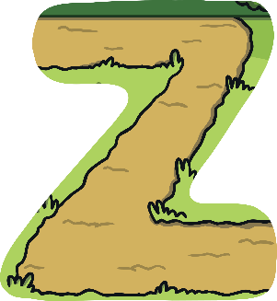




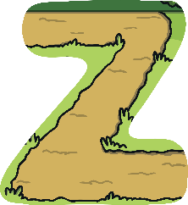

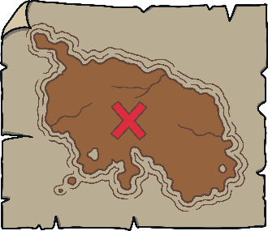







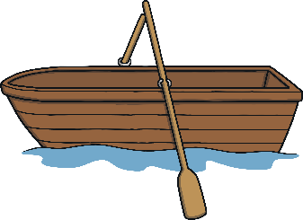
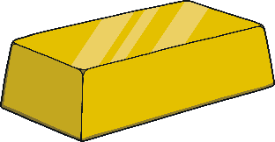





Revisit and Review
Let’s practise Sam’s Sounds and Tricky Words!
w
er
v
ure
air
qu
ng
j
ch
z
ar
x
zz
ee
ow
ur
ai
sh
igh
th
y
or
oo
oa
ear
th
oo
oi
so
have
come
said
like
some

Slide 3




Teach
Kit and Sam were back home after their visit to Gran and Grandad’s house. “We had great fun on our visit but we missed you Ben,” said Kit.

Slide 4
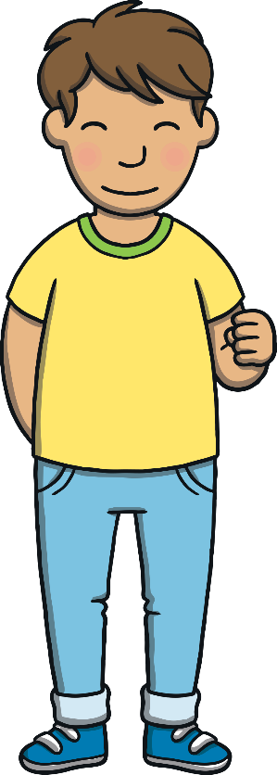

Teach
Kit picked up the magic map. “Gran was right, the map got us into trouble this time. We must be careful how we use the magic objects.”

Slide 5
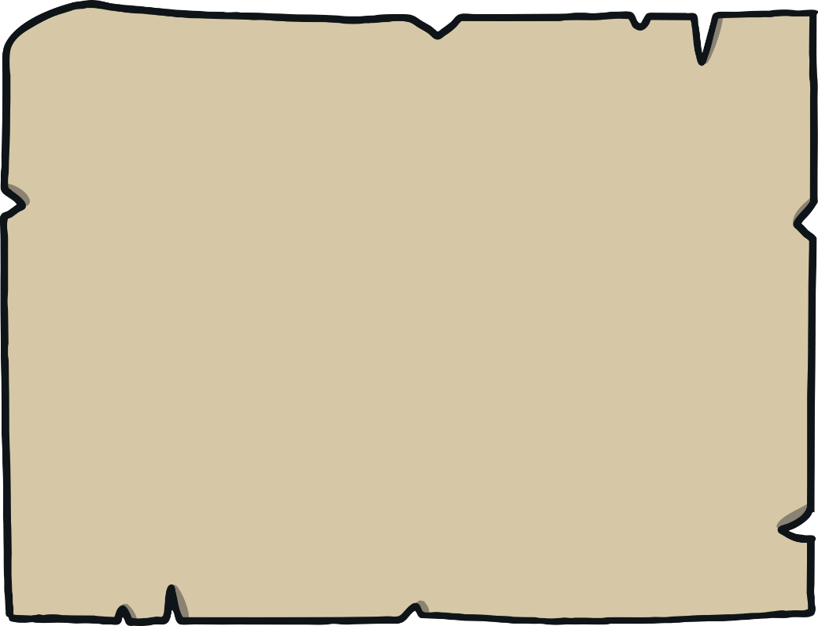
Practise
Mountain Adventure
The magic map is showing Kit and Sam some of the things they saw on their trip to Everest. Can you write down a word to match each picture?
?

Slide 6
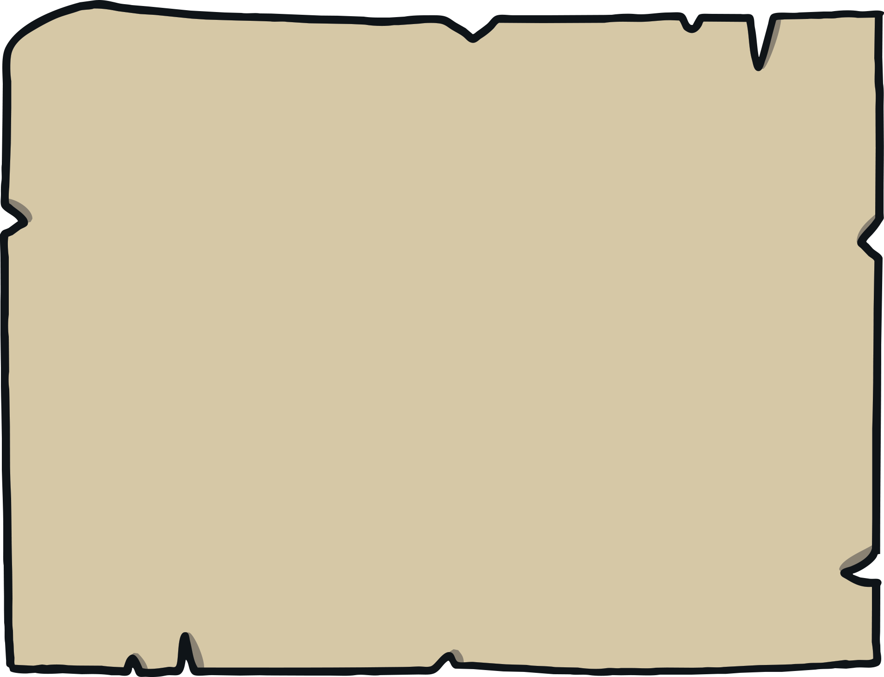
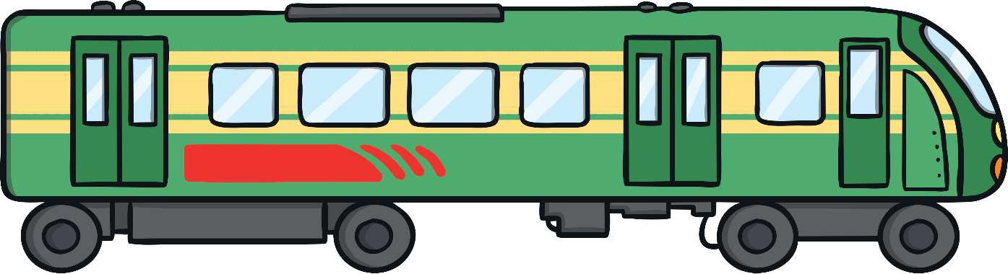

Practise
train
Check

Slide 7
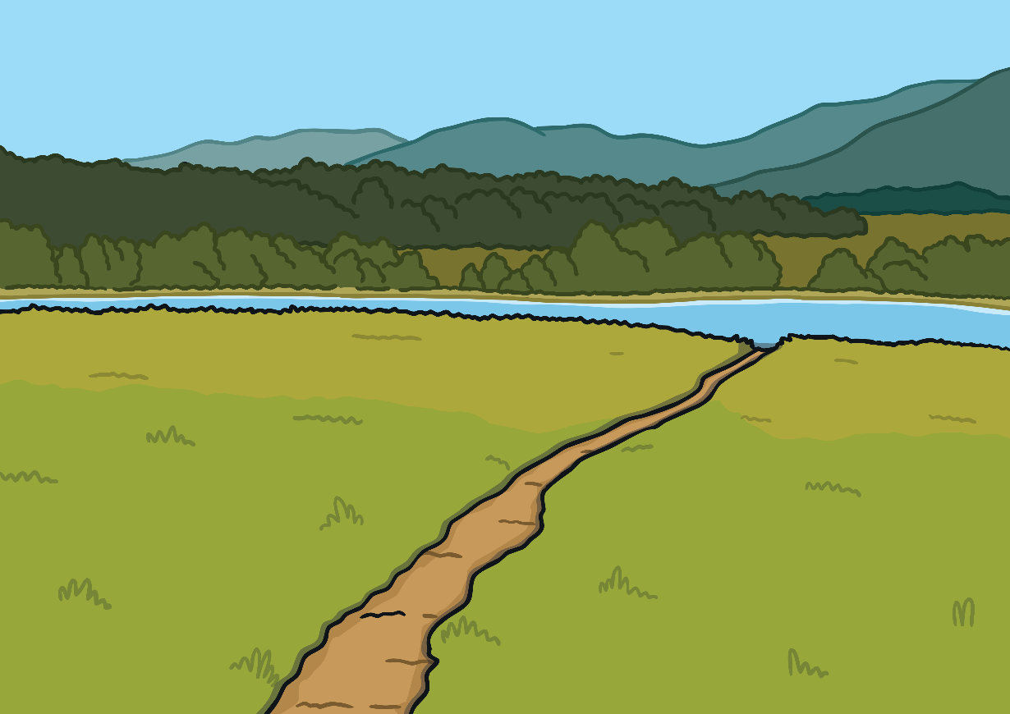
Practise
track
Check

Slide 8

Practise
frog
Check

Slide 9
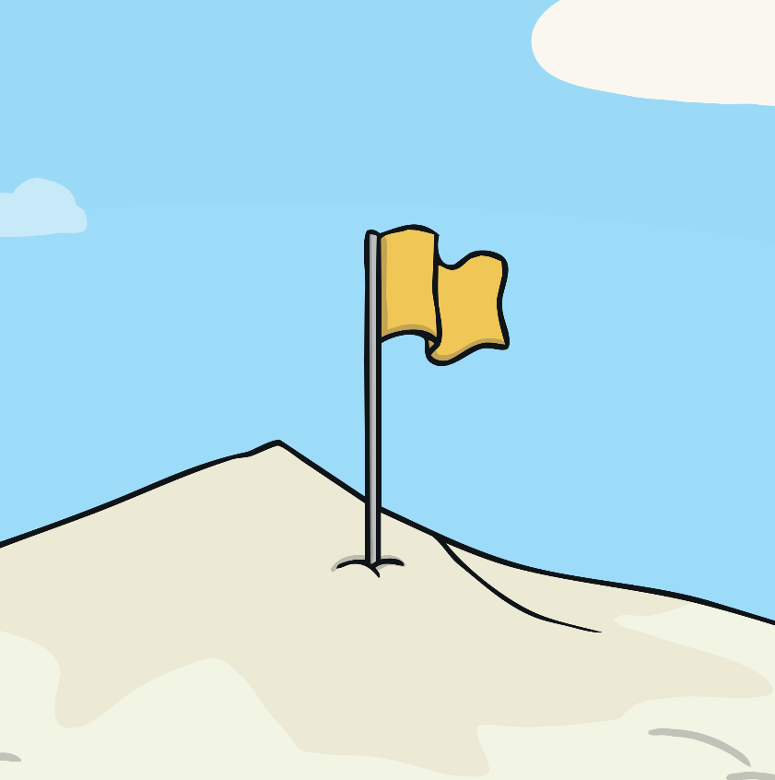
Practise
flag
Check

Slide 10

Practise
frost
Check

Slide 11
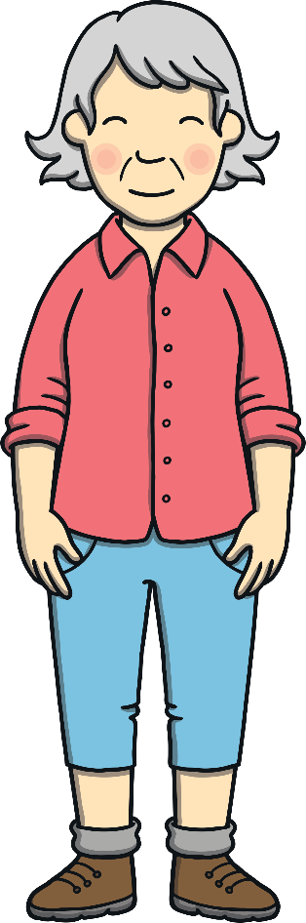
Practise
Gran
Check

Slide 12
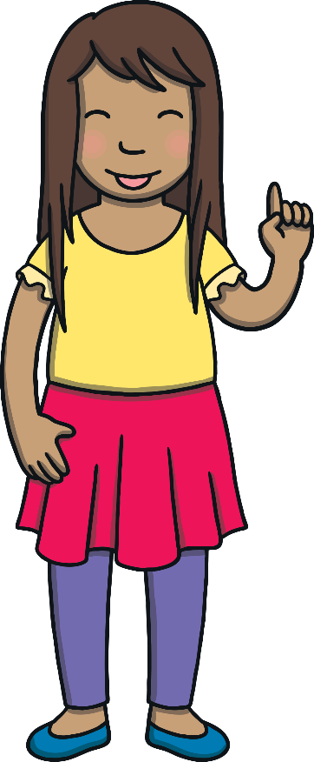
Apply
“You’re right, the magic map is powerful,” said Sam. “We should write down our adventure to remind ourselves that we must be careful with it!”

Slide 13
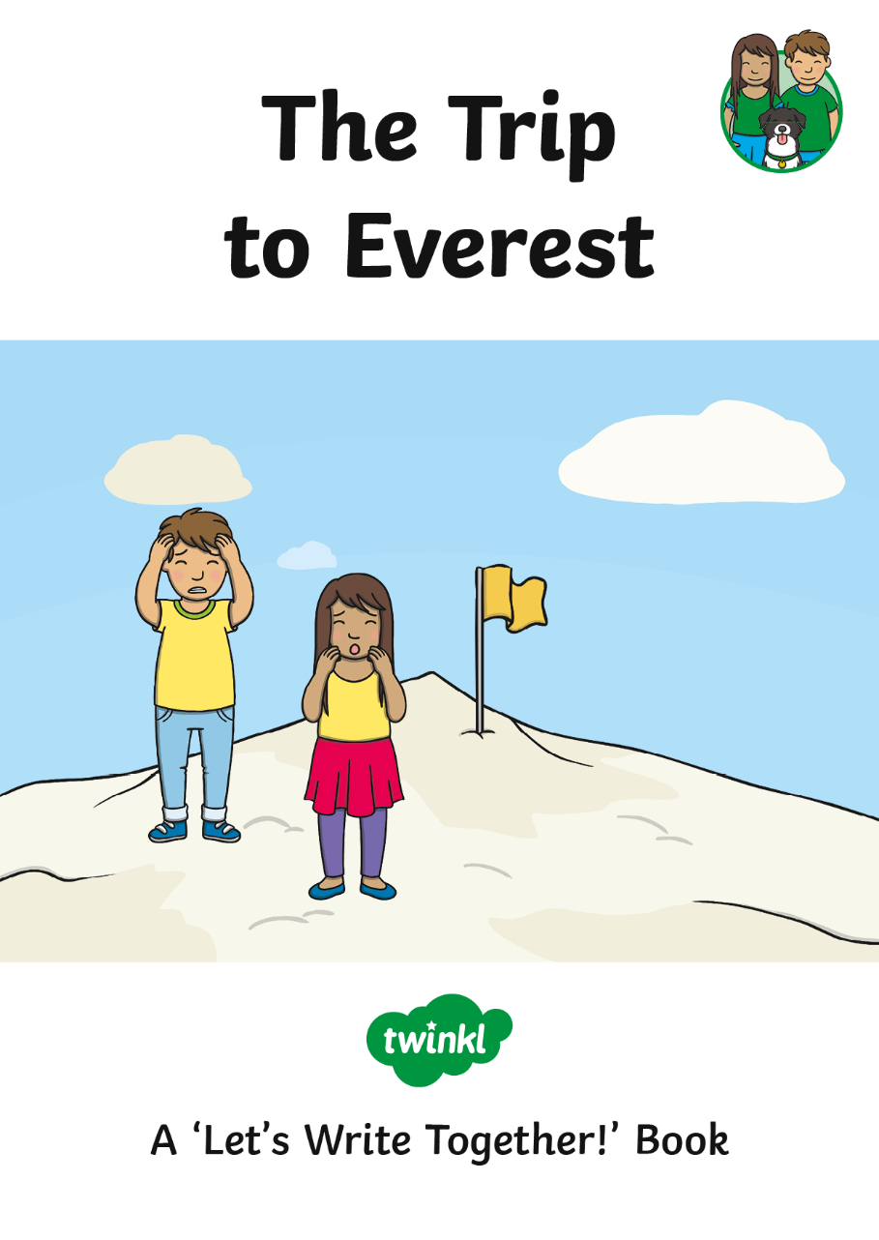
Apply

Slide 14
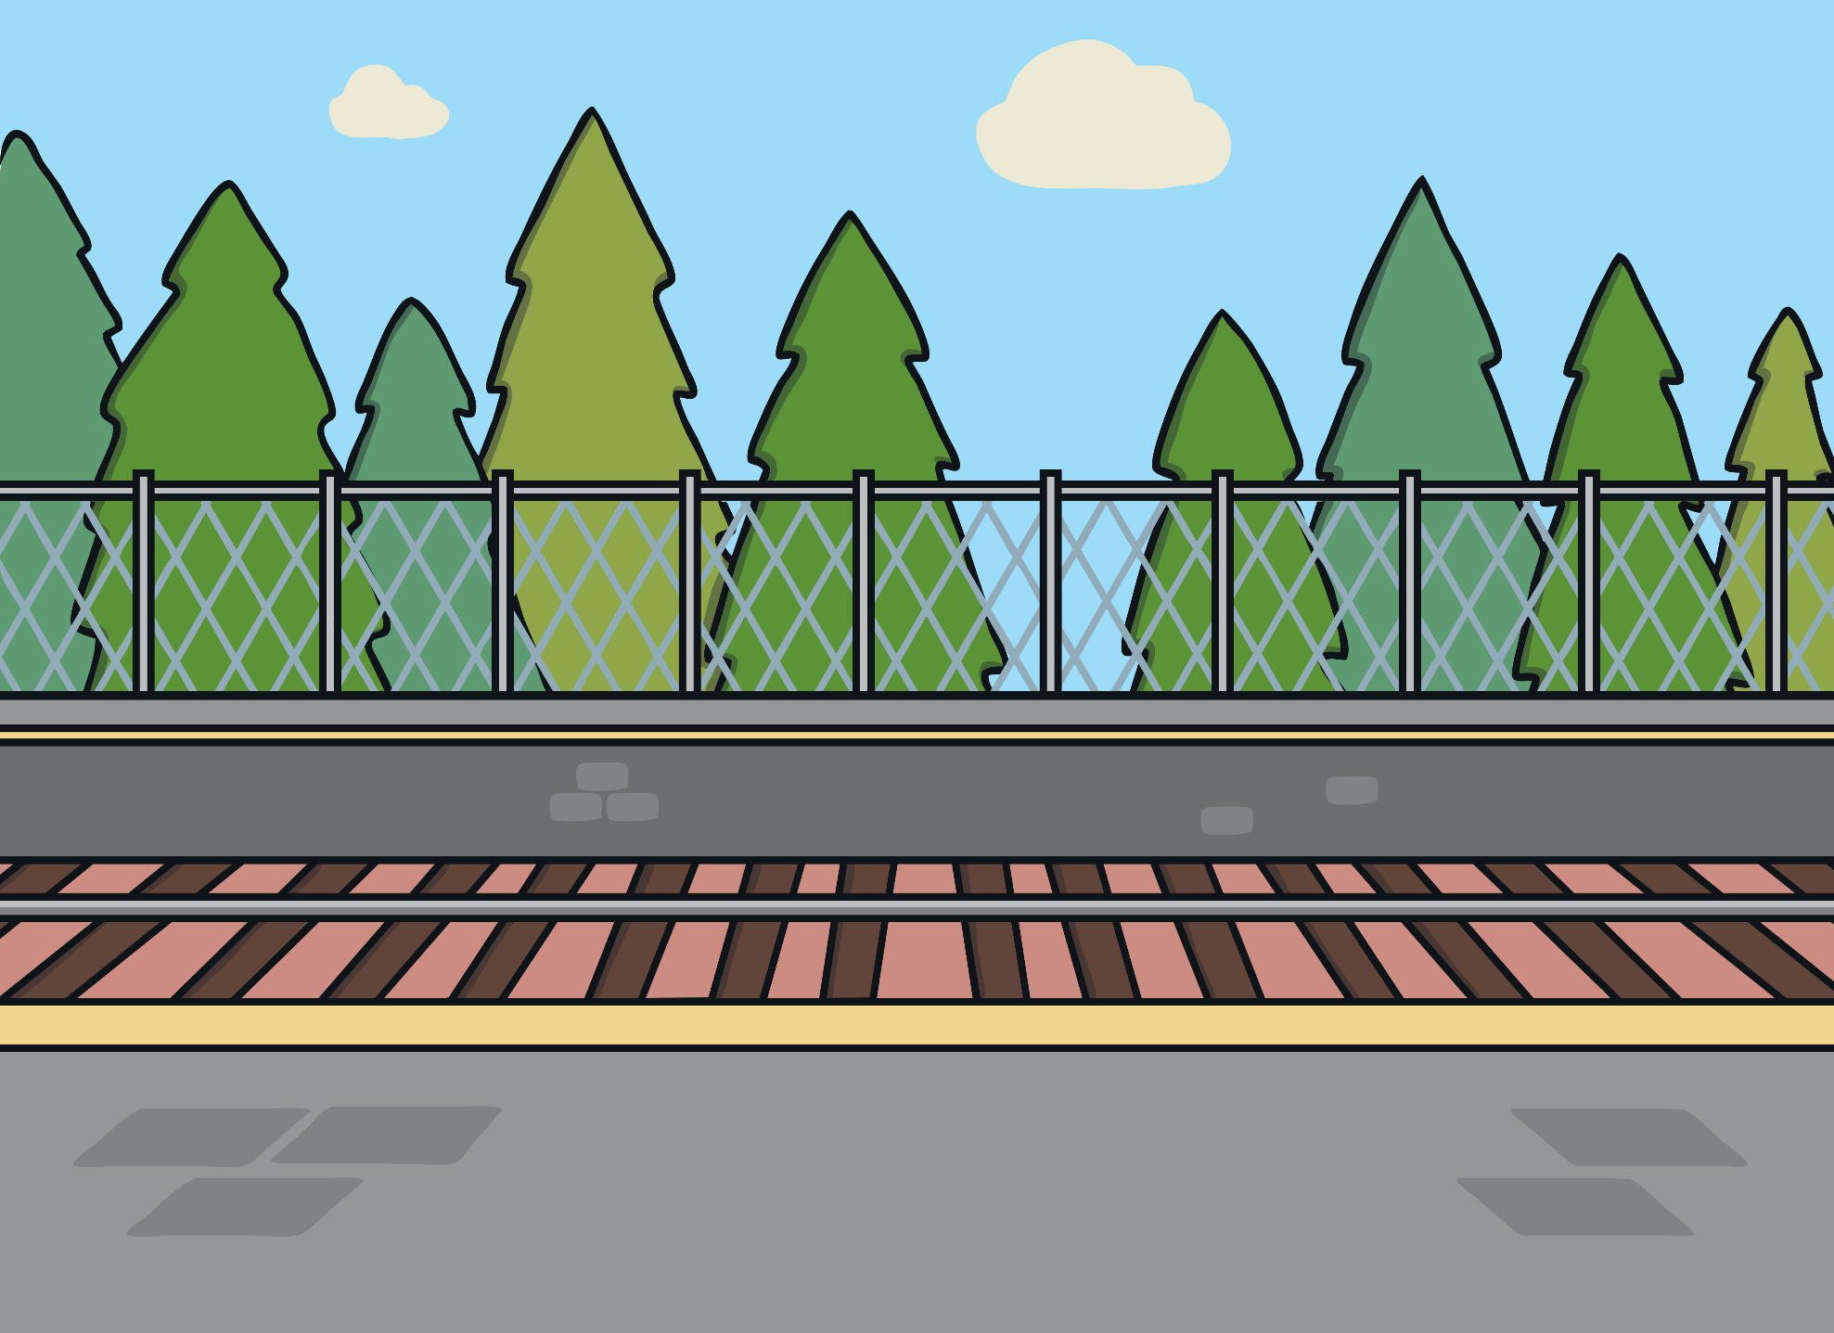
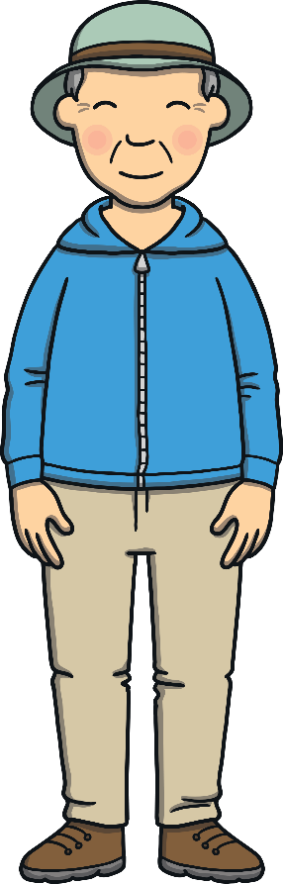
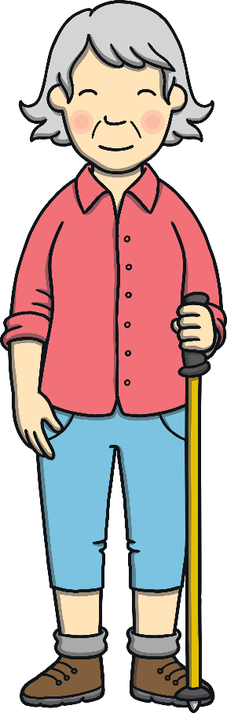
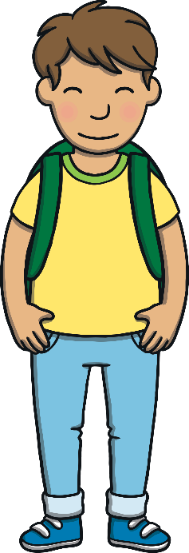
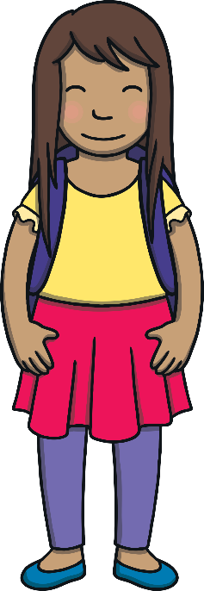
Apply
Show Suggestion
Kit and Sam went on a train trip with Gran and Grandad.

Slide 15
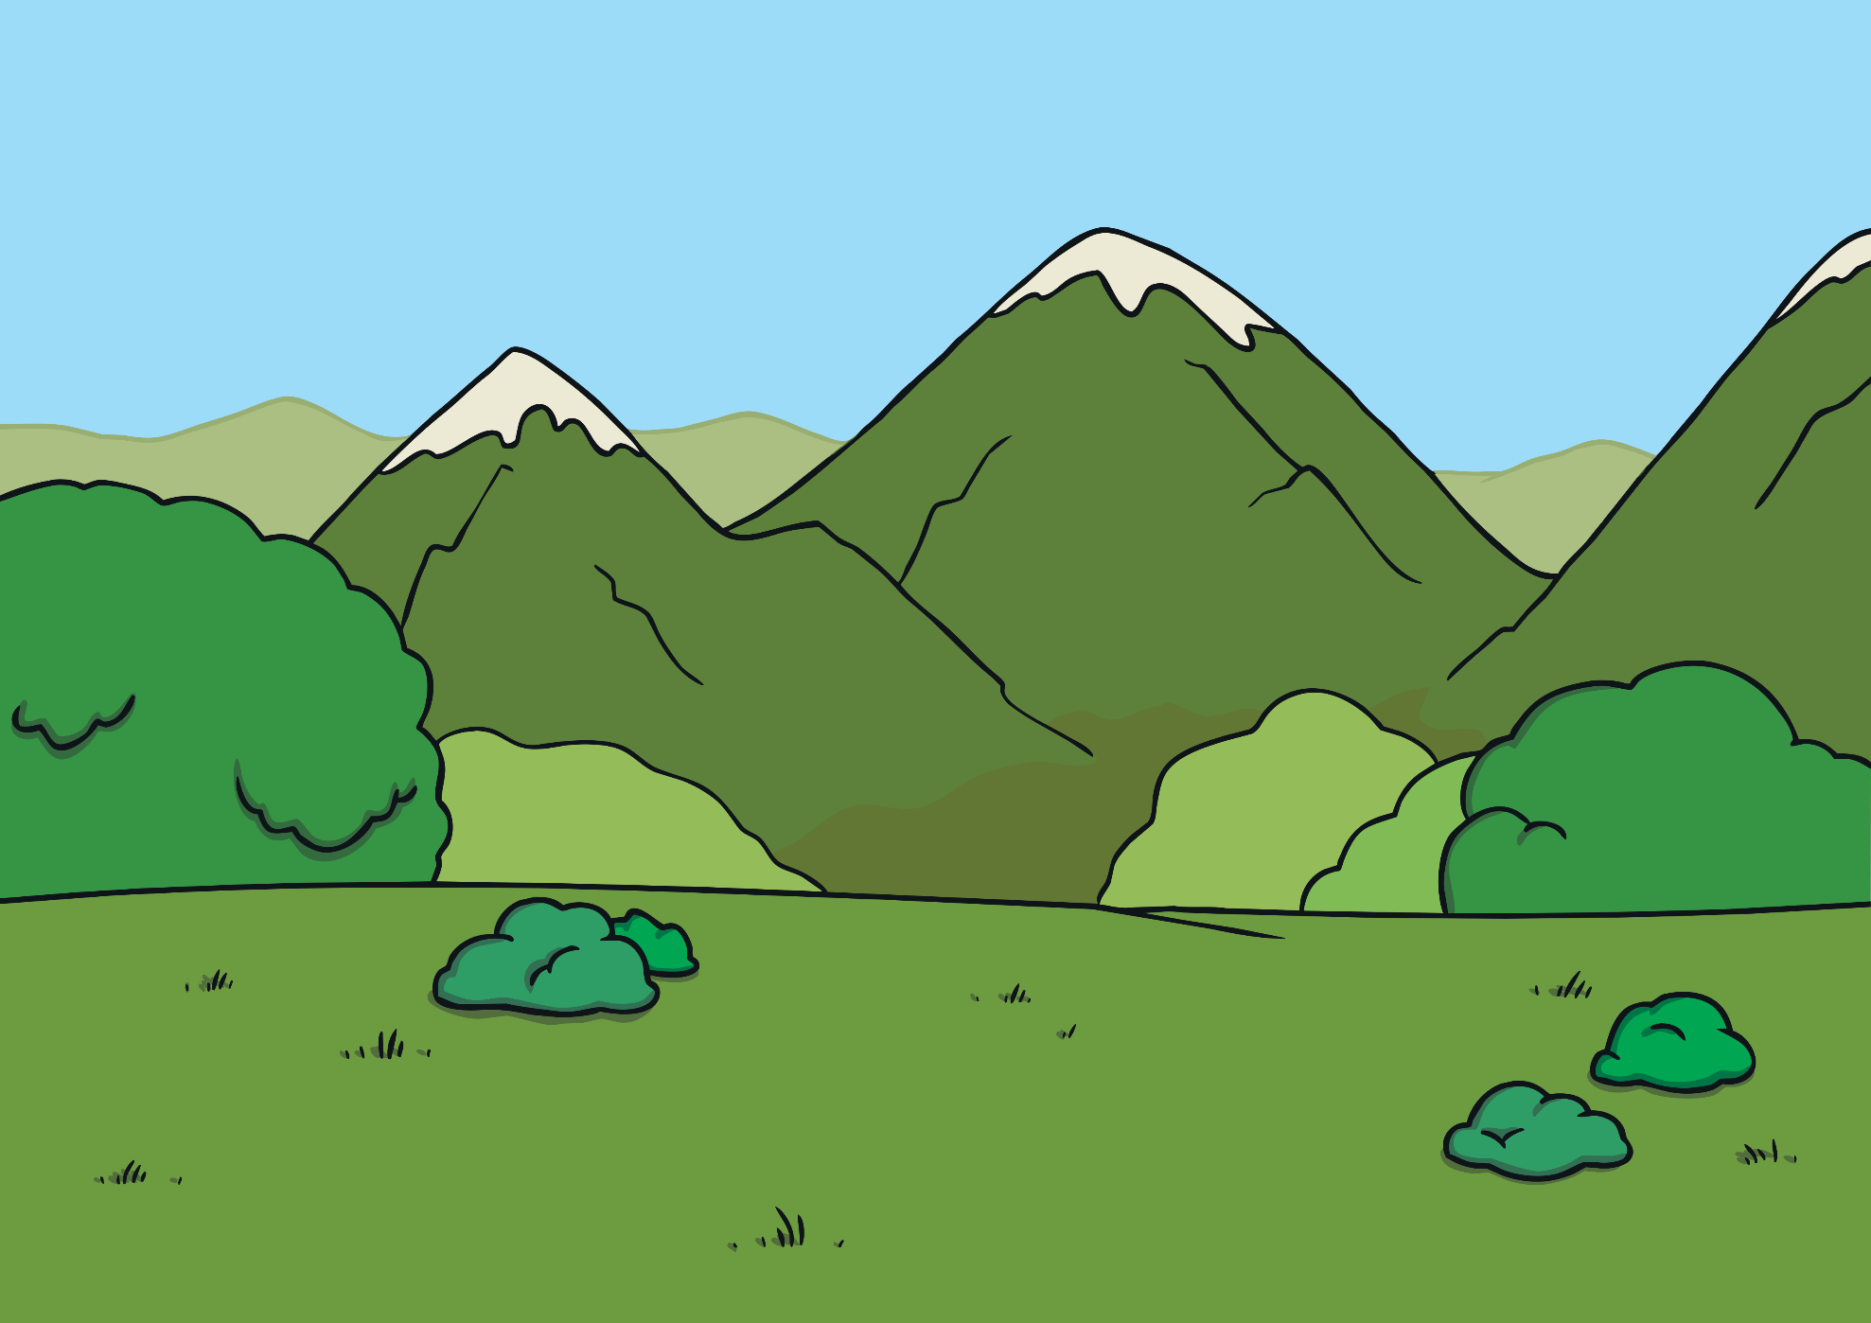
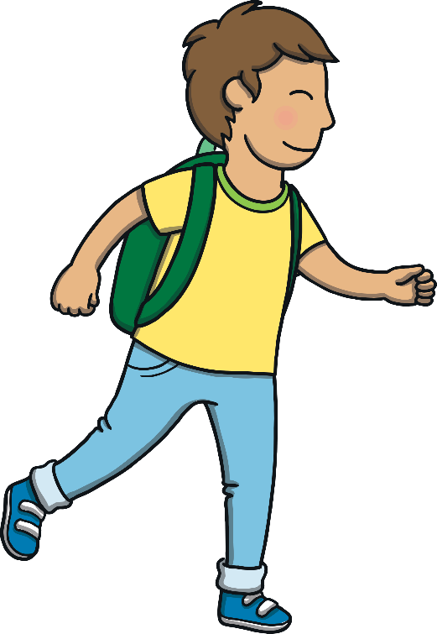
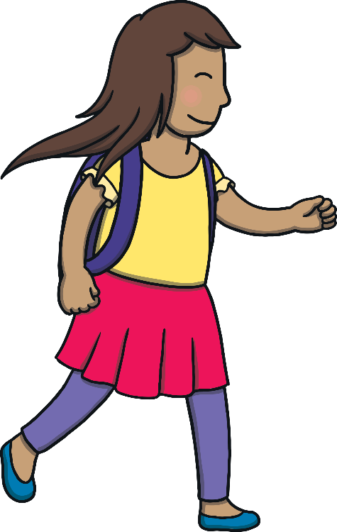
Apply
Show Suggestion
“Let us look for things along the track.”

Slide 16
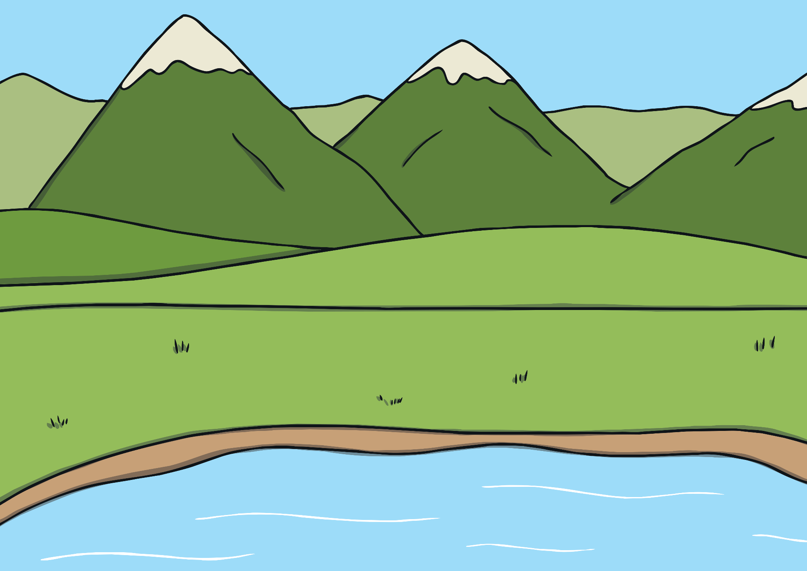
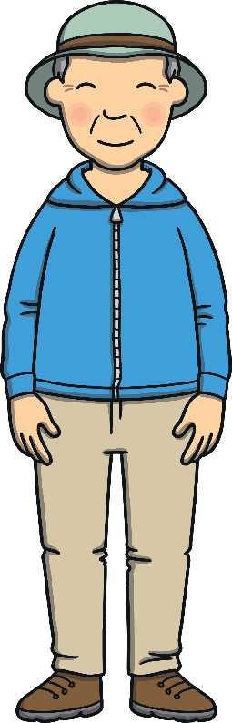

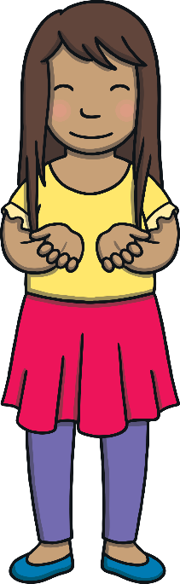
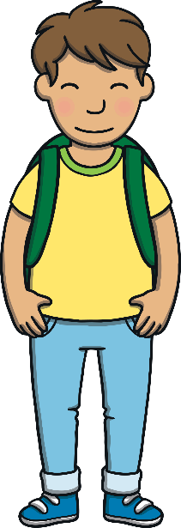

Apply
Show Suggestion
Sam had a frog. She put it into the pond.

Slide 17


Apply
Show Suggestion
The map took Kit and Sam to the top of Everest.

Slide 18

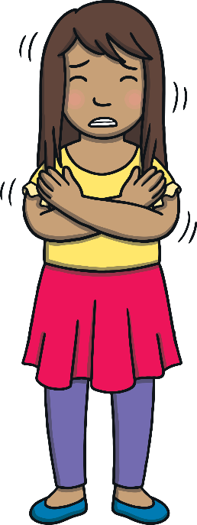
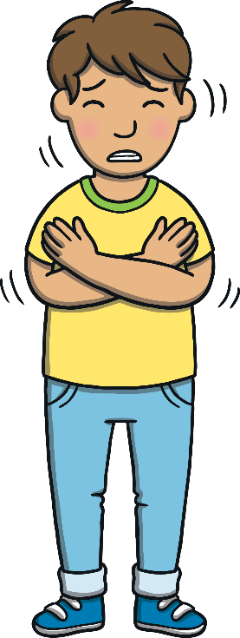
Apply
Show Suggestion
“It is freezing. We must go down the track.”

Slide 19
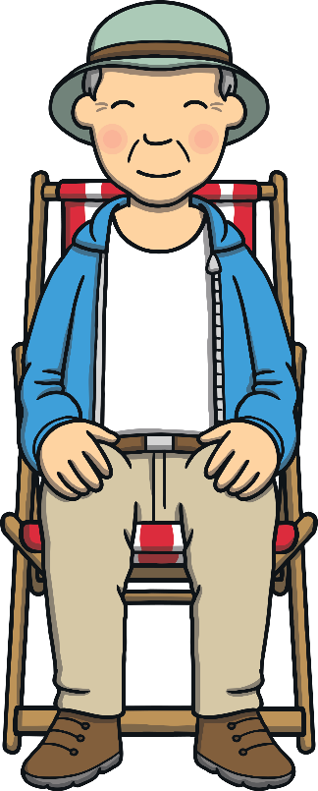
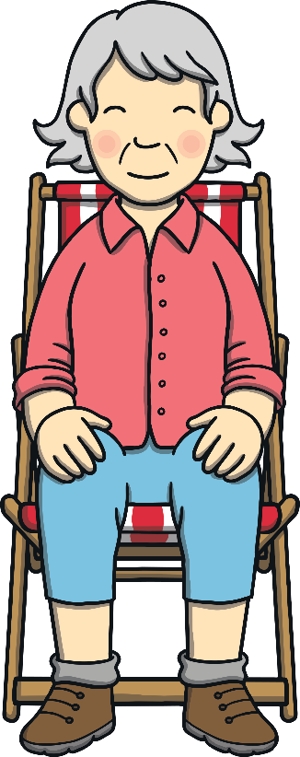
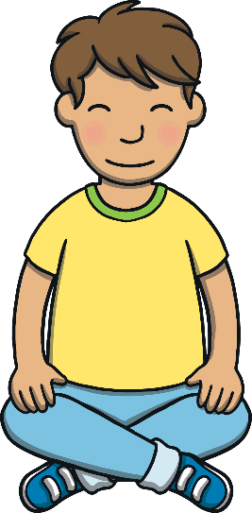
Apply
Show Suggestion
“It is good to see you again, Gran and Grandad.”

Slide 20



Apply
“If the watch takes us to different times and the map takes us to different places, I wonder what this book does?” said Kit, as he and Sam stared at the book.

Slide 21

Today, we have written sentences to create a book together.

