Slide 1
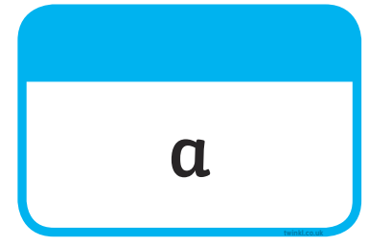







Tricky Words

Slide 2
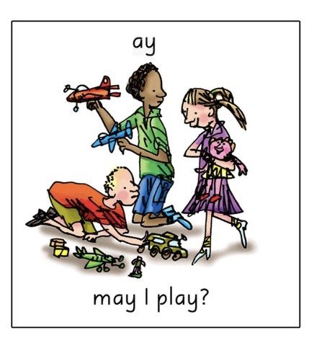
Our Set 3 phoneme for today is…. ay
spray play
day
may
way
say
pay

Slide 3
LO: To say the last word in a rhyming couplet.
Monday 8th March 2021

Slide 4
Today we will be thinking of rhyming words. For example…
  Zog, the biggest dragon, was the keenest one by far.
He tried his hardest every day to win a golden ...
star.

Slide 5
How about this one?
  Zog, went off to practice, flying fast and free.
He soared and swooped and looped the loop then crashed into a…
tree.

Slide 6
What do you think might rhyme with this?
  Zog, felt proud and happy and Pearl felt good as well.
She took the dragon’s temperatures, and nursed them when they
fell.

Slide 7
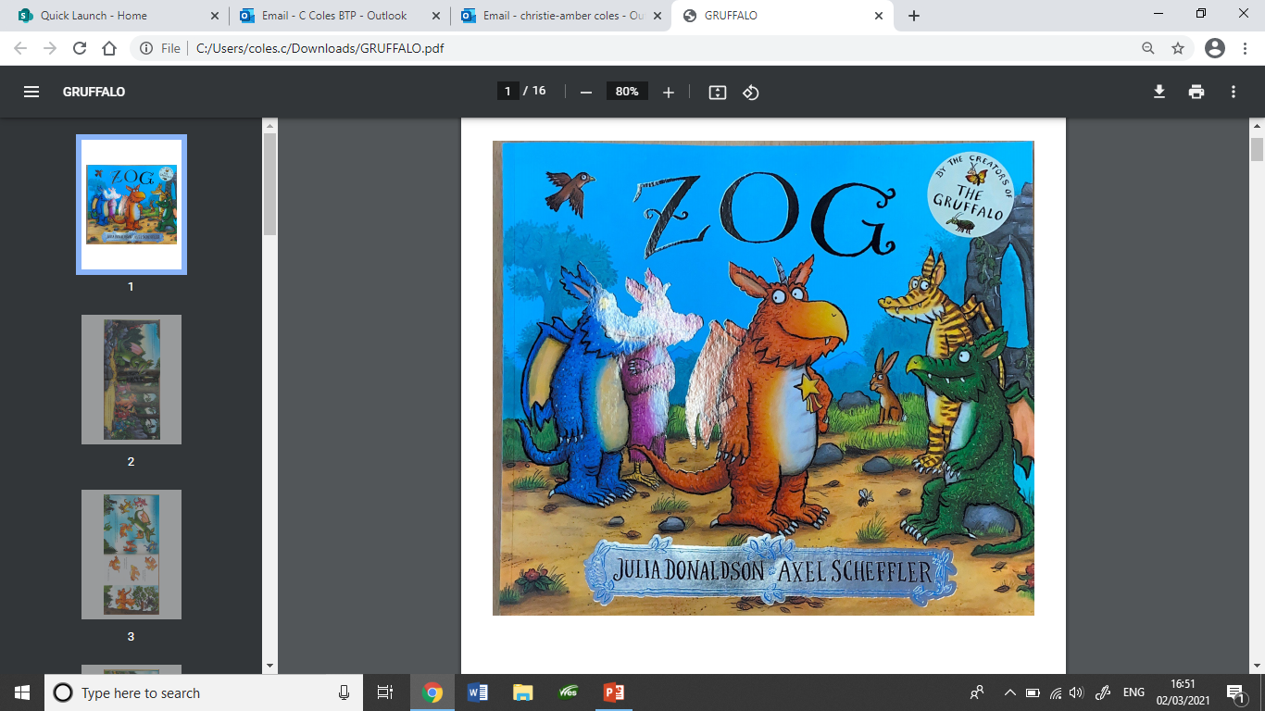

Slide 8
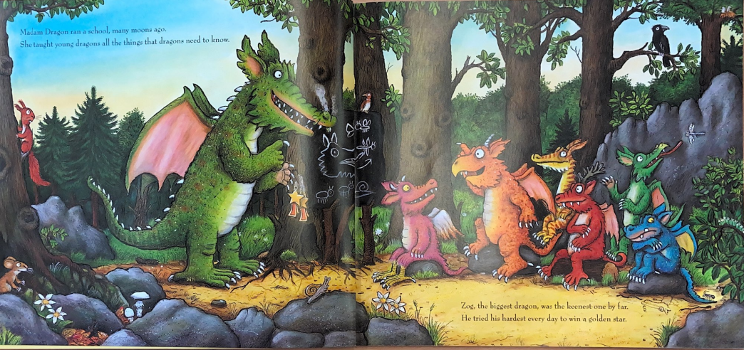
ago
know
far
star

Slide 9
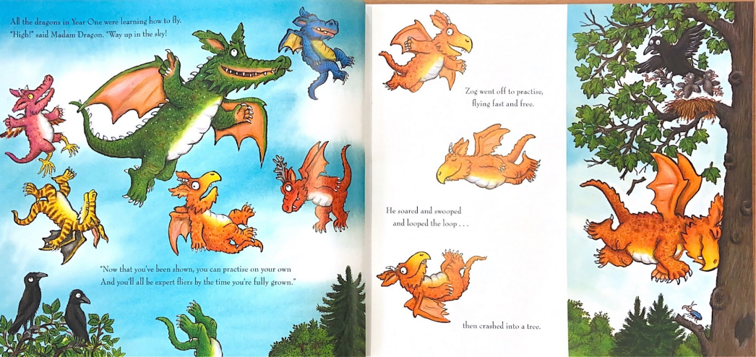
fly
sky
free
tree
own
grown

Slide 10
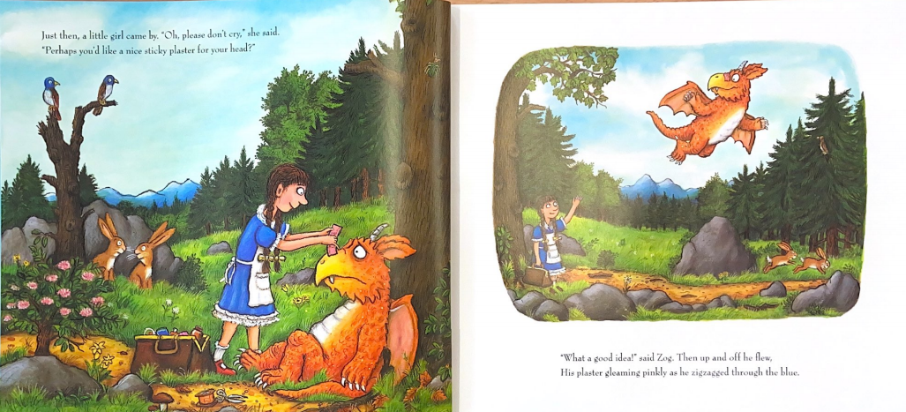
said
head
flew
blue

Slide 11
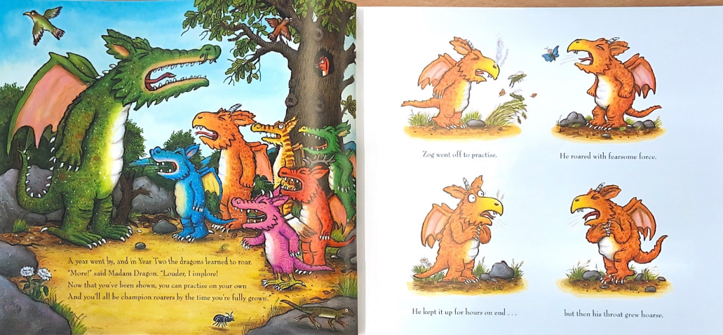
force
hoarse
roar
own
implore
grown

Slide 12
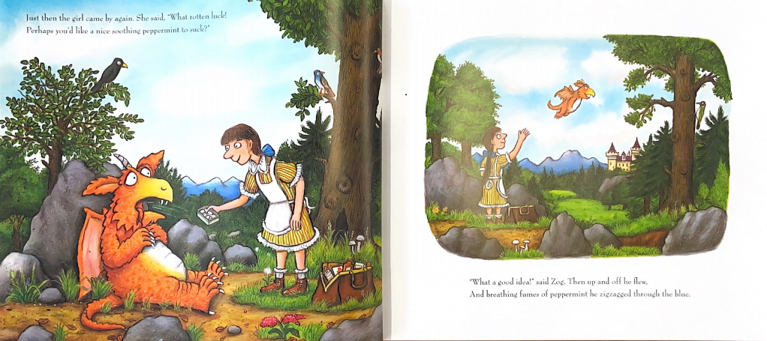
luck
suck
flew
blue

Slide 13
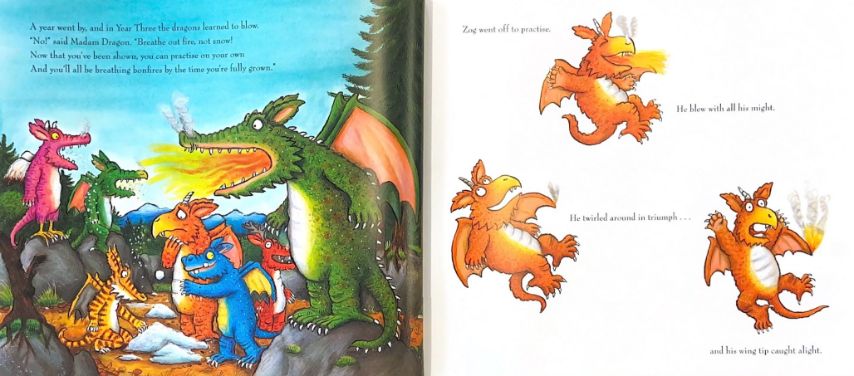
blow
snow
might
own
grown
alight

Slide 14
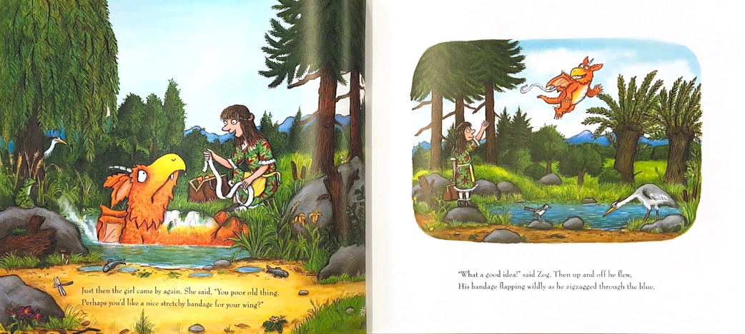
flew
thing
blue
wing

Slide 15
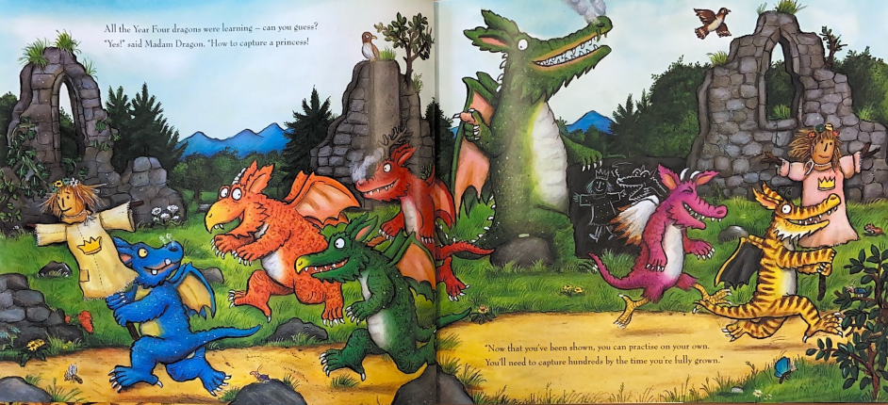
guess
princess
own
grown

Slide 16
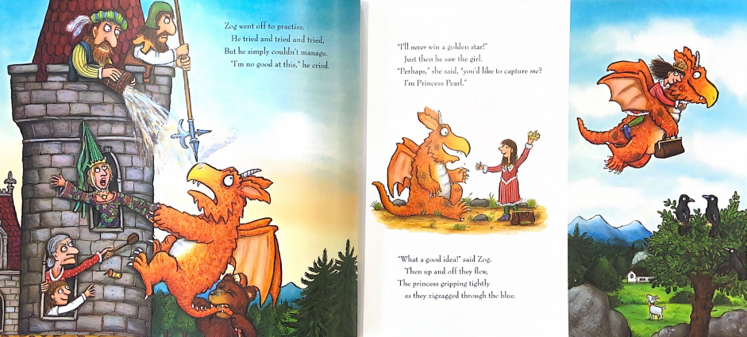
girl
Pearl
tried
cried
flew
blue

Slide 17
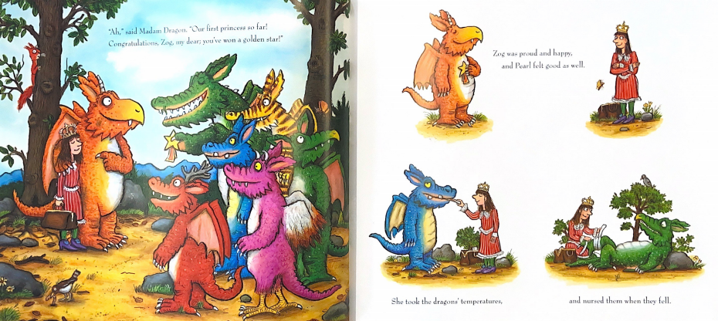
far
star
well
fell

Slide 18
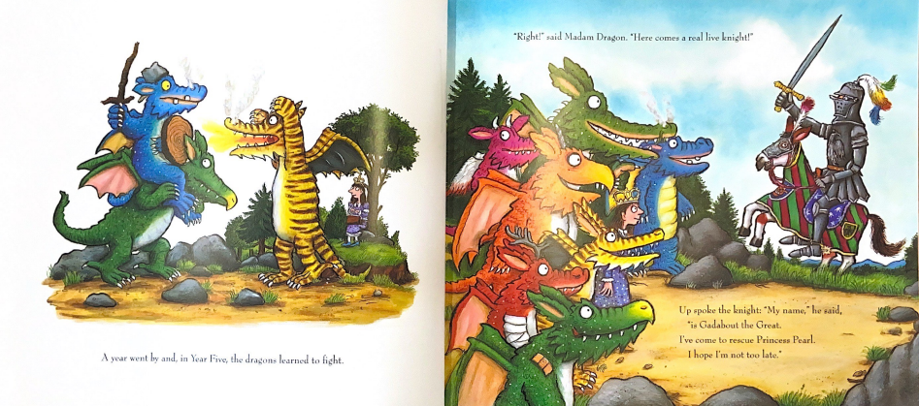
fight
knight
great
late

Slide 19
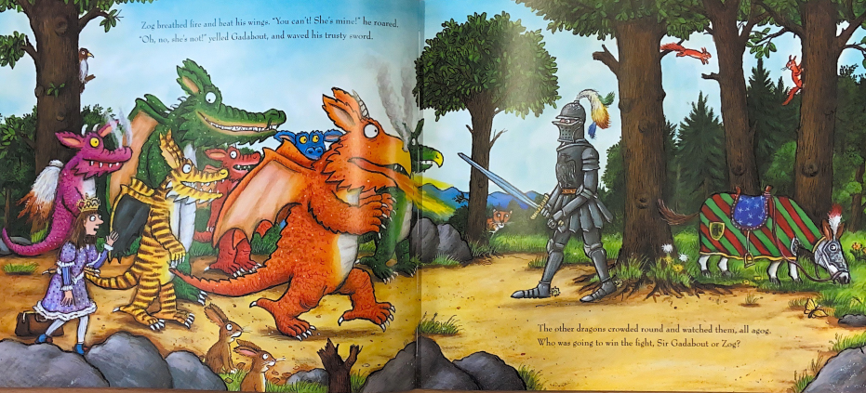
roared
sword
agog
zog

Slide 20
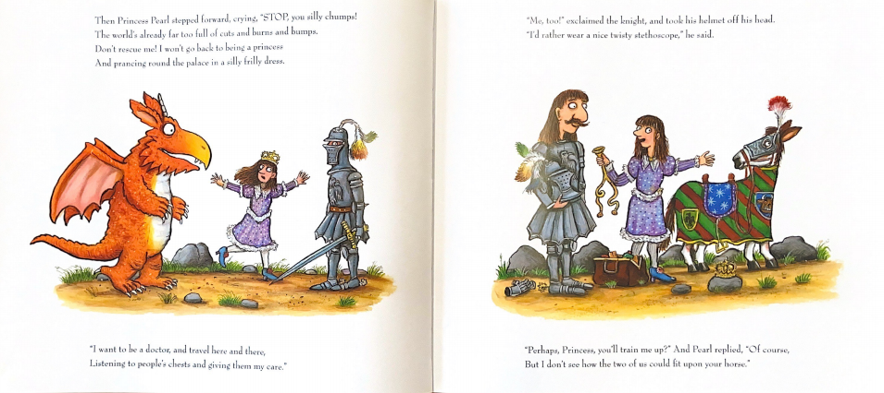
head
chumps
said
bumps
princess
dress
there
course
care
horse

Slide 21
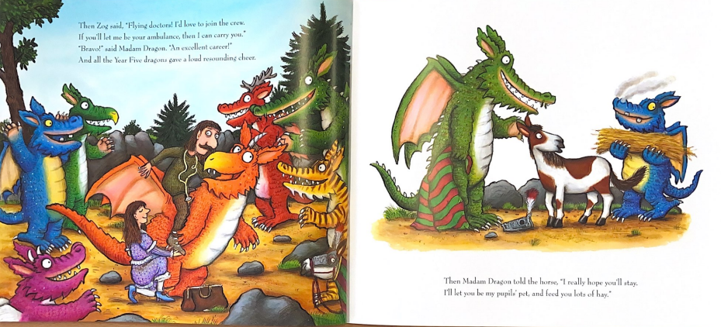
crew
you
career
steer
stay
hay

Slide 22
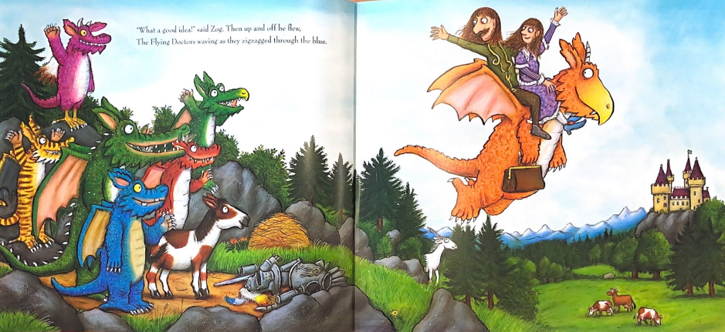
flew
blue

Slide 23
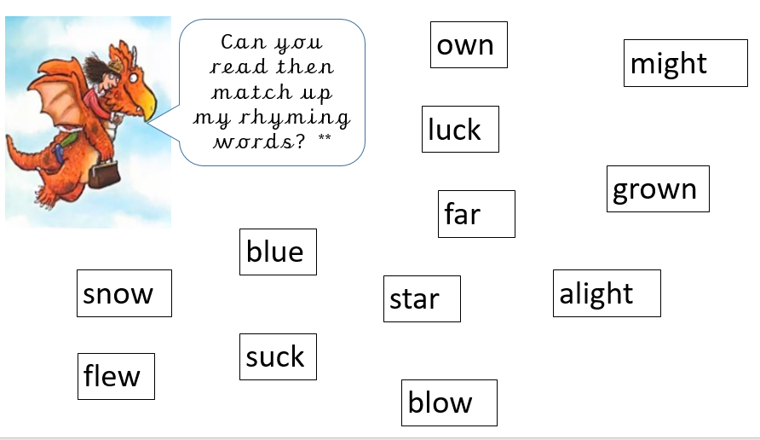
Well done!
You have been able to say plenty of words that rhyme with others!
Your task is to read
the words and match
the words that rhyme.

