Slide 1
LO: To draw a portrait of Queen Elizabeth I
Monday 8th March 2021

Slide 2
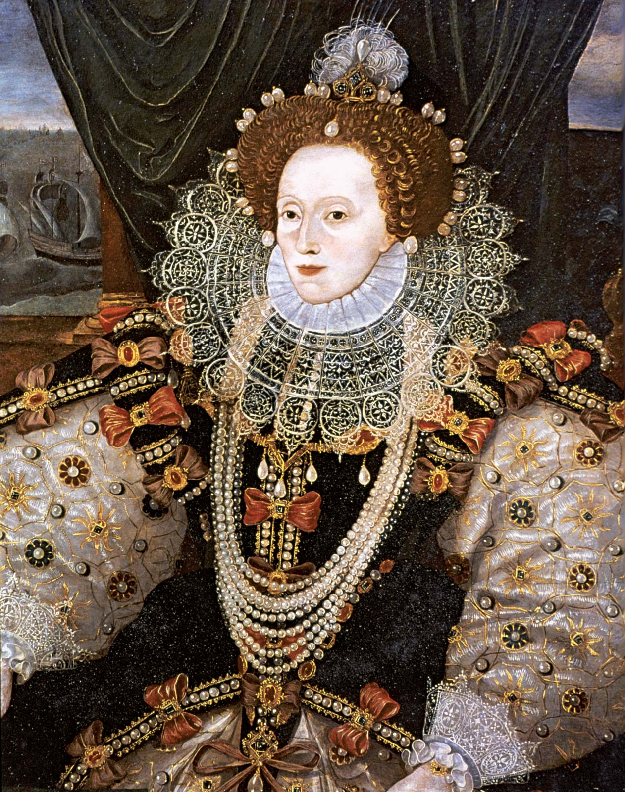
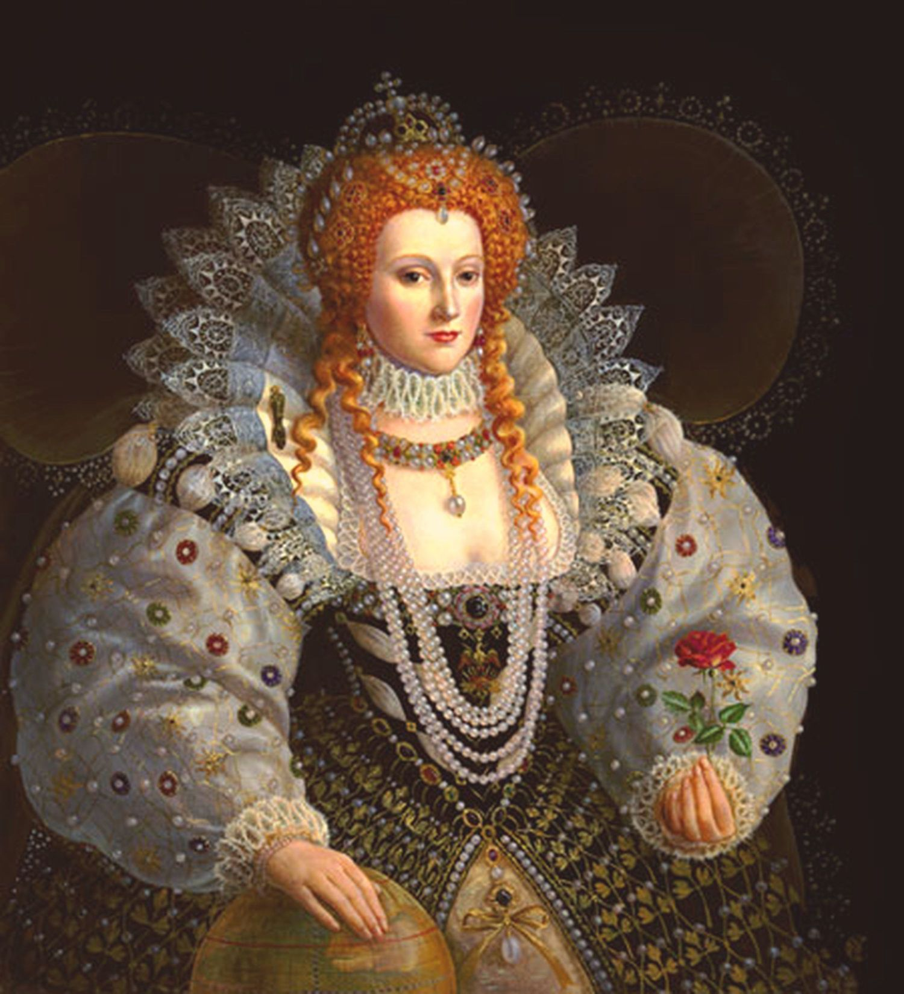
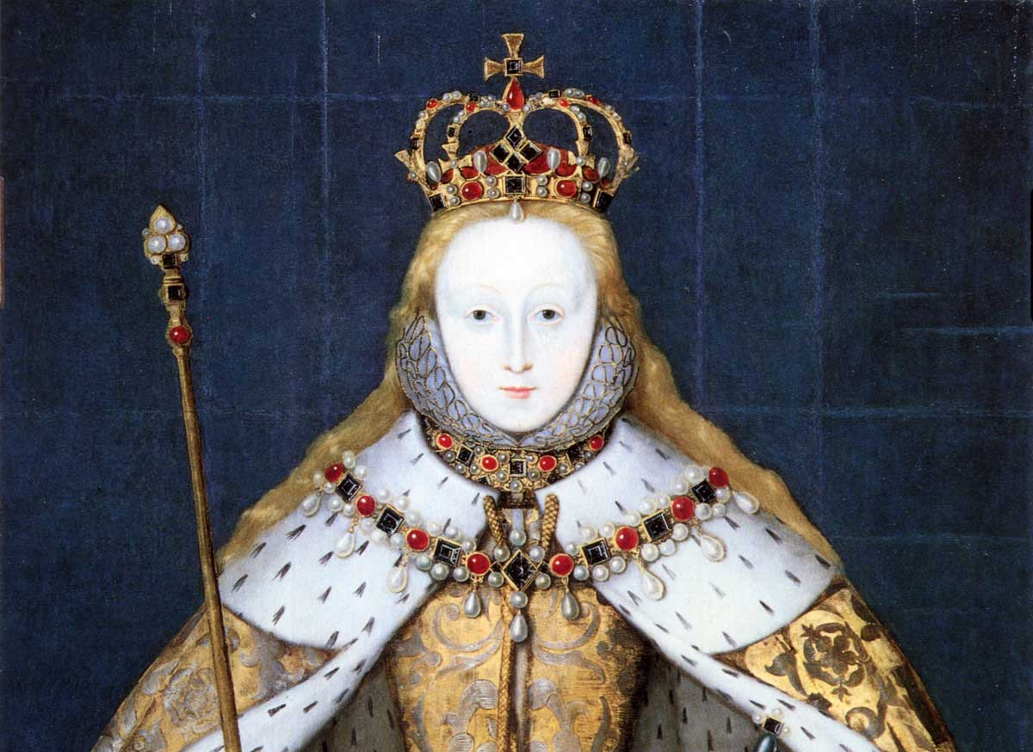
Today we will be drawing a portrait of Queen Elizabeth I
Around 1600 (400 years ago!)

Slide 3

Step 1
Draw a faint oval. You will go back over this later after you have drawn the hair.

Slide 4
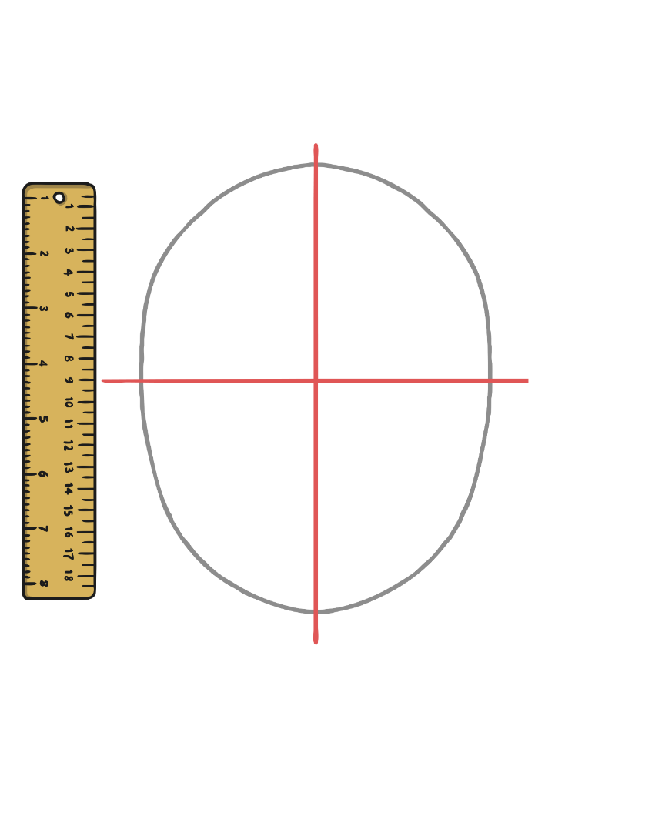
Step 2
Mark some very faint guide lines with a pencil and ruler.

Slide 5
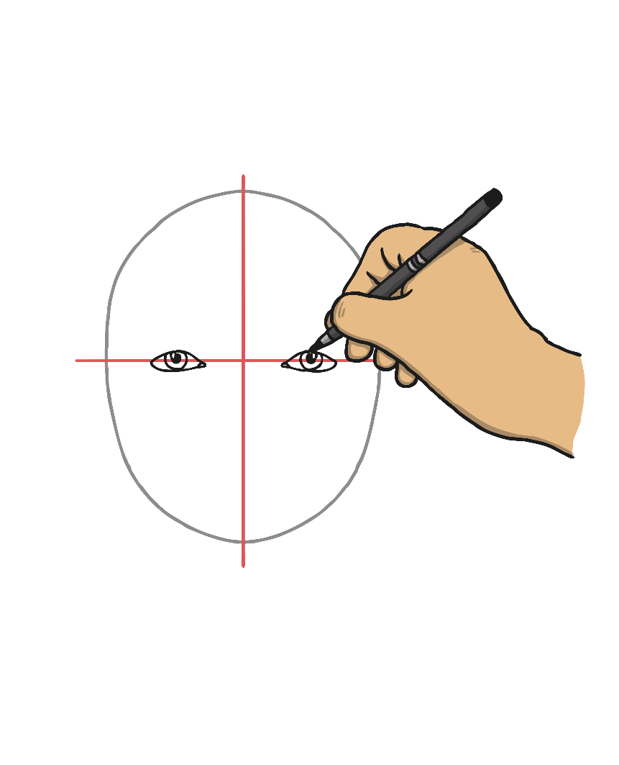
Step 3
Draw the eyes.
Don’t forget eyelashes!

Slide 6
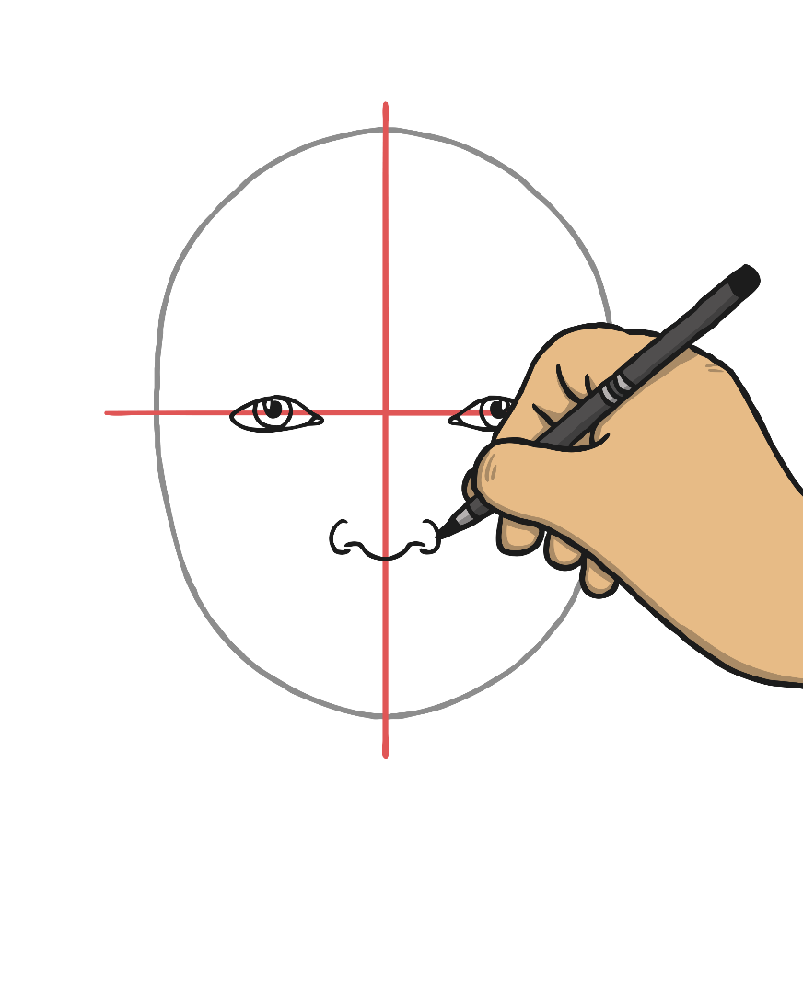
Step 4
Draw the nose.

Slide 7
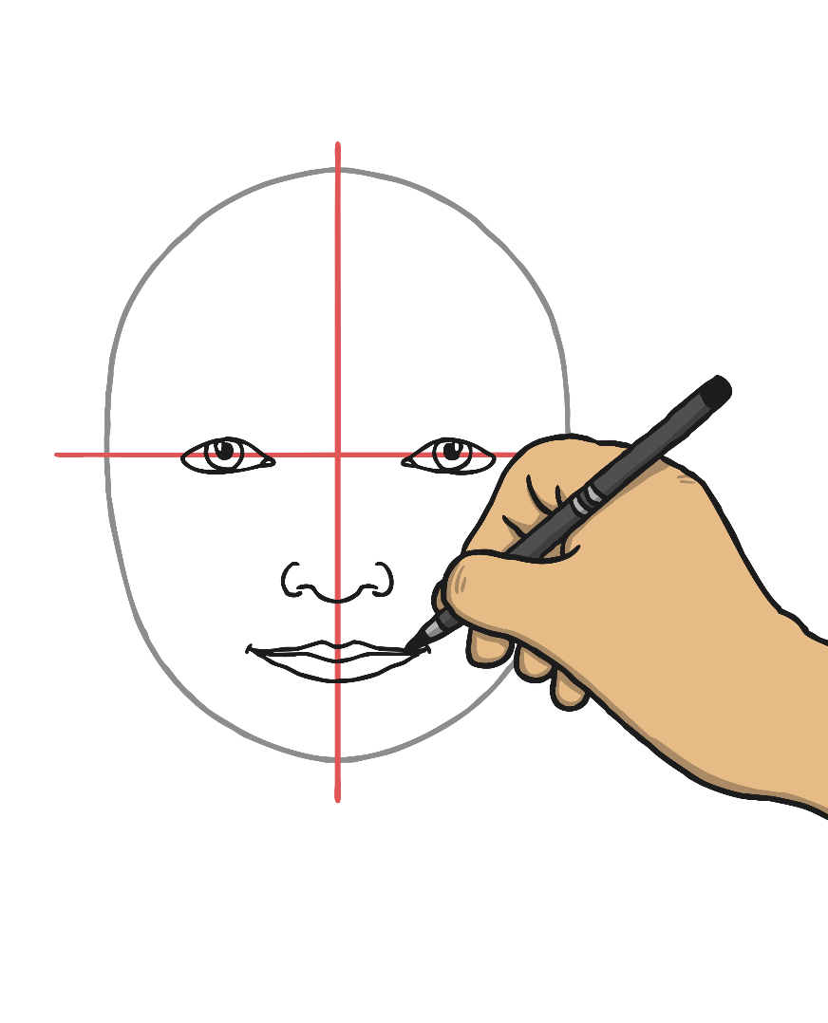
Step 5
Draw the mouth.

Slide 8
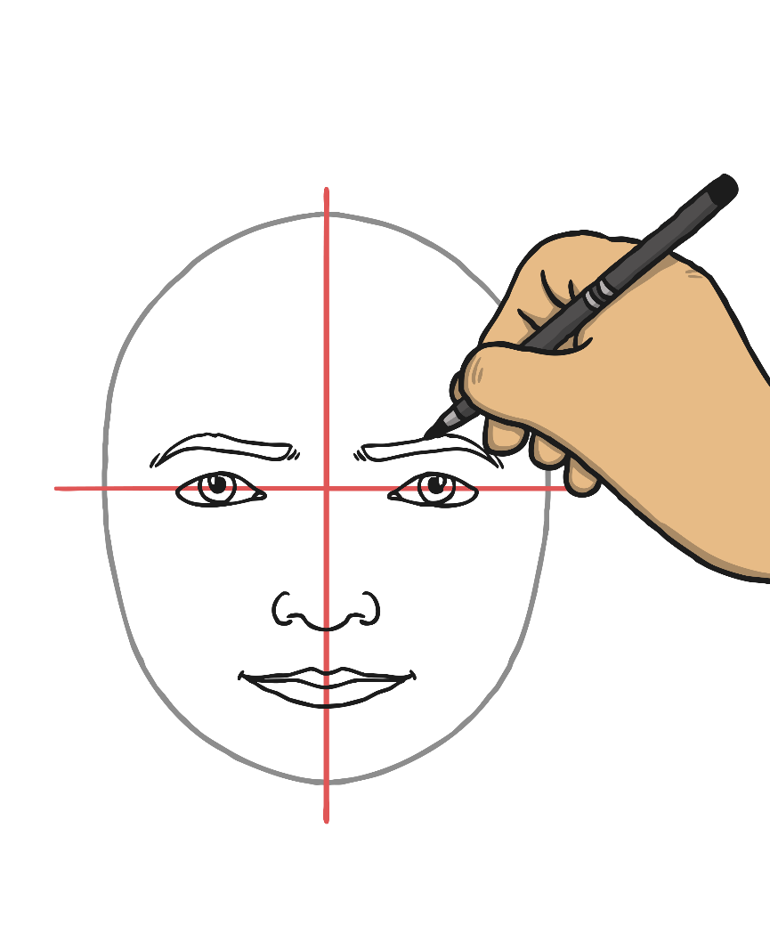
Step 6
Draw the eyebrows.

Slide 9
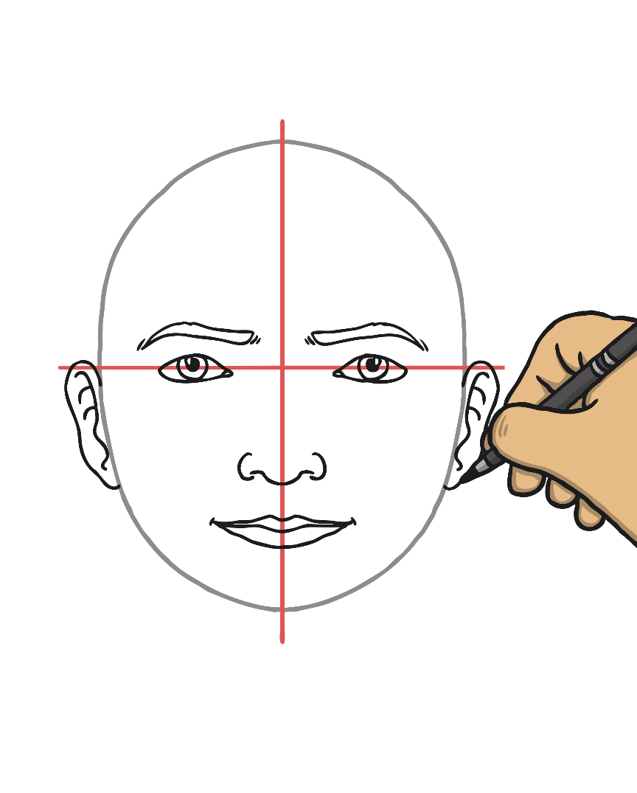
Step 7
Draw the ears.

Slide 10
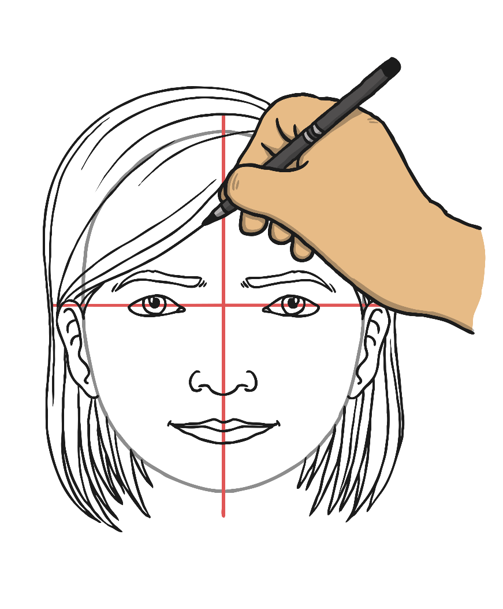
Step 8
Draw the hair and hair accessories.

Slide 11
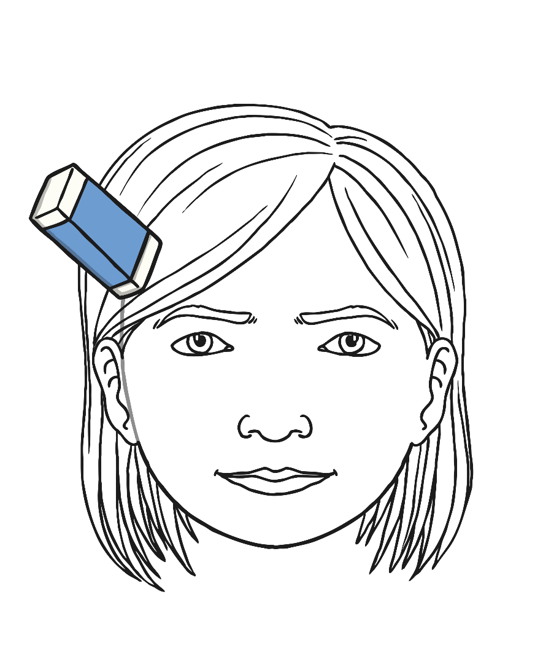
Step 9
Go over the lines of the oval that isn't covered by hair. Erase the faint guide lines and the oval lines that are covered by hair.
Do some shading to show lines on the face and blend them using your fingers.

Slide 12
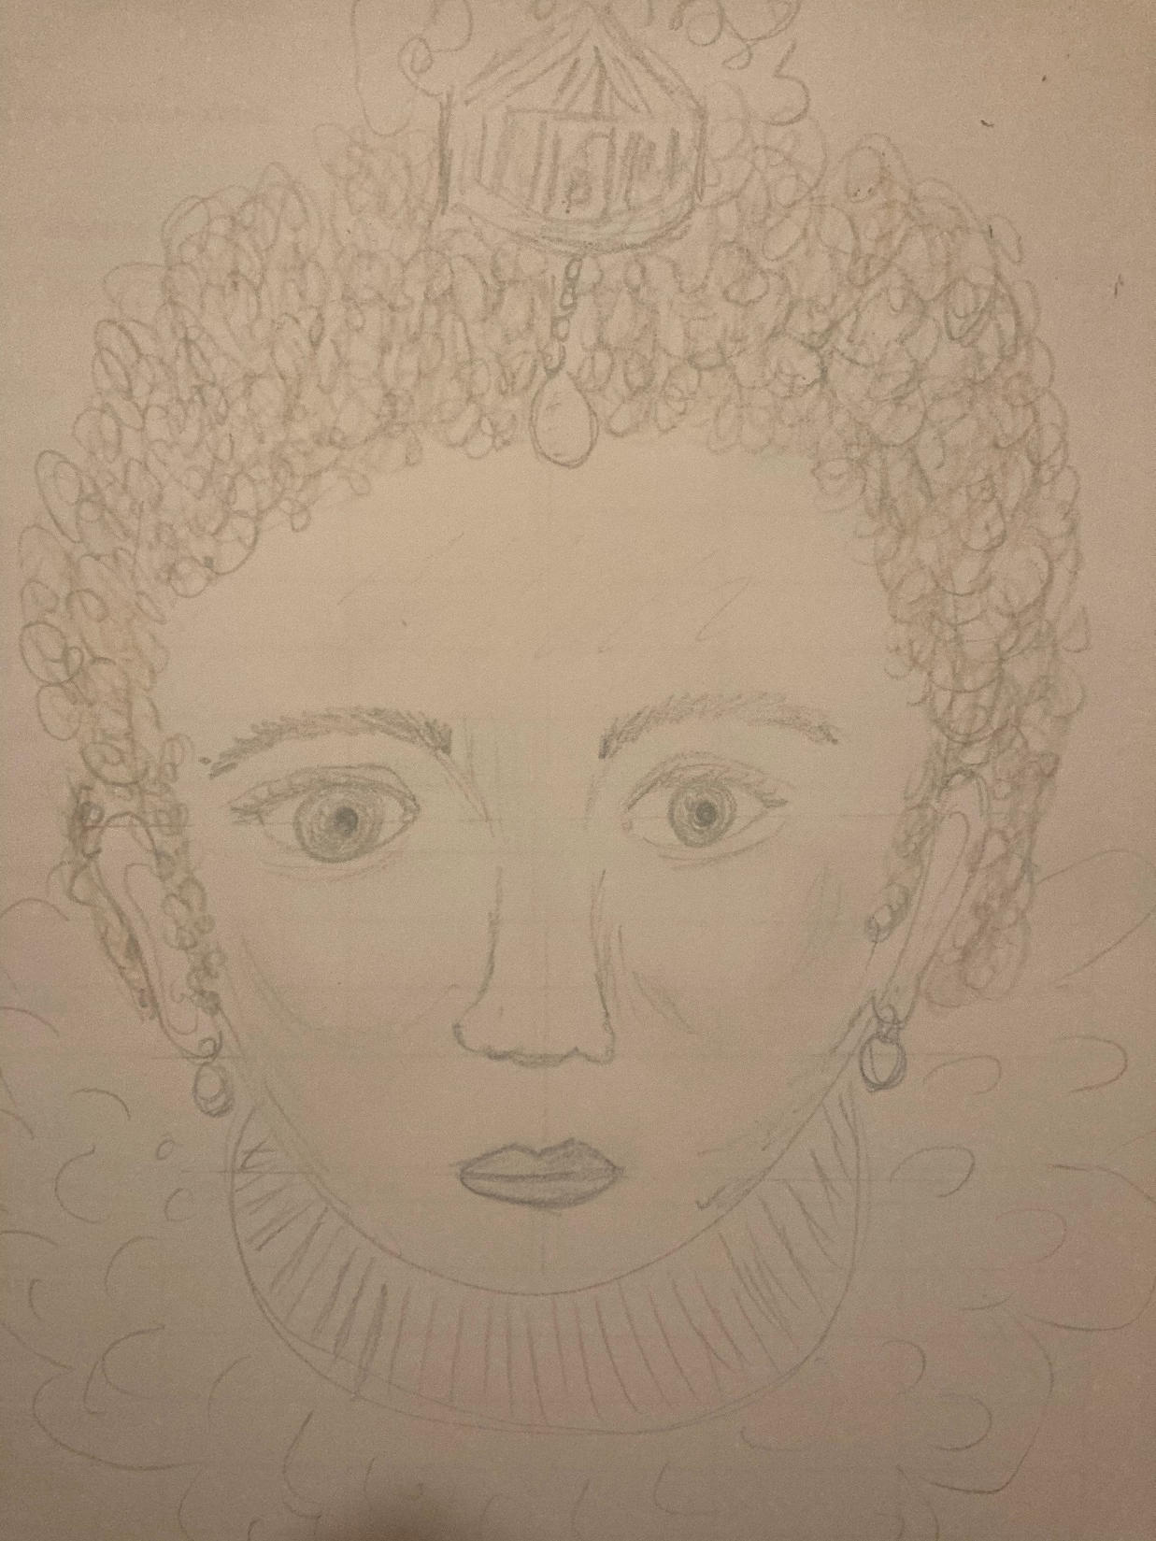
Step 10
Colour in the hair. She had vivid aubourn (orangey / brown) hair and this is the only part you should colour in.
Add in the ruff and lace around the head and neck and any other details like earrings or jewels.

Slide 13
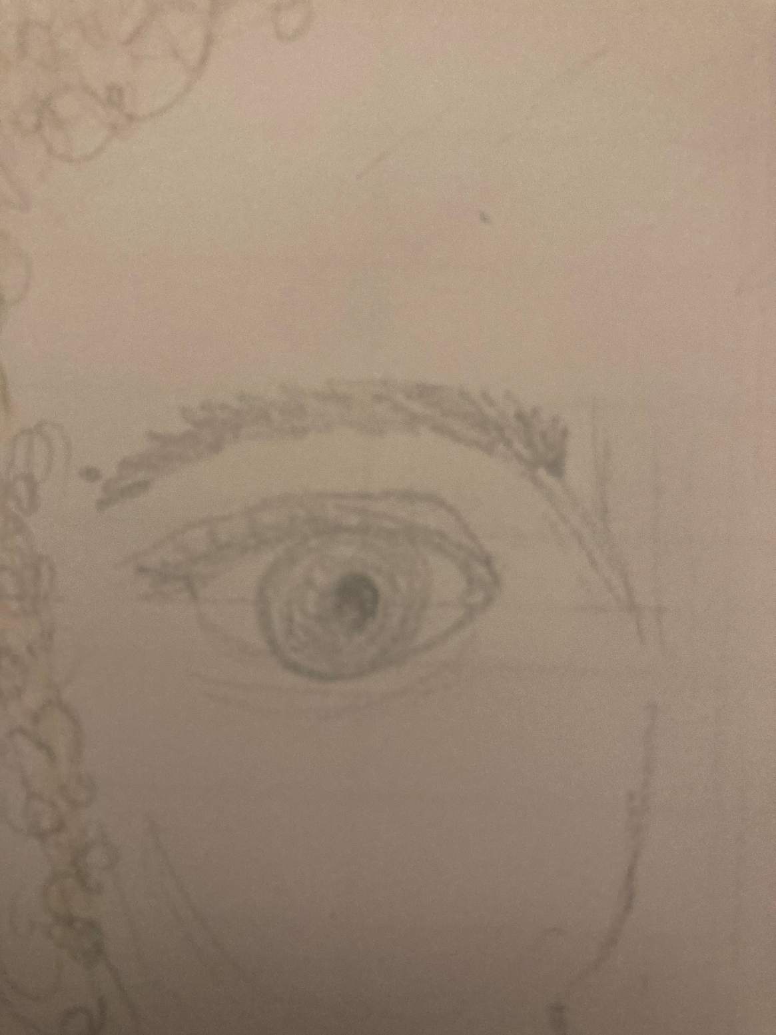
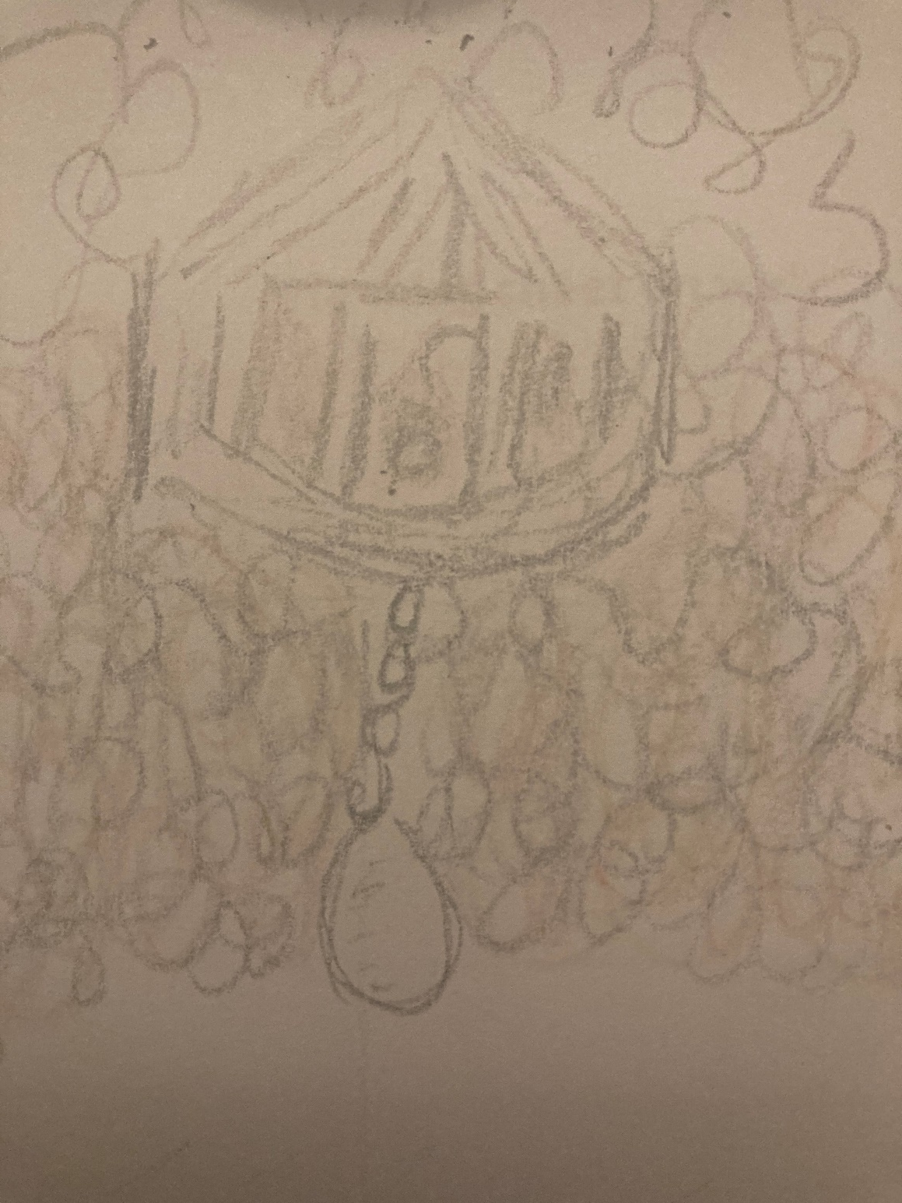
Hair accessories
Eyes and eyebrows

Slide 14
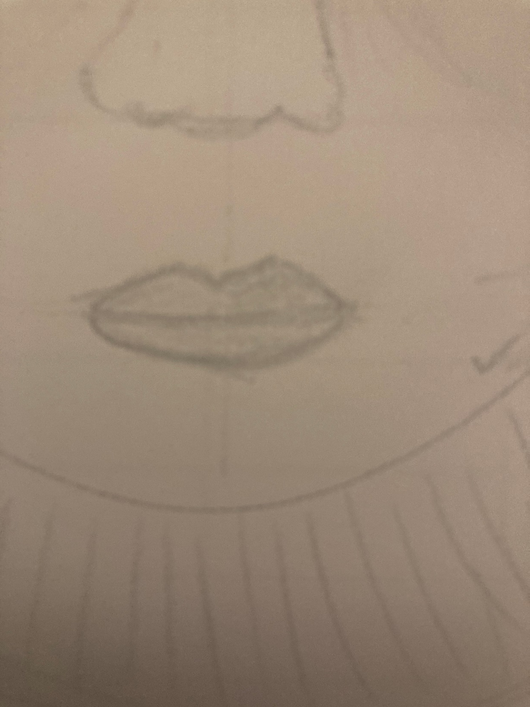
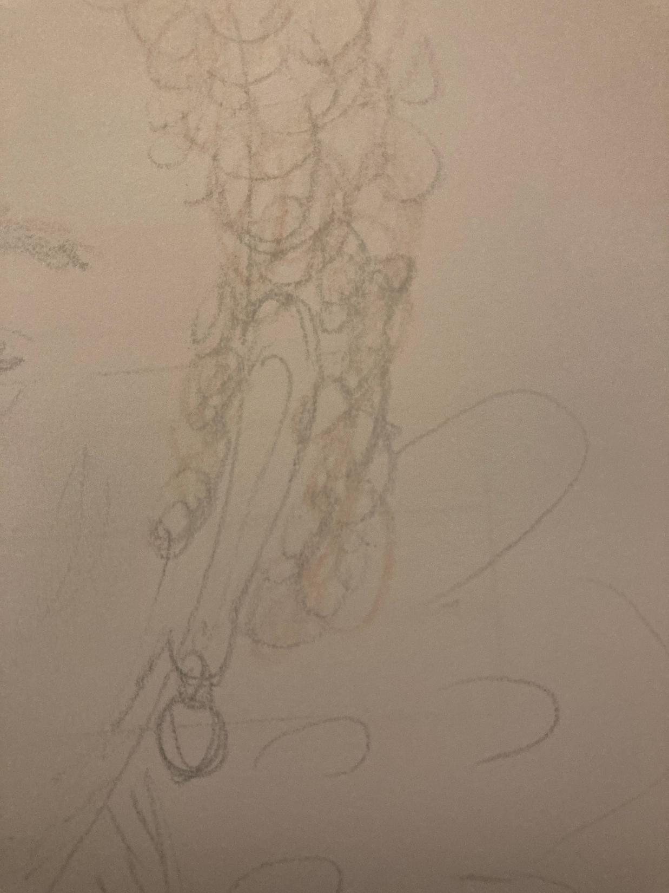
nose and mouth
Ears and earrings

