Slide 1









Slide 2
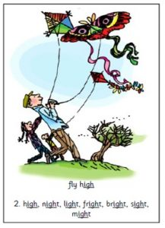
Our Set 3 phoneme for today is…. igh
might light
high
night
sight
fright
bright

Slide 3
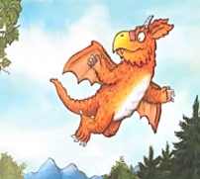
Wednesday 10th March
L.O. To order events that happen in ‘Zog’.
To write a sentence for each event.

Slide 4
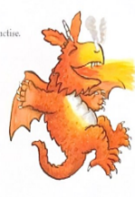
We will read again part of our book ‘Zog’.
We want to find out what skill Zog learnt in each year of Dragon School.
Dragon school starts at Year 1 and ends at Year 5.

Slide 5
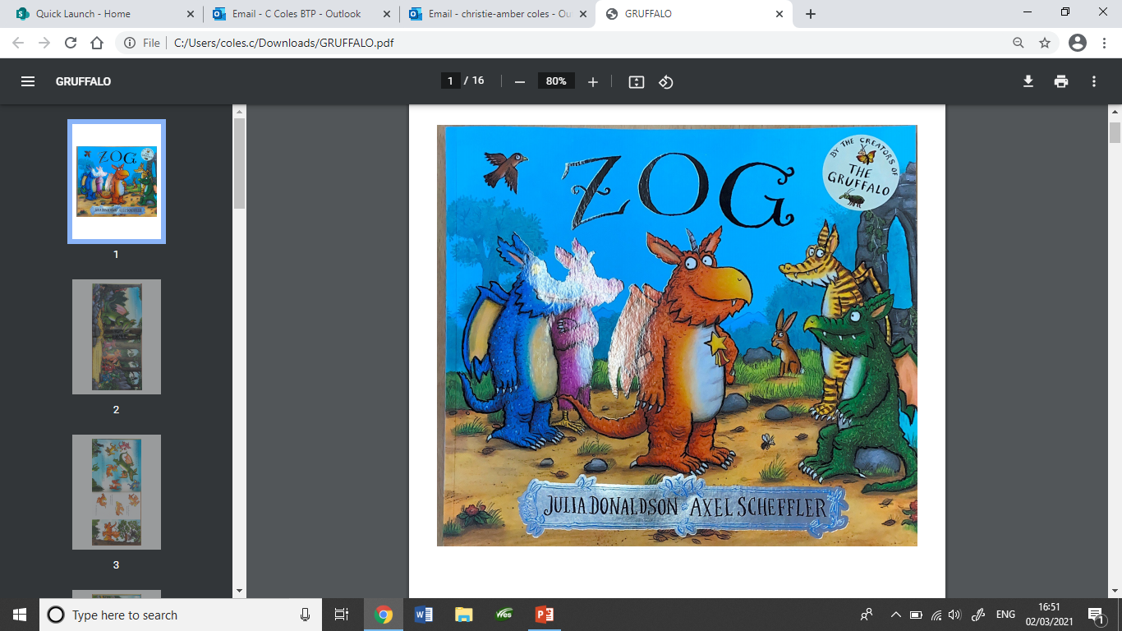

Slide 6
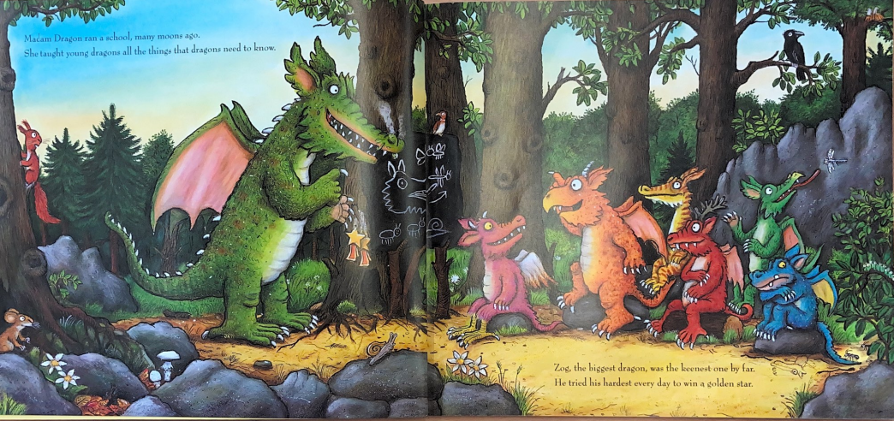

Slide 7
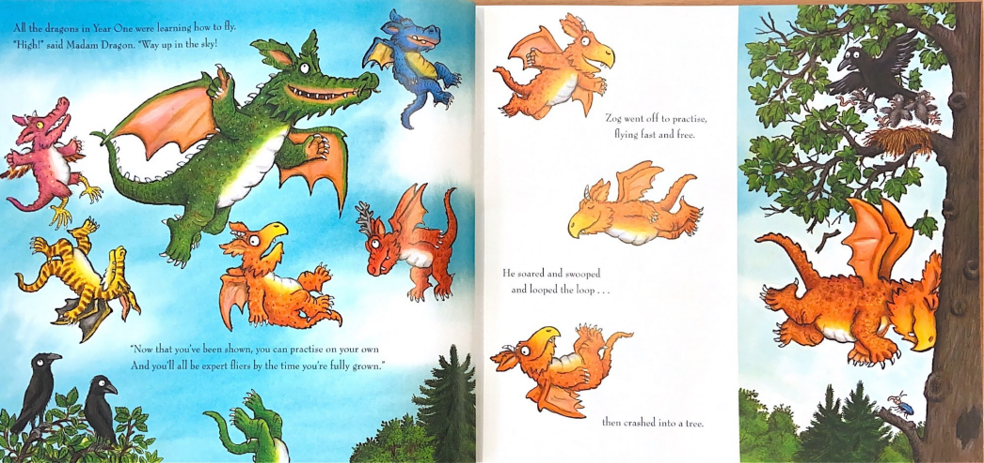

Slide 8
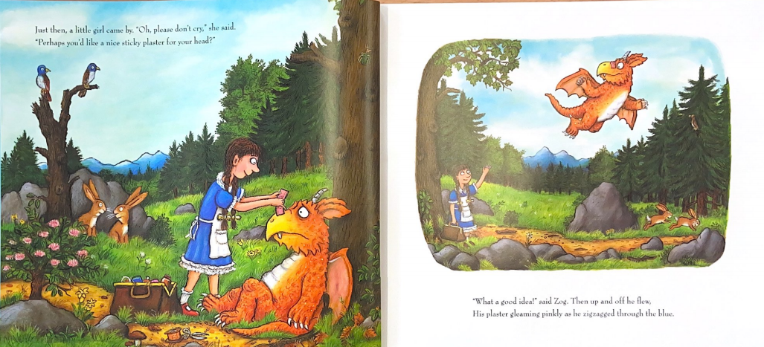

Slide 9
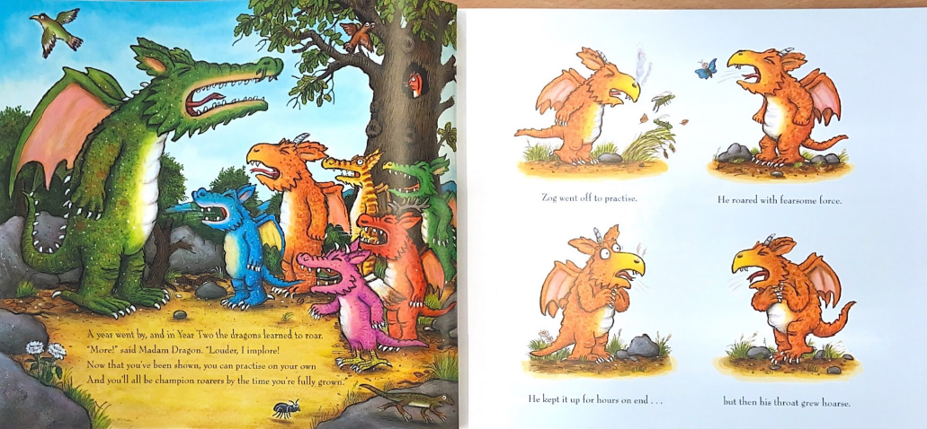

Slide 10
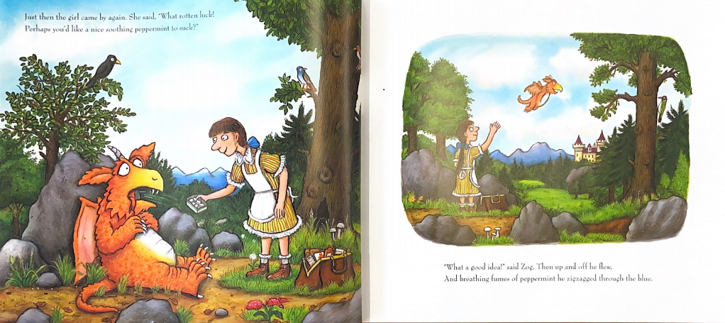

Slide 11
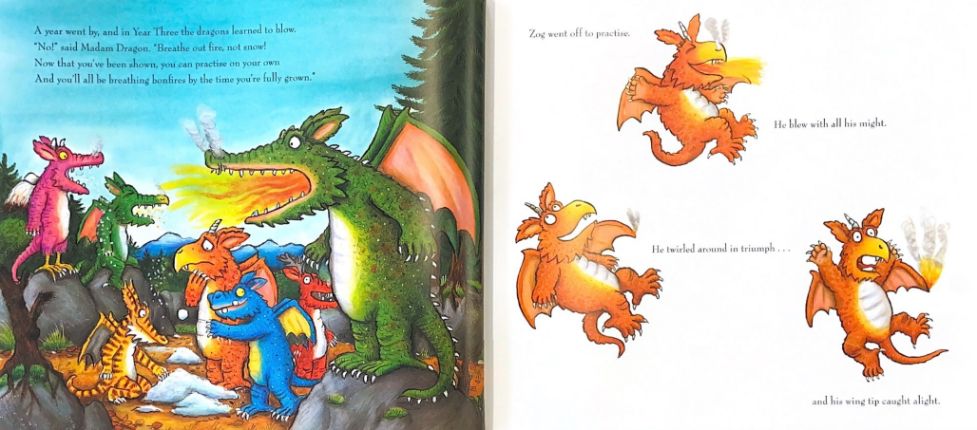

Slide 12
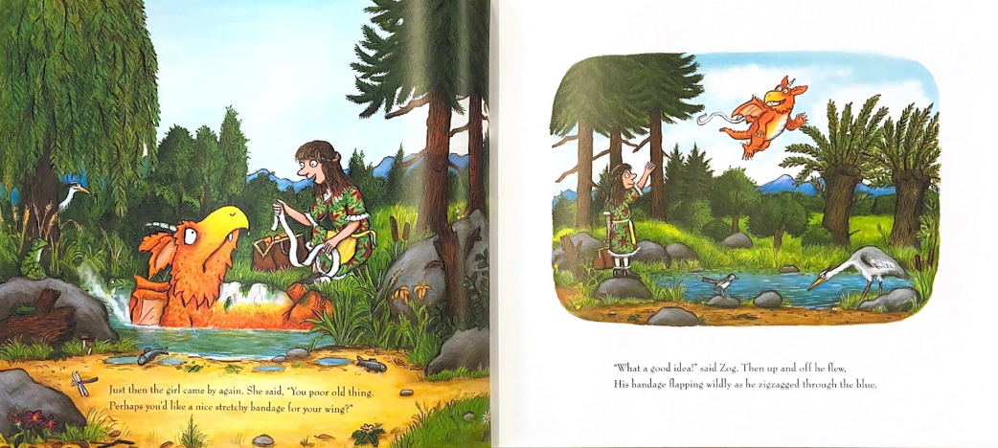

Slide 13
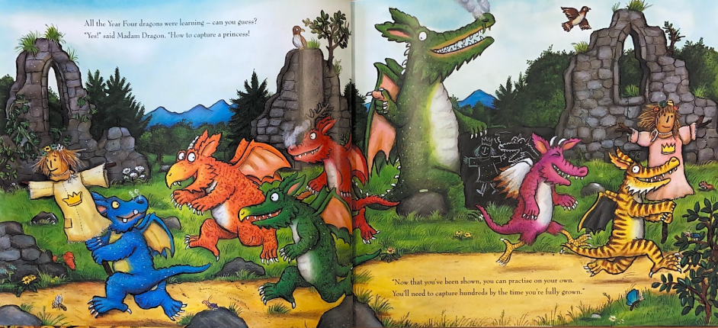

Slide 14
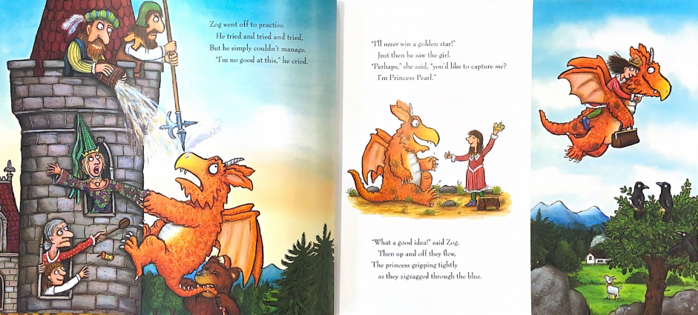

Slide 15
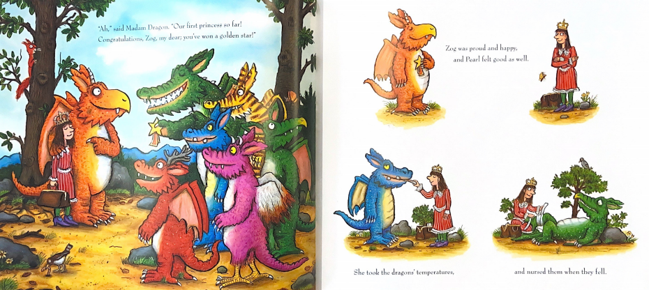

Slide 16
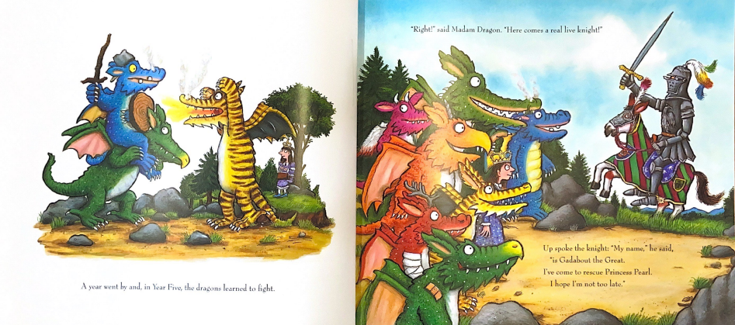

Slide 17
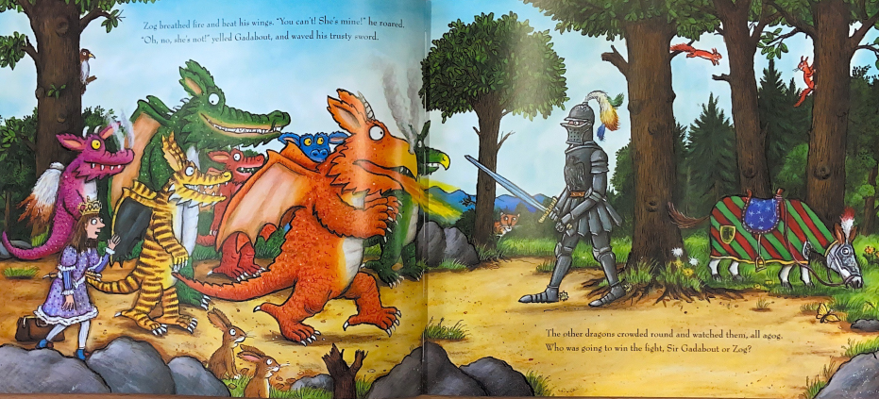

Slide 18
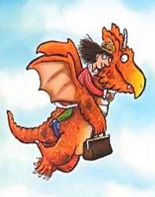
Your task
To match the pictures to the correct school Year.
To write a sentence for what skill Zog has learnt in each Year.
Options for recording
Use the following powerpoint slide. Reorder the pictures under the school Years. Add a text box under each picture and type the skills Zog learnt.
Print off the powerpoint slide. Cut and stick the pictures and write a sentence to say what skills Zog learnt each Year.
Use the Word doc format. Either print off or edit the Word doc.

Slide 19
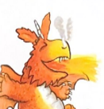
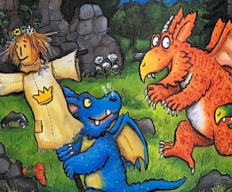
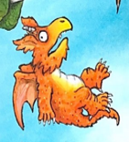
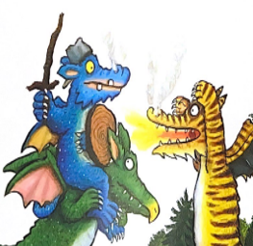
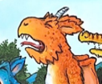
In Year 1 Zog learnt…
In Year 2 Zog learnt…
In Year 3 Zog learnt…
In Year 4 Zog learnt…
In Year 1 Zog learnt…

Slide 20
Pictures for using in class.

