Slide 1




Slide 2

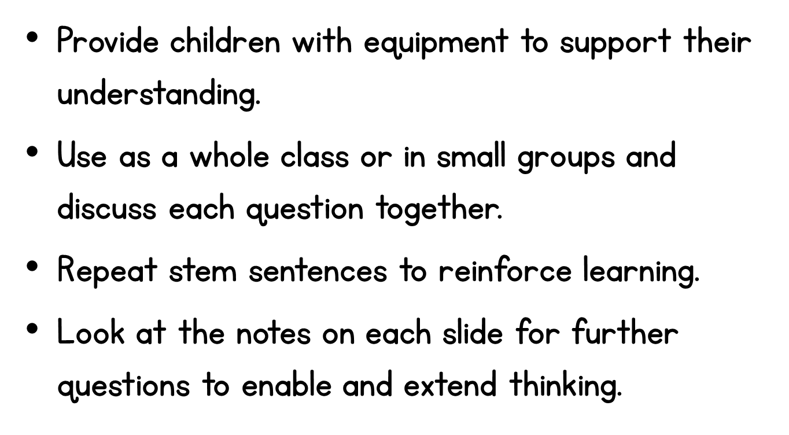

Slide 3


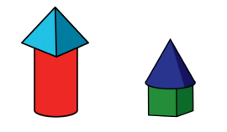
Notes:
Do both objects line up at the bottom?
Do both objects line up at the top? Which object reaches the top line?
Is it important that the objects line up to measure? Why? Why not?

Slide 4
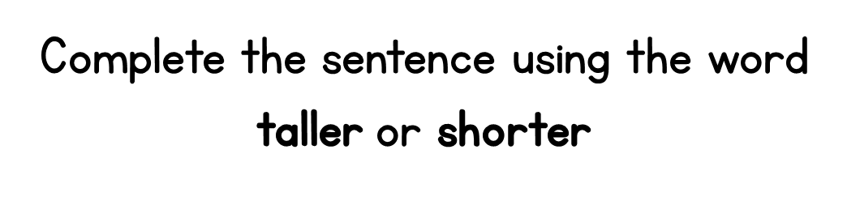
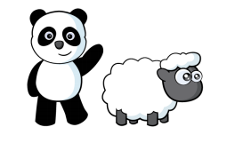


Notes:
Do both objects line up at the bottom?
Do both objects line up at the top? Which object reaches the top line?
Is it important that the objects line up to measure? Why? Why not?

Slide 5

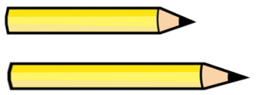

Notes:
What makes this question more difficult?
Would it be easier if you could line up the pencils?
How did you know the middle pencil was the longest?

Slide 6

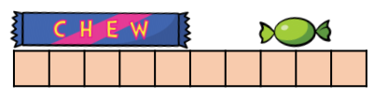

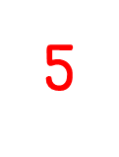


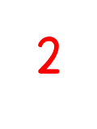
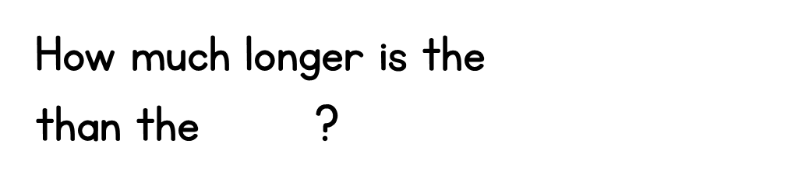
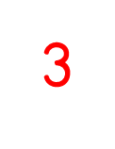
Notes:
Is measuring using squares easy?
Do all of the squares have to be the same size? Why? Why not?
Did Dexter need to place the chew and the sweet in a specific spot?
Why is it helpful to line up the squares with the start of the object?

Slide 7


Notes:
How can you prove it is shorter?
Can there be different correct answers?

Slide 8

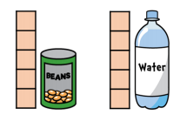




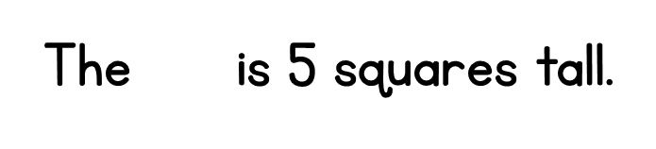

Notes:
Why is it important to line up the bottom of the squares with the bottom of the item being measured?
How many squares would both the can and the bottle be?

Slide 9

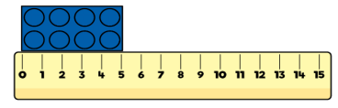
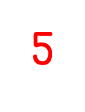




Notes:
What is the same and what is different when measuring with a ruler and measuring with blocks?
What does cm mean?
Why do you NOT line up the object you are measuring with the end of the ruler?

Slide 10


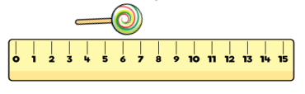

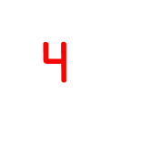


Notes:
Why could you make the mistake and think it is 7cm long?
How could you correct the mistake?
Can you still figure out how many cm long the lolly is just by looking?

