Slide 1
Tuesday 2nd fEBRUARY 2021
LO: To write a diary from the view of the kapok tree.

Slide 2

Writing a Diary Entry
When you write a diary entry, you are writing about a day in the life of a real person or character.
The diary entry has to sound as if the person or character has written it, so it needs to be written from their point of view.
It also needs to be exciting
and interesting to read.
To get this right,
just follow a few easy steps...

Slide 3
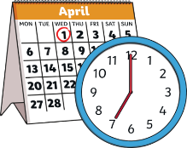
Diary Writing Must...
include the date and/or time
The date or time can be written at the top of the page like this...
Tuesday 2nd February
Dear Diary,
First, I woke up at 5am and heard the sound of the animals waking and birds singing. I rustled my long branches and I saw my green leaves moving in the warm breeze.
Then, I noticed something strange below me…

Slide 4
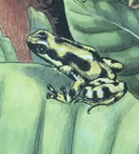
Diary Writing Must...
use the words
‘I’, ‘my’, ‘we’ and ‘our’
These words are special because they tell us the diary is being
written by someone and they are talking about themselves.
We call this kind of writing ‘first person’. Look at these two examples. Which one uses the correct words to be written in ‘first person’?
I looked around my rainforest home.
When the tree frog climbed up me, I felt his tiny feet on my thick bark . First person!
First person!
She looked around her rainforest home.
When the tree frog climbed up her, she felt his tiny feet on her thick bark. Not first person!
Not first person!

Slide 5
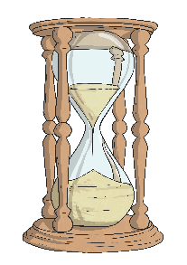
Diary Writing Must...
be written in the past tense
When we write a diary, we write in the past tense.
This is because we are writing about something that has
already happened.
Look at the sentence below. How would you change it into the past tense?
I can not sleep very well as I am so excited about seeing the animals today! I wake up at 5am and look around me…
I could not sleep very well as I was so excited about seeing the animals today! I woke up at 5am and looked around me…

Slide 6

Diary Writing Must...
use time linking words, e.g. ‘next’, ‘first’ and ‘then’
A diary is usually describing lots of events.
To make sense of when these events happened it is helpful to include time linking words, such as ‘next’, ‘first’ and ‘then’.
If we just use one word, such as ‘and’ to link the events in our diary it can get very boring!

Slide 7
Diary Writing Must...
write as if you were there
When we write a diary, we have to make
the reader think we were really there.
We can do this by including lots of detail and description.
What extra detail and description could you add to make it sound as if it was written by someone who was really there?

Slide 8
Diary Writing Must...
describe feelings
A diary is usually a secret place to write how you feel about what has happened to you in the day.
In a diary, you might include feelings, hopes or fears that you wouldn’t want anyone to know about.
Question: What might the tree feel if it saw someone with an axe?
How might it feel if the man walked away?

Slide 9
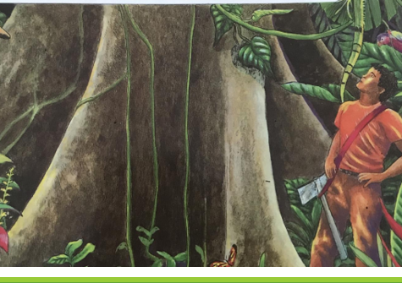
Tuesday 2nd February 2021
Dear Diary,
First, I woke up at 5am and heard the sound of the animals waking and happy birds singing. I waved my long branches and I saw my green leaves wiggling in the warm breeze.
Then, I head a noise. I saw a man below me holding a sharp axe. All around me, the animals and birds had gone quiet. What did he want? We were all scared.
After that, he lay down and fell asleep by my trunk. Slowly the animals came to talk to him. The boa slithered up to him and said I was a tree of miracles! I felt proud.

Slide 10
Your Task
What would the Kapok Tree write in its diary, after the man had come to chop it down?
- What might it see/hear/feel as the day goes on and the animals talk to the man to stop him cutting you down.
- What order did the events happen in? First, Then, Next, After that, Finally.
2) Write your own diary entry as if you were the Kapok Tree. Imagine you are remembering what has happened through the day.
- You don’t have to include every animal, just two or three of your favourite ones!

Slide 11

Use the templates available to write your diary. Add an exciting picture of what happened.

Slide 12
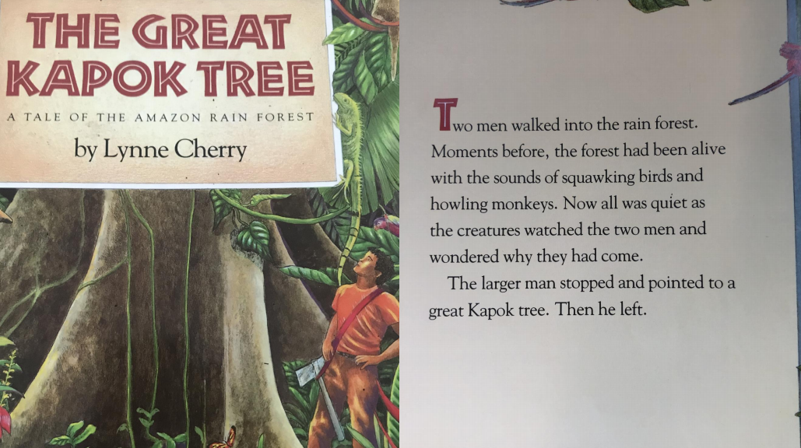

Slide 13
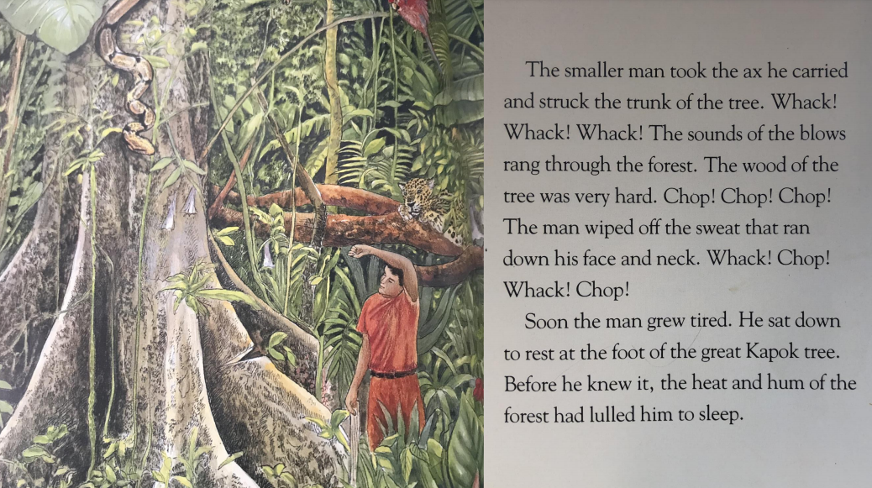

Slide 14
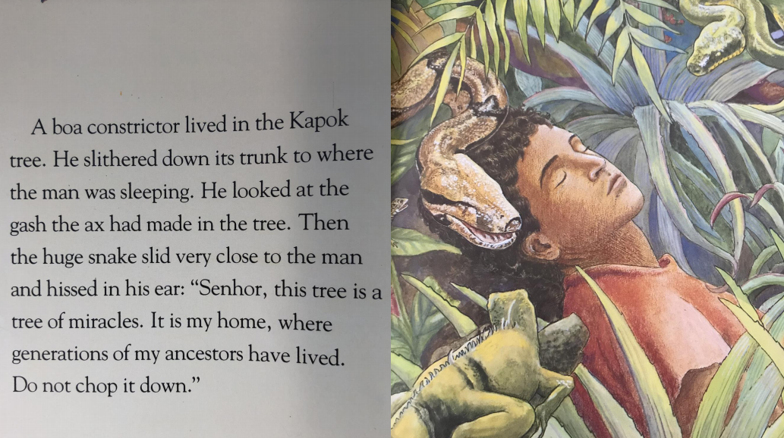

Slide 15
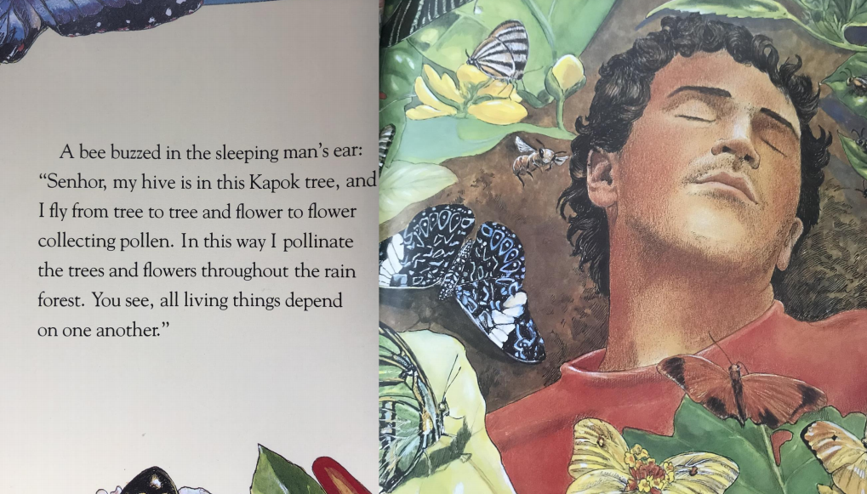

Slide 16
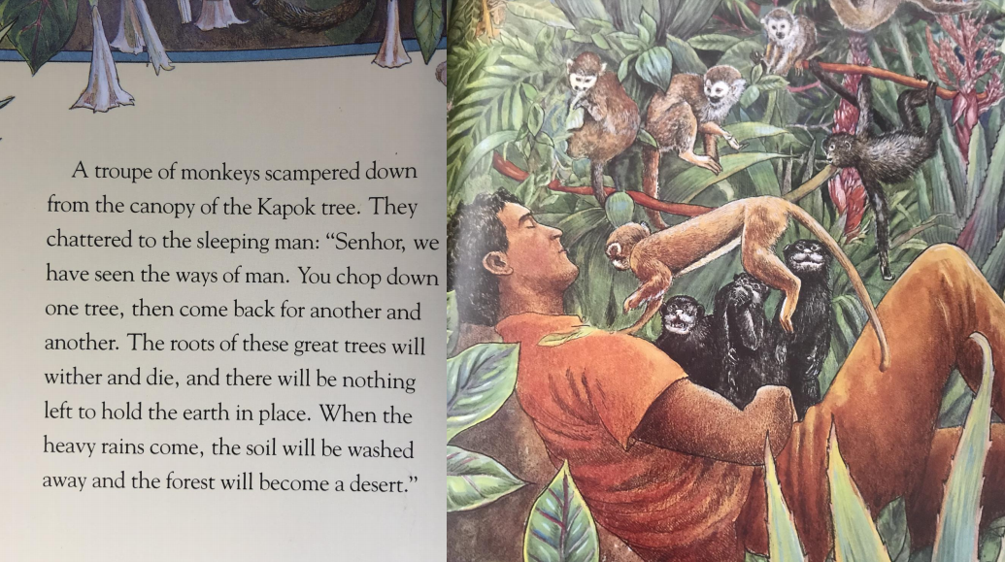

Slide 17
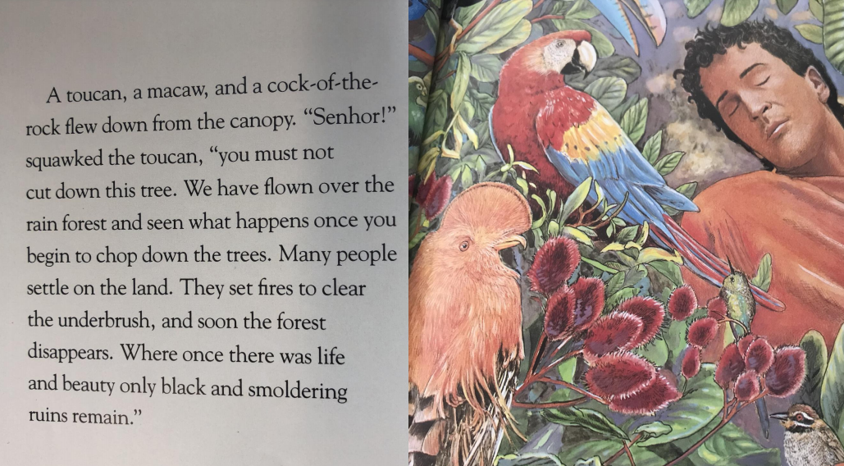

Slide 18
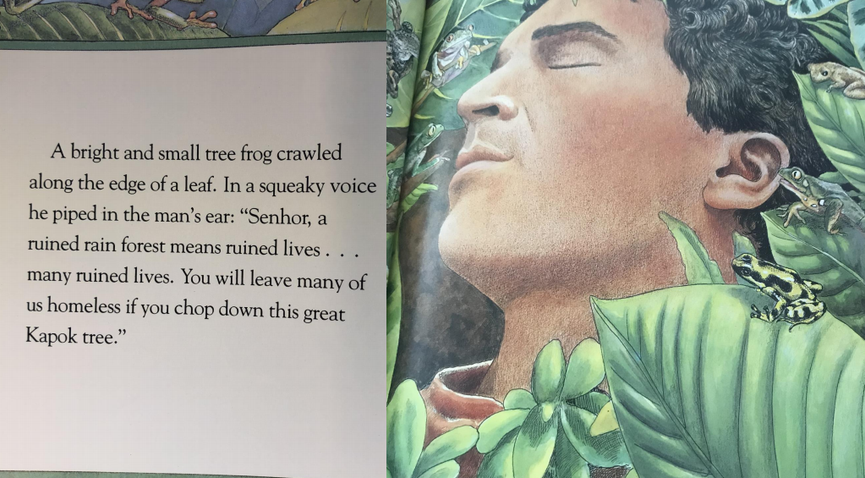

Slide 19
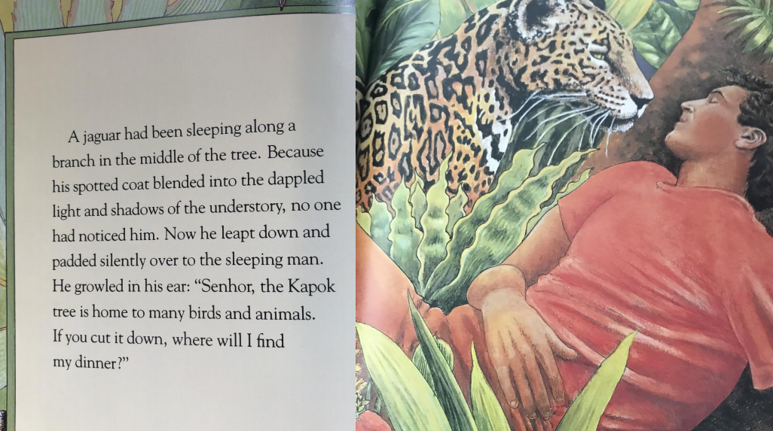

Slide 20
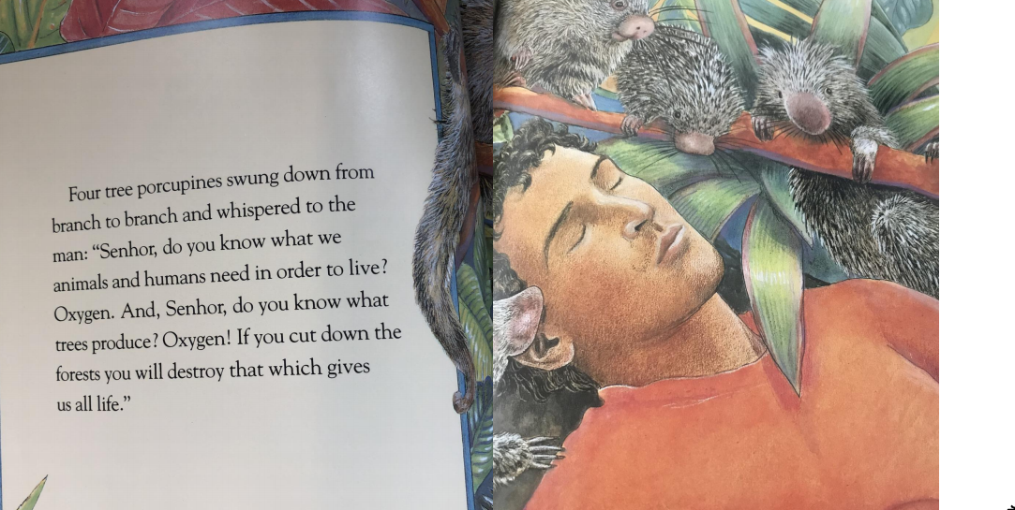

Slide 21
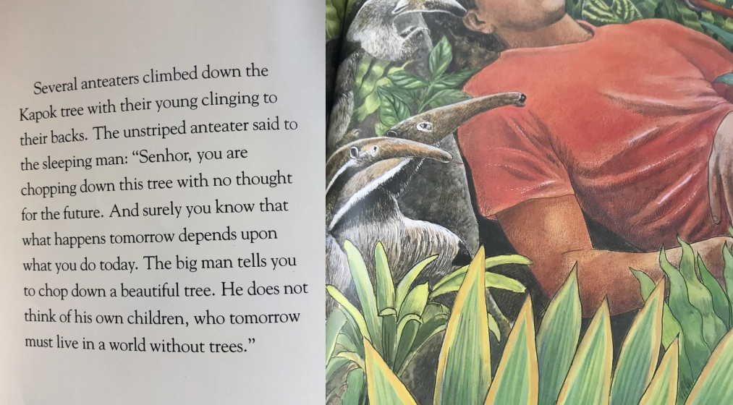

Slide 22
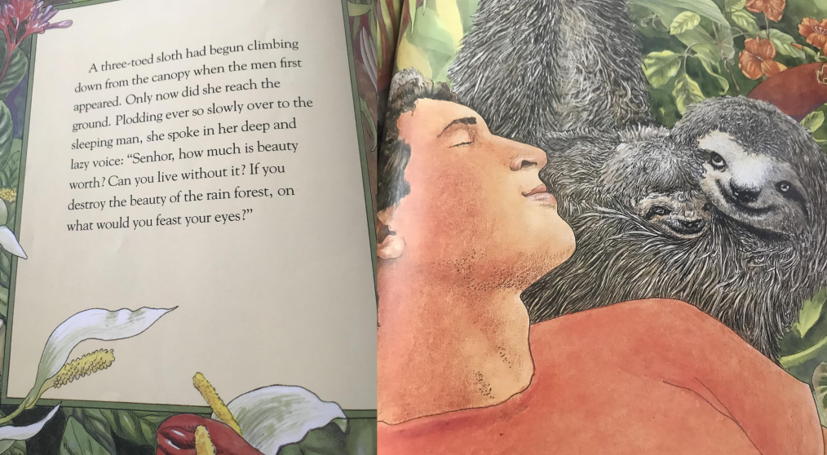

Slide 23
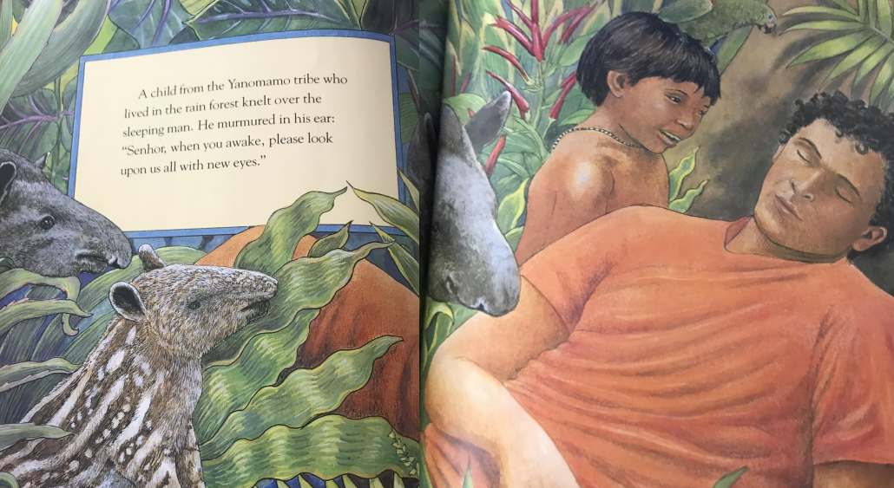

Slide 24
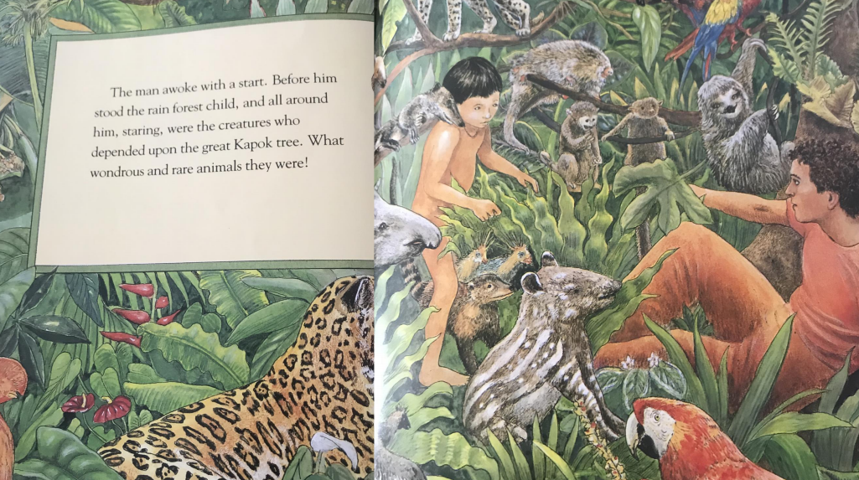

Slide 25
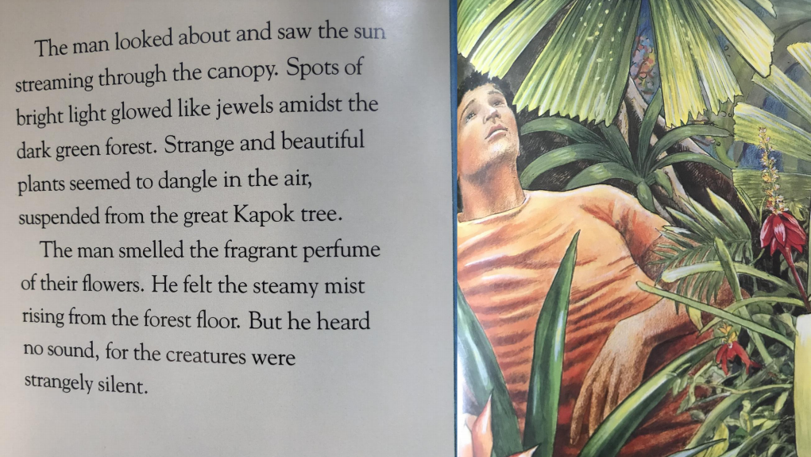

Slide 26


