Slide 1

?
What do you think this book is going to be about?
?
Do you think it is fiction or non-fiction?
?
Who might the main characters be?

Slide 2
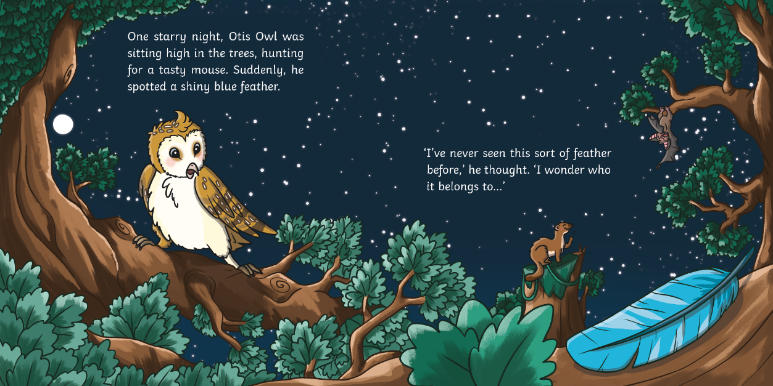
?
Why is Otis Owl awake at night-time?

Slide 3
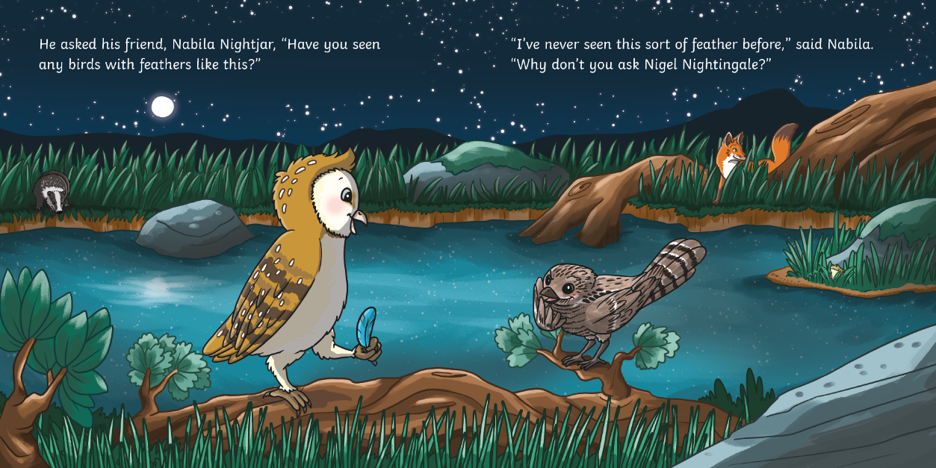
?
What do you notice about the feathers on Otis Owl and Nabila Nightjar? What sort of colours are they?

Slide 4
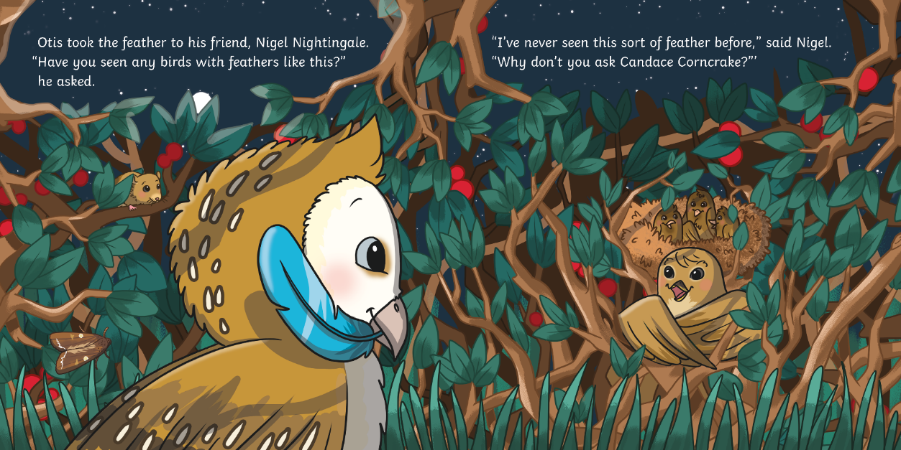
?
Do you think Candace Corncrake will have the answer?

Slide 5
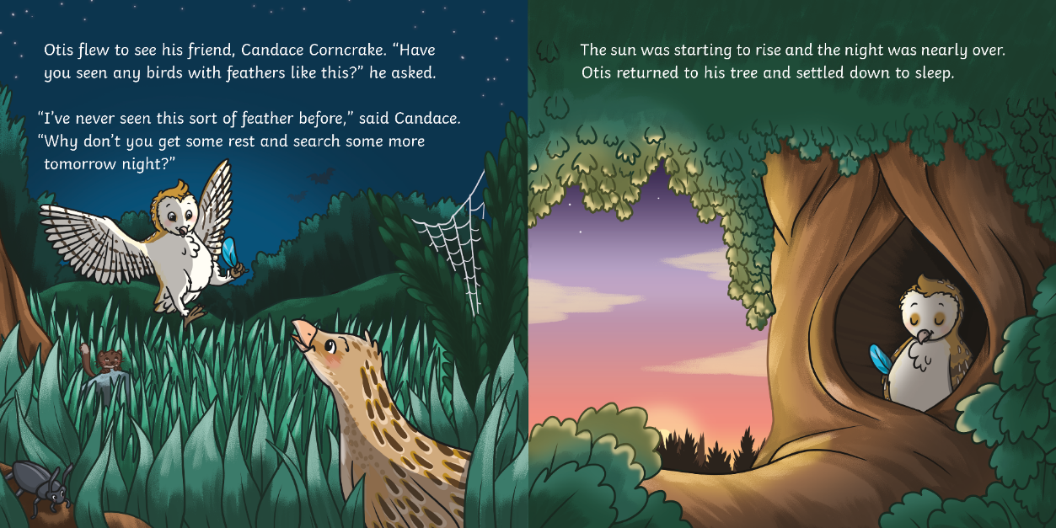
?
How does Candace know that it’s nearly time for Otis to go to sleep?

Slide 6
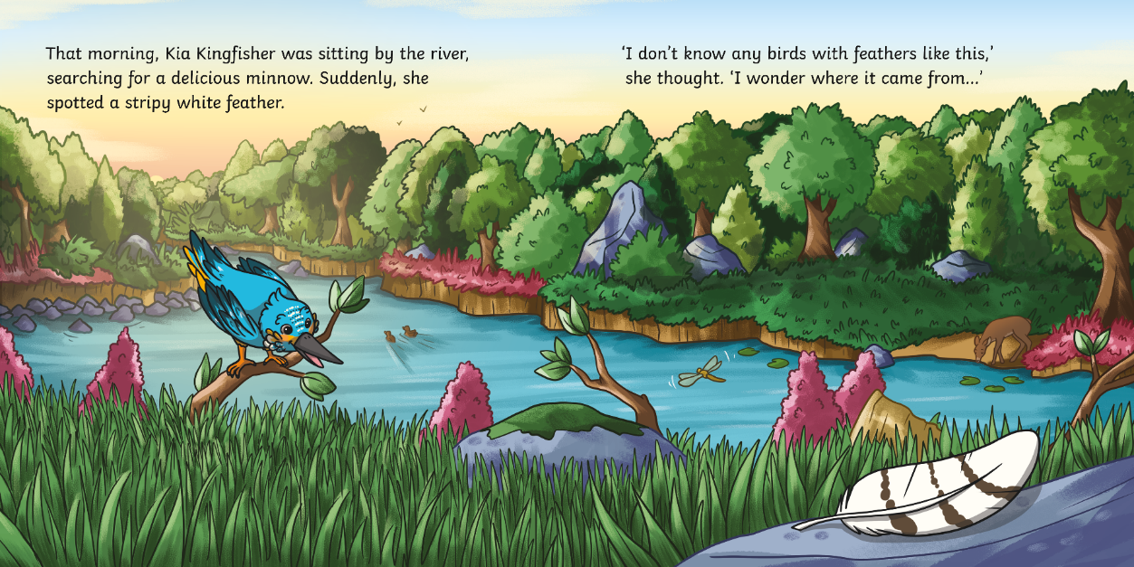
?
What do you notice about Kia Kingfisher’s feathers?

Slide 7
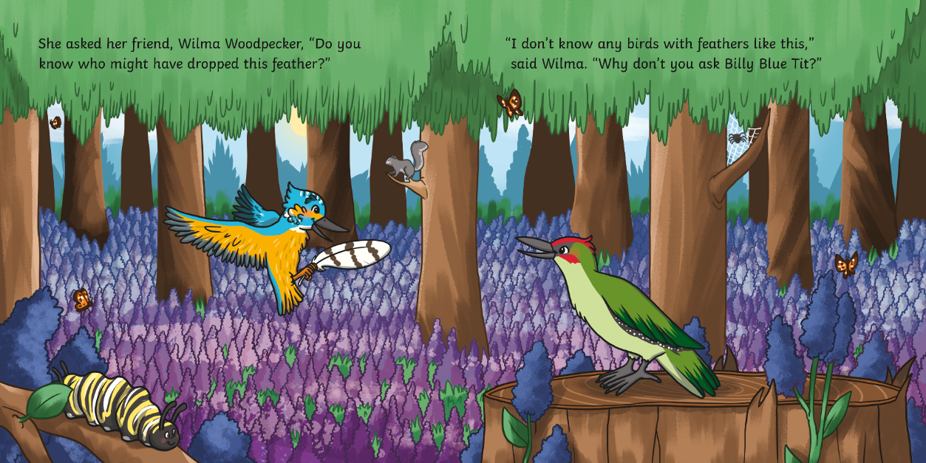
?
Who do you think might have dropped the feather?

Slide 8
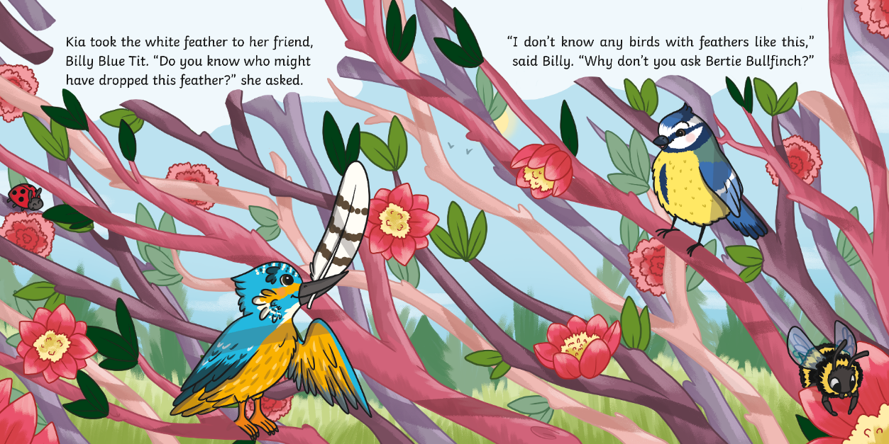
?
Why do you think Kia and her friends have never seen a feather like this before?

Slide 9
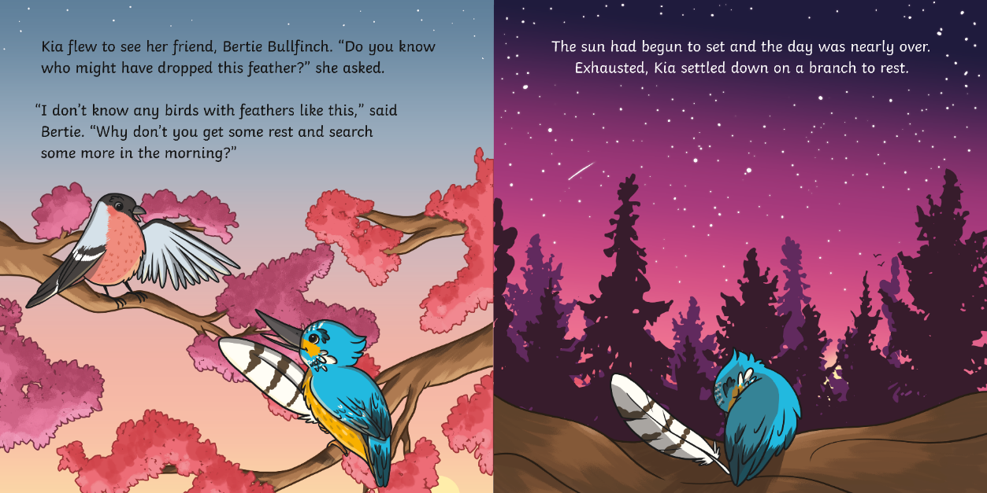
?
Can you think of another word that means the same as ‘exhausted’?

Slide 10
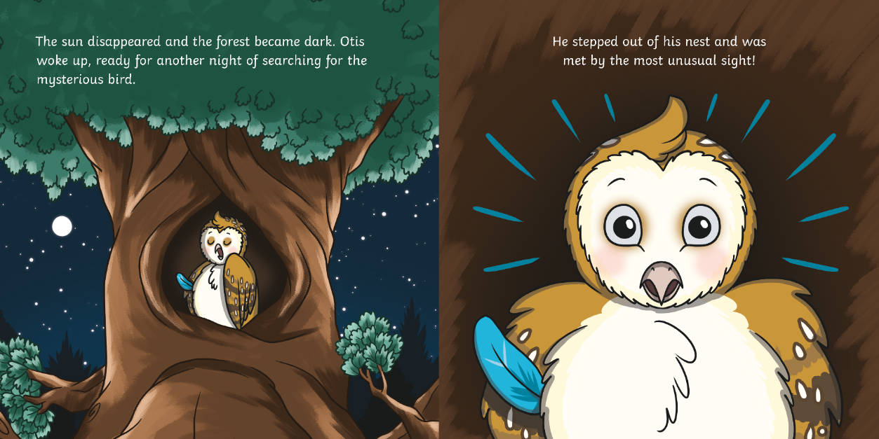
?
What do you think Otis can see?

Slide 11
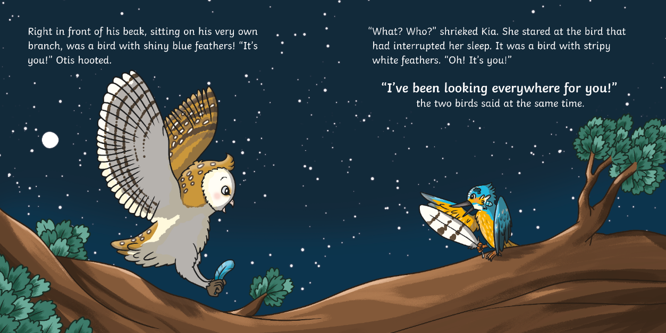
?
How do you think Kia and Otis feel when they first meet?

Slide 12
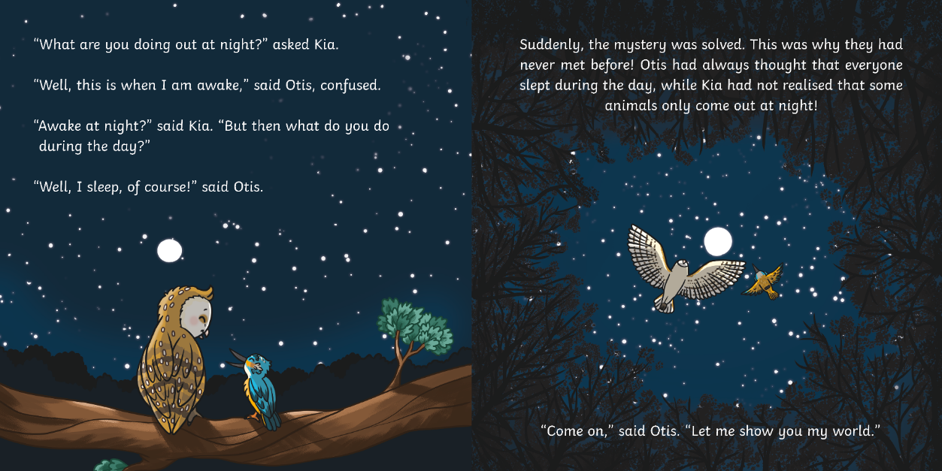
?
Can you explain why Otis and Kia have never met before?

Slide 13
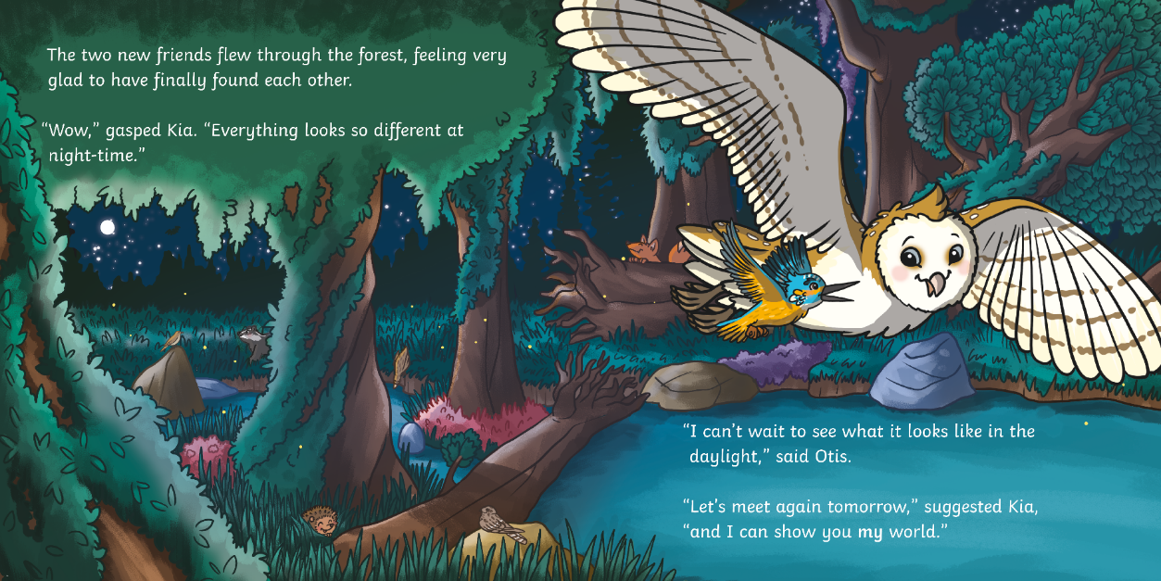
?
Why do you think everything looks different at night-time for Kia?

Slide 14
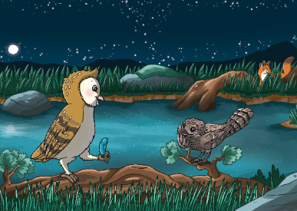
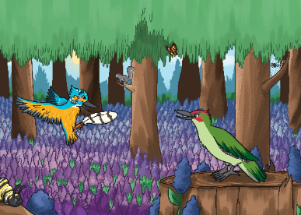
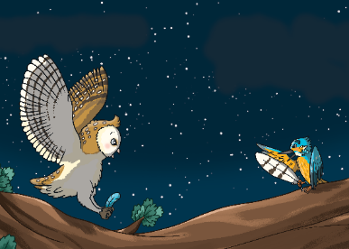
?
Who are the main characters in this story?
Otis Owl and Nabila Nightjar
Kia Kingfisher and Wilma Woodpecker
Otis Owl and Kia Kingfisher

Slide 15
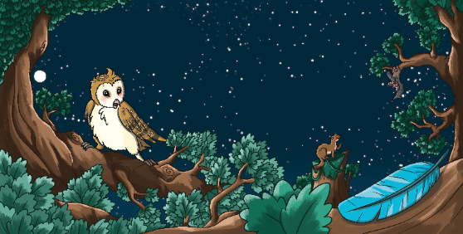

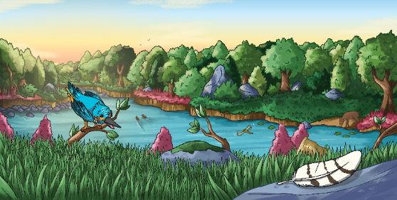
?
What is the problem in the story?
?
How is the problem fixed?

Slide 16
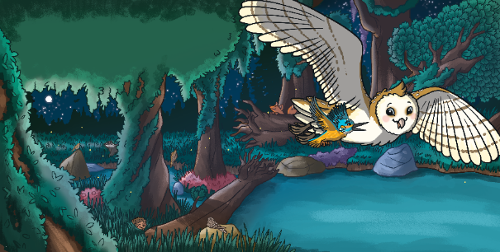


?
Which event happens first?

