Slide 1









Slide 2



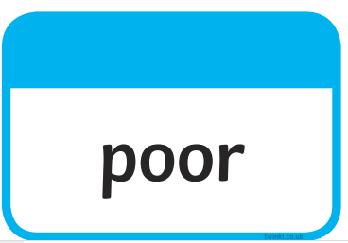




Tricky words…harder!

Slide 3
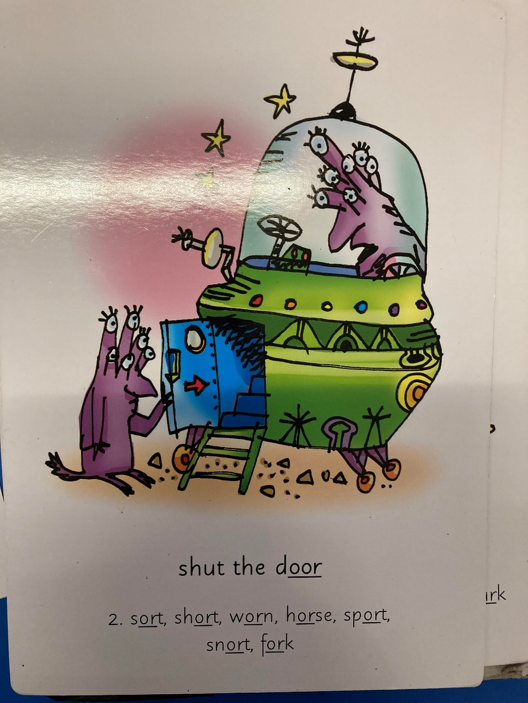
Our Set 2 phoneme for today is….or
snort sport
sort
short
worn
horse
fork

Slide 4
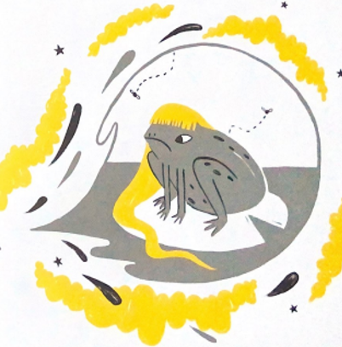
Tuesday 23rd March
Literacy
L.O. To write a recipe (from the witch) for a curse on Rapunzel.

Slide 5
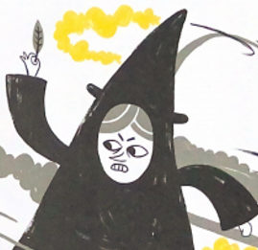
What is the meaning of a curse in our story?
It is a spell that a witch can create to make a bad thing happen to another character.
We are going to pretend to be the witch in our Rapunzel story.
You are going to create your own curse to put on Rapunzel.

Slide 6
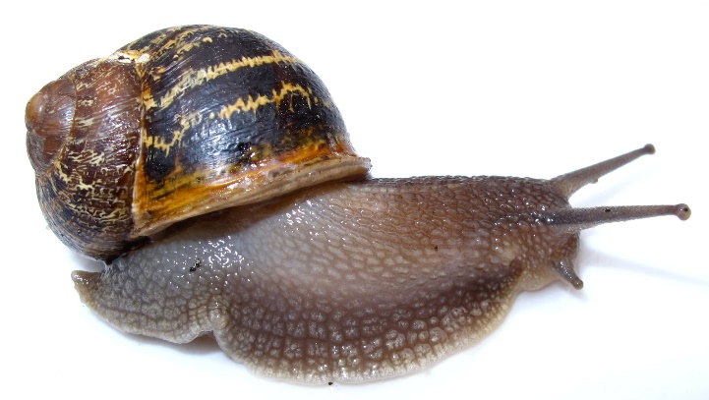
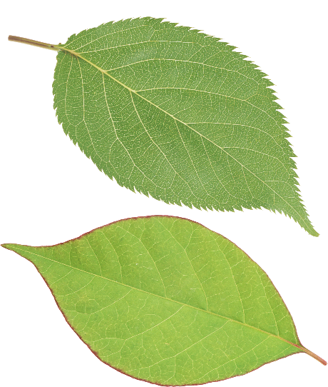
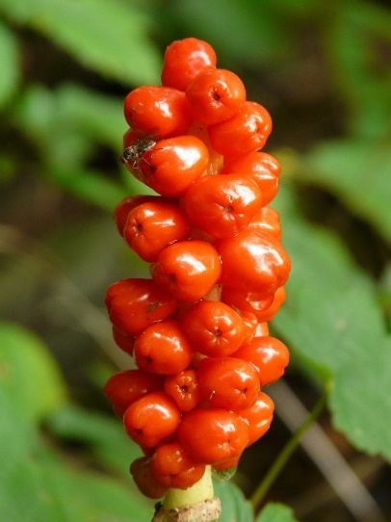
My Witch’s Curse
What will your curse do to Rapunzel?
e.g. It will turn her into a slimy snail!
What ingredient will you need? Make a list.
e.g
Crushed snail shells
Snail slime
Chopped leaves
Poisonous berries

Slide 7
Instructions for how to make the curse
Collect stripy snail shells.
Grind the shells to make a powder.
Throw the powder into the cauldron of hot, muddy water.
Add the snail slime, chopped leaves and poisonous berries.
Boil the potion in the cauldron all night long under a full moon.
Put in a spoon of sugar, so that Rapunzel thinks it is nice and sweet!

Slide 8

What are your magic spell words?
When Rapunzel sips the potion I will say…
Hocus Pocus!
Abracadabra!
Petronas!

Slide 9
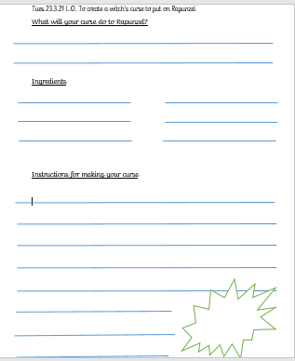
How to record your curse.

Slide 10
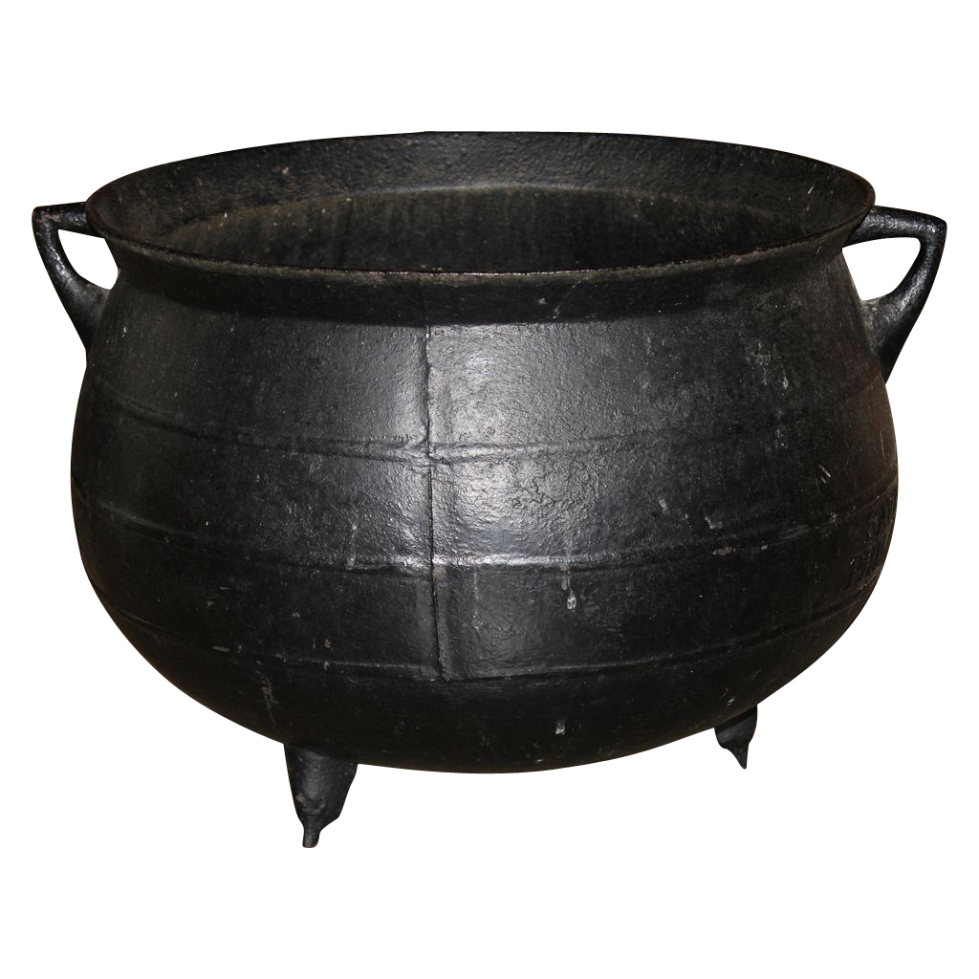
23.3.21
Recording Curse – easier option. Write down the ingredients you will put in your curse.
Write a sentence about what it will do to Rapunzel.

