Slide 1


Slide 3
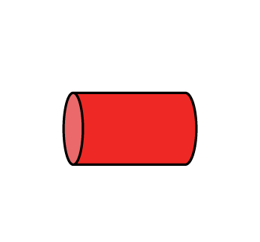
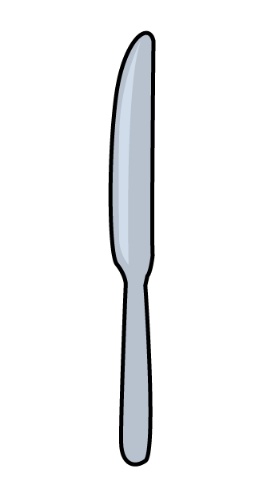
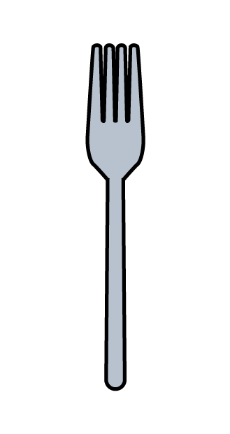

1) What is this shape called?
2) 3 tens =
3) Let’s count in 2s! 0…
4) Which of these has capacity?

Slide 4
1) What is this shape called?
2) 3 tens =
3) Let’s count in 2s! 0…
4) Which of these has capacity?
cylinder
30
2, 4, 6, 8, 10, 12…

Slide 6
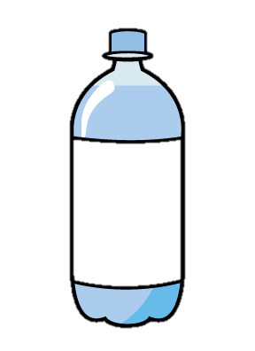
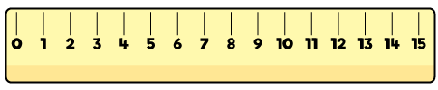
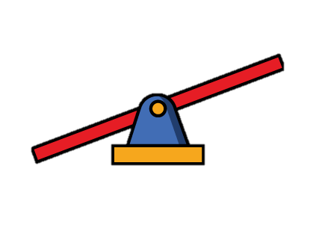
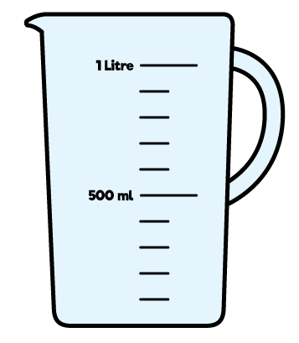
How can we measure capacity?
length
mass
capacity

Slide 7
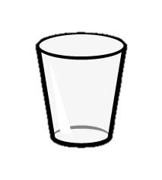

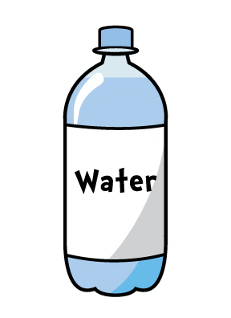
Have a think
How many can a
bottle of water fill?
5

Slide 8

One fills 5
So 5 fills one

Slide 9
If 5 fills one
Have a think
How many would 15 fill?
3

Slide 10
Have a go at question 1 on the worksheet

Slide 11

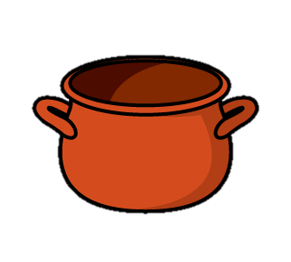



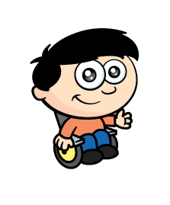

What is the capacity of the pot?
Have a think
1
6
6
2
3
4
5

Slide 12
Why is this incorrect?
Have a think
1
6
6
2
3
4
5

Slide 13
What is the correct way to measure capacity?
?
1
6
6
2
3
4
5

Slide 14
Have a go at question 2 on the worksheet

Slide 15


How many does it take to fill…?
3
12
6

Slide 16
Have a think
3
12
6
How many does it take to fill ?
It takes 2 3 + 3 = 6

Slide 17
Have a think
3
12
6
How many does it take to fill ?
It takes 2 6 + 6 = 12

Slide 18
Have a think
3
12
6
How many does it take to fill ?
It takes 4 3 + 3 + 3 + 3 = 12

Slide 19
Have a go at question 3 on the worksheet

