Slide 1
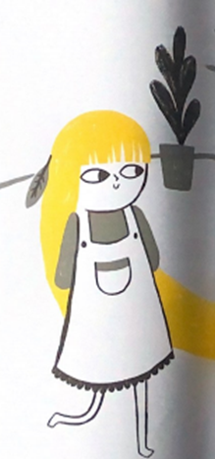
What would Rapunzel daydream about doing when locked up in the tower? 24.3.21
L.O. Write from a character’s viewpoint.

