Slide 1


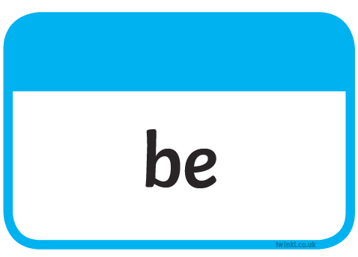
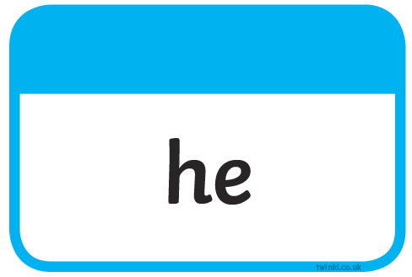



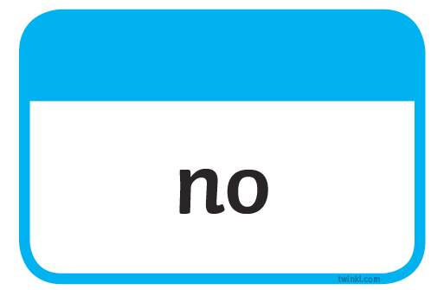

Slide 2



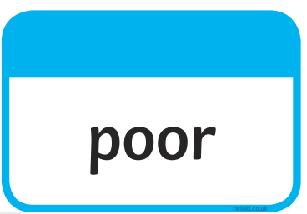
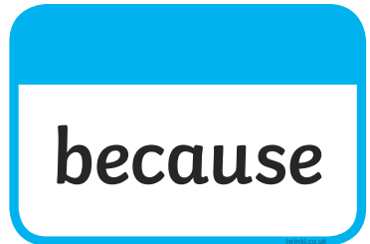

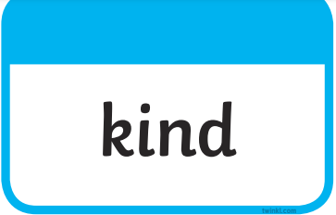
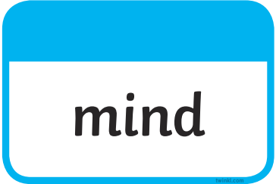
Tricky words…harder!

Slide 3
LO: To write from a character’s point of view.
Wednesday 24th March 2021

Slide 4


Slide 5


Slide 6
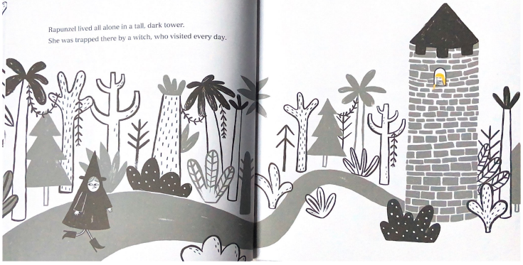

Slide 7
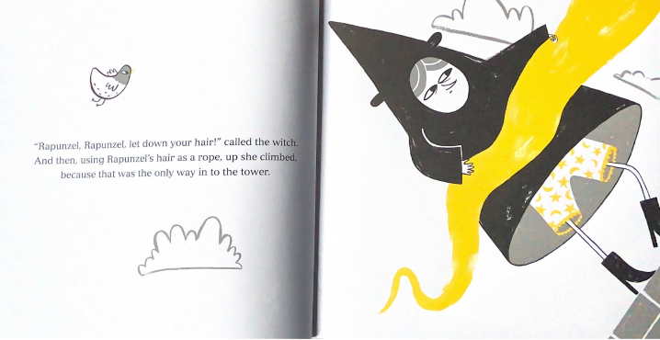

Slide 8
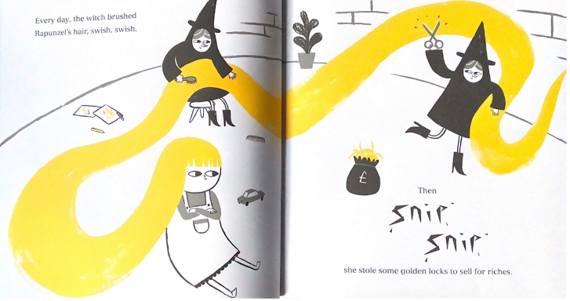

Slide 9
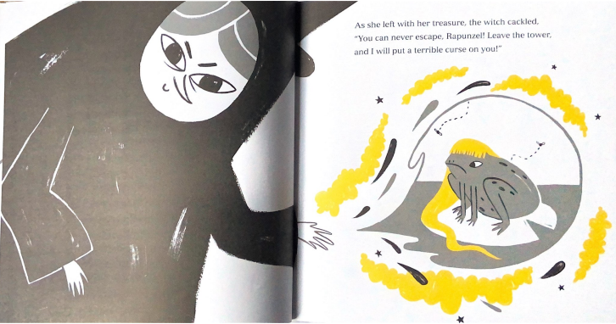

Slide 10
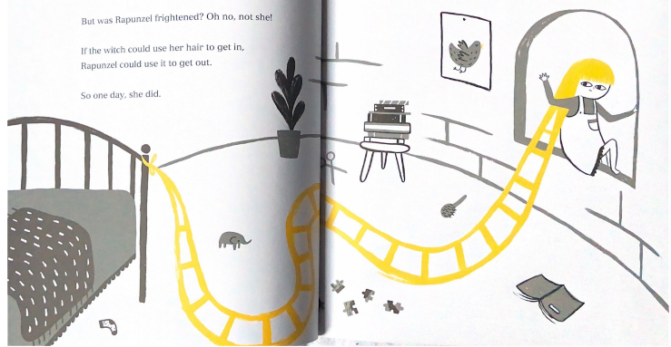

Slide 11
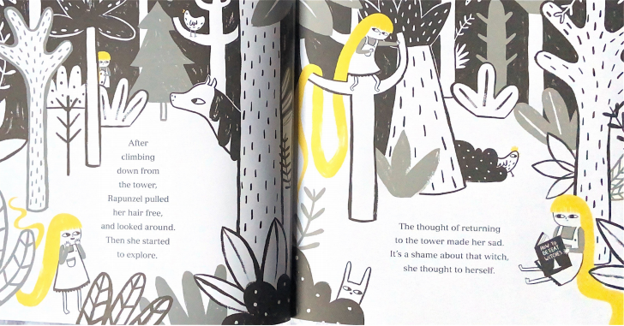

Slide 12
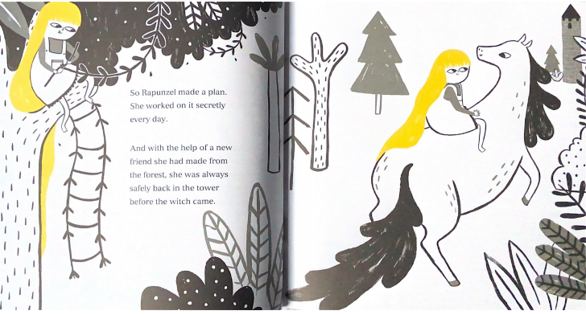

Slide 13
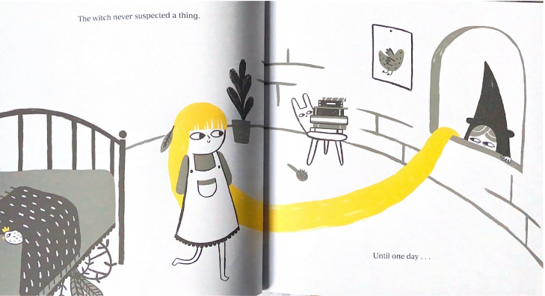

Slide 14
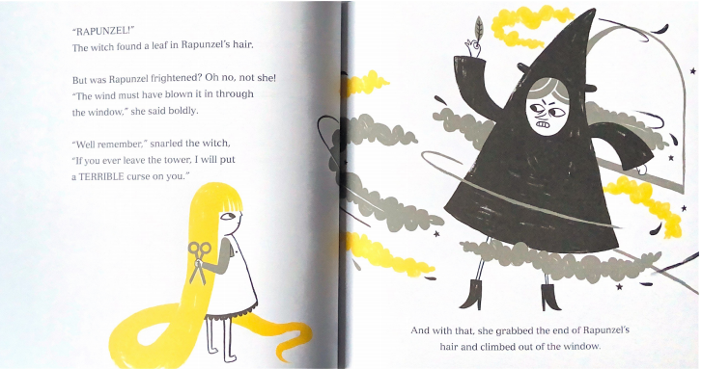

Slide 15
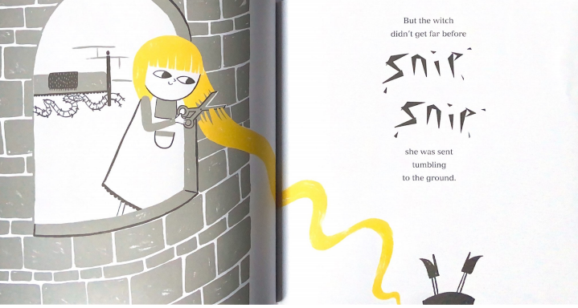

Slide 16
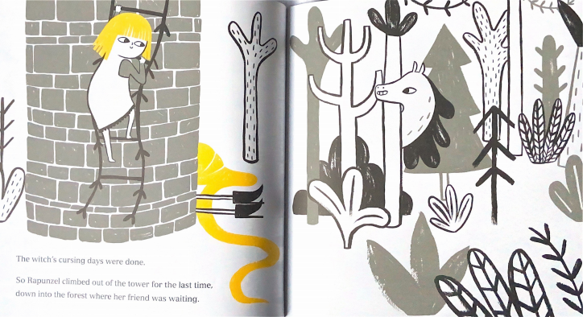

Slide 17
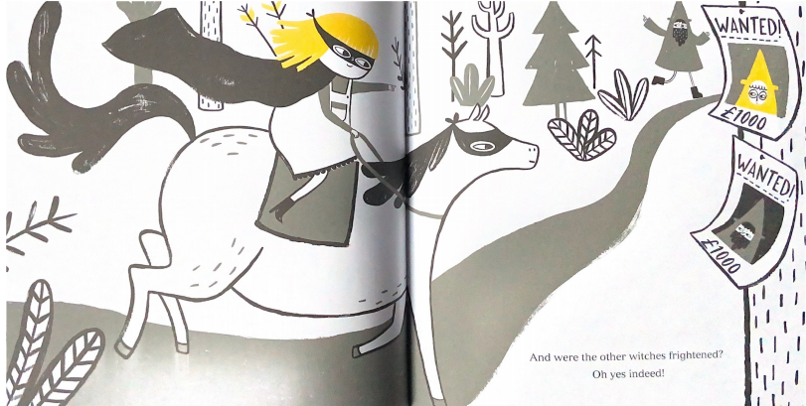

Slide 18
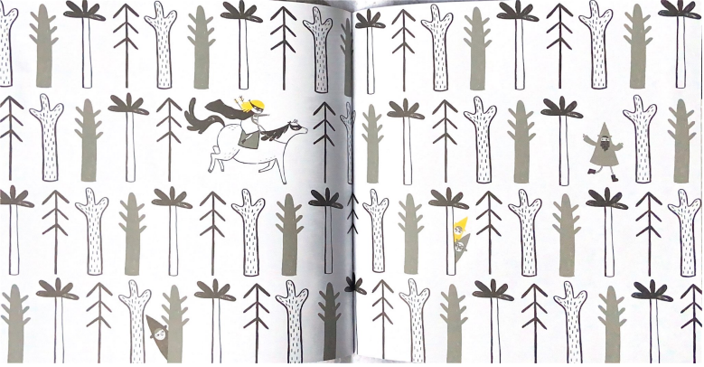

Slide 19
Your Task
Imagine you are Rapunzel. You are daydreaming about what you will do when you escape from the tower.
Partner Talk
Use the questions below to help you think about what Rapunzel would want to do.
What would she want to see? (buildings, people, countries)
What would she want to smell? (flowers, favourite food)
What would she want to feel? (sand in her toes, sunshine)
What would she want to taste? (fruit, snowflakes)
What would she want to hear? (her mother’s voice, birds, music)

Slide 20
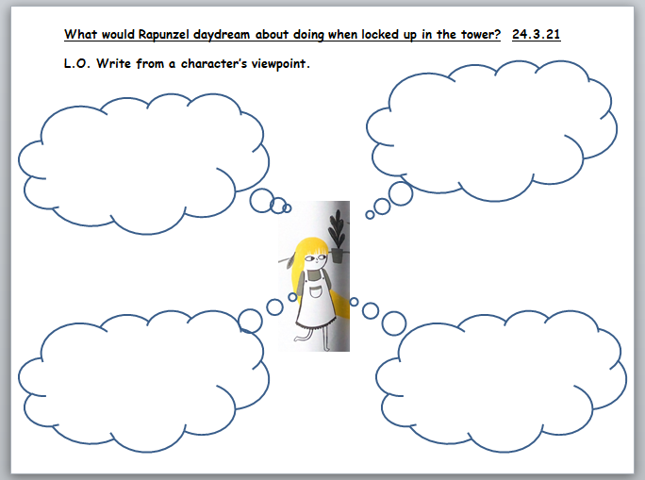
When you write about the daydream you should write in first person using ‘I’ because you are imagining that you are Rapunzel. You can write the daydream in paragraphs like the example below or in speech bubbles using the sheet provided. Remember to use adjectives.
Example
When I dream about leaving this tower, I think about all of the wonderful places I will visit. I want to go to the magnificent waterfall, deep in the forest and feel the cool spray on my face. I want to eat the juicy strawberries growing in the castle garden. When I escape I will sit under a shady tree and listen to the birds happily singing and take a nap on the soft forest floor. All day I dream of hugging my family again. I can’t wait to see my mother’s face when she sees me for the first time and I would give all I have to hear her tell me that she loves me once again.

