Slide 1
Do the find the word-search or dot to dot task!

Slide 2
Our Common Exception Words

Slide 3









Slide 4



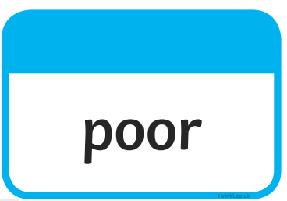
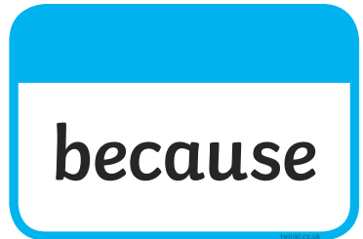



Tricky words…harder!

Slide 5
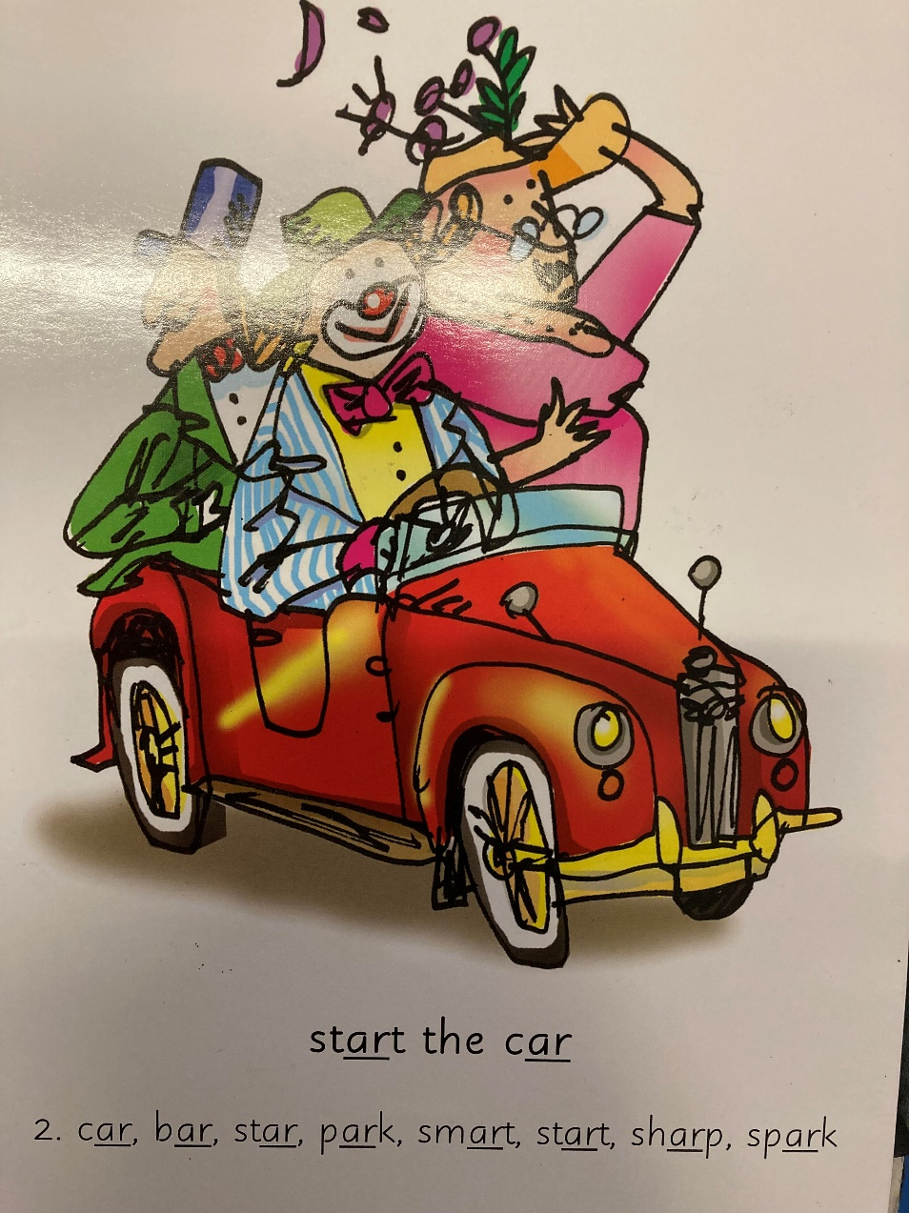
Our Set 2 phoneme for today is….ar
sharp spark
car
bar
star
park
start

Slide 6
LO: To write a story about a character from your imagination.
Monday 22nd March 2021

Slide 7

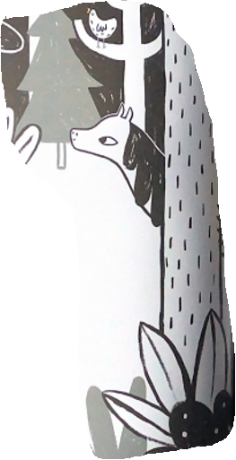
What setting might this be?
deep
a wood
large
a forest
beautiful
a rainforest
an orchard
dark
How could you describe this setting?
creepy
damp

Slide 8
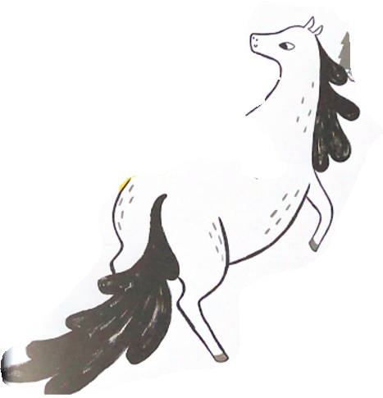
This is your main character for your story…what sort of animal is it?
fast
a pony
a horse
beautiful
elegant
strong
How could you describe me?
gentle
clever

Slide 9
So…your story is about a horse in a wood!
Who will I meet?
Why is it there?
What will happen to it?
How will my story end?
What will I do?
What danger will I get in?
I’m your main character!
How will I feel?
Who will help me?

Slide 10

So…your story is about a horse in a wood!
A beginning!
Describe the setting!
How will my story end?
Describe the character!
What must you include?
Who will help me?
A problem!

Slide 11
What time conjunctions can you use?
Once there was
Then
Finally
Next
There are some great time conjunctions you can use!
Suddenly
After that

Slide 12
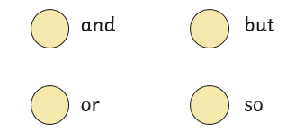
Here is an example story…
Once there was a white horse called Star and she lived in a dark wood. She loved to run around all day.
The wood had lots of trees but it was not a creepy wood. It was full of nice animals.
One hot day, Star was out for a run when she fell in a big hole! She was very sad.
So she called and called for help because she was trapped.

Slide 13
Here is an example story…
Suddenly, she heard a lot of voices from the top of the hole. It was a kind fox and a cute rabbit who wanted to help save her.
Then they threw down a thick rope made of vines, so she could climb back up again.
Talk to the person next to you about your story ideas!
Star was very happy and the fox and the rabbit jumped on her back. In the end, they rode off looking for their next adventure.

Slide 14
Your Task
To write a story about the horse in the forest what will happen?
Use adjectives
Use time conjunctions
Use capital letters and full stops

Slide 15
Monday 22nd March 2021
LO: To write a story about a horse in a wood
Include capital letters at the start of your sentences and full stops at the end.
Include adjectives to describe things.
Use and but so and or to link your ideas.

Slide 16


Slide 17
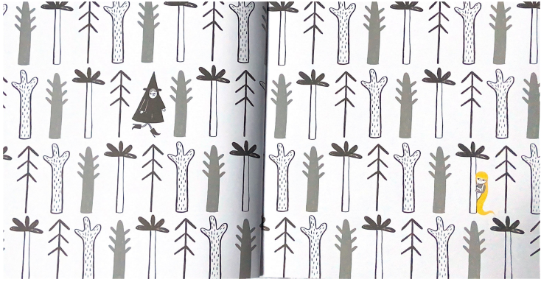

Slide 18
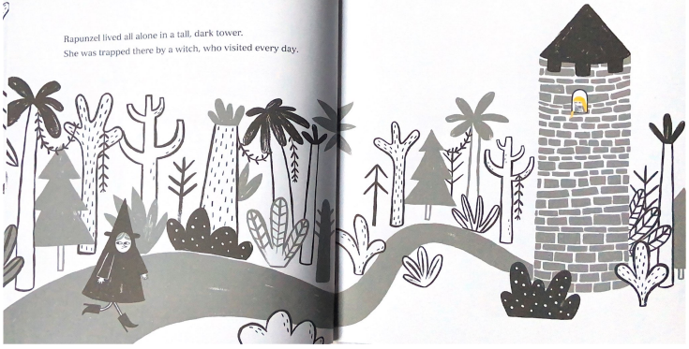

Slide 19
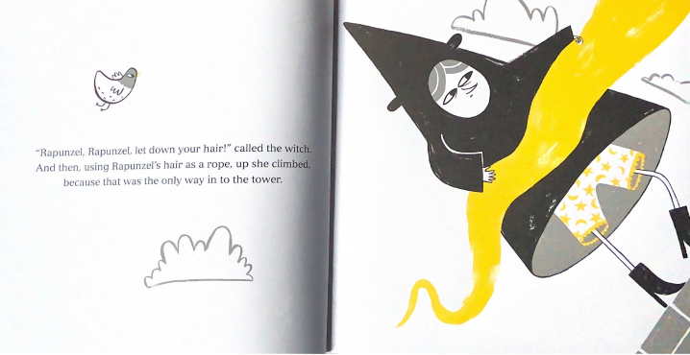

Slide 20
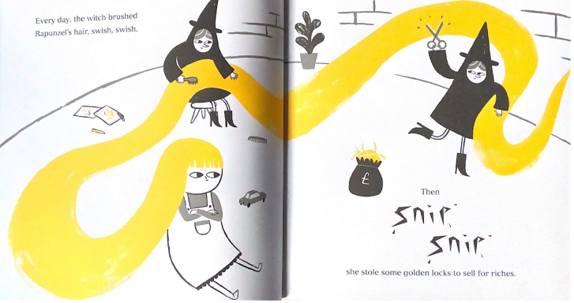

Slide 21
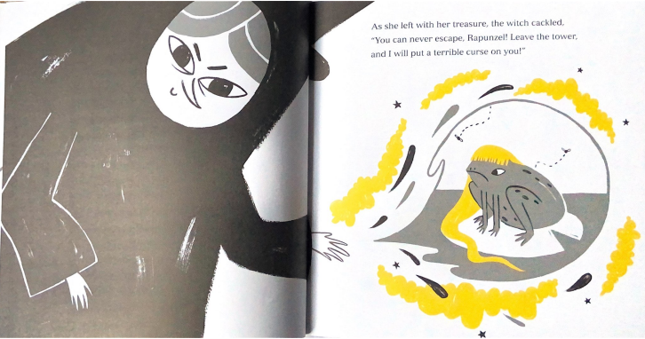

Slide 22
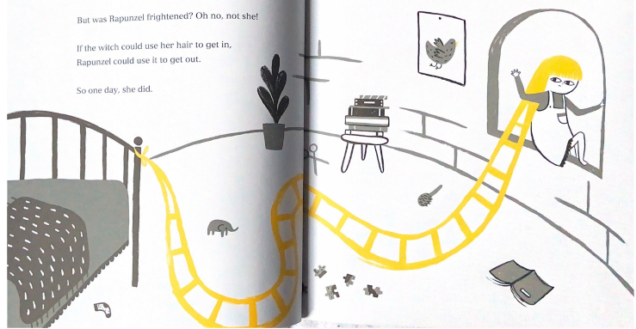

Slide 23
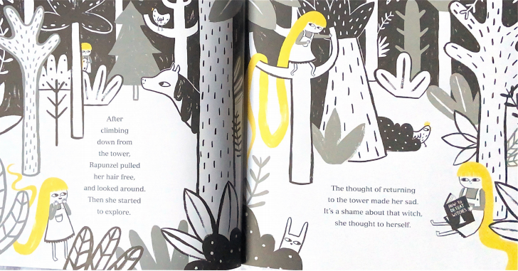

Slide 24
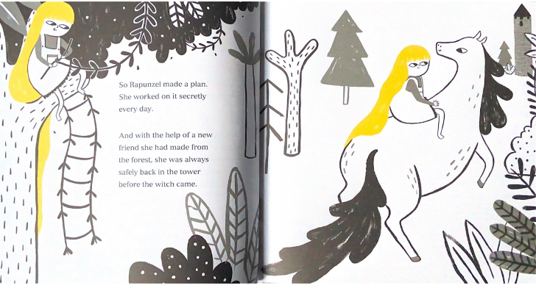

Slide 25
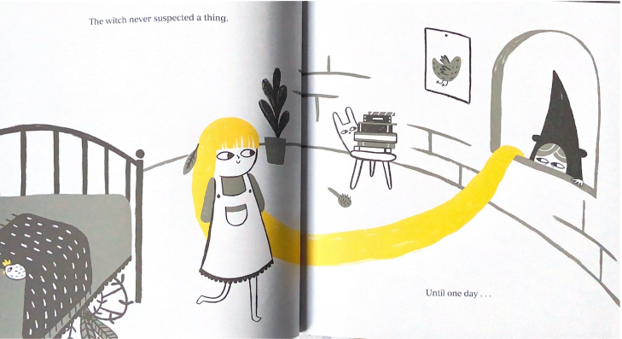

Slide 26
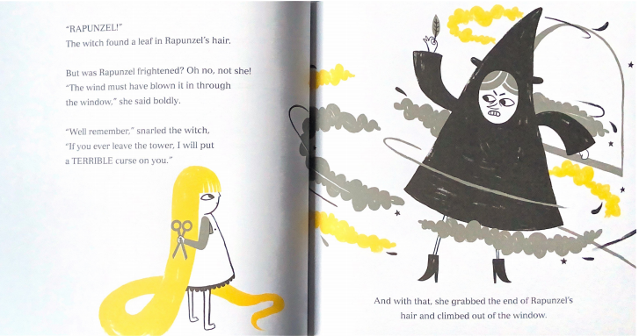

Slide 27
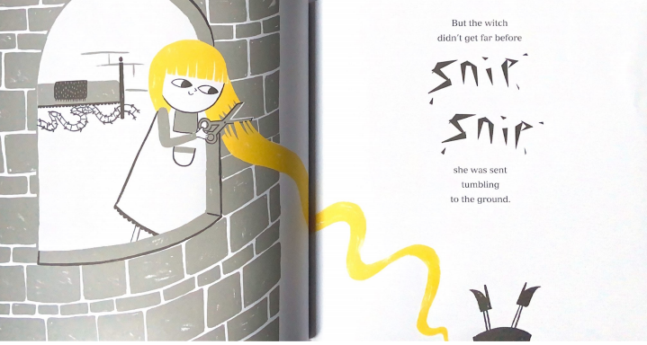

Slide 28
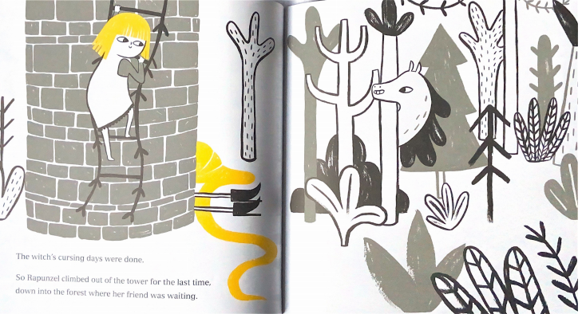

Slide 29
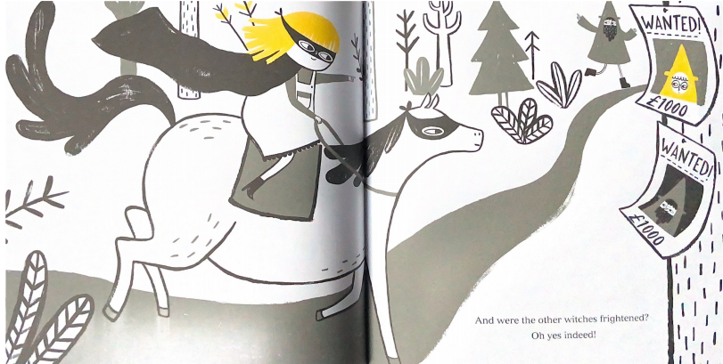

Slide 30


