Slide 1
LO: Art – Castle Themed Individual Piece based on Paul Klee the artist.
Monday 22nd March 2021

Slide 3
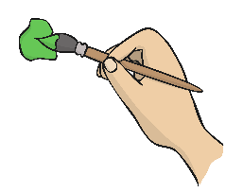
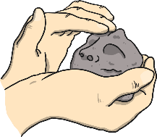

What Is an Artist?
What do you think an artist is?
Being an artist means making music, drawing, painting, making something out of clay, making models and lots of other things. Maybe you can think of other activities an artist might do?
Art means making something that makes people feel different when they look at it, hear it or touch it.
Think About It
Do you think you are an artist?
Becoming an artist often needs to be studied and practised. We are going to learn about Paul Klee, a famous artist who had to work very hard.

Slide 4

Young Paul Klee
Paul Klee was born in Switzerland on 18th December 1879.
He was the son of a musician and Paul learned how to play the violin as a young boy. He was very talented and was offered a place to play with a special orchestra.
When he was a teenager, Paul decided he didn’t want to study music anymore. His parents were disappointed but agreed that he could study art instead.

Slide 5
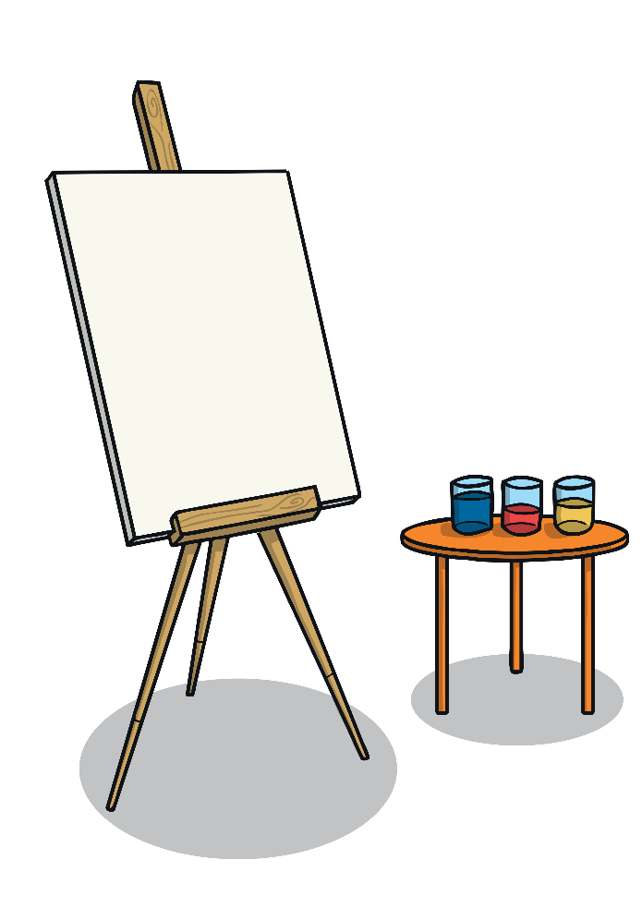

Studying Art
In 1898, Paul Klee went to the Academy of Fine Arts in Munich, Germany. He soon showed a talent for landscape pictures. Paul also filled notebooks with comic sketches.
Paul realised he wasn’t very good at using colour in his artwork and he began to think he would never be a painter.
In 1901, Paul went to Italy. He studied art by the great artists from years before. He realised he had a lot to learn about using colour and when he went home, he had some art lessons.
landscape – Pictures which are of areas of land, such as mountains, hills, forests and beaches.

Slide 6
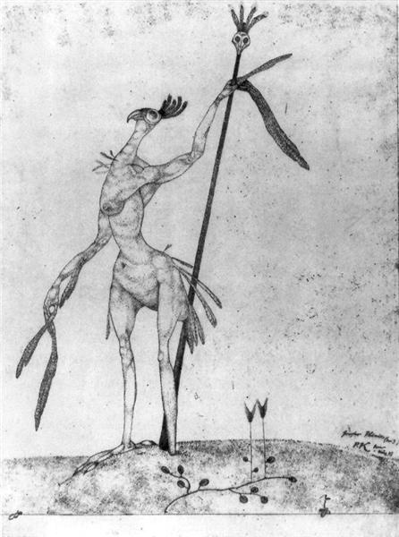
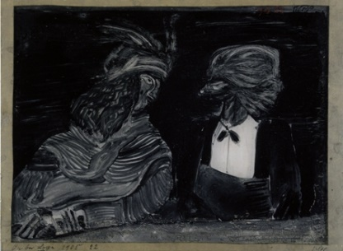
Experimenting with Art
In 1905, Paul started trying out different techniques with art. He started drawing on blackened glass with a needle and scratching pictures on plates made from metal.
Paul still wanted to learn how to use colour properly.
In 1911, he met some other artists called August Macke and Wassily Kandinsky. They became good friends and all experimented with colour in their paintings.
Click on the pictures to enlarge them.
Phenix (1905)
In the Box (1908)
Click for next page

Slide 7
back
Phenix (1905)

Slide 8
back
In the Box (1908)

Slide 9
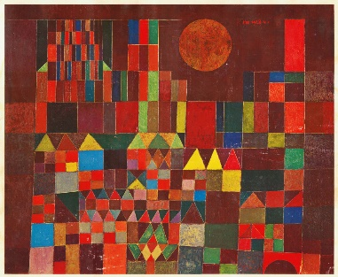
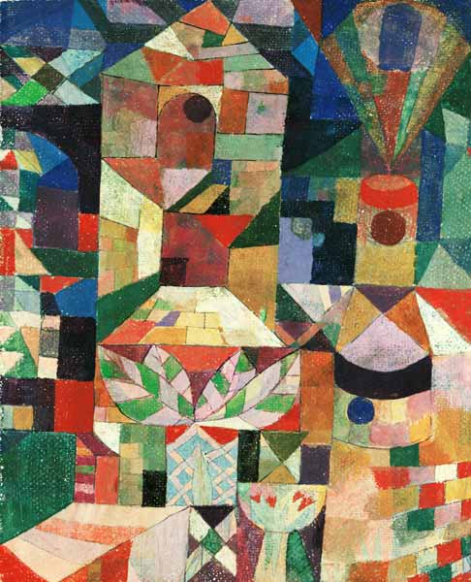
Bold Colours
In the years that followed he went to Paris, Tunisia and other places that made him want to try painting using bold colours. You can see this in his paintings, Castle and Sun and Castle Garden.
Talk About It
What do you think of these paintings?
Click on the pictures to enlarge them.
Castle and Sun
Castle Garden
Click for next page

Slide 10
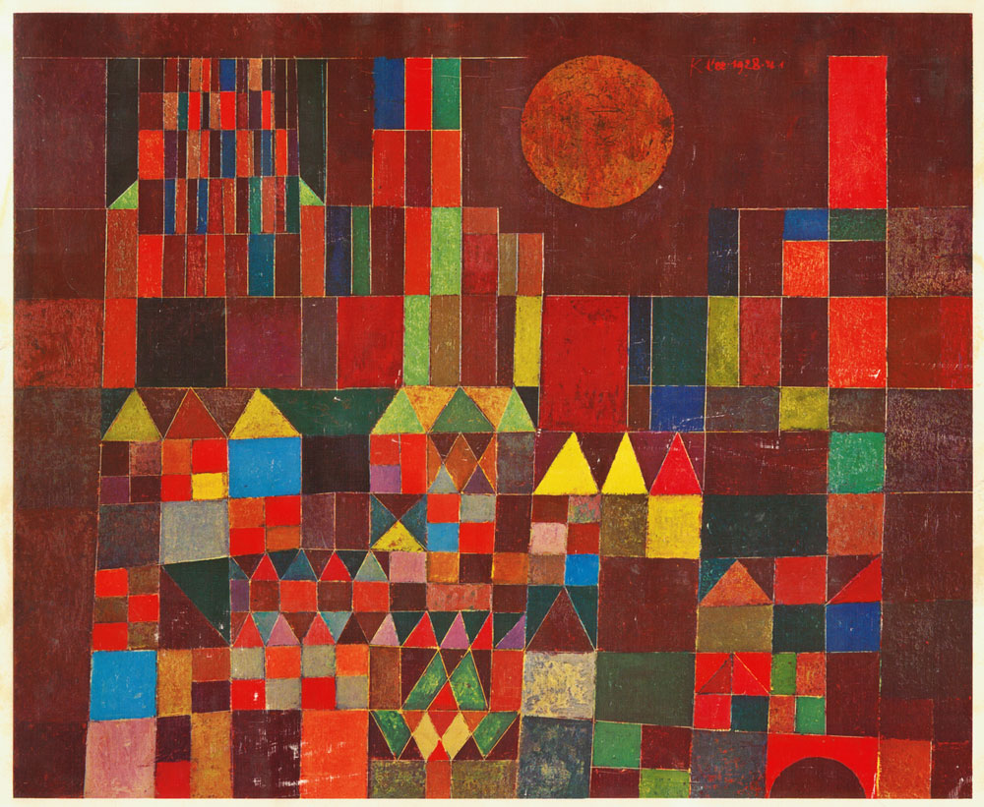
Castle and Sun

Slide 11
Castle Garden
back

Slide 12
Watch this quick video to get some clues on how to create your castles.
Castle Collage Tutorial

Slide 13
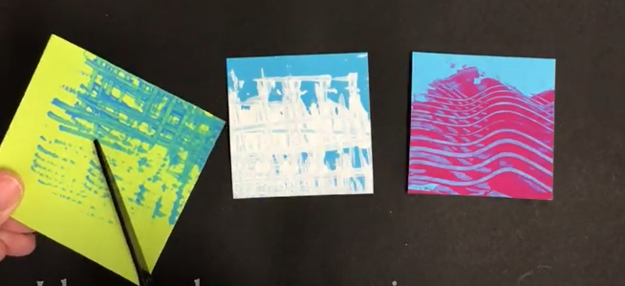
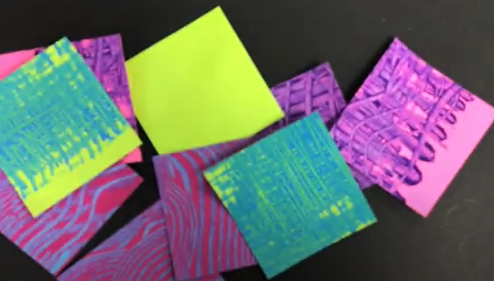
Session 1
You will be creating the
painted squares for
your castle.
You can choose any
colours you like
and create any
texture.

Slide 14
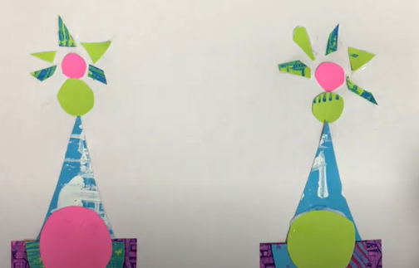
Session 2
You will be given an A3 sheet of paper to work on and there will be many other materials / paints / collage resources that you might need to add extra detail to your collage.

