Slide 1
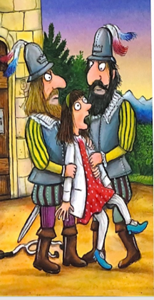
Literacy
Thursday 18th March
L.O. To write an explanation text to describe how to rescue Princess Pearl.

Slide 2
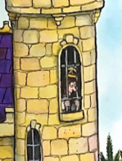
Writing an Explanation
This is writing to explain how to do something.
We are going to write an explanation text about how to rescue Princess Pearl from her uncle’s castle.
Let’s read part of the story again.

Slide 3


Slide 4
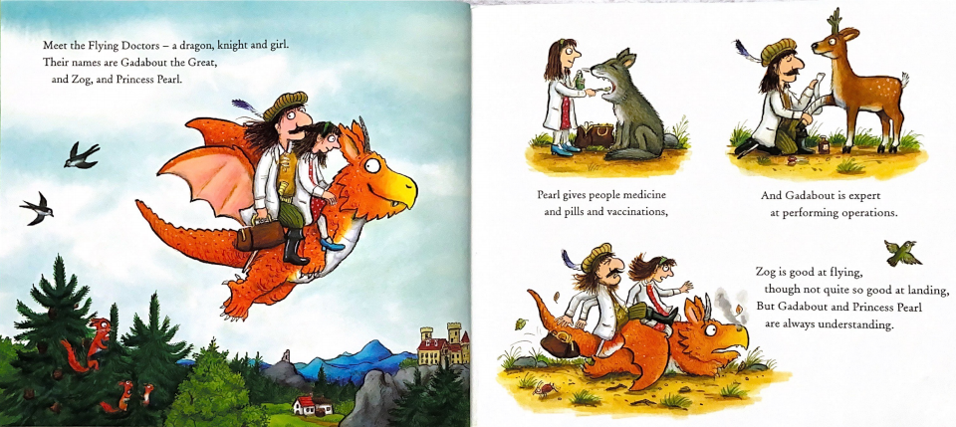

Slide 5
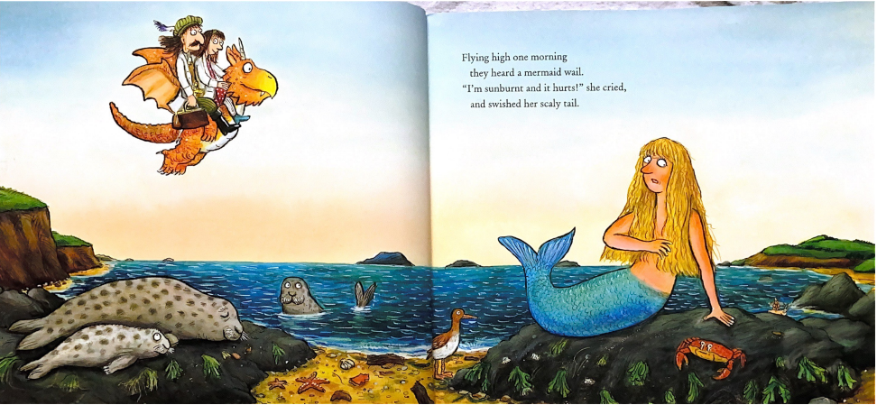

Slide 6
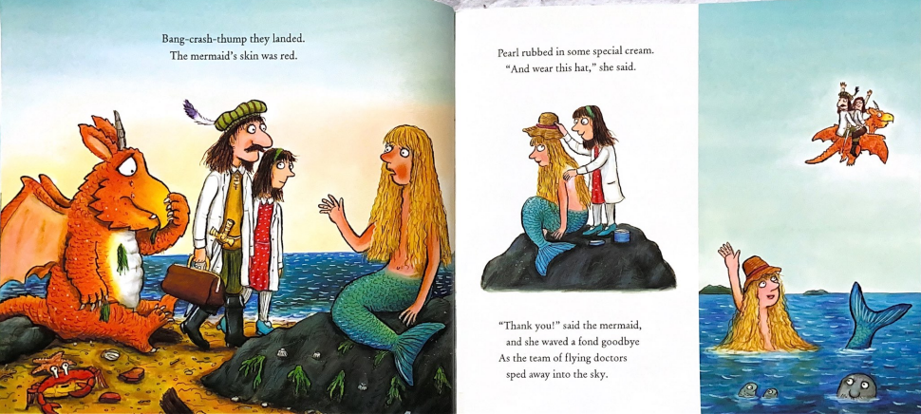

Slide 7
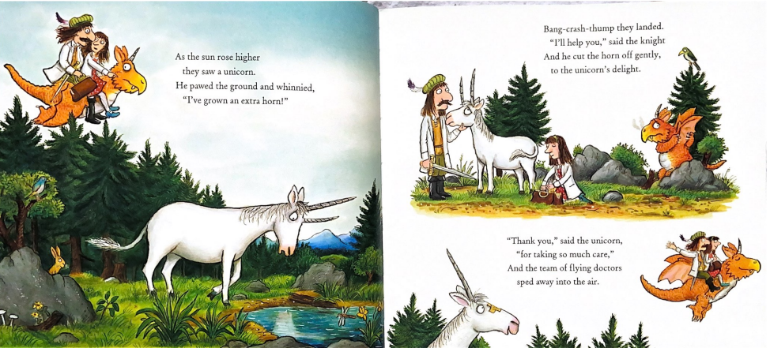

Slide 8
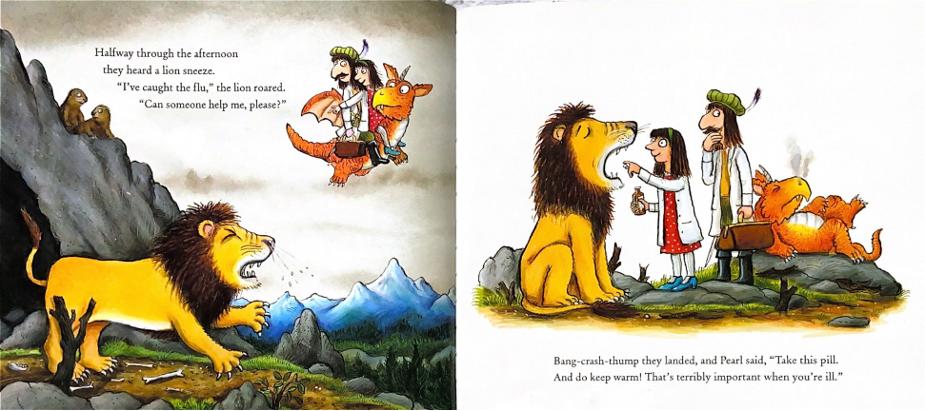

Slide 9
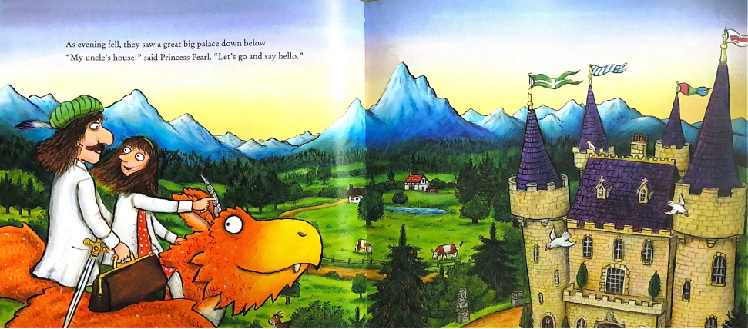

Slide 10
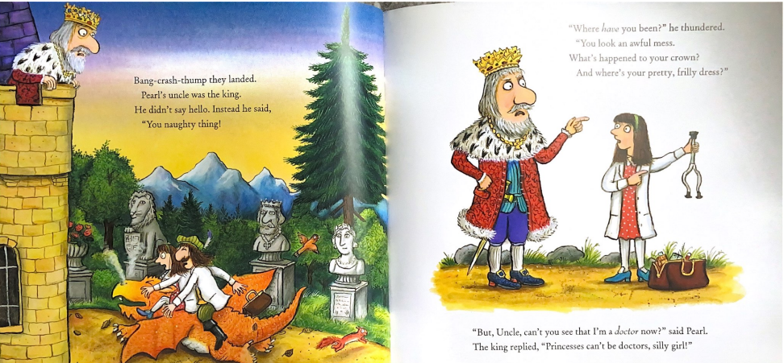

Slide 11
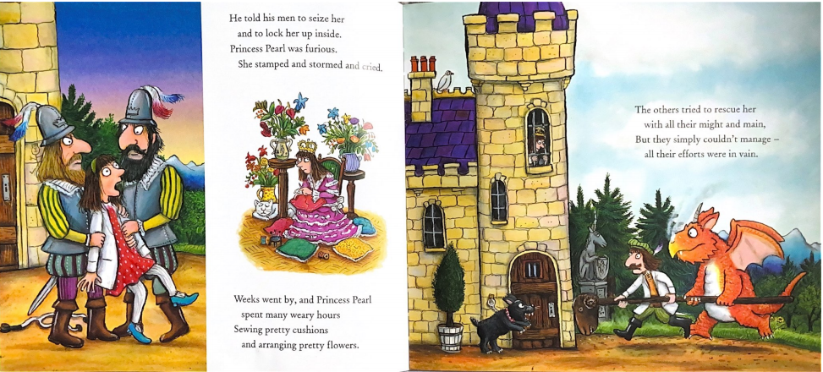

Slide 12
What we need to include to make our explanation clear.
Title
Clear and simple sentences. We do not add adjectives or description.
We write in the present tense.
We can use sub-headings.
We can add drawings.
We use time conjunctions to show the steps to follow in order.
Let’s look at an example.
first | then | next
After that | now | finally

Slide 13

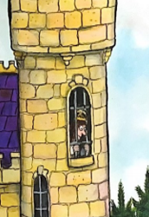


How to rescue Princess Pearl from the castle.
We must free Pearl so that the Flying Doctors can help poorly animals again!
This is how we will do it.
title
introduction
Sub-headings
Stop the dog barking.
Getting up the tower.
pictures
First, give the dog a bone so that he is happy and quiet.
Then, put a ladder on the tower so that Pearl can climb down.
Sentences to explain

Slide 14
18.3.21. L.O. To write an explanation text: How to rescue Princess Pearl

