Slide 1


Slide 3



1) How do you spell 13?
2) Let’s count in 2s:
8, 10, 12, ___, ____
3) Let’s count in 5s:
15, 20, 25, ___, ____
4) Which is heavier?

Slide 4
1) How do you spell 13?
2) Let’s count in 2s:
8, 10, 12, ___, ____
3) Let’s count in 5s:
15, 20, 25, ___, ____
4) Which is heavier?
thirteen
14
16
30
35

Slide 6




Measure mass
Have a think
has a mass of
6

Slide 7

Measure mass
Have a think
has a mass of
5

Slide 8

Compare mass
Have a think
Which is heavier?

Slide 9

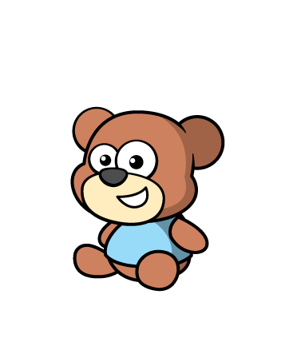
Compare mass
Have a think
Which is lighter?

Slide 10
Have a go at question 1 on the worksheet

Slide 11



Compare mass
Have a think
Put these objects in order from lightest to heaviest
lightest
heaviest

Slide 12

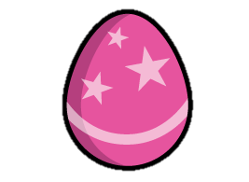
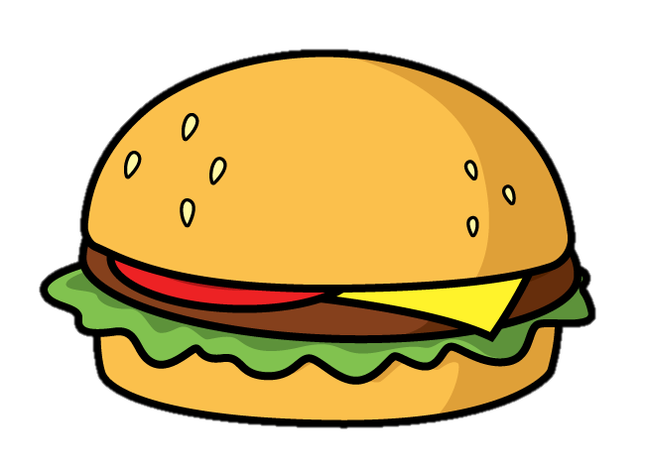
Compare mass
Have a think
The is heavier than the
The is lighter than the

Slide 13



Compare mass
Have a think
heavier than
lighter than
lighter than
The are the
The are the
heavier than

Slide 14
Have a go at questions 2 and 3 on the worksheet

