Slide 1


Slide 4
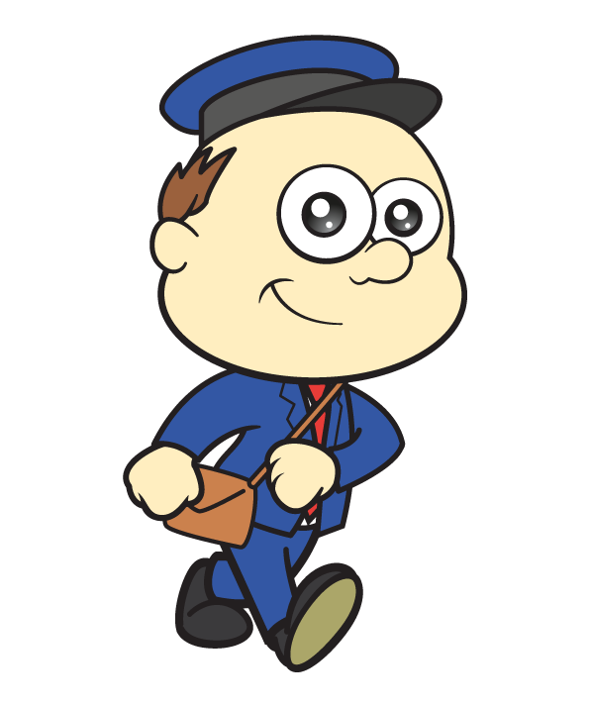
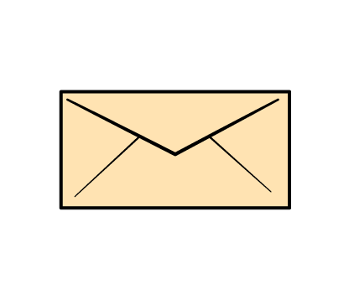
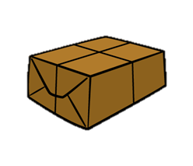
Let’s talk about mass
Lighter

Slide 5


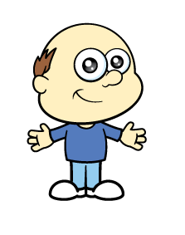
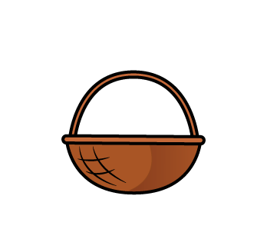
Let’s talk about mass
Heavier

Slide 6
Find a basket or a bucket.
Can you make it heavier and then lighter?

Slide 7

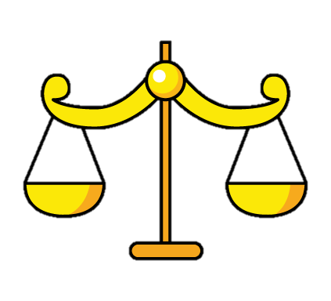
How can we measure mass?
We can use a balance scale.

Slide 8

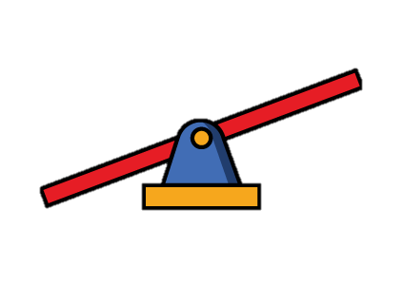
Have a think
Let’s measure mass.

Slide 9

Have a think
Let’s measure mass.

Slide 10
Have a think
Let’s compare mass.
The is heavier than the
The is lighter than the

Slide 11


Let’s compare mass.
Have a think
The scale is balanced!
The has the same mass as the

Slide 12
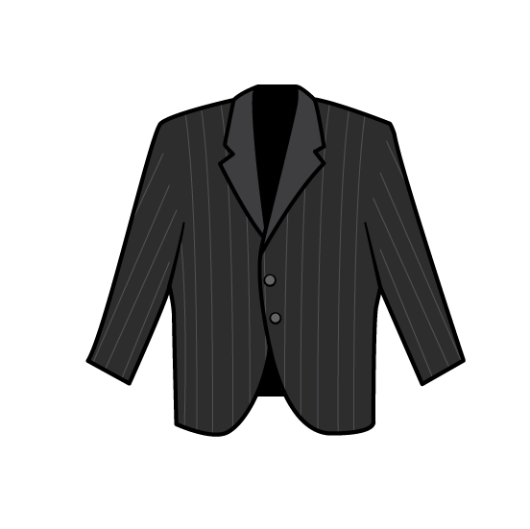
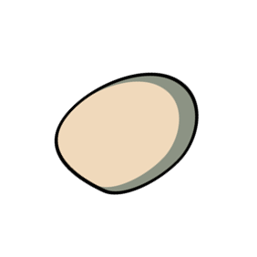
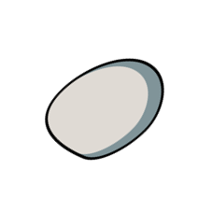
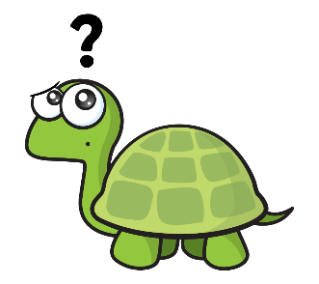
Have a think
Which parcel is heavier?

Slide 13
Can you find two objects?
Which one is heavier?

