Slide 1


Slide 3
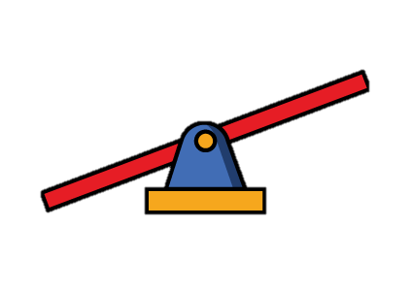


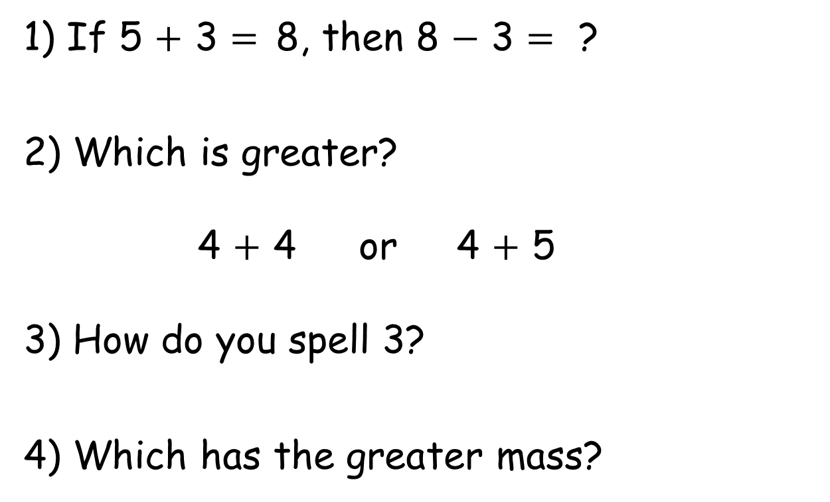
1) If 5 + 3 = 8, then 8 $−$ 3 = ?
2) Which is greater?
4 + 4 or 4 + 5
3) How do you spell 3?
4) Which has the greater mass?

Slide 4
1) If 5 + 3 = 8, then 8 $−$ 3 = ?
2) Which is greater?
4 + 4 or 4 + 5
3) How do you spell 3?
4) Which has the greater mass?
5
three

Slide 6

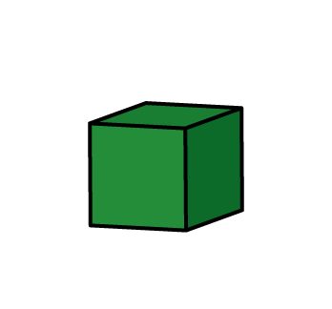

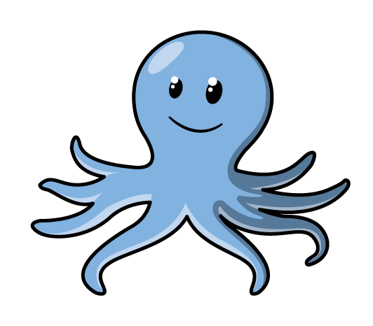
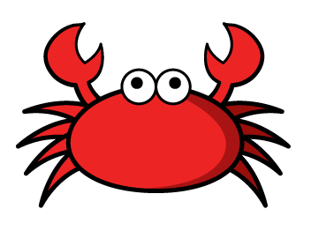
Measure mass
Have a think
The has a mass of
7
The has a mass of
5
How much heavier is the ?
2

Slide 7

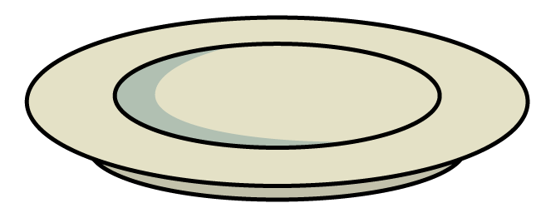
Measure mass
Have a think
The has a mass of
5
The has a mass of
3

Slide 8
Have a think
The has a mass of
5
The has a mass of
3
How many blocks are needed to balance the scale?
8

Slide 9
Have a go at question 1 on the worksheet

Slide 10

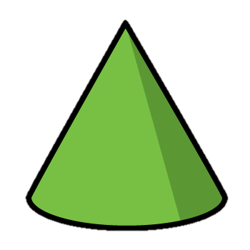
Have a think
What is the mass of a ?
=
2

Slide 11
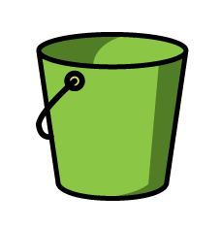
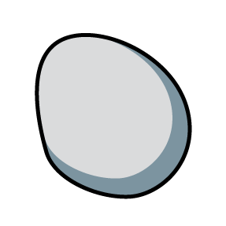
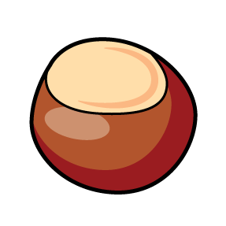
Have a think
=
10
=
6
=
2
What is the mass of ?
12
What is the mass of ?
10

Slide 12
Have a think
=
10
=
6
=
2
What could make mass of 12 ?

Slide 13
Have a go at questions 2 and 3 on the worksheet

Slide 14
Have a think
What is the mass of ?
=
8

Slide 15
Have a go at question 4 on the worksheet

