Slide 1
LO: To use watercolours to paint a character.
Monday 15th March 2021

Slide 2
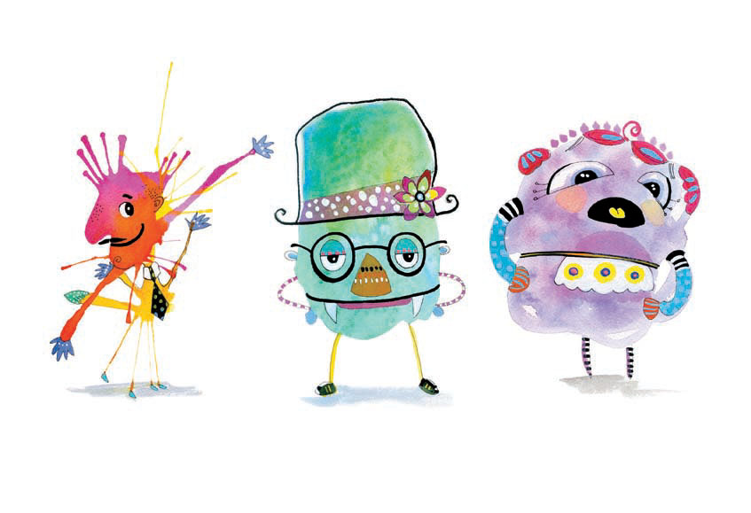
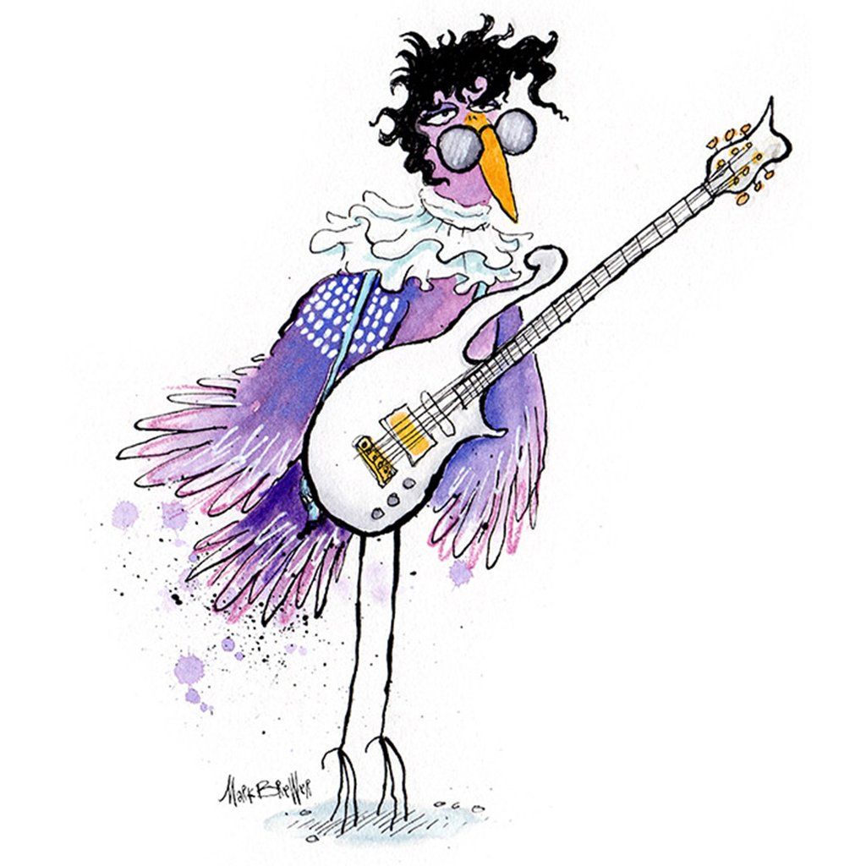
Today we will be using watercolours to create a painting of a character.

Slide 3
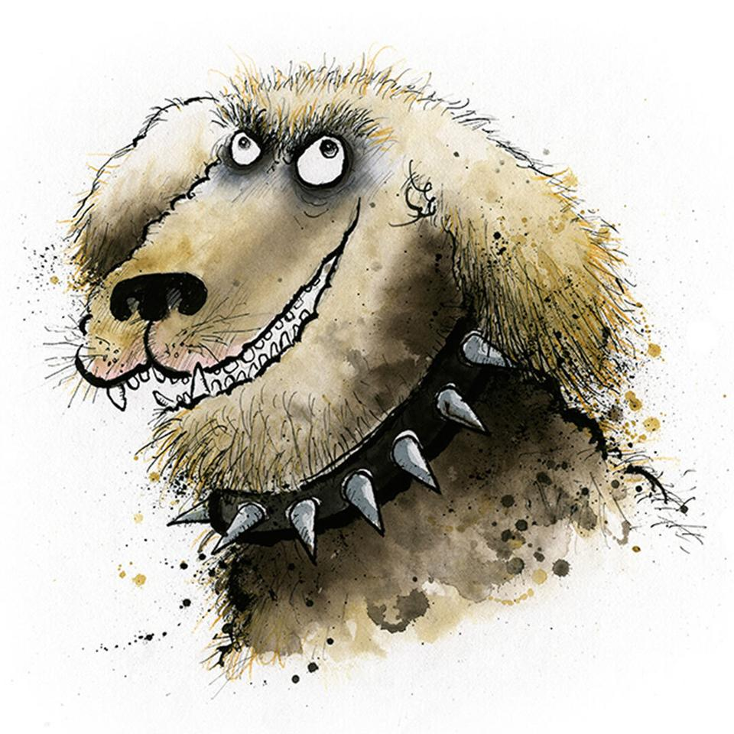
Watch this quick video to get some clues on how to use watercolours.
Watercolour Tutorial

Slide 4
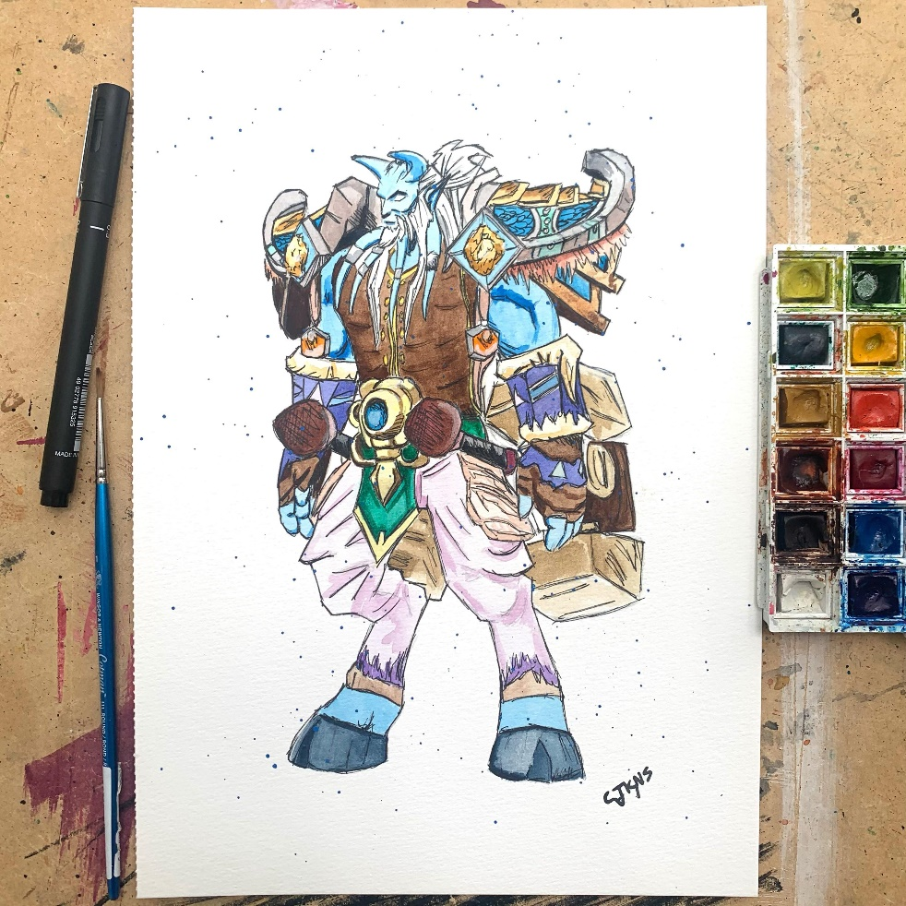
Your Task:
Think about the character that you invented for your Zog and the Flying Doctors piece of writing in Literacy.
You will be drawing the character using pencil and then filling in the gaps with your watercolour paints.
Think about what the tutorial said, keep your paint wet, use gentle strokes and you can mix the colours in your mixing tray to create different colours.

Slide 5
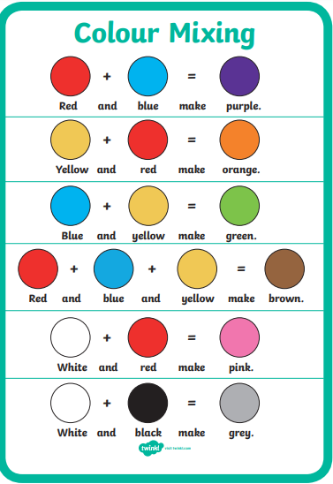
Colour Mixing
You can make different colours using the primary colours, red, blue and yellow.

Slide 6
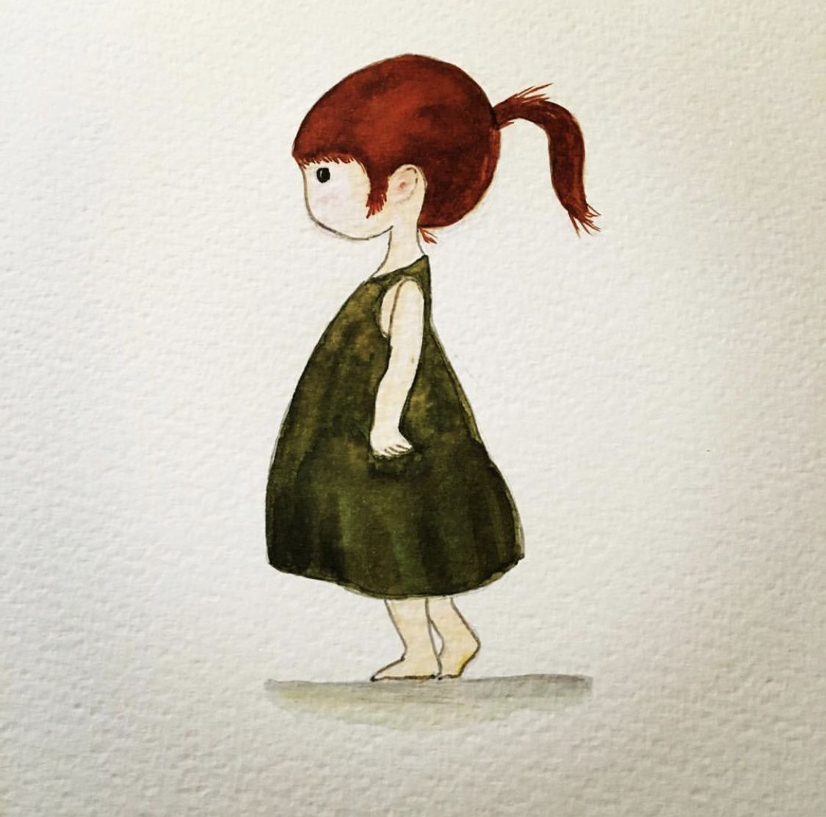
So…
- Use watercolour paper for the best result.
- Keep your paint wet.
- Be gentle with your brush and stroke the paper, don’t jab at it.
- Be patient!
- Have fun!

