Slide 1


Slide 3


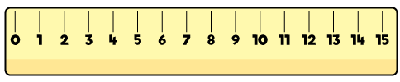
1) How do you spell 20?
2) What number comes next? 21, 20 ___
3) What is this shape called?
4) Mass is measured using a

Slide 4
1) How do you spell 20?
2) What number comes next? 21, 20 ___
3) What is this shape called?
4) Mass is measured using a
twenty
19
cylinder

Slide 6

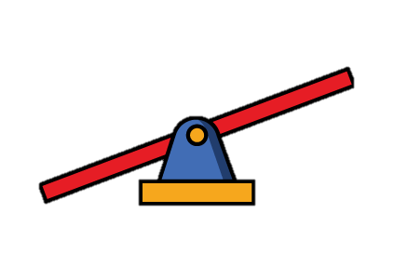
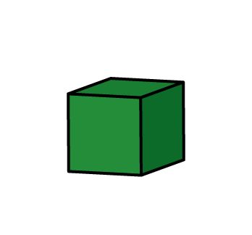
Measure mass
The have a mass of 3

Slide 7

Measure mass
The has a mass of 5

Slide 8

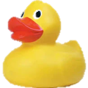
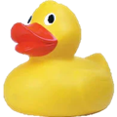
Measure mass
Have a think
The has a mass of 2

Slide 9
Have a go at question 1 on the worksheet

Slide 10


Measure mass
Have a think
The has a mass of
6
Tiny has a mass of
6

Slide 11


Measure mass
Have a think
The has a mass of
4
The has a mass of
2

Slide 12
Have a go at questions 2 and 3 on the worksheet

