Slide 1
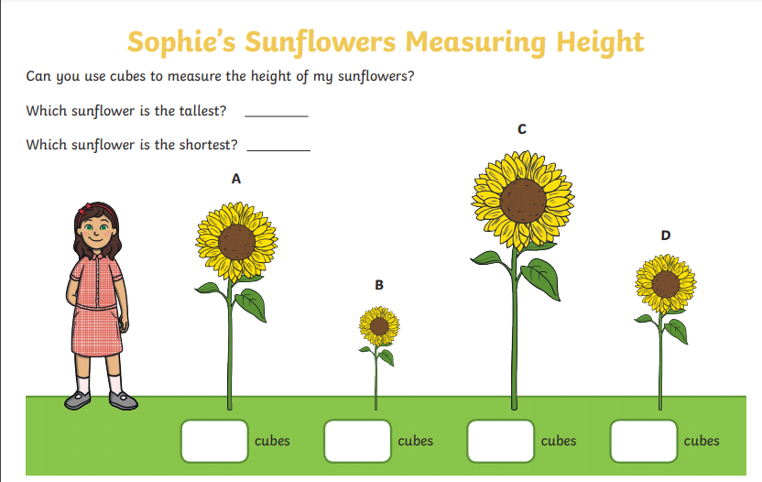
cm
cm
cm
cm

