Slide 1




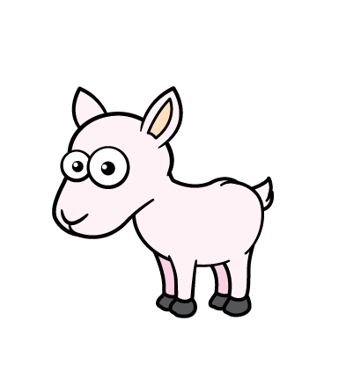


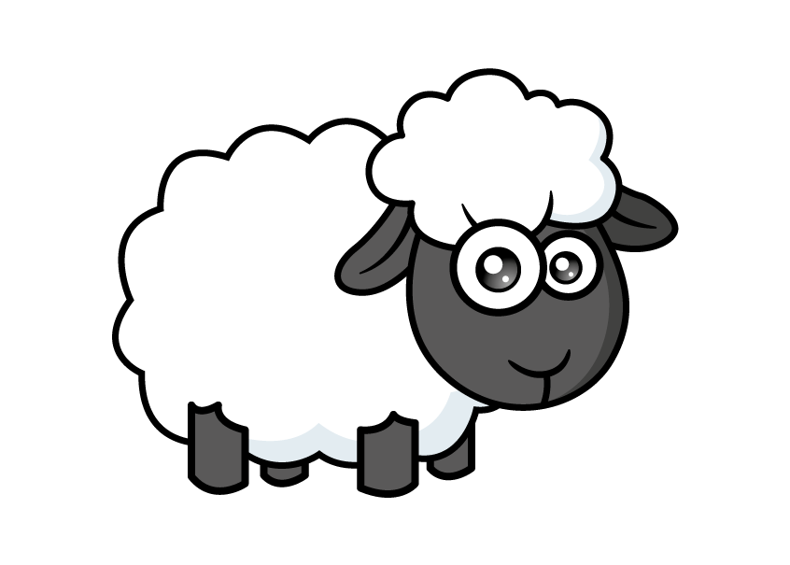

Slide 2


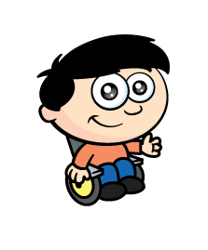
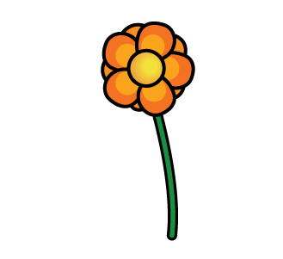

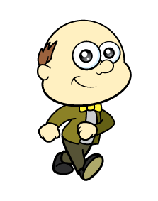

Farmer Rose is getting ready for a party.
He asks his friends to pick some flowers.
I picked
27!
I picked
31!
I picked
29!
Who picked the most?
Ron - 31

Slide 3
I picked
27!
I picked
31!
I picked
29!
Can you put them in order from
least to greatest?

Slide 4

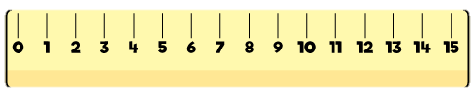
Let’s measure height.
11 cm
6 cm
8 cm
8 cm
You can use
a ruler!

Slide 5
Let’s compare height.
11 cm
8 cm
8 cm
6 cm
Which is the tallest?
Which is the shortest?
How can you describe these 2?

Slide 6
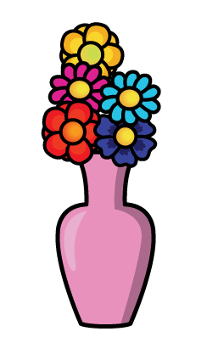
Farmer Rose needs the flowers put into groups of 5
45
How many flowers are there?
5
10
15
20
25
30
35
40
45
Can you count in 5s?

Slide 7

How many ways can you arrange 5 orange and purple flowers?
6
1 + 4
2 + 3
3 + 2
4 + 1
5 + 0
0 + 5
Can you make each
group different?
Have a think

Slide 8


