Slide 1
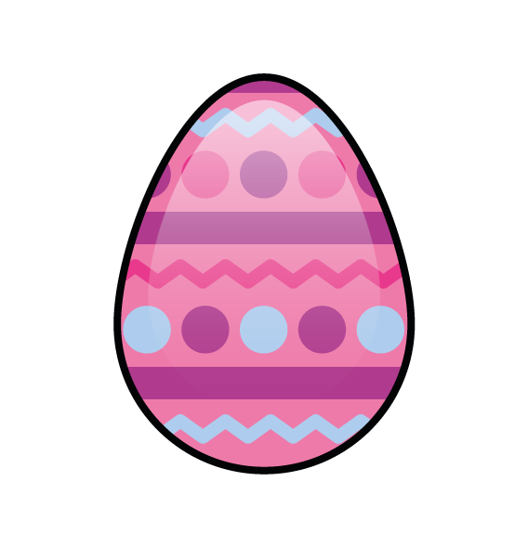
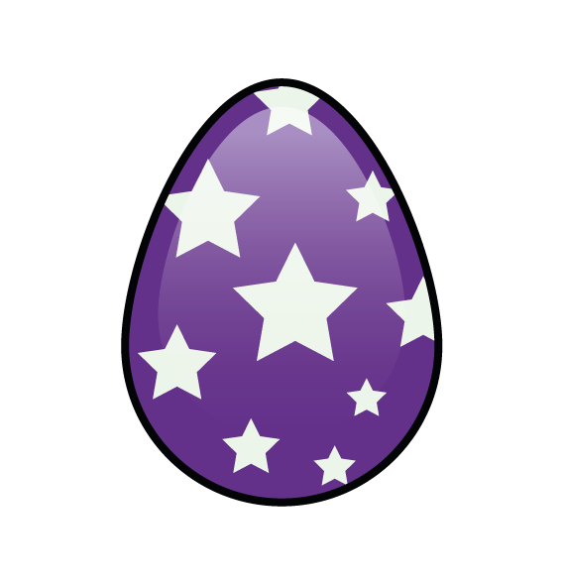
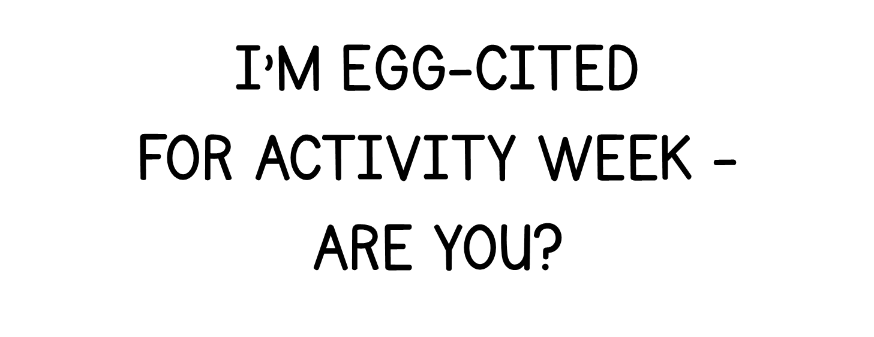
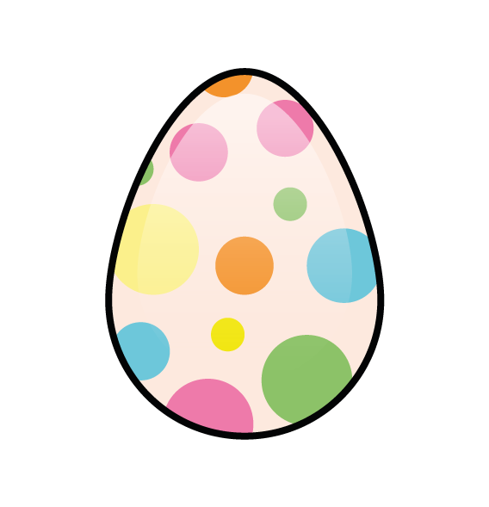
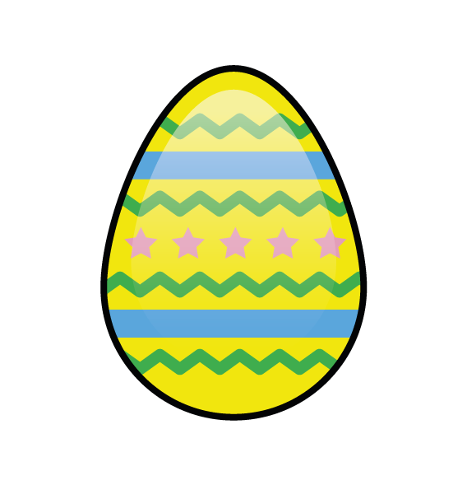

Slide 2
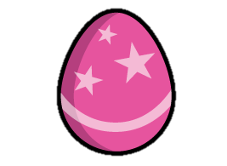
Number bonds to 10
1 + 9 = 10
2 + 8 = 10
3 + 7 = 10
4 + 6 = 10
5 + 5 = 10

Slide 3
What are the other number bonds to 10?
6 + 4 = 10
7 + 3 = 10
8 + 2 = 10
9 + 1 = 10
10 + 0 = 10

Slide 4


How many eggs?
30
Each basket has 10 eggs.
I can count in 10s!
10
20
30

Slide 5

How many eggs?
25
Each basket has 5 eggs.
I can count in 5s!
5
10
20
15
20
25

Slide 6

What do you know?
The is lighter than the
The is heavier than the

Slide 7

What do you know?
The has a mass of
?
2

Slide 8
What is the mass?
?
If 1 has a mass of 2
?
Then 3 have a mass of
6

Slide 9
What is the mass?
?
If 1 has a mass of 2
?
Then have a mass of
5
10

Slide 10





Let’s Sort by colour!
Blue
Green

Slide 11
Let’s Sort!
Rolls
Does not roll

Slide 12
Let’s Sort!
Stacks
Does not stack

Slide 13
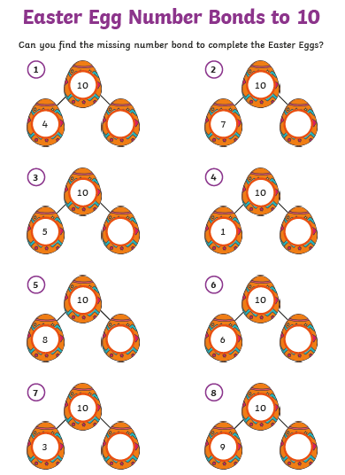
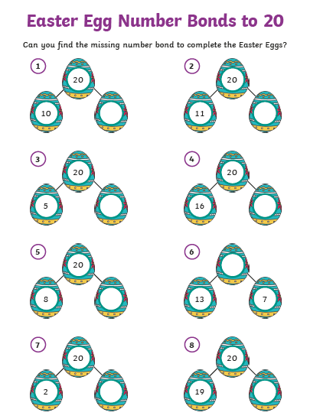
Your task for today…choose one or both to do! Use practical resources to help you find the bonds!

