Slide 1
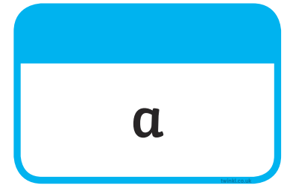







Tricky Words

Slide 2





Slide 3
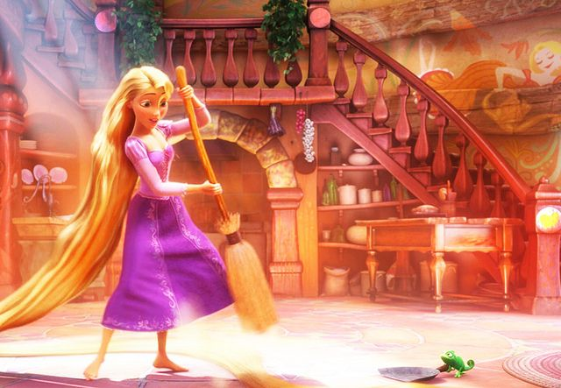
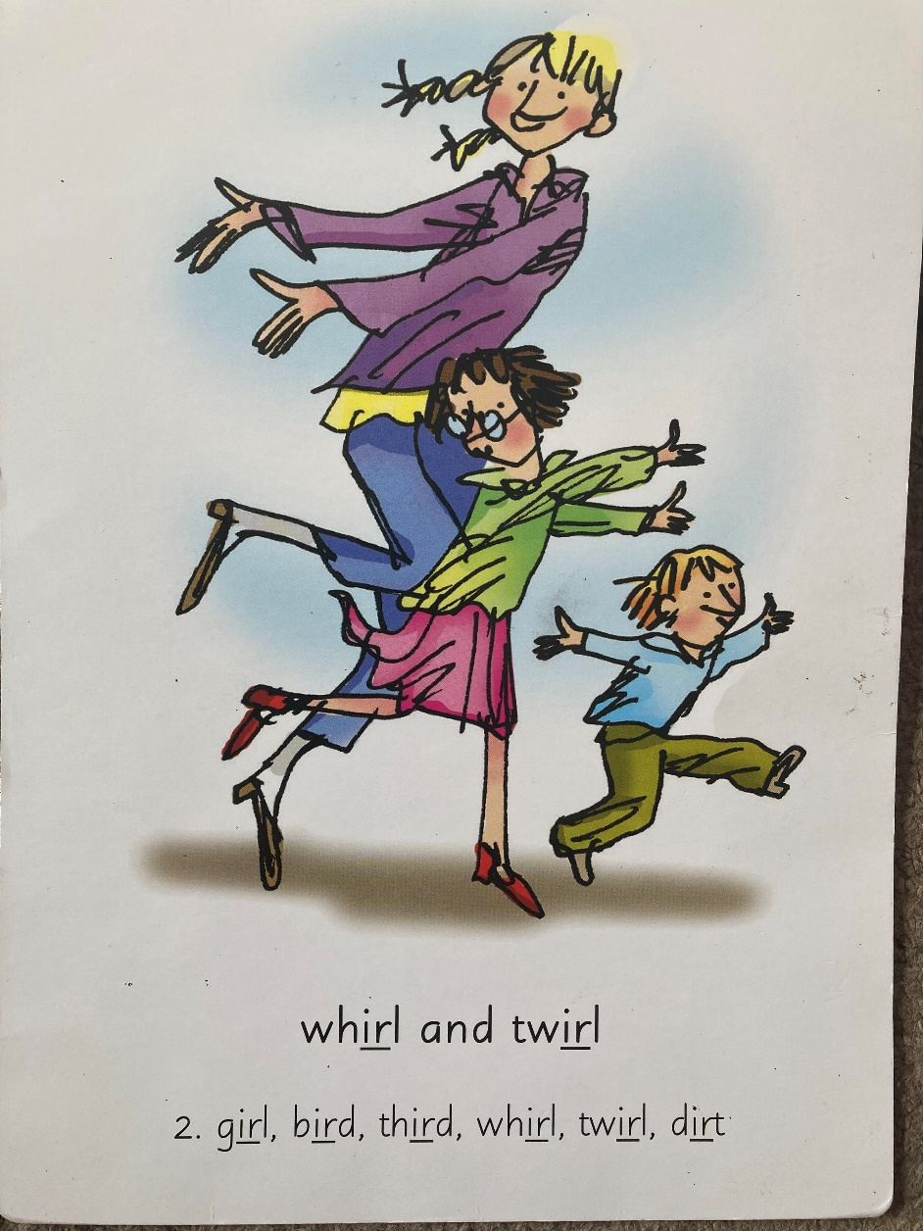
Our Set 2 phoneme for today is….ir
whirl twirl
girl
bird
third
dirt

Slide 4
LO: To complete the sentences given.

Slide 5
Task: Read the extract about Rapunzel and Tangled.

Slide 6
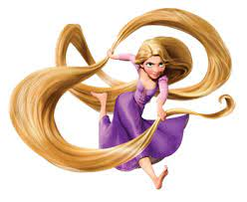
TANGLED
Rapunzel is about a lost princess whose mother was very ill and she got a healing flower that only works when Rapunzel would sing a song.
She falls for a rogue thief named Flynn Eugene Fitzherbert Rider, the kingdom's most wanted-and most charming-bandit.
Flynn Rider, hides out in a mysterious tower, he's taken hostage by Rapunzel, a beautiful and feisty teenager with 70 feet of magical, golden hair.

Slide 7
Rapunzel, wants to escape the tower where she's been locked away for years.
She makes a deal with the handsome thief, after hitting him on the head with a frying pan!
The unlikely pair set off on an adventure, complete with a super-cop horse, a colourful chameleon and a gruff gang of pub thugs.

Slide 8
Together they go on a whirlwind adventure. Near the end of the film it is revealed that Rapunzel has brown hair!
Eugene chopped her hair off using a broken mirror after he got stabbed by Mother Gothel.
She wanted to keep Rapunzel all to herself because she looks around 100 years old and as Rapunzel sings the following lyrics:
Flower, gleam and glow
Let your power shine,
Make the clock reverse, bring back what once was mine,
Heal what has been hurt,
Change the fates design,
Save what has been lost,
Bring back what once was mine,
What once was mine.

Slide 9
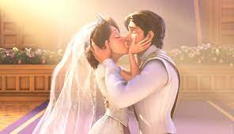
It either makes the person young again or it heals them. At the end of the film Rapunzel married Eugene.

Slide 10
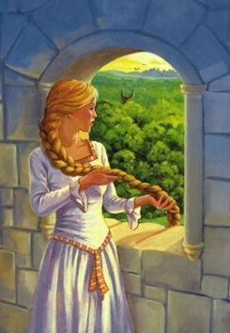
RAPUNZEL
A lonely couple that wanted a child lived next to a walled garden which belonged to an enchantress named Dame Gothel. The man’s wife noticed a plant which would make her better and save the baby. He stole the plant, BUT it belonged to Gothel and she caught him.
He begged for mercy and so the old woman agreed to be kind on condition that the unborn child would be given to her when she was born. When the baby was born the young girl was brought up by Gothel as her own.

Slide 11
The enchantress kept Rapunzel in a tower. Whenever someone came to see Rapunzel in the tower, they said Rapunzel, Rapunzel let down your hair and her long beautiful golden hair would fall down from the tower so that the person would climb up on her hair.
One day, a handsome prince rode through the forest and heard Rapunzel singing from her tower. Enchanted by her singing voice he went to look for the girl and found the tower but he couldn’t find a way to see her. When he finally climbed up, when Dame Gothel was gone, he asked her to marry him and she accepted.

Slide 12


What differences do you notice in the stories?

Slide 13
Can you finish these sentences?
Rapunzel is about a lost princess who…
Flynn meets Rapunzel when…
Flynn and Rapunzel…
At the end of the film…

Slide 14
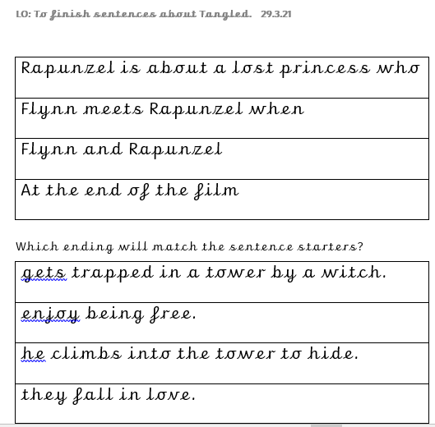
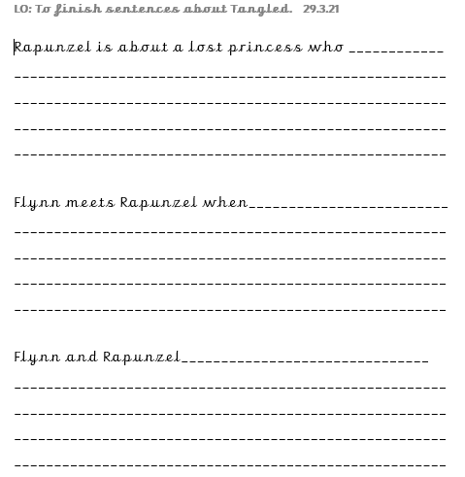
Complete the task you are given.

