Slide 1



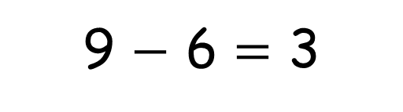
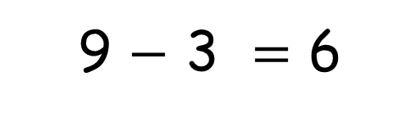
Can you think of another
fact family for 9?
9
animals
3 + 6 = 9
6 + 3 = 9
9 $−$ 3 = 6
9 $−$ 6 = 3

Slide 2
**Can you think of another
fact family for 9?
9
animals

Slide 3
*Can you think of another
fact family for 5?
5
animals

