Slide 1


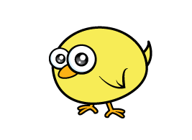
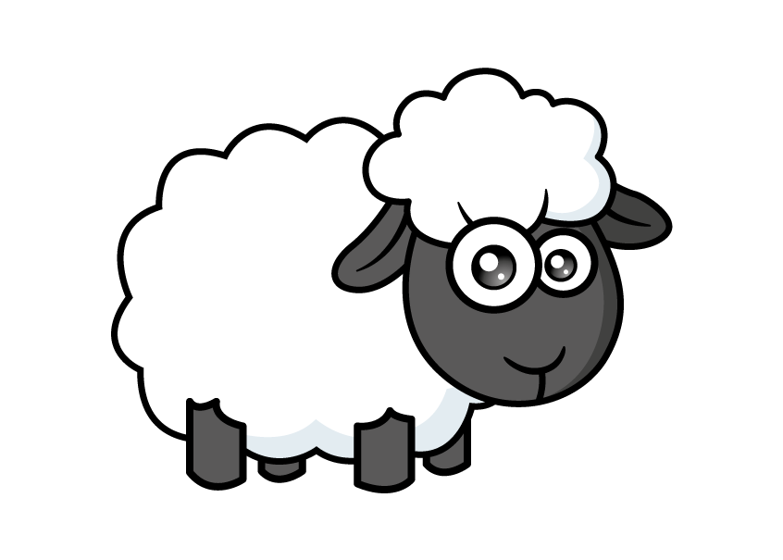

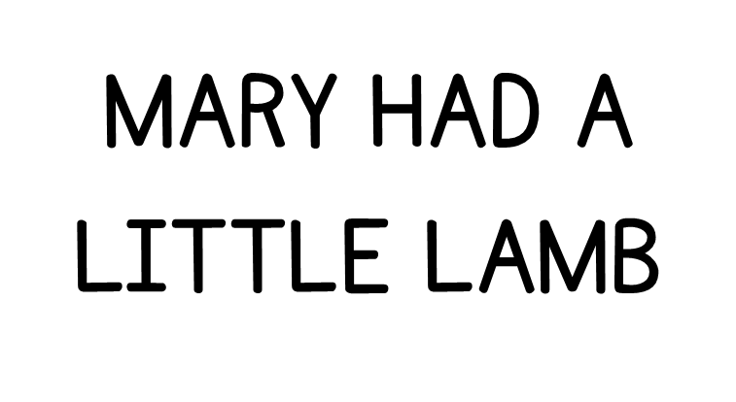
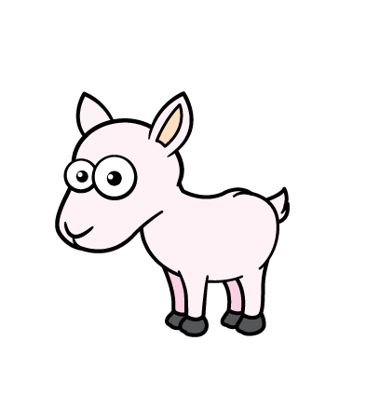


Slide 2




Farmer Rose has many animals.
He has one more chick than he has eggs.
I counted 19 eggs!
10
20
One more than 19 is

Slide 3
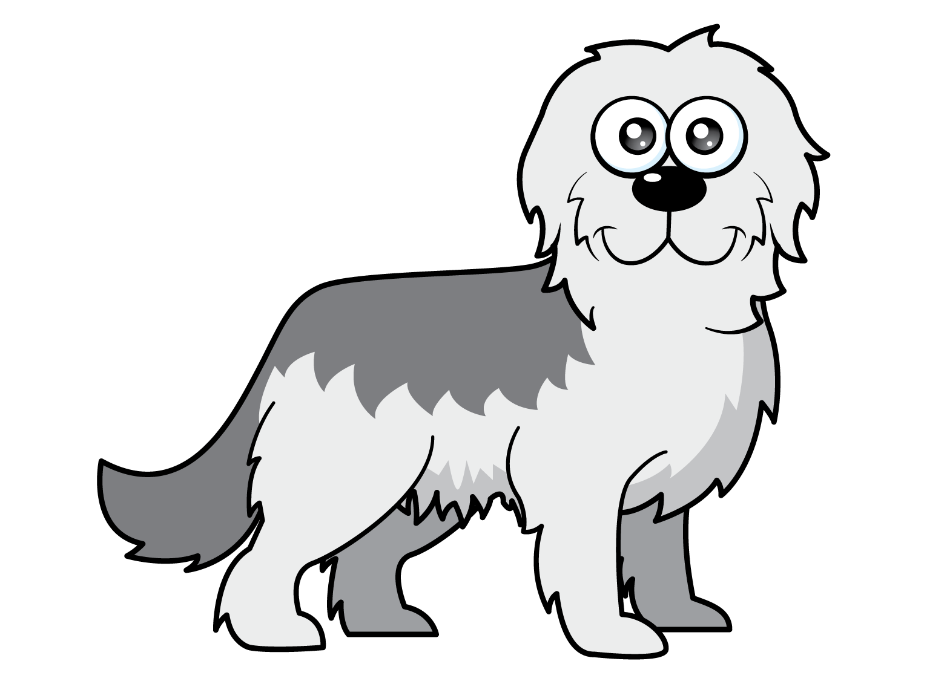
Fido has herded the lambs into groups of 10
How many lambs are there?
20
10
Great job,
Fido!
20

Slide 4
Fido has herded the lambs into groups of 5
How many lambs are there?
20
10
20
5
I see
5 more!
15

Slide 5

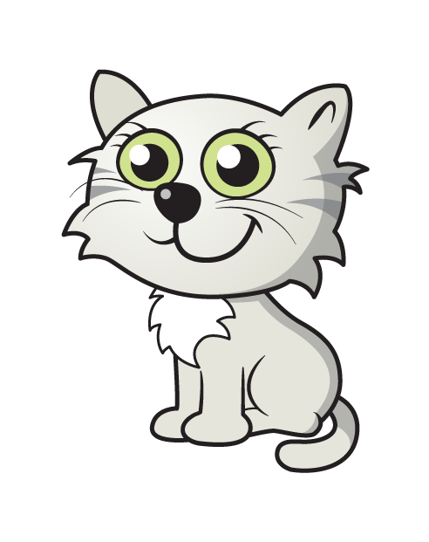
White Rose farm cats love to sleep in baskets.
4
8
12
2
6
10
How many kittens are there?
12
Can you count in 2s?

Slide 6


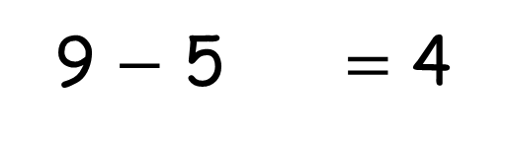
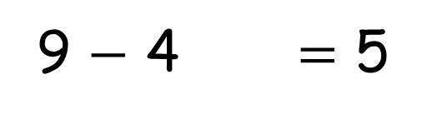
What is another way to
sort the animals?
9
animals
5 + 4 = 9
4 + 5 = 9
9 $−$ 5 = 4
9 $−$ 4 = 5

Slide 7
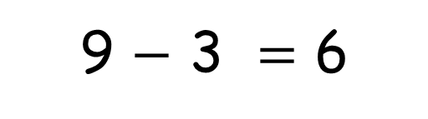
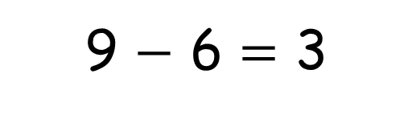
Can you think of another
fact family for 9?
9
animals
3 + 6 = 9
6 + 3 = 9
9 $−$ 3 = 6
9 $−$ 6 = 3

Slide 8

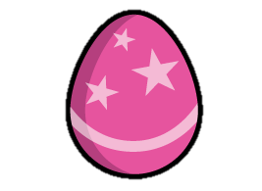
What do you know?
The is lighter than the
The is heavier than the

Slide 9


What do you know?
?
The has a mass of
3

Slide 10
What is the mass?
?
If 1 has a mass of 3
?
Then 2 have a mass of
6

