Slide 1









Slide 2
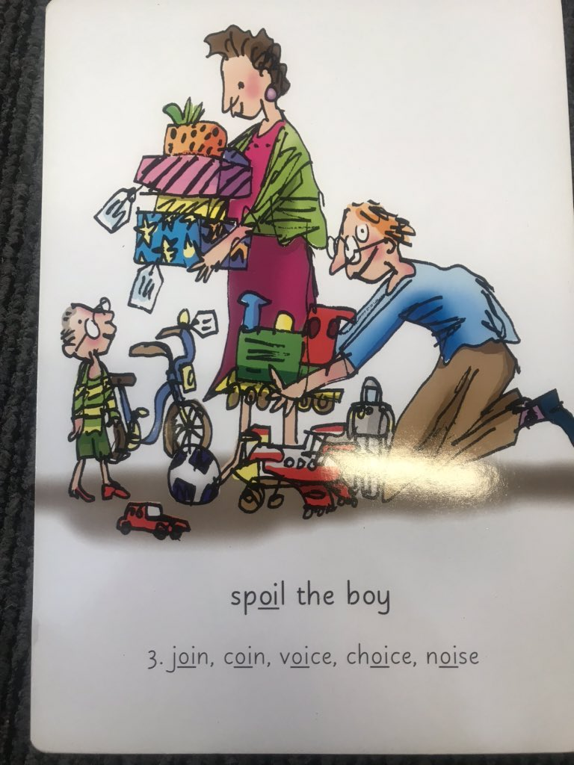
Our Set 3 phoneme for today is….oi
noise spoil
join
coin
voice
choice

Slide 3
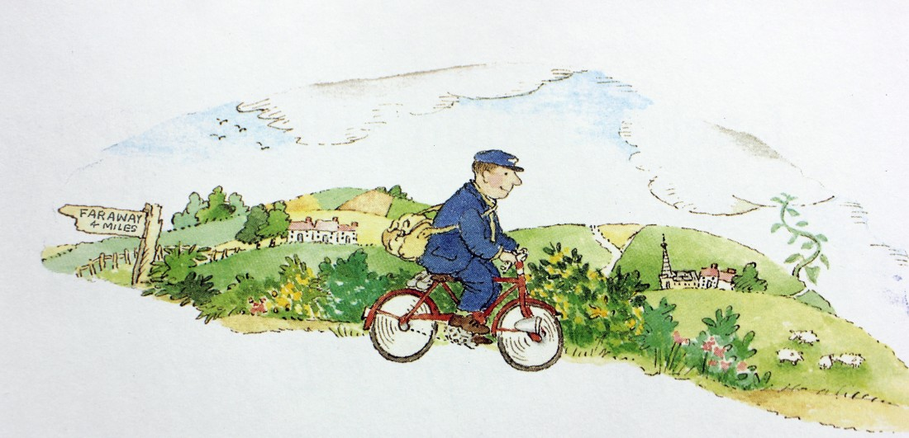
Tuesday 20th April
L.O. To match letters to characters

Slide 4
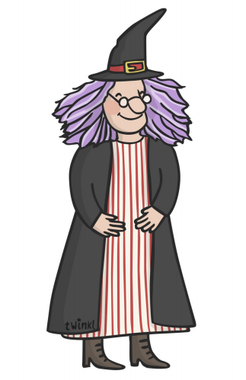
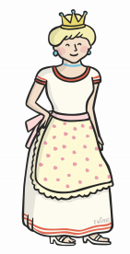
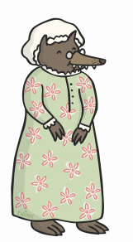


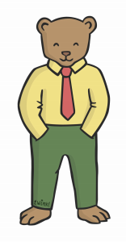
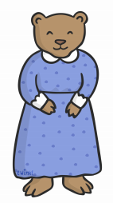
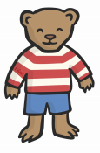
Who are these characters?

Slide 5
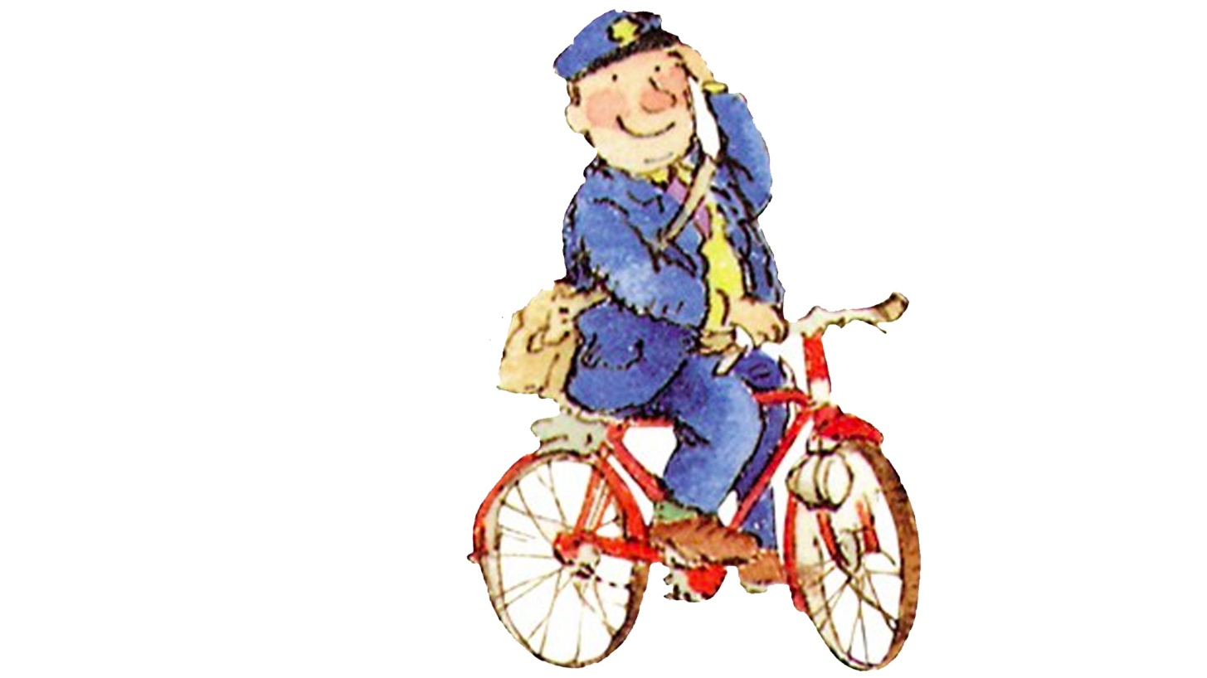
The Jolly Postman delivers letters to different fairy tale characters.

Slide 6
Look at the letters and decide which character the postman will give it to.
Make sure you read each letter carefully, who is it to? What is it about?

Slide 7
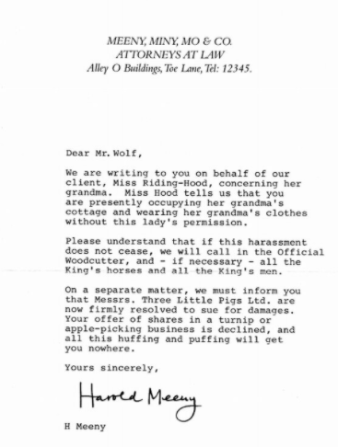
Your Task is to match the letters to the characters!

Slide 8
Extension write a sentence about how the character might feel about receiving the letter.

Slide 9
Mr. Wolf would feel cross because he won’t be able to stay in Grandma’s house and is in trouble.
Capitals for names!
Conjunctions
to link ideas!
Full stops at the end!

Slide 10
Let’s check if you got them right!
I bet you won’t get them right!
I bet they will!

Slide 11
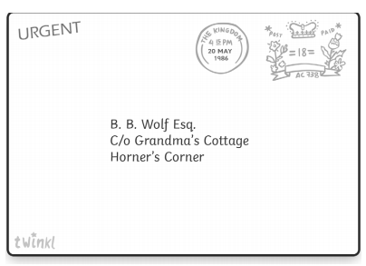
I felt angry.

Slide 12
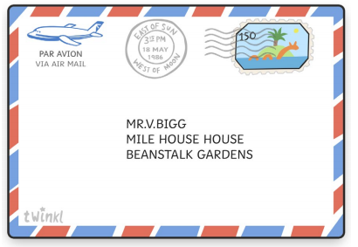
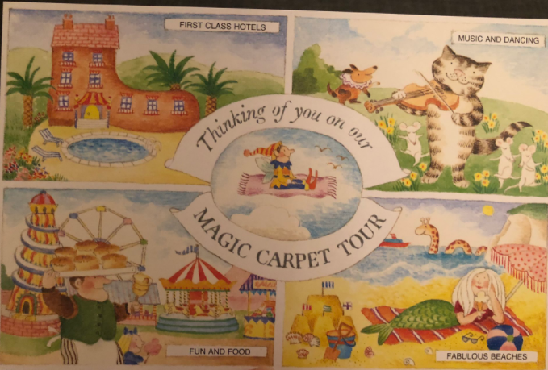
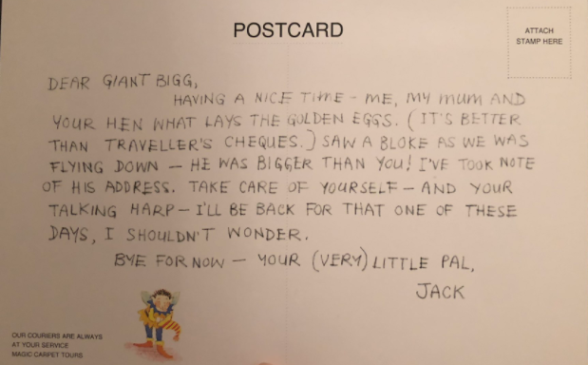
I felt jealous.

Slide 13
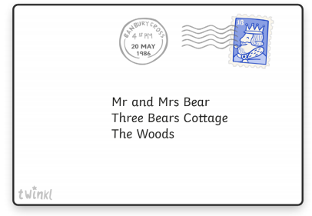
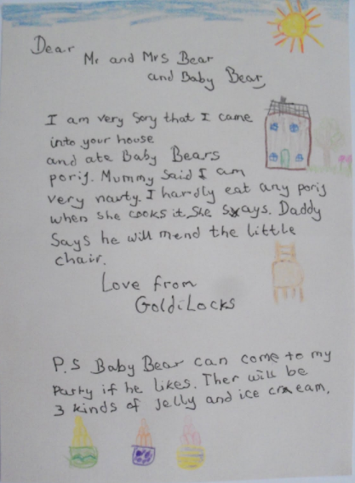
We felt happy.

Slide 14
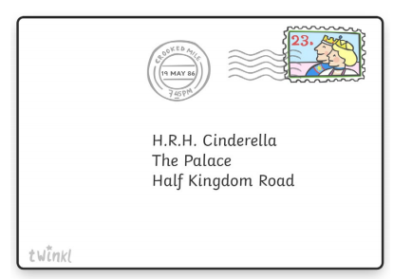
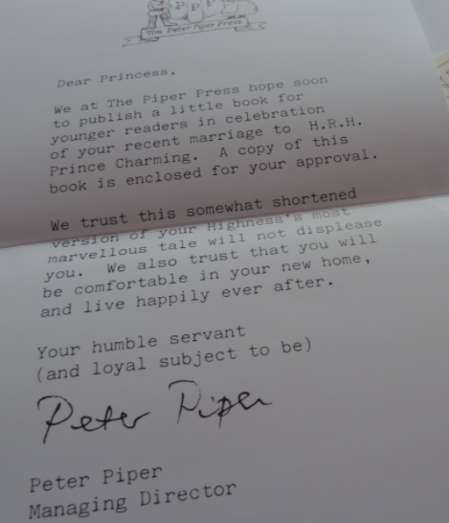

I felt excited.

Slide 15
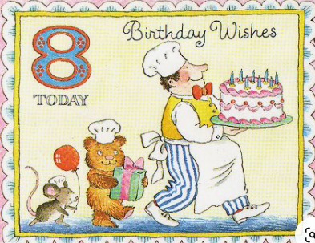
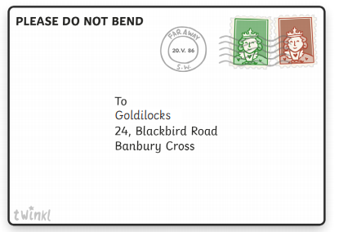
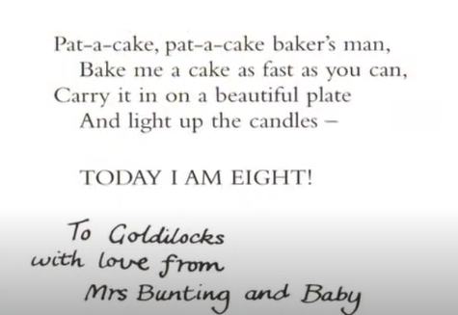
I felt loved.

Slide 16
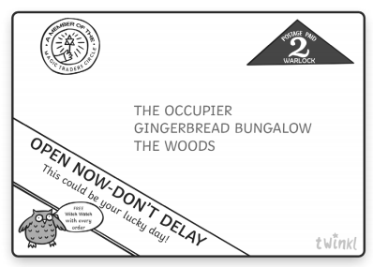
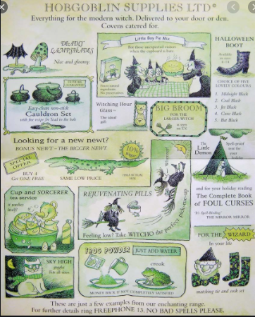
I felt excited.

Slide 17
How did each character feel?
What sentences did you write?

